Slide 1
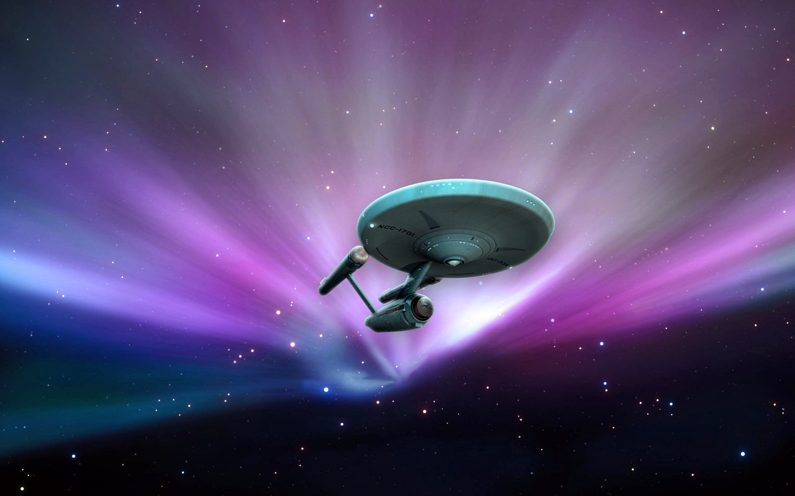
The New Frontiers
ESE 444 Group Project
Starring: Keshav Kohli, Maryl Lambros, Jesse Weisberg

Slide 2

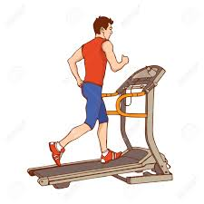
Concept
Measures your pulse and temperature
Tells you when your BPM is too high (age related)
Cools you off with an automatically triggered fan

Slide 3
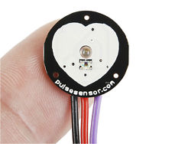
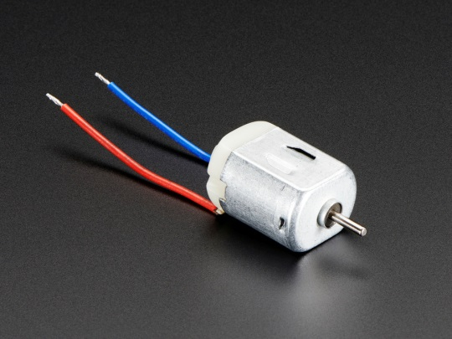
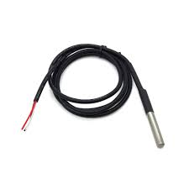
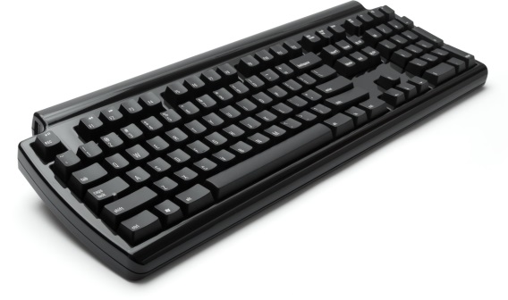
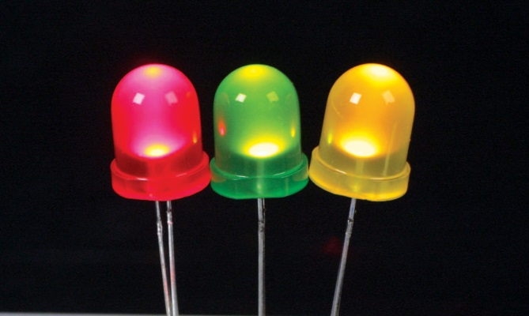
System Components
Sensors
Actuators

Slide 4
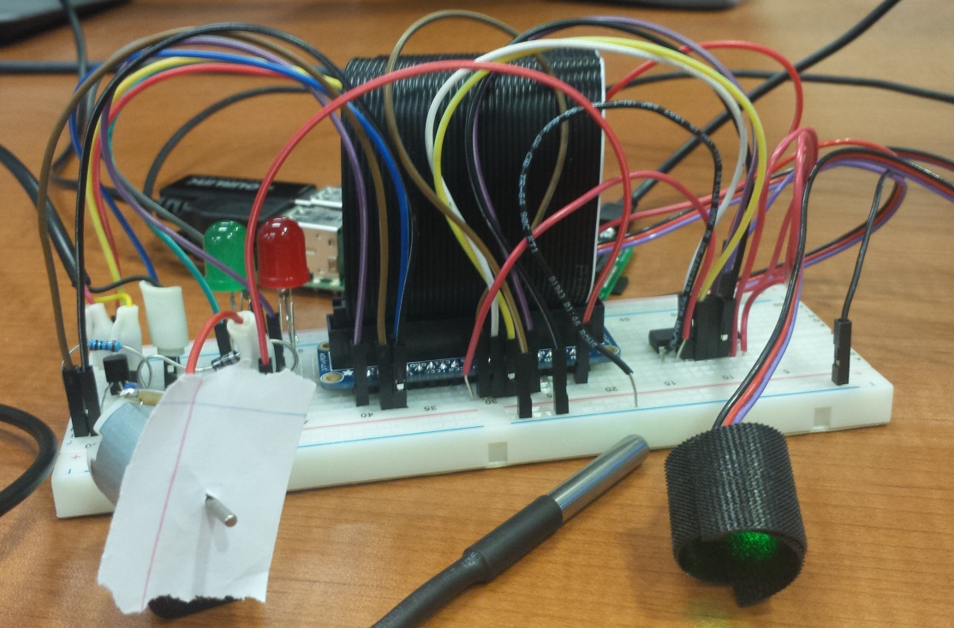
Overview
Pulse Sensor
DC motor (fan)
Temp Input
Temp Sensor
Raspberry Pi
LED lights
Age input
Pulse & age input

Slide 5
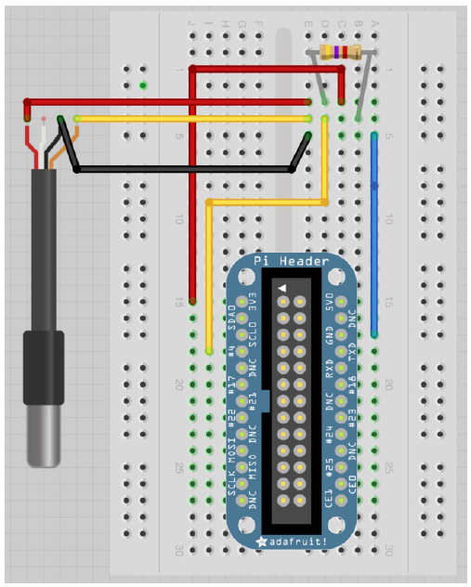
Temperature Sensor Schematic

Slide 6
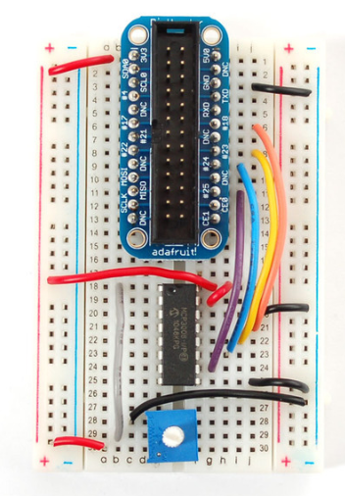
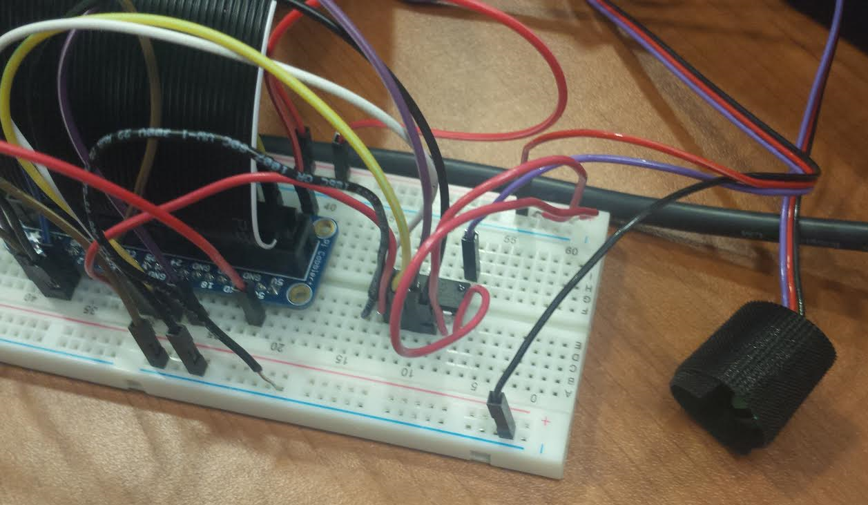
Pulse Sensor Schematic

Slide 7

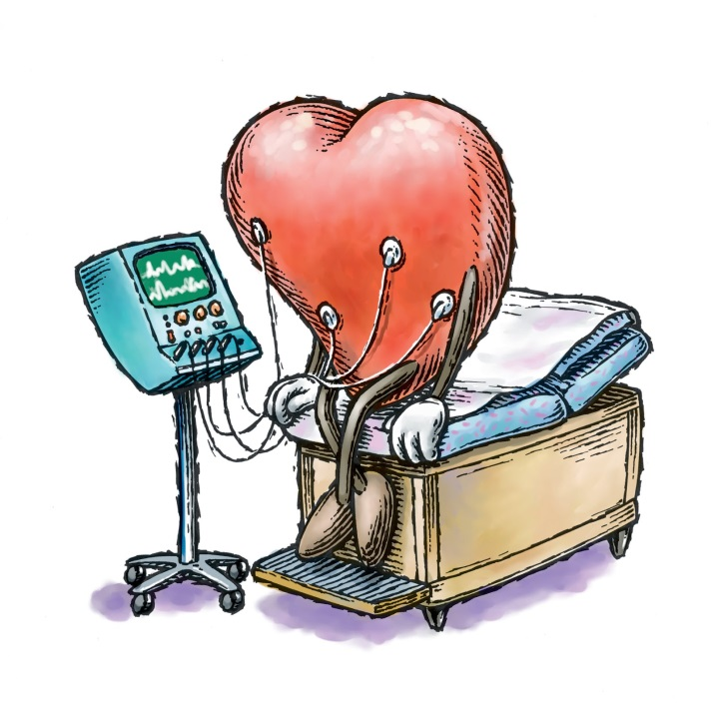
Age Input Schematic
Age | BPM limit
< 20 | 120
> 20 and < 50 | 100
> 50 | 80

Slide 8
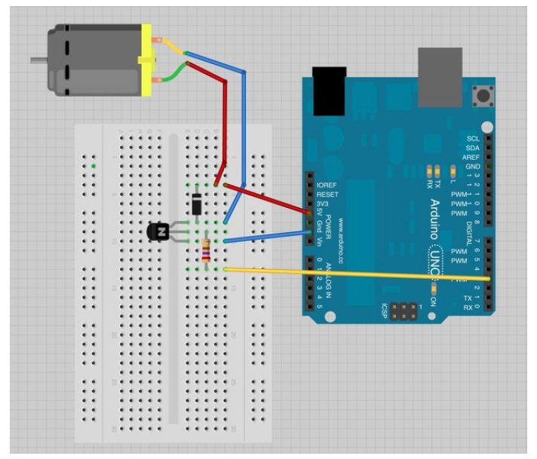
DC Motor Schematic

Slide 9
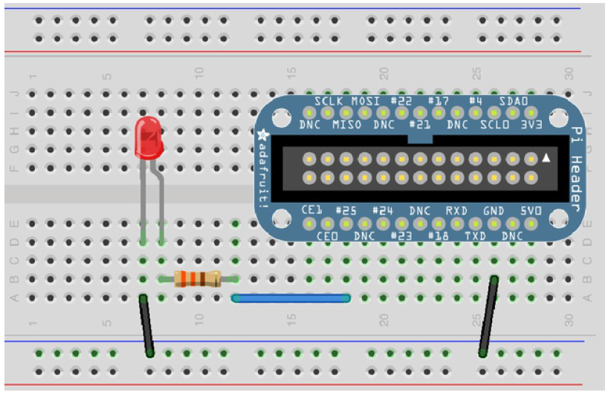
LED Light Schematic

Slide 10



Troubleshooting

Slide 11
Demo
https://drive.google.com/?utm_source=en&utm_medium=button&utm_campaign=web&utm_content=gotodrive&usp=gtd&ltmpl=drive&authuser=0#my-drive

