Slide 1
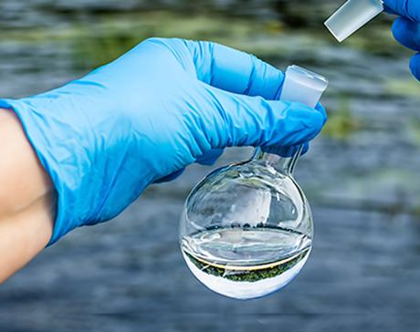
ENVIRONMENTAL SUSTAINABILITY
MACHINE LEARNING: PREDICTING THE POTABILITY OF WATER
By: Jessica Zimmerman | Beruchya Dao-Bai | Mohamad Kassim | Elizaveta Lyadova
https://github.com/jessezimm/Environmental_Sustainability

Slide 2
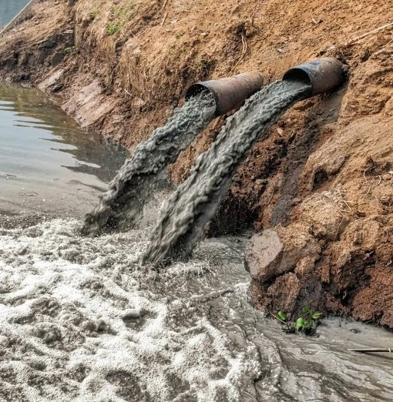
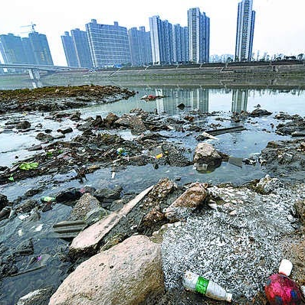
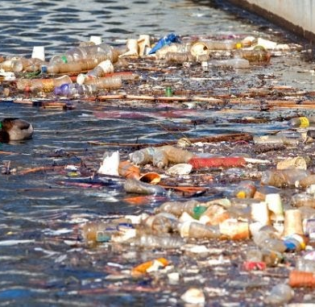
SELECTED TOPIC & REASONING
Environmental sustainability is one of the most pressing issues of the century. From climate change to pollution, major ills to the environment affect humanity and the biosphere. Given the urgency of action on environmental sustainability, our group saw it fit to inform the world on water pollution and the suitability of drinking water.

Slide 3



QUESTIONS TO ANSWER THROUGH MODEL
What makes water potable?
What factors contribute to water potability?

Slide 4
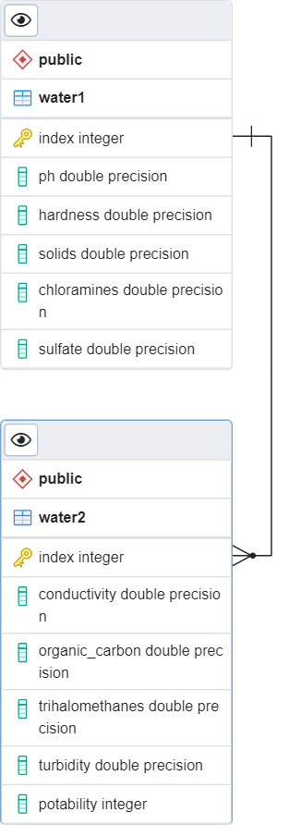



DATA SOURCE & DATABASE
Data source: https://www.waterqualitydata.us/
The final dataset contains water characteristics from 3276 different water samples
SQL database created and hosted in cloud through Microsoft Azure
IP addresses were used to manage security and connect to the server
Two datasets joined together using a common index
An engine in Jupyter notebook accesses the database

Slide 5

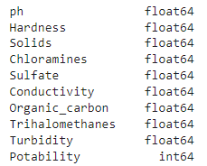
DATA PREPROCESSING
Confirm all the data is numeric or convert if needed
Fill null values with the mean of column

Slide 6
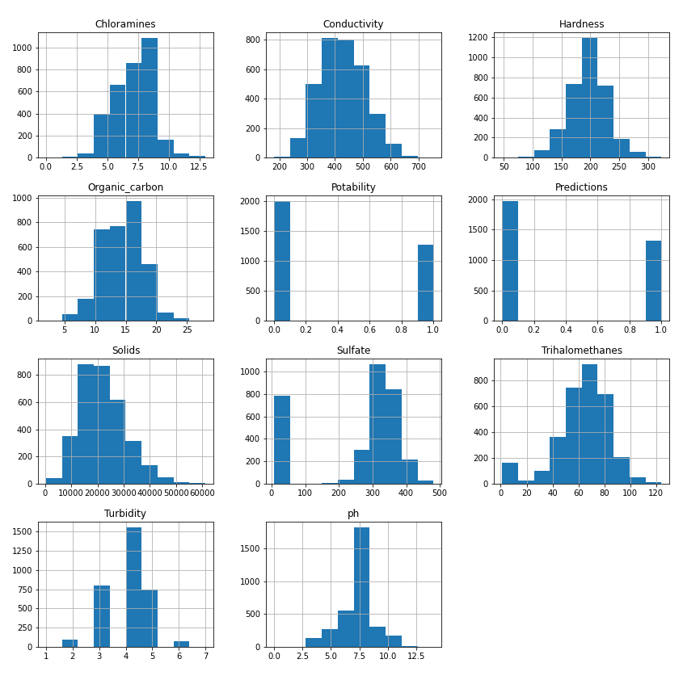
VISUALIZE ALL THE DATASET FEATURES

Slide 7
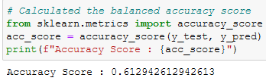
EXPLORATORY DATA ANALYSIS
Feature Selection: imblearn package to assess feature importance
Result: No stand-out variables. Keep all variables.
Feature Transformation: sklearn package for scaling variables
Intent: Limits influence of large data values. Aim for better model accuracy.

Slide 8
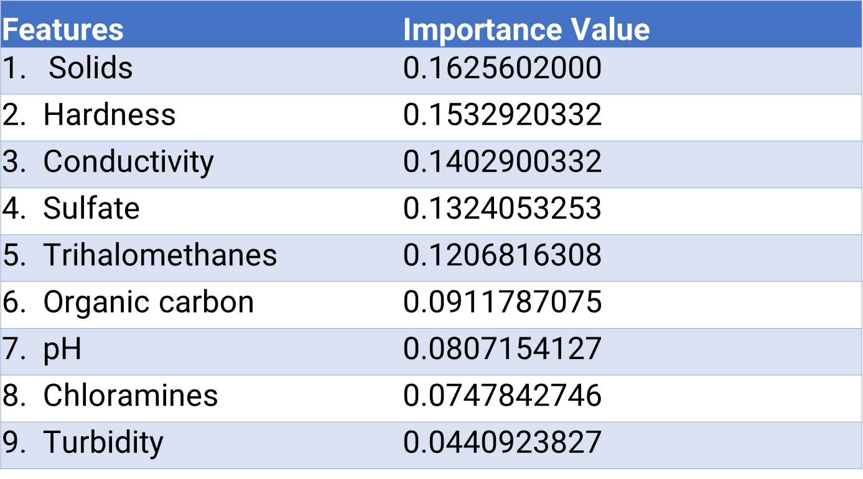

FEATURES BY IMPORTANCE TO DETERMINE POTABILITY

Slide 9
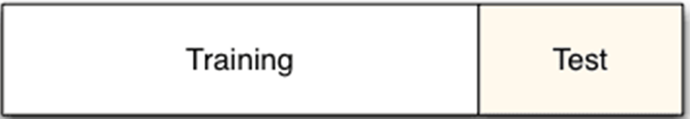

TRAIN & TEST SPLITS
Sklearn package for splitting data
Changed train size to 80%
Stratified on “y” to preserve the proportion of target (potability)

Slide 10

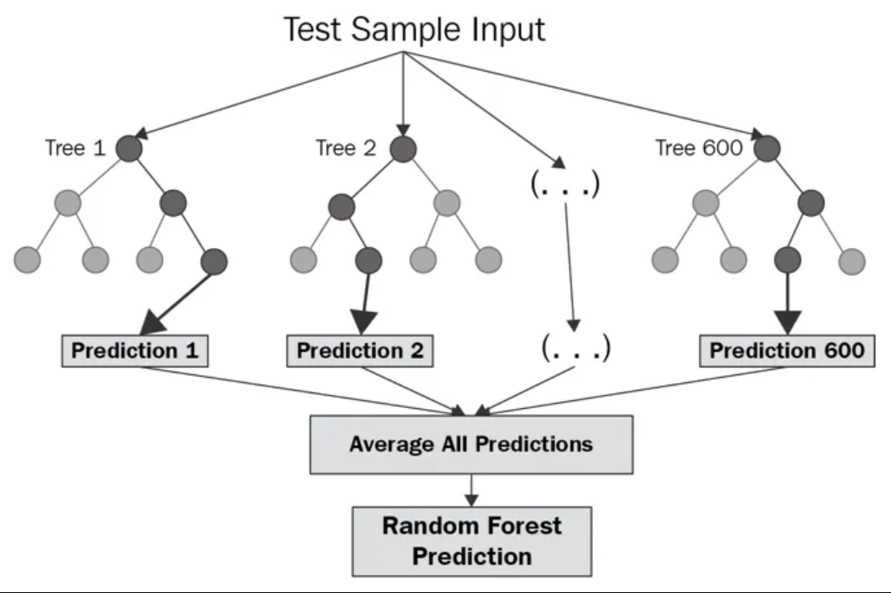
MACHINE LEARNING MODEL
Model type: Balanced Random Forest Classifier
Creates smaller simpler decision trees based on a random subset of features
Smaller trees combine to create a strong learner

Slide 11


MODEL BENEFITS & LIMITATIONS
Benefits
Limitations
Robust against overfitting
> Smaller decision trees are trained on different subsets
N_estimators input enables easy algorithm tuning
> Higher number of trees usually yields better performance
Feature importance outputs show minimal variability
Model is not easily interpretable
Computationally intensive with large datasets

Slide 12

TROUBLESHOOTING
Relatively small (3276) dataset led to modelling challenges
Transformation by data scaling was inadequate
Hypothetical doubling of dataset (6552) for potability simulation led to better training of the model with overfitting risk
Scaling lowered accuracy (0.61) and skewed predictions with either 0s or 1s in new prediction column

Slide 13


PROVISIONAL RESULTS
Accuracy score
Confusion Matrix
Measures | Precision | Recall | F1-score | Support
Not Potable (0) | 0.946 | 0.926 | 0.936 | 800
Potable (1) | 0.888 | 0.918 | 0.903 | 511
Accuracy | 0.923 | 0.923 | 0.923 | 0.923
macro avg | 0.917 | 0.922 | 0.919 | 1311
weighted avg | 0.924 | 0.923 | 0.923 | 1311
Potability | Predicted Not Potable | Predicted Potable
Actually Not Potable | 741 | 59
Actually Potable | 42 | 469

Slide 14
RESULTS
Accuracy score
Confusion Matrix
Measures | precision | recall | f1-score | support
Not Potable (0) | 0.732 | 0.675 | 0.702 | 400.000
Potable (1) | 0.547 | 0.613 | 0.578 | 256.000
accuracy | 0.651 | 0.651 | 0.651 | 0.651
macro avg | 0.639 | 0.644 | 0.640 | 656.000
weighted avg | 0.660 | 0.651 | 0.654 | 656.000
Potability | Predicted not Potable | Predicted Potable
Actually not Potable | 270 | 130
Actually Potable | 99 | 157

Slide 15

TABLEAU DASHBOARD
Tableau Dashboard Link

Slide 16
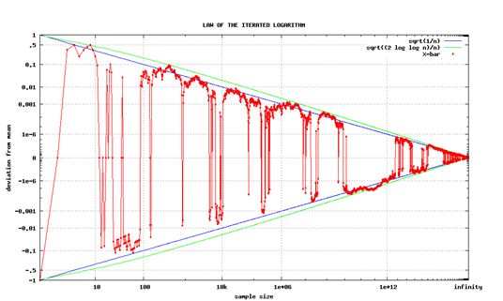



KEY TAKEAWAYS
POTABILITY IS WELL PREDICTED BY OUR MODEL BASED ON CHANGES
ATTEMPTS AT MODEL IMPROVEMENT WERE SUCCESSFUL
- FEATURE SELECTION
-TREATED MISSING VALUES
-ALGORITHM TUNING
-ARTIFICIALLY ENLARGED DATASET
CONCLUSION: A LARGER DATASET LIKELY YIELDS MORE CONCLUSIVE RESULTS & SCALING IS NOT A ONE-SIZE FIT ALL FOR ALL KINDS OF DATASETS
Notes:
Attempts at model improvement were successful:
Treated missing values
Feature selection
Feature transformation
Algorithm tuning
Removed scaler
Doubled dataset for more efficient training

Slide 17





TOOLS USED FOR THE PROJECT
Technologies, languages, tools, and algorithms used throughout the project:
GitHub
Python
Pandas
SQL
Tableau

Slide 18


