Slide 1
Environmental Sustainability : Water Potability Dashboard
By: Elizaveta Lyadova, Mohamad Kassim, Jessica Zimmerman, Beruchya Dao-Bai

Slide 2


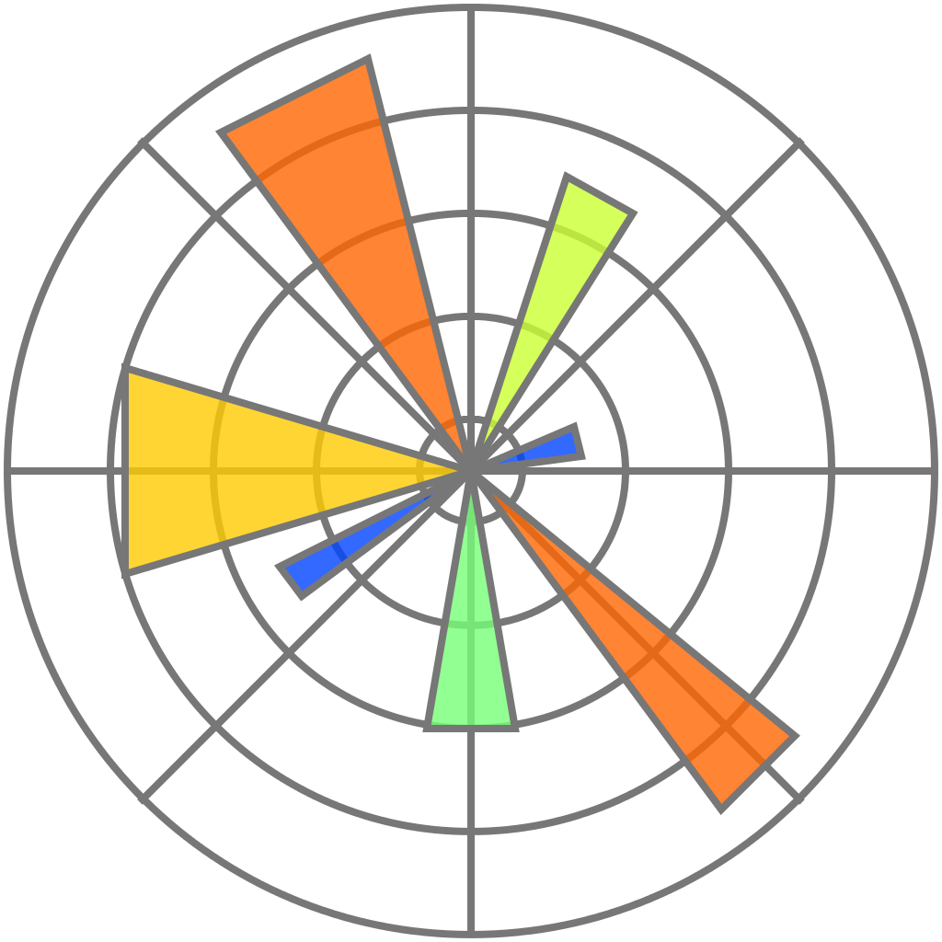

Dashboard Tools
Python: Matplotlib
Tableau for Data visualization
Google slides

Slide 3
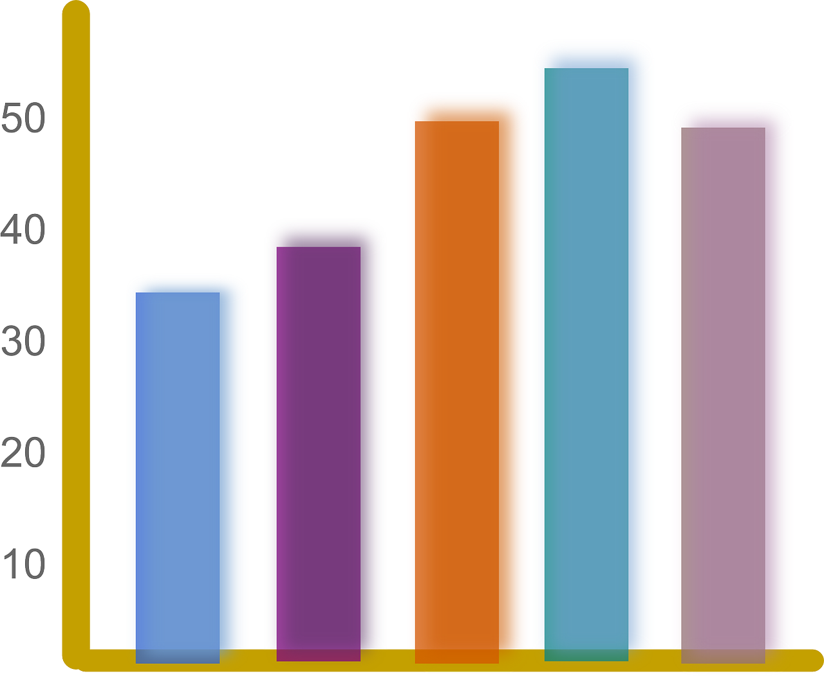
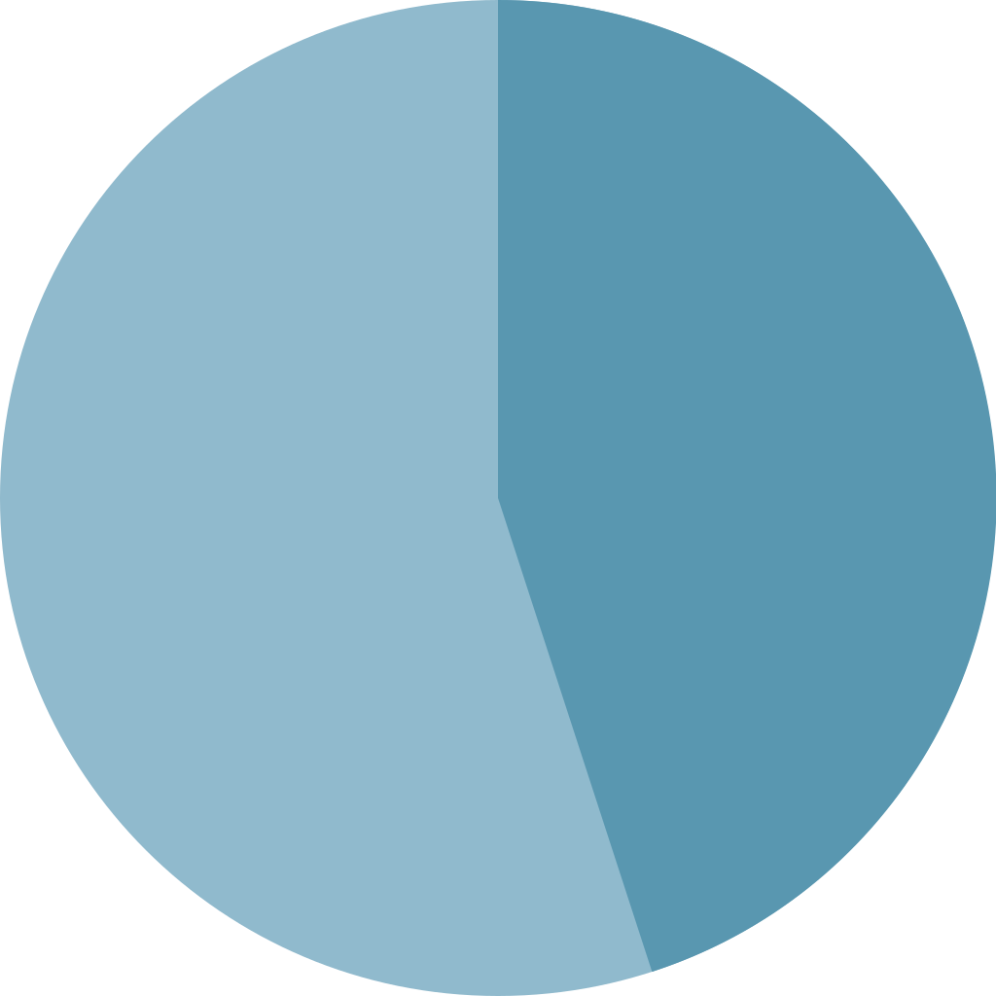
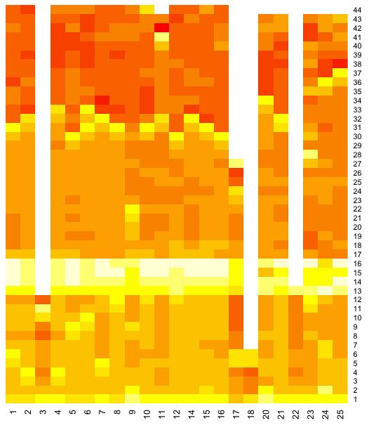
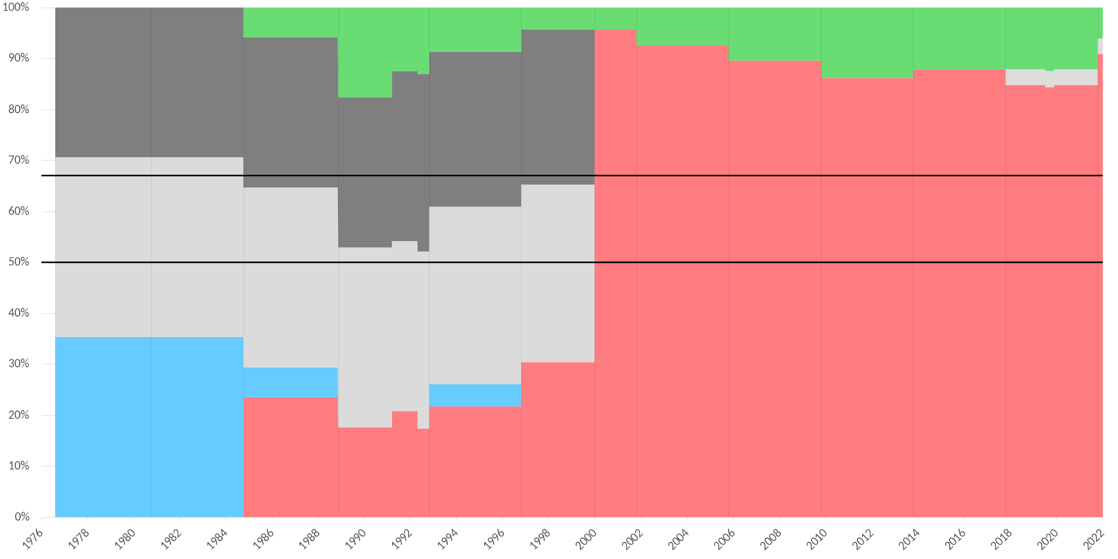
Description of Dashboard Elements
Tableau interactive map
Interactive map of potability based on pH
Pie charts Highlighting divide between potable and non-potable water resources
Histograms Showing variable values that tend to lead to potable versus non-potable water
Barcharts
Python chart highlighting potability based on pH
Heatmap
Demonstrating all water variables included in modelling

Slide 4
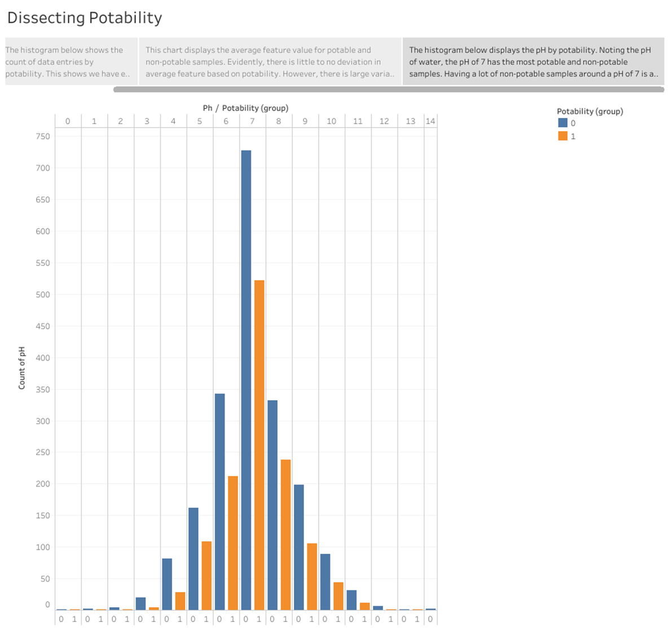
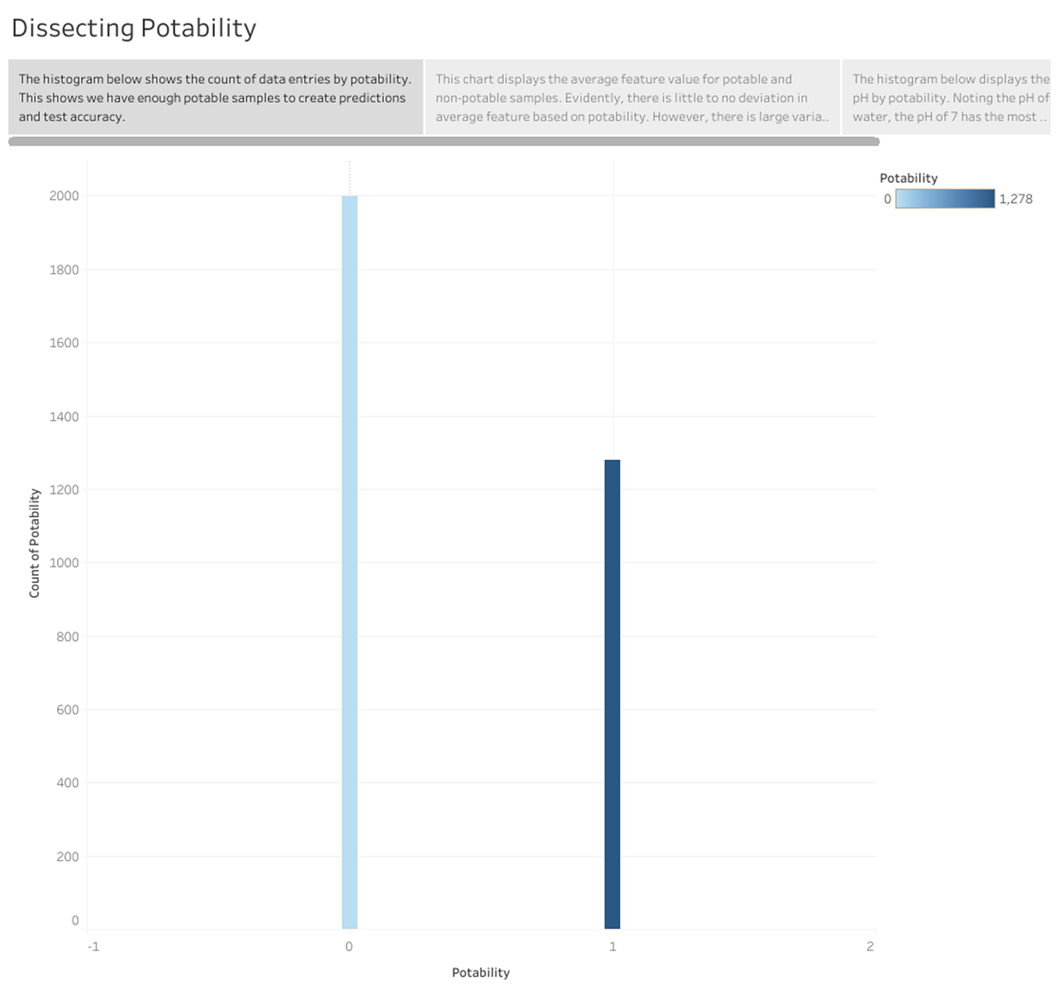
Tableau Graph Potability
Link here
NB:
0 = not potable
1 = potable

Slide 5
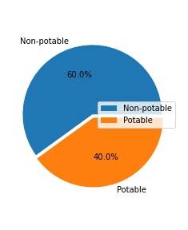
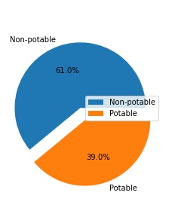
65%
Model Prediction Comparison
Model Potability Predictions
Potability
Accuracy Score
Potable: 1311
Non potable: 1965
Potable: 1278
Non potable: 1998

Slide 6
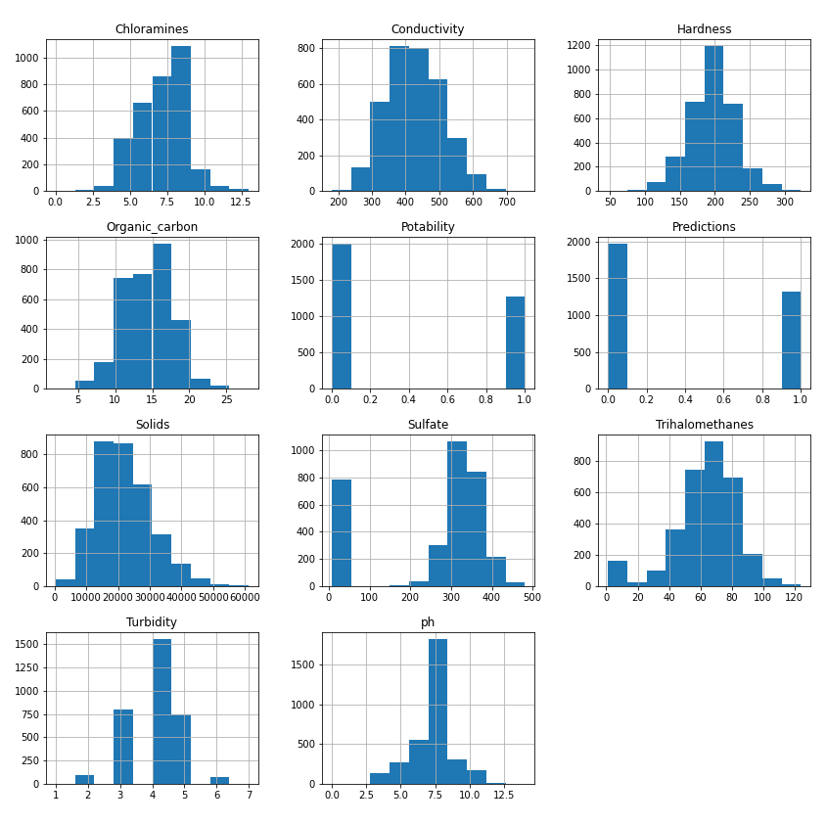
Histograms of Water Features

Slide 7
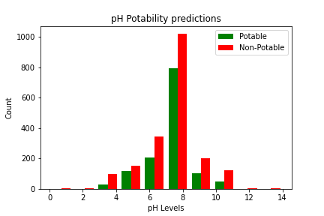
Potability Predictions
based on pH levels

Slide 8
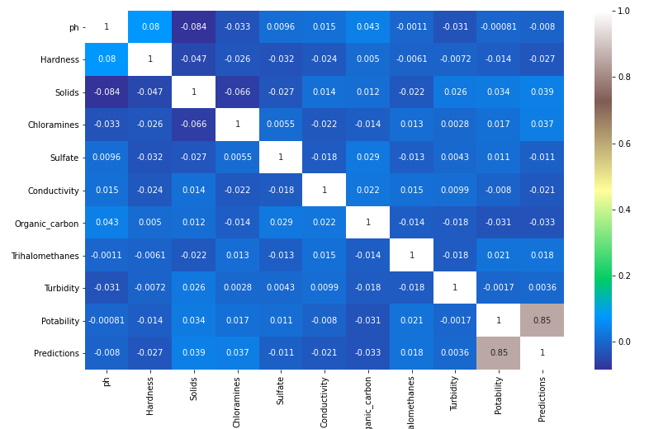
Heatmap of Water Potability Variables

