Slide 1
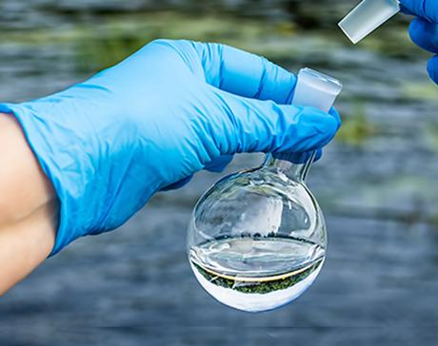
ENVIRONMENTAL SUSTAINABILITY
MACHINE LEARNING: PREDICTING THE POTABILITY OF WATER
By: Jessica Zimmerman | Beruchya Dao-Bai | Mohamad Kassim | Elizaveta Lyadova
https://github.com/jessezimm/Environmental_Sustainability

Slide 2
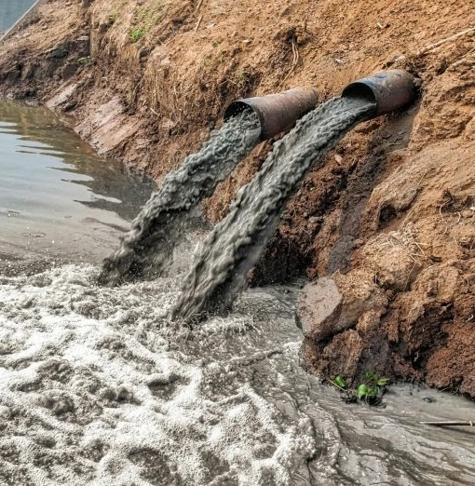
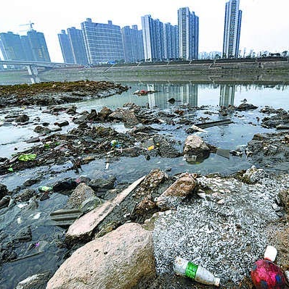
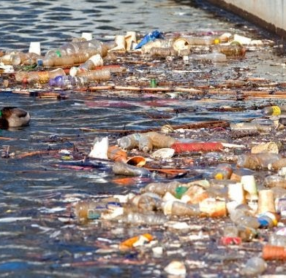
SELECTED TOPIC & REASONING
Environmental sustainability is one of the most pressing issues of the century. From climate change to pollution, major ills to the environment affect humanity and the biosphere. Given the urgency of action on environmental sustainability, our group saw it fit to inform the world on water pollution and the suitability of drinking water.
Notes:
J: Environmental sustainability - pressing, we sit it in the crazy weather patterns, rising sea levels, polluted water
We felt it was important to understand water potability, perhaps enable more access to clean water

Slide 3



QUESTIONS TO ANSWER THROUGH MODEL
What makes water potable?
What factors contribute to water potability?
Notes:
B: In line with our theme on environmental sustainability and water resources, we designed our model to show whether water is potable, or safe to drink based on a number of variables which we will share in the following slides. All in all our basic question can be summarized as: Is water potable based on a key number of chemical and physical properties of water, yes or no?

Slide 4
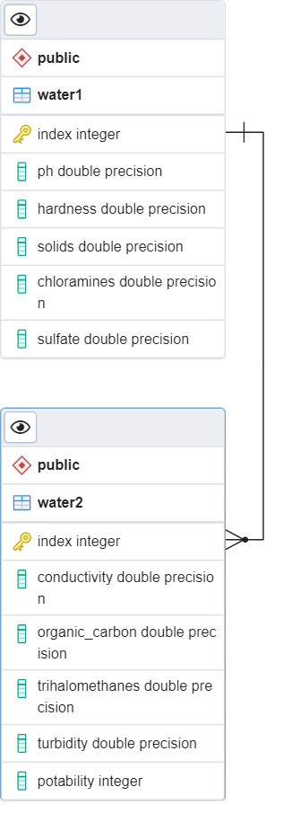



DATA SOURCE & DATABASE
Data source: https://www.waterqualitydata.us/
The final dataset contains water characteristics from 3276 different water samples
SQL database created and hosted in cloud through Microsoft Azure
IP addresses were used to manage security and connect to the server
Two datasets joined together using a common index
An engine in Jupyter notebook accesses the database
Notes:
B: We found a dataset with 3276 different water samples. And this dataset was then set up in a Microsoft cloud database where a left join was performed on the index value of two tables.
The final database had the following features: pH, water hardness, solids present in the water, chloramines, sulfate, conductivity, carbon, trihalomethanes, turbidity and a potability column. With that we were able to carry out our model and ultimately add a potability prediction column based on our model

Slide 5

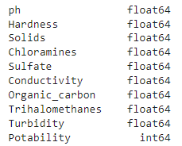
DATA PREPROCESSING
Confirm all the data is numeric or convert if needed
Fill null values with the mean of column
Notes:
M: preprocessing of data included filling null values and ensuring that the right data types would be used

Slide 6
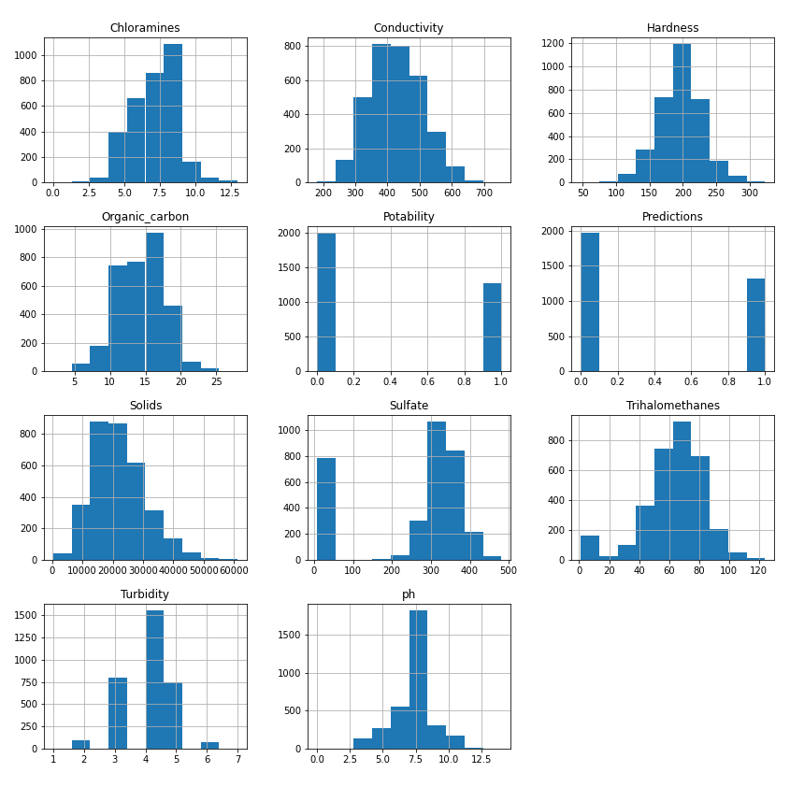
VISUALIZE ALL THE DATASET FEATURES
Notes:
M: The better understand our data we chose to view them as histograms. For example, the pH histogram shows that most samples were around the normal water pH of 7

Slide 7
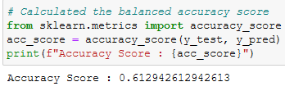
EXPLORATORY DATA ANALYSIS
Feature Selection: imblearn package to assess feature importance
Intent: Simplify model.
Feature Transformation: sklearn package for scaling variables
Intent: Limits influence of large data values.
Notes:
J: Identify ways to improve model accuracy
One select only features relevant to the model
Transform variables
Standard scalar to normalize variables with mean = 0, std dev = 1
Minimize the influence of large data values that might not be an accurate reflection of the entire dataset

Slide 8
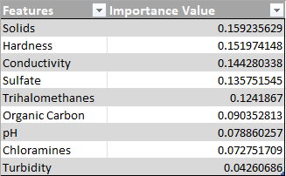

FEATURES BY IMPORTANCE TO DETERMINE POTABILITY
Features Importance Value
Solids 0.159235629
Hardness 0.151974148
Conductivity 0.144280338
Sulfate 0.135751545
Trihalomethanes 0.1241867
Organic Carbon 0.090352813
pH 0.078860257
Chloramines 0.072751709
Turbidity 0.04260686
Notes:
J: Look at importance of different variables
Solids and hardness are most important

Slide 9
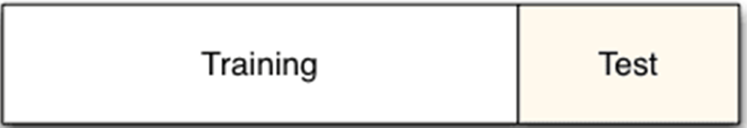

TRAIN & TEST SPLITS
Sklearn package for splitting data
Changed train size to 80%
Stratified on “y” to preserve the proportion of target (potability)
Notes:
J: Default train size is 75%, increased to 80% -> aiming to improve model accuracy
Stratified on “y” meaning we would preserve the proportion of our target in the train set
So it equates to the proportion present in the original dataset

Slide 10
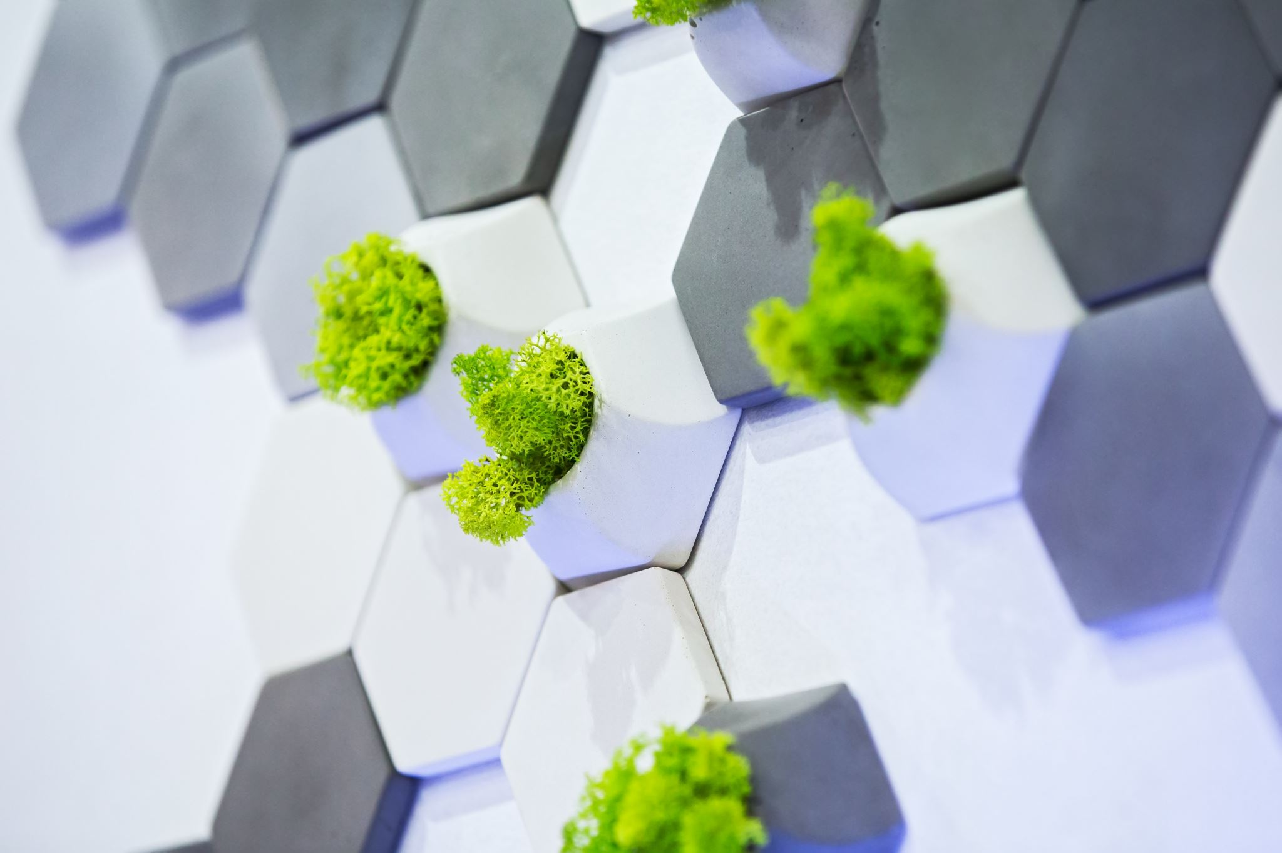
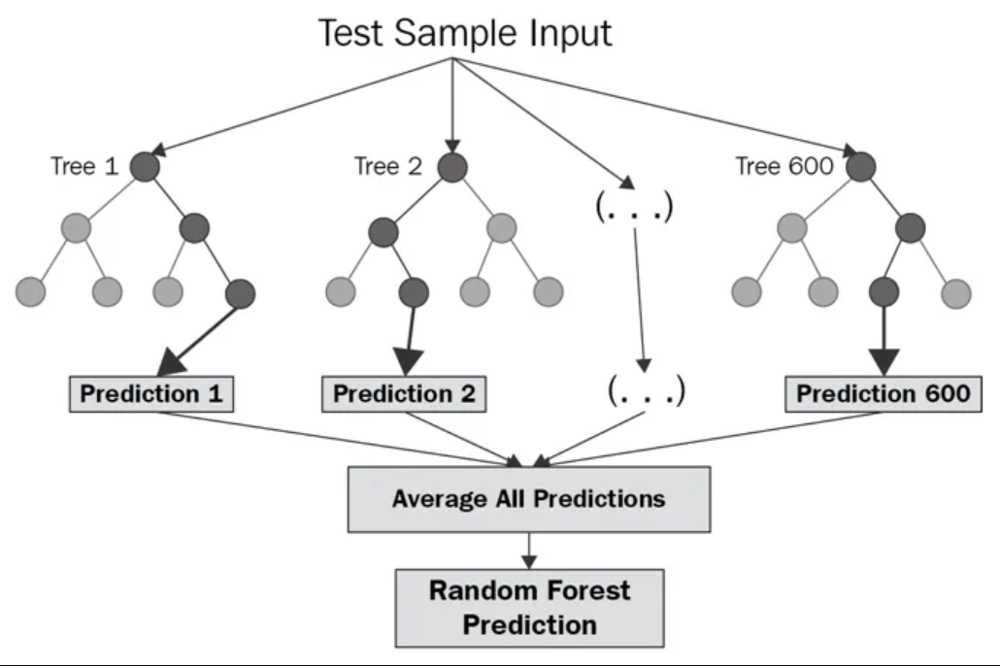
MACHINE LEARNING MODEL
Model type: Balanced Random Forest Classifier
Creates smaller simpler decision trees based on a random subset of features
Smaller trees combine to create a strong learner
Notes:
J: The Balanced Random Forest Classifier creates smaller simpler decision trees trained on a random subset of features, a bunch of weak learners
These smaller trees are combined to form a strong learner which is usually the average prediction of all the weak learners
The prediction, in our case is, potable or not potable.

Slide 11


MODEL BENEFITS & LIMITATIONS
Benefits
Limitations
Robust against overfitting
> Smaller decision trees are trained on different subsets
N_estimators input enables easy algorithm tuning
> Higher number of trees usually yields better performance
Feature importance outputs may show minimal variability
Model is not easily interpretable
Computationally intensive with large datasets
Notes:
J: Benefits of this kind of model
Robust at overfitting because the smaller decision trees are each trained on a different subset of data
Can tune the algorithm easily with the n_estimators input
The higher the input, the more decision trees the model creates, usually yields better performance
Limits
Feature importance may not tell the full story, maybe none of the features are that great at predicting potability
Model is easy to understand conceptually, but you really can’t control what the model does, the coefficients it creates
Creating more decision trees, adding massive datasets can strain your computer’s memory and also take a long time to render

Slide 12

TROUBLESHOOTING
Relatively small (3276) dataset led to modelling challenges
Transformation by data scaling was inadequate
Hypothetical doubling of dataset (6552) for potability simulation led to better training of the model with overfitting risk
Scaling lowered accuracy (0.61) and skewed predictions with either 0s or 1s in new prediction column
Notes:
M[orange box]: We attempted an experiment based on the thought that our accuracy could potentially be higher with a larger dataset. We artificially doubled the dataset by replicating each record twice to have a dataset of 6552 records. When we doubled the values no accuracy change happened.
B [grey box]: As expected we faced some challenges with setting up our model as Mohamed shared and having coherent values in the newly created prediction column. Our main issue is that we couldn’t figure out why our model only predicted all 0s (i.e. not safe to drink) or all 1s potable/safe to drink whether it was based on the original or artificially doubled dataset. We knew that we had to fix that and we started off by changing parameters in the algorithm like the n_estimators values, train_size, or the random_state of selection. Nothing positive availed in the prediction column until we went back to removing the data scaling method we had used. I realized our dataset was not suited for scaling and that affected all the predictions by making them either exclusively potable or exclusively not potable. After realizing scaling was not necessary for our dataset, accuracy rose and predictions were varied.
NB: n_estimators = number of trees in the forest to improve performance of model but it makes the model slower
Random_state = control the random factor of selection in the training and testing aspect, basically making the train size not different everytime providing us with more stability to troubleshoot other areas

Slide 13


PROVISIONAL RESULTS
Accuracy score
Confusion Matrix
Measures | Precision | Recall | F1-score | Support
Not Potable (0) | 0.946 | 0.926 | 0.936 | 800
Potable (1) | 0.888 | 0.918 | 0.903 | 511
Accuracy | 0.923 | 0.923 | 0.923 | 0.923
macro avg | 0.917 | 0.922 | 0.919 | 1311
weighted avg | 0.924 | 0.923 | 0.923 | 1311
Potability | Predicted Not Potable | Predicted Potable
Actually Not Potable | 741 | 59
Actually Potable | 42 | 469
Notes:
M: While we were troubleshooting we tested the fact that an increase in our dataset size could improve our accuracy, and so, we doubled our dataset and we tried two things. First thing is that we doubled the dataset and rerun the model the accuracy was still low at around 60%. The second attempt involved descaling the doubled dataset and that led to an accuracy of 92% which confirmed that scaling our dataset was an issue.

Slide 14
RESULTS
Accuracy score
Confusion Matrix
Measures | precision | recall | f1-score | support
Not Potable (0) | 0.732 | 0.675 | 0.702 | 400.000
Potable (1) | 0.547 | 0.613 | 0.578 | 256.000
accuracy | 0.651 | 0.651 | 0.651 | 0.651
macro avg | 0.639 | 0.644 | 0.640 | 656.000
weighted avg | 0.660 | 0.651 | 0.654 | 656.000
Potability | Predicted not Potable | Predicted Potable
Actually not Potable | 270 | 130
Actually Potable | 99 | 157
Notes:
B: With a final score of 65%, we knew it was not perfect but we also realized where our model could improve based on the experiment we carried out with the provisional results by increasing the dataset size and descaling the dataset.This score right here is based on a descaled dataset and the original data source of 3000+ records. We will speak more about these lessons as we discuss the takeaways after viewing the dashboard on Tableau.

Slide 15

TABLEAU DASHBOARD
Tableau Dashboard Link
Notes:
J: [Introduction] Here’s our dashboard and we used tools such as python, tableau and google slides to prepare the layout. We have included a tableau interactive map, pie charts, histograms, barcharts and a histogram
J: Dashboard Graph 1
Histogram of pH filtered by potable and nonpotable data, pH is displayed on the top
Non Potable - blue, potable - orange
Many potable and nonpotable samples with a pH of 7, which we know is the pH of water
So pH cannot be the only factor in determining water potability or we may need to resample our dataset
Dashboard Graph 2
0 not potable, 1 is potable - basic count of samples
Tells us we have enough potable samples to create predictions and test accuracy
Dashboard Graph 3
Average feature value filtered by potable and non-potable
Not much variation in average value based on potability
Large range in feature values - some single digits, others in thousands
May need to transform some variables
M: Dashboard Graph 4 “pH predictions for potability”
Similar to prior graph but displaying predictions instead of original potability, created in python and slightly cleaner
M: Dashboard Graph 5
Heatmap is displayed to highlight:
Heatmaps helps to visualise data through variations in colouring. Heatmaps are good for showing variance across multiple variables, revealing any patterns, displaying whether any variables are similar to each other, and for detecting if any correlations exist in-between them (source:
B: Dashboard Graph 6 pie charts
With an accuracy score of 65% the predictions classified more values as potable than the original potability with a number of inaccurate predictions based on the accuracy score

Slide 16
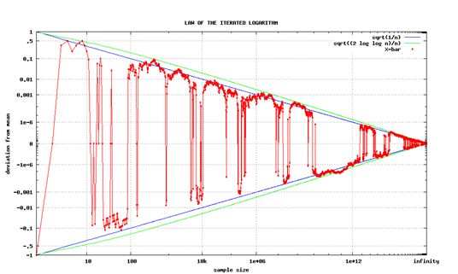



KEY TAKEAWAYS
POTABILITY PREDICTION IS 65% ACCURATE BY OUR MODEL
ATTEMPTS AT MODEL IMPROVEMENT WERE SUCCESSFUL
- FEATURE SELECTION
-TREATED MISSING VALUES
-ALGORITHM TUNING
-ARTIFICIALLY ENLARGED DATASET
CONCLUSION: A LARGER DATASET LIKELY YIELDS MORE CONCLUSIVE RESULTS & SCALING IS NOT A ONE-SIZE FIT ALL FOR ALL KINDS OF DATASETS
Notes:
B: Overall our modelling experience to determine whether water was potable, ‘yes’ or ‘no’ was interesting and informative. Our main takeaways are that our model stands a chance at being more accurate provided more time and resources. Some other lessons we learnt are the importance of selecting the right features to explore, for example in the case of water potability the chemical and physical properties of water such as pH, water hardness etc helped us determine water potability. Additionally, treating missing values like we did by filling null values with the mean of the column, and increasing the train_size and n_estimators to tune the algorithm helped make it more precise and accurate by 1-3% based on the different combinations. We also learnt that scaling a dataset may or may not work for every kind of dataset and that was really important in our case. And ultimately, we really think that our provisional results hinted at the fact that a larger dataset would significantly improve our chances of having more accurate scores.
Individual Team member challenges:
L :Tableau
J: Tableau & Machine learning
M: Machine Learning & Data processing
B: Database & Machine Learning

Slide 17





TOOLS USED FOR THE PROJECT
Technologies, languages, tools, and algorithms used throughout the project:
GitHub
Python
Pandas
SQL
Tableau
Notes:
B: With that, we have come to the end of our presentation on modeling to predict water potability and we used tools such as GitHub, Python, Pandas, SQL, and Tableau to make our project happen.To tackle our challenge we worked collaboratively on most parts and also specialized for eg. Dataset cleaning and database work was Mohamed and I, Machine learning: Mohamed and Jessica, and I supported with troubleshooting and tuning the algorithm, Dashboard: Jessica and Liza on Tableau, and myself on the design, python graphs and layout, and finally on presentation we had Liza & Jessica on content creation and organization, and I helped with the overall design and content. Thank you so much for you attention. We hope you have enjoyed our presentation.

Slide 18


