Slide 1


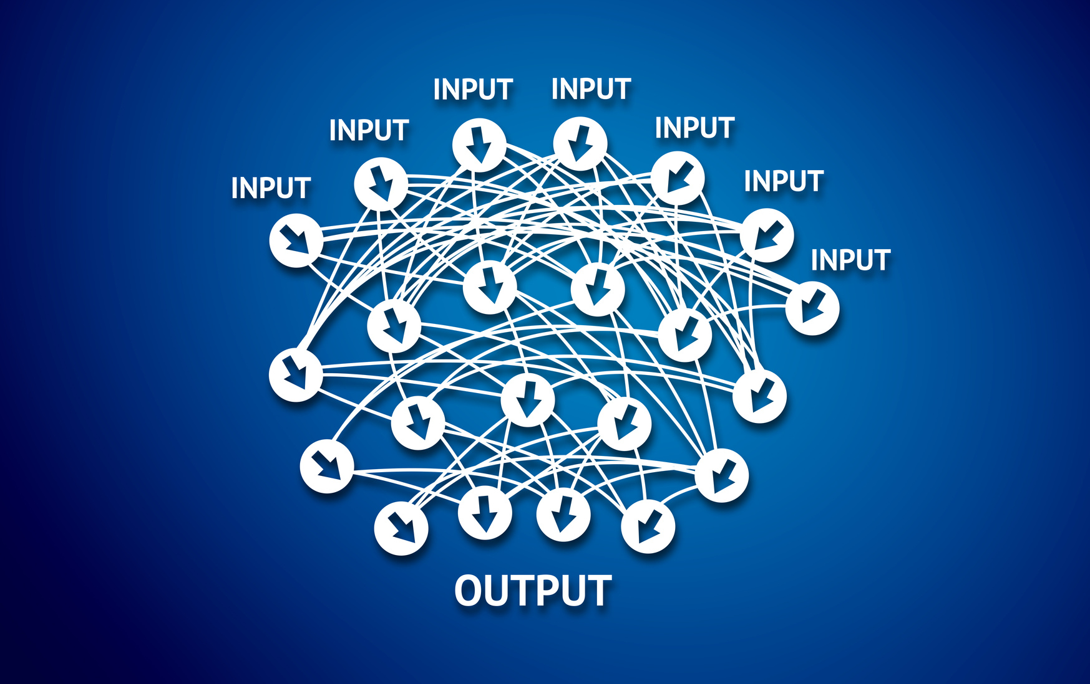




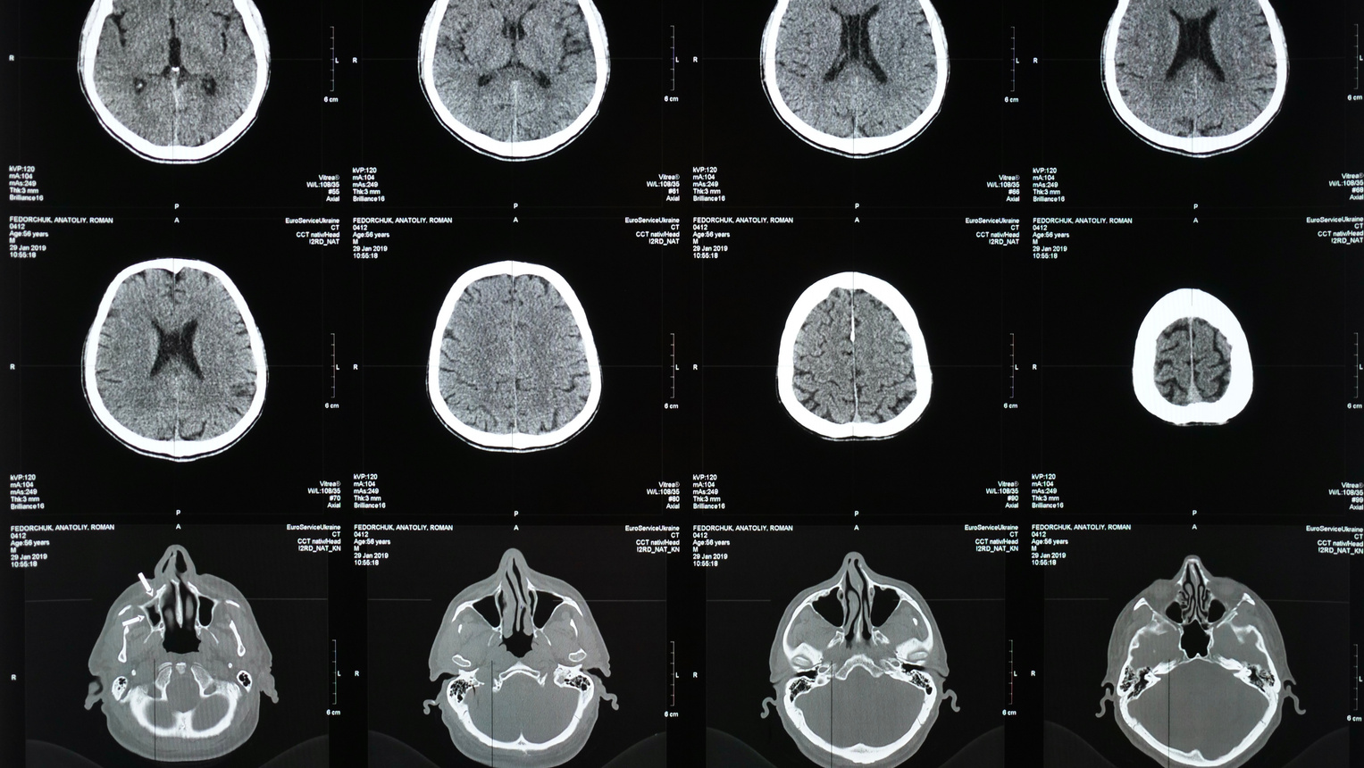
BRAIN TUMOR DETECTION USING DEEP LEARNING
COMP263-001 Deep Learning
Winter 2025
Group 2
Arcan Caglayan
Jessica Marie Hernandez
Jane | Yi-Chen Hsu
Sean | Sandeep Neupane
Vincent | Tsang Kwong Ngan
Diego Armando Sarmiento Ahumada

Slide 2
Content
List
01
.
Problem
08
.
Comparison
09
02
.
Challenges
.
Scope
03
.
Dataset
10
.
Key Findings
04
Success and Limitations
.
Preprocessing
11
.
05
Suggestions for Future Work
.
Supervised Learning
12
.
13
06
.
Work Distribution
.
Unsupervised Learning
07
.
State-of-the-Art Models

Slide 3
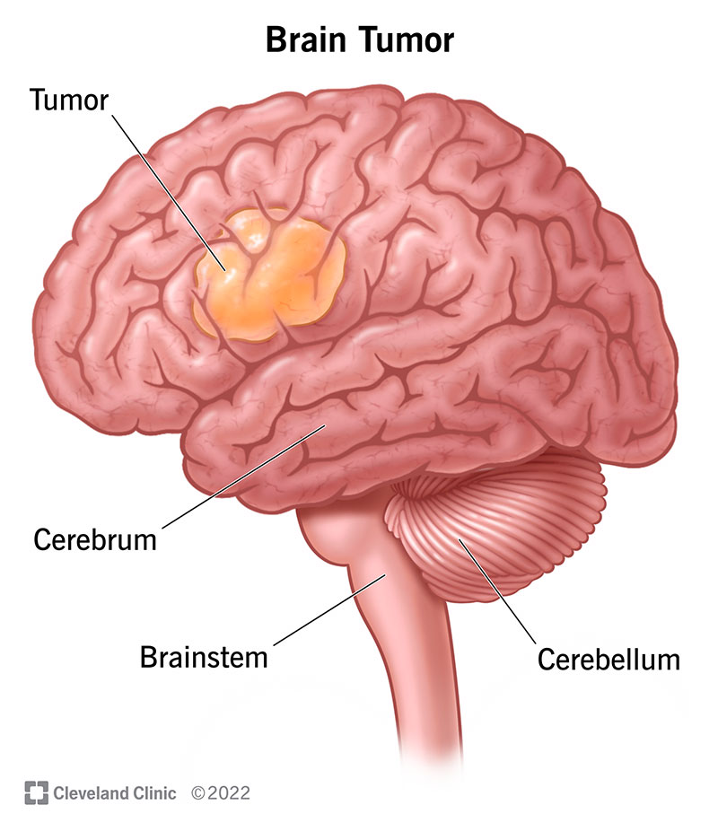
01
Problem
Challenges in Brain Tumor Diagnosis
Brain tumors are life-threatening and require early, accurate diagnosis.
Current diagnostic practice relies heavily on manual MRI scan analysis by radiologists.
This process is:
Time-consuming
Prone to human error
There is a growing need for automated, accurate solutions to assist in clinical decision-making.
Deep learning offers a promising path for improving detection accuracy and efficiency.

Slide 4




02
Scope
Model Development
Implement supervised, unsupervised, and state-of-the-art deep learning models
Focus on image-based tumor classification using MRI scans
Tasks in Scope
Data preprocessing and augmentation
Model training and testing
Evaluation of performance metrics: accuracy, recall, precision, f1 score
Dataset Utilization
Use the Brain MRI Images for Brain Tumor Detection dataset
Includes T1-weighted, contrast-enhanced MRI scans
Balanced: tumor vs non-tumor categories
Out of Scope
Clinical validation
Hospital system integration
Real-time deployment

Slide 5
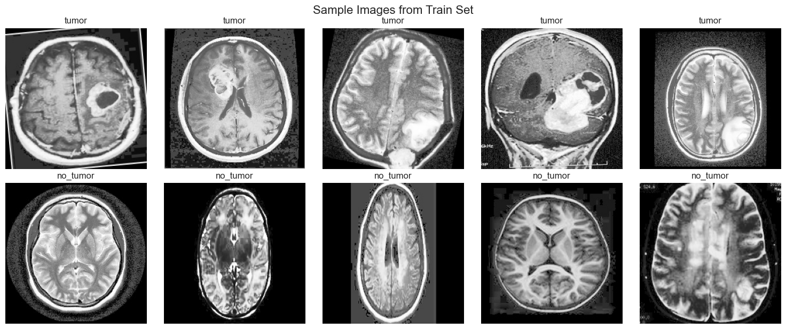
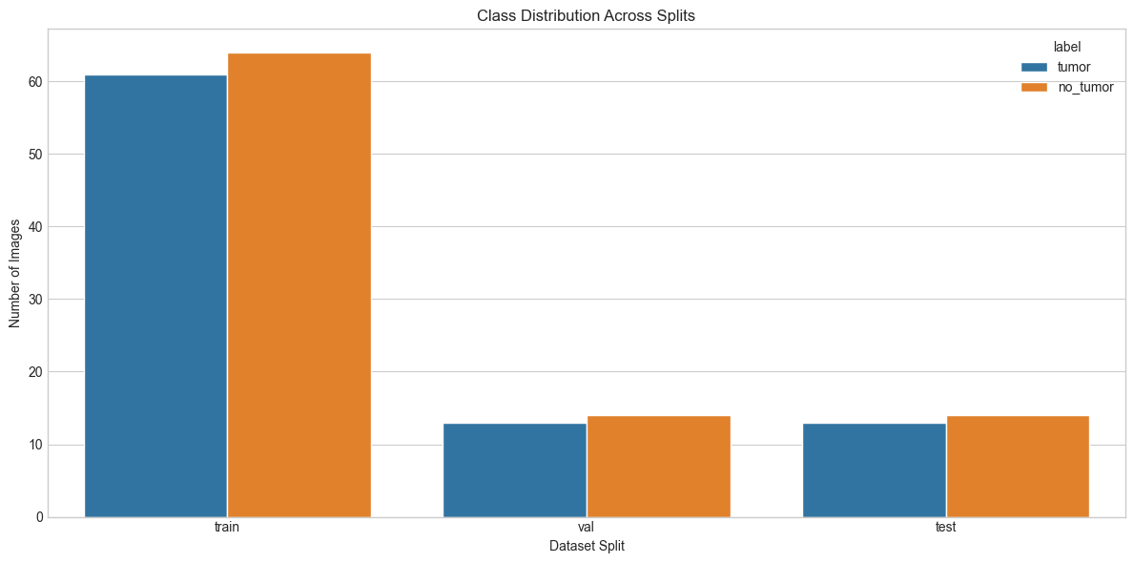
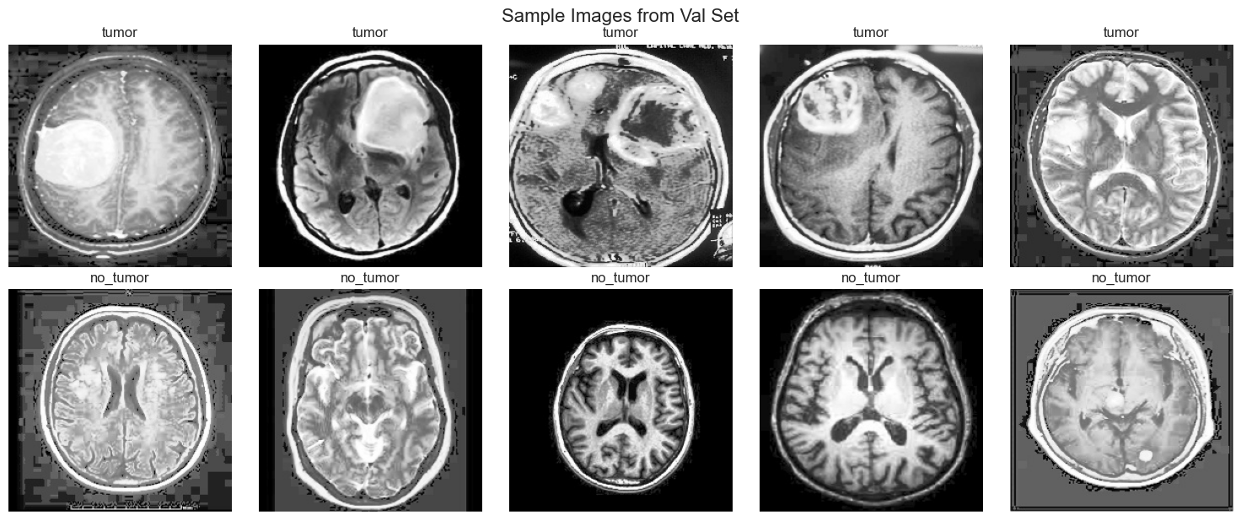
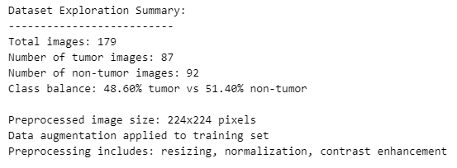
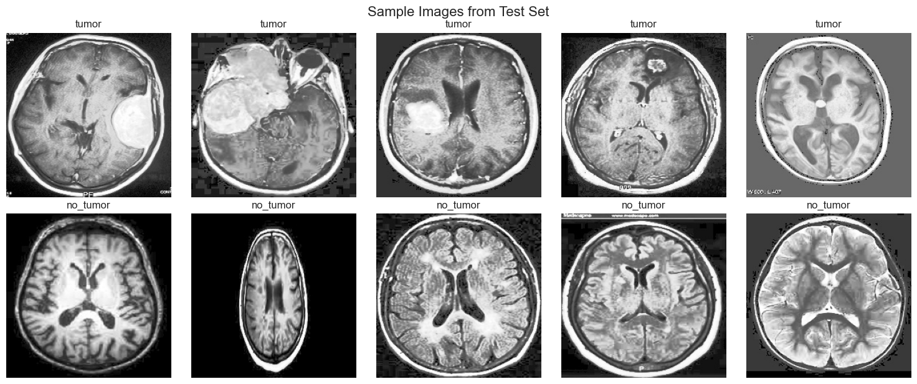
03
Dataset

Slide 6
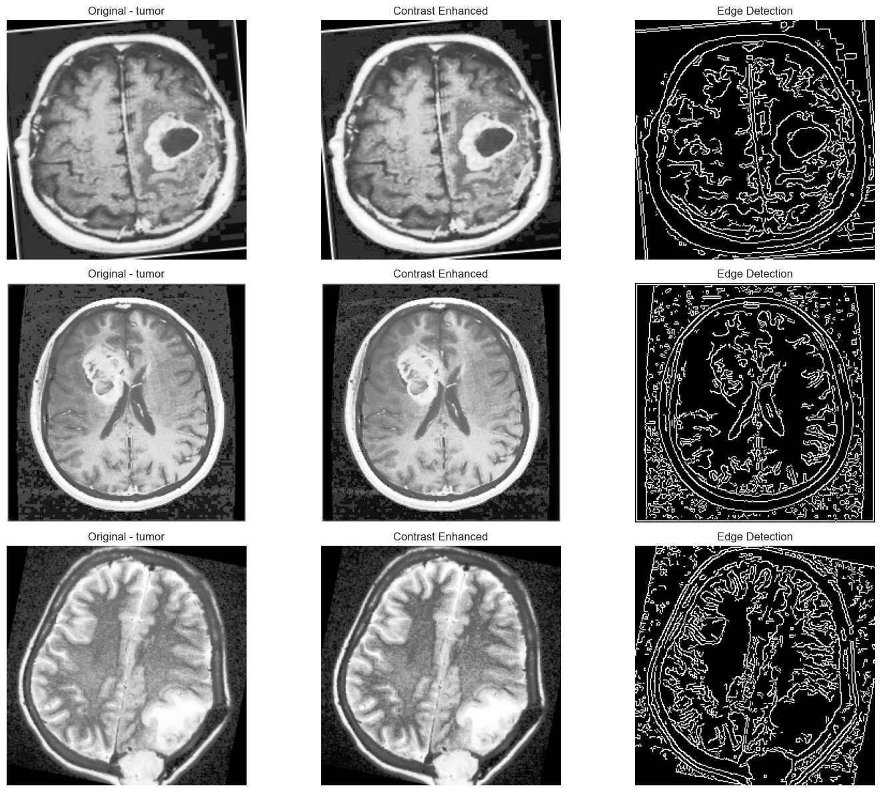
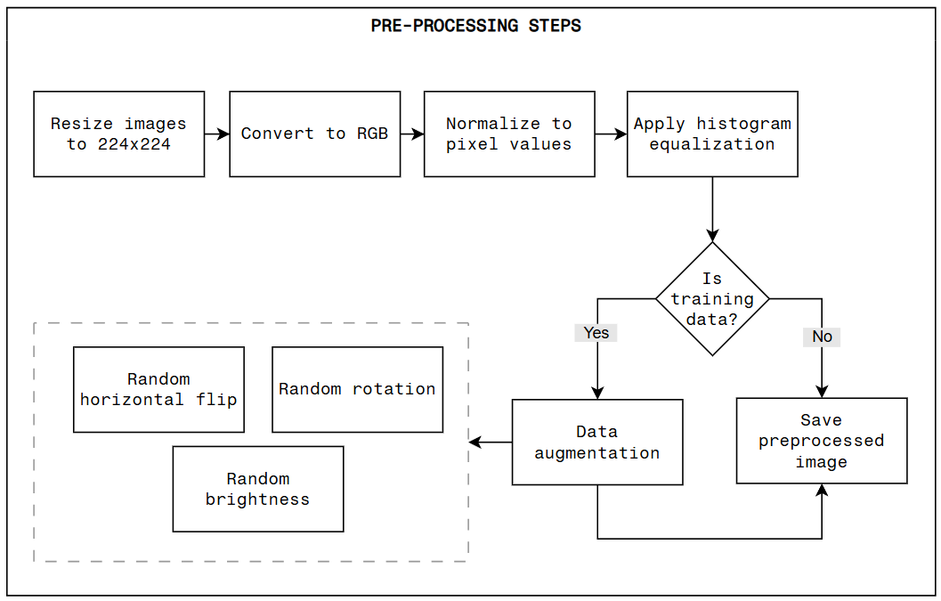
04
Preprocessing

Slide 7
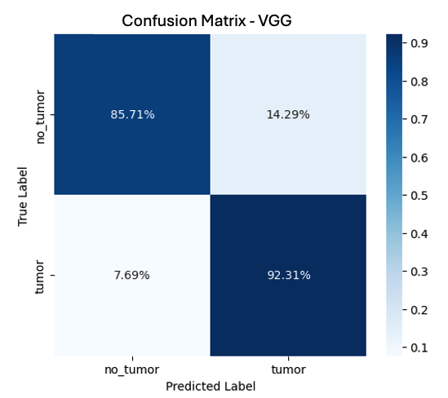
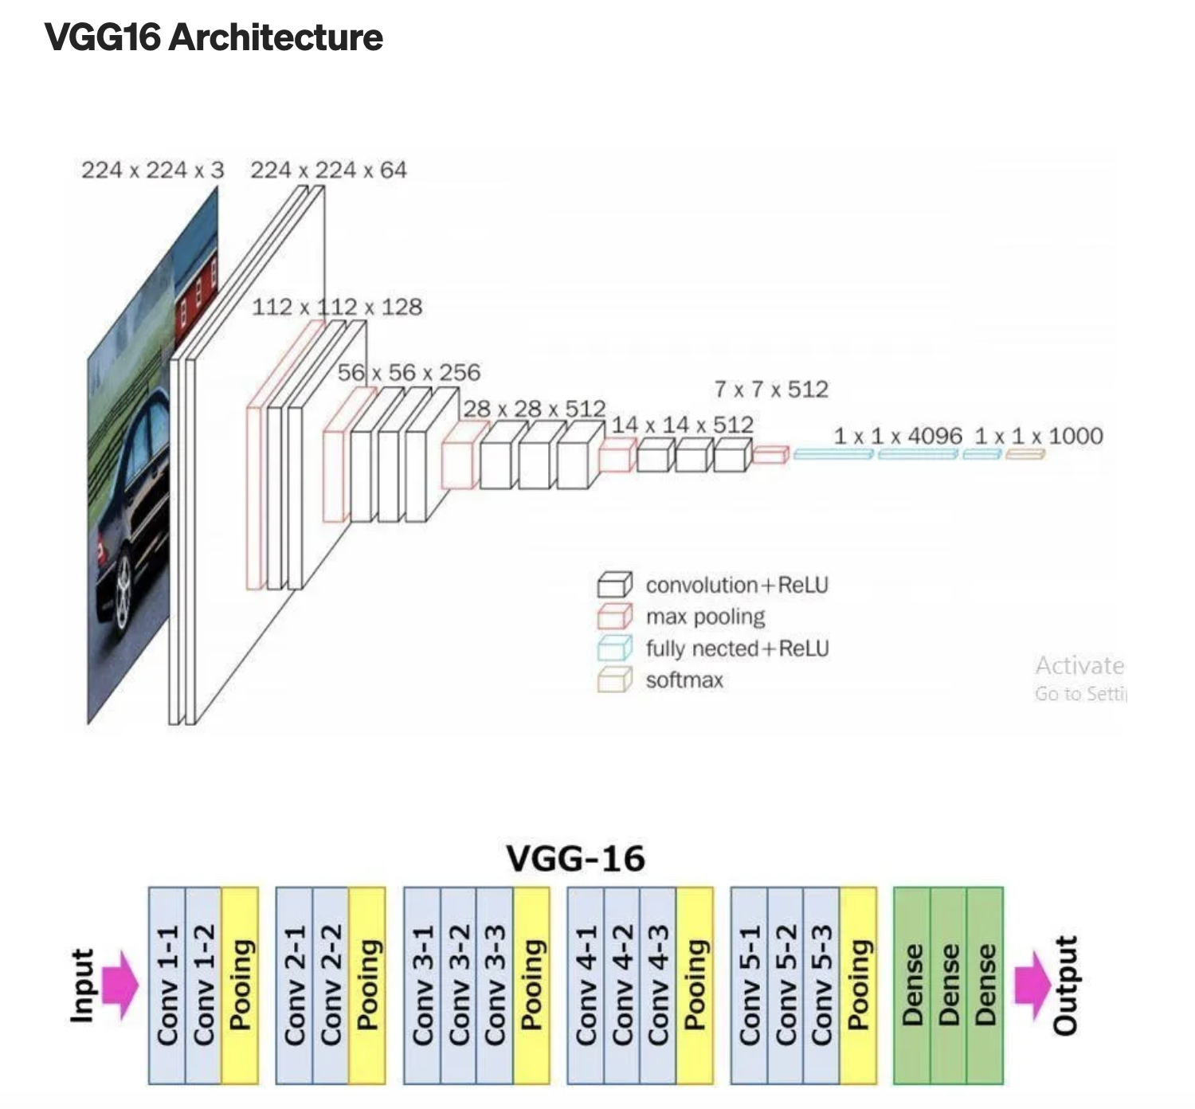
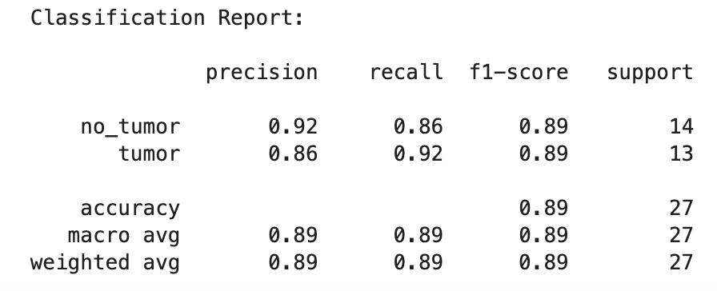
05
Supervised Learning

Slide 8
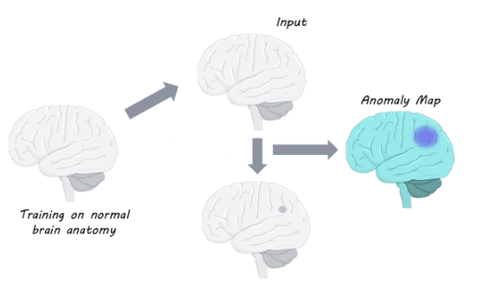
06
Unsupervised Learning
Autoencoders and variational autoencoders (VAE) have been shown to be effective in unsupervised anomaly detection. For this project we implemented both models to identify brain tumors by processing tumor images as anomalies.
Images 224 x 224 (grayscale).
Noise factor = 0.2.
Threshold = 95, 90, 85 percentiles.
Epochs = 18.
https://www.brainpost.co/weekly-brainpost/2025/2/18/detecting-brain-imaging-anomalies-using-generative-ai

Slide 9
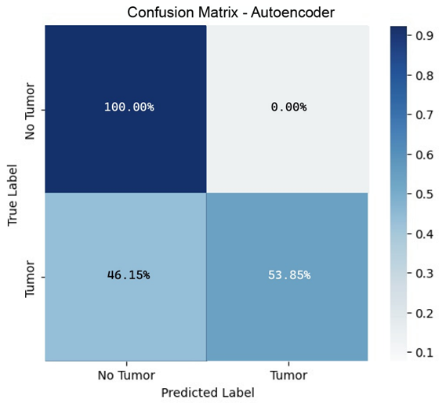
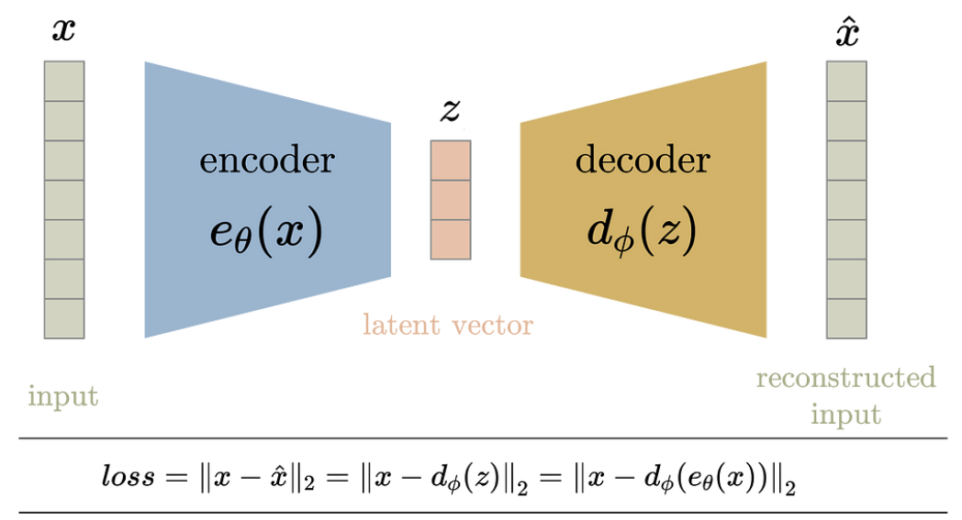
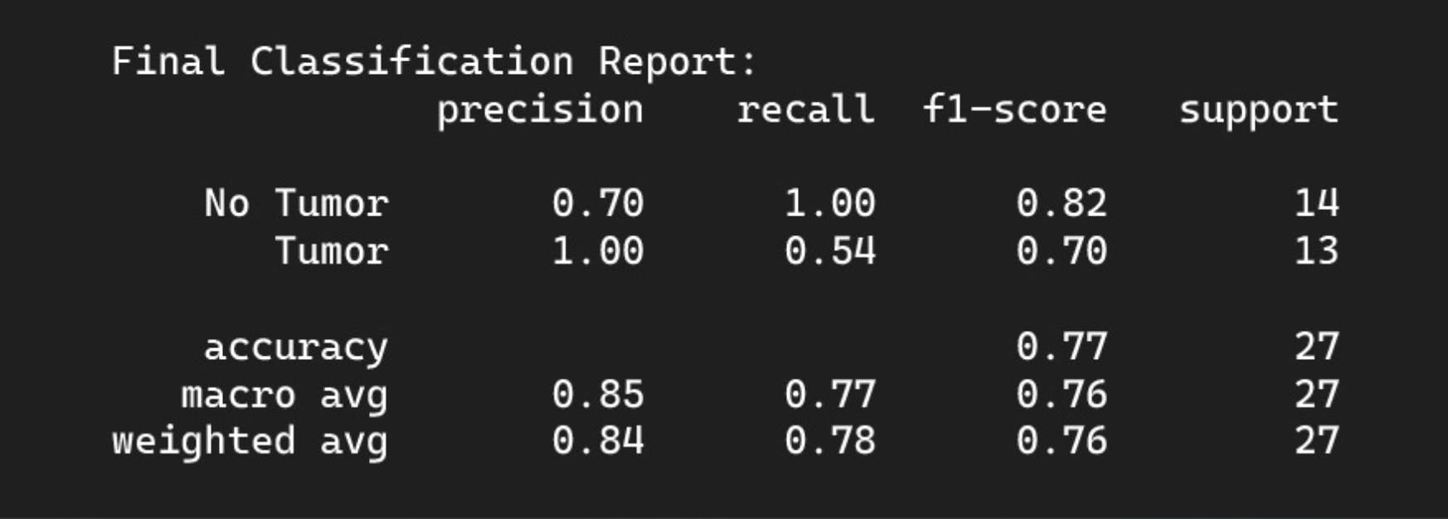
06
Unsupervised Learning
https://towardsdatascience.com/difference-between-autoencoder-ae-and-variational-autoencoder-vae-ed7be1c038f2/

Slide 10
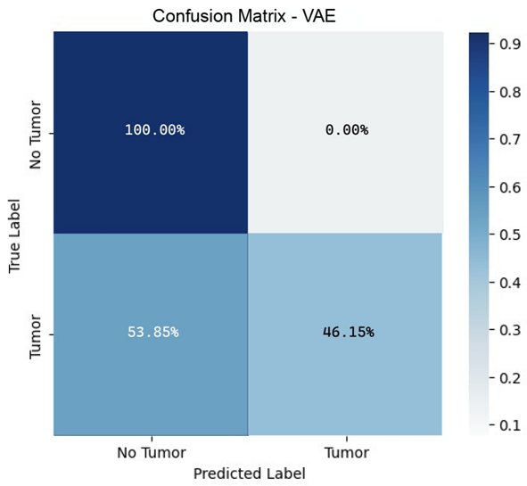
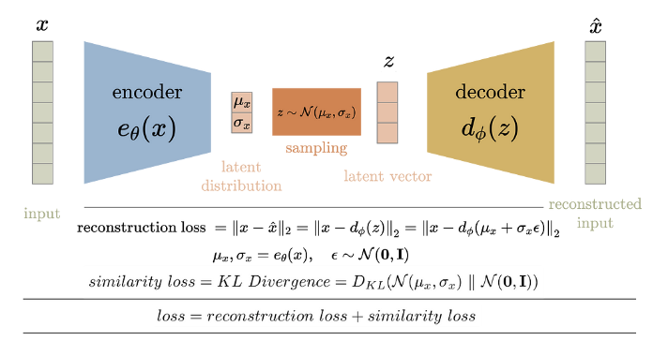

06
Unsupervised Learning
https://towardsdatascience.com/difference-between-autoencoder-ae-and-variational-autoencoder-vae-ed7be1c038f2/

Slide 11
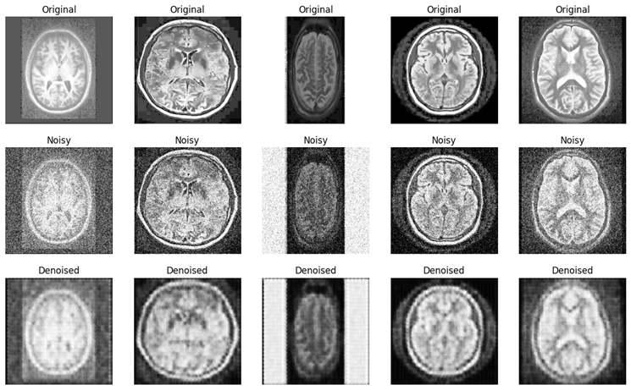
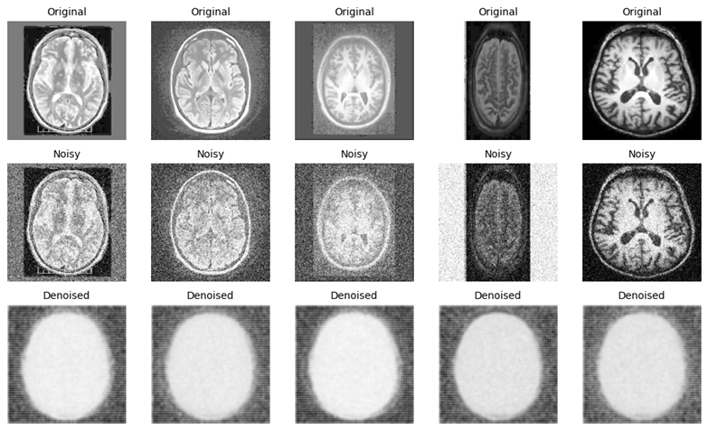
06
Unsupervised Learning
Autoencoder
Variational AutoEncoder (VAE)

Slide 12
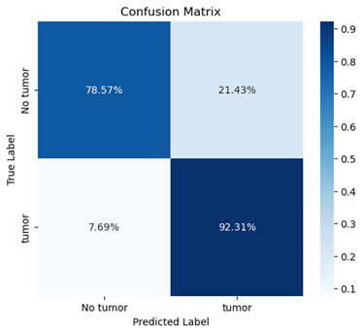
07
State-of-the-Art Models
Vision Transformer or ViT
Released in Oct 2020 for vision recognition
Several variants now exist
Said to outperform similar CNN models by upto 4x
Using google/vit-base-patch16-224-in21k
Uses self-attention mechanism
Captures long-range dependencies and contextual information
Uses attention maps
Matrics that represent the importance of different parts of input image

Slide 13
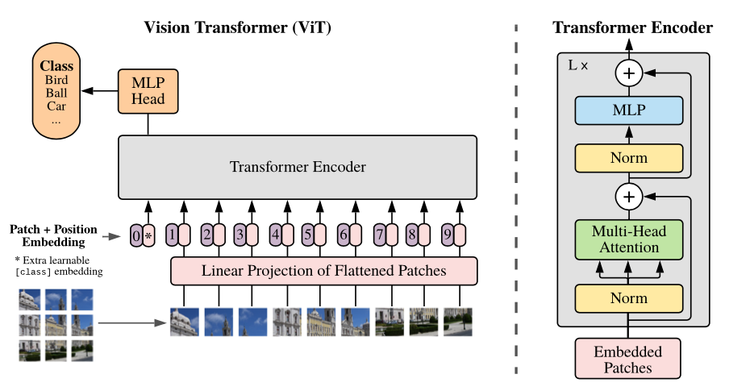
07
State-of-the-Art Models
Split an image into patches (fixed sizes)
Flatten the image patches
Create lower-dimensional linear embeddings from these flattened image patches
Include positional embeddings
Feed the sequence as an input to a SOTA transformer encoder
Pre-train the ViT model with image labels, then fully supervised on a big dataset
Fine-tune the downstream dataset for image classification

Slide 14
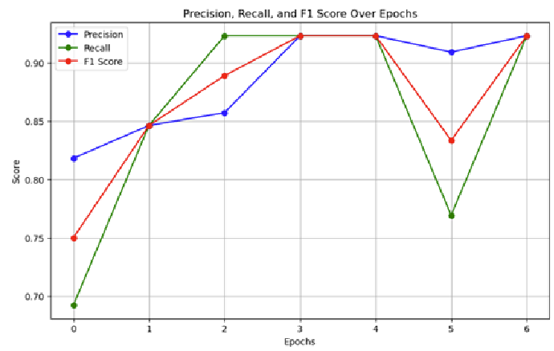
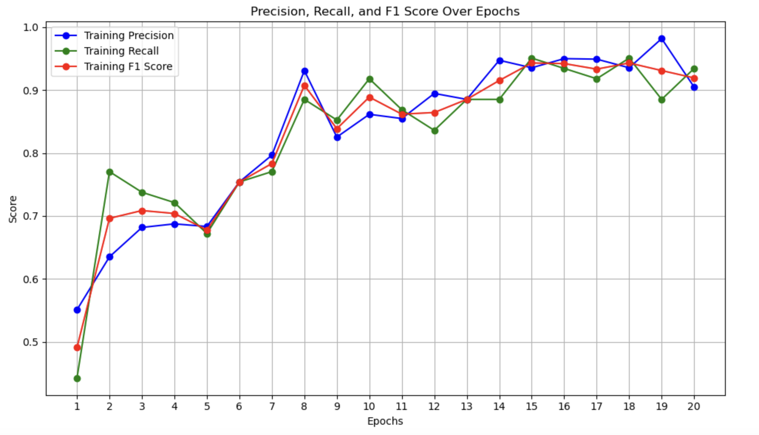
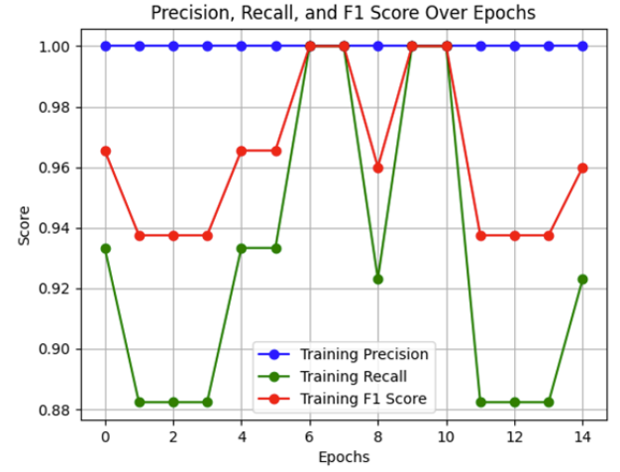
08
Comparison
VGG
Supervised Learning
ViT
State-of-the-Art Model
VGG
Gradual and stable learning
ViT Fast convergence with high early performance EfficientNet Consistently perfect precision; recall varies Overall ViT is fastest to learn, VGG is most stable, EfficientNet avoids false positives best
EfficientNet
State-of-the-Art Model

Slide 15
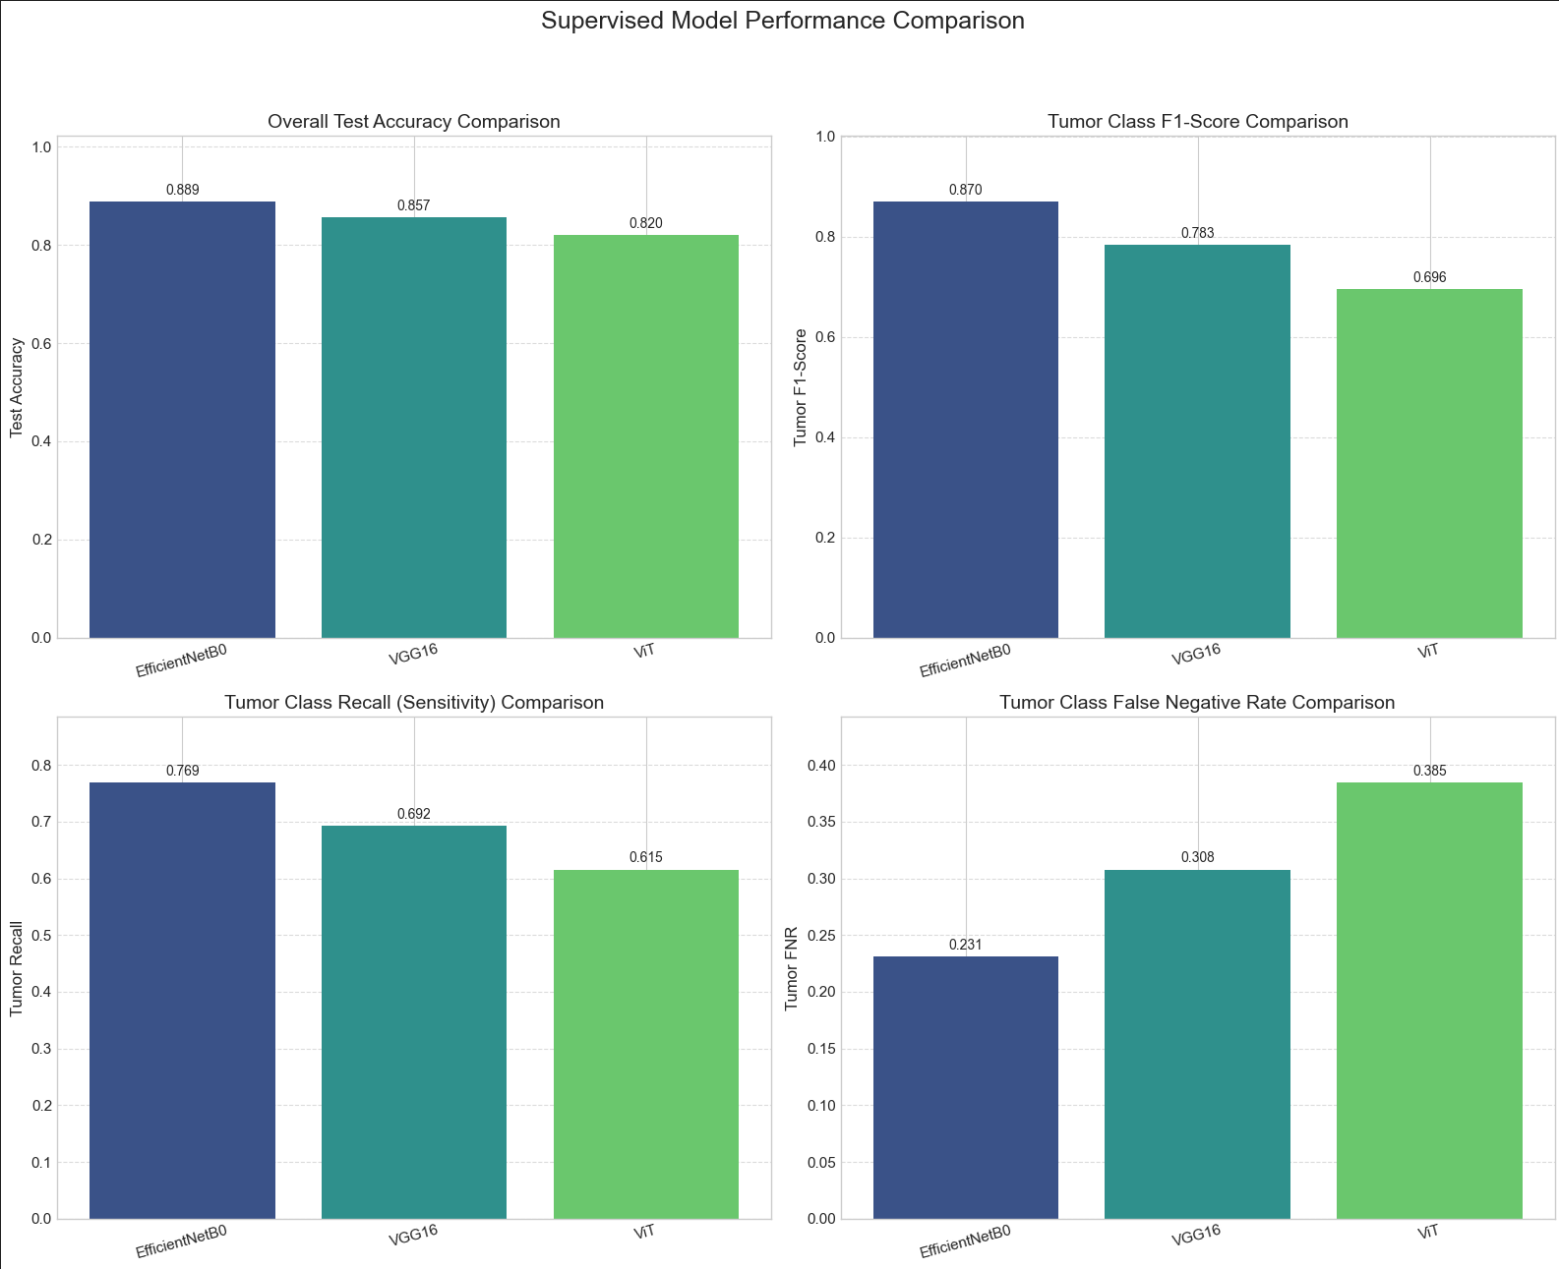
08
Comparison
Among the supervised models: EfficientNet clearly excels in recall (lowest False Negative Rate) and F1-score, while VGG and ViT lag significantly in sensitivity, confirming EfficientNet's strength in minimizing missed tumors despite ViT's faster training

Slide 16
08
Comparison
Criteria | VGG | Autoencoder | VAE | Vision Transformer | EfficientNet
Model Architecture | VGG16 (Convolutional Neural Network) | Denoising Autoencoder | Variational Autoencoder (VAE) | ViT (vit-base-patch16-224-in21k, Transformer) | EfficientNet (pre-trained model)
Training Method | Supervised, trained on labeled data | Unsupervised, trained on No Tumor only | Unsupervised, trained on No Tumor only | Supervised fine-tuning on labeled dataset | Transfer learning with class weighting and layer unfreezing
Accuracy | 85.71% | 77.00% | 73.00% | 82.00% | 88.89%
Recall | 69.23% | 53.85% | 46.15% | 61.54% | 76.92%
Precision | 90.00% | 53.85% | 46.15% | 80.00% | 100.00%
F1-Score | 78.26% | 62.00% | 51.00% | 69.57% | 87.00%
False Negatives | 1 | 6 | 7 | 5 | 3
False Positives | 2 | 0 | 0 | 2 | 0
Strengths | High precision; simple to train | Strong “no tumor” detection | No false positives on non-tumor | Faster training, generalizes well | Strong balance; perfect tumor precision
Weaknesses | Misses some tumor cases | Moderate recall; loses detail in reconstructions | Low recall; poor reconstruction | Recall not good | Some false negative cases; needs recall improvement

Slide 17
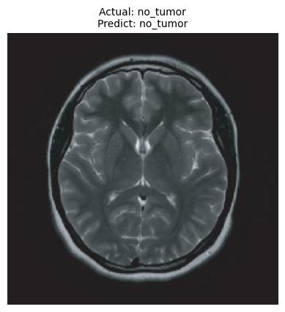

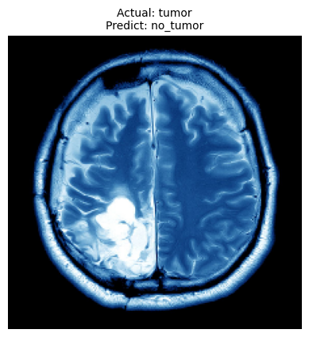


08
Comparison
VGG | ViT | EfficientNet
No Tumor
No Tumor
No Tumor
No Tumor
Tumor
No Tumor
Tumor
Tumor

Slide 18




09
Challenges
Limited Dataset Size
Impacts model reliability and accuracy
High Misclassification Risks
Critical medical consequences
Interpretability Challenges
Difficult to justify clinical use
Computational Complexity
Resource-intensive, costly implementation

Slide 19
10
Key Findings
Supervised models (VGG)
performed well in binary classification tasks, achieving high accuracy on tumor vs non-tumor MRI data.
Unsupervised models (Autoencoder, VAE)
effectively identified anomalies, demonstrating potential in cases with limited labeled data.
State-of-the-art models (ViT, EfficientNet)
showed competitive results with enhanced performance when fine-tuned but required more compute resources and careful preprocessing.
Performance Trade-offs
ViT balanced accuracy and recall best; Unsupervised models had low tumor recall. EfficientNet avoided false positives.

Slide 20


11
Success and Limitations
Successes
Limitations
High accuracy
VGG achieved 86%, EfficientNet 89%, suitable for clinical use
Effective Transfer Learning
Fine-tuned state-of-the-art models quickly adapted to the dataset
Strong Precision
EfficientNet showed 100% precision, minimizing false positives
Automated Preprocessing
Robust pipeline improved image quality and model input consistency
Misclassification Rates
VGG (31%) showed false-negative rates, inherently risky for medical applications
Interpretability Issues
Complex models like ViT and Autoencoder inherently lack transparency, limiting clinical trust
Model Complexity
Advanced models require significant computational resources, increasing operational complexity
Fixed Dataset Size
Reliance on a fixed dataset restricts model scalability and extensive validation

Slide 21
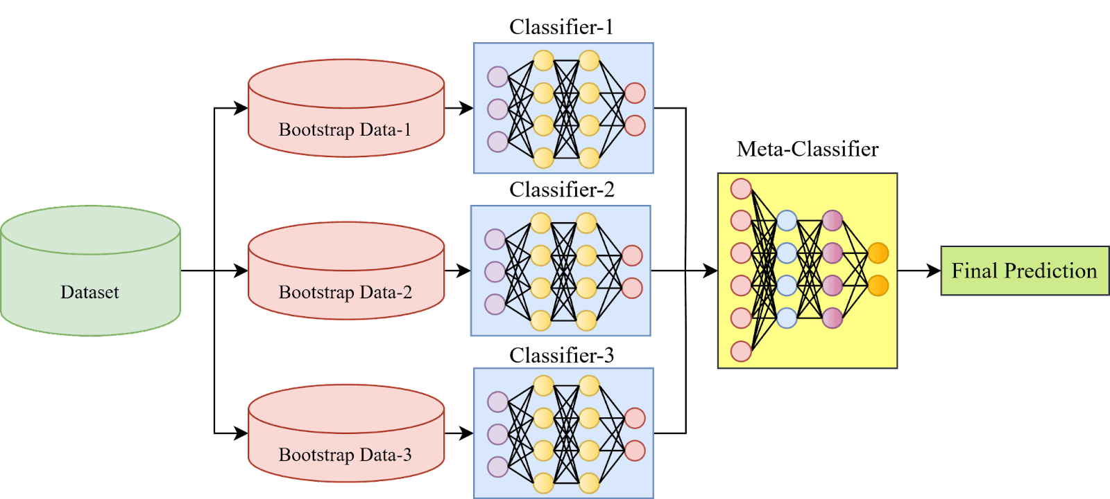

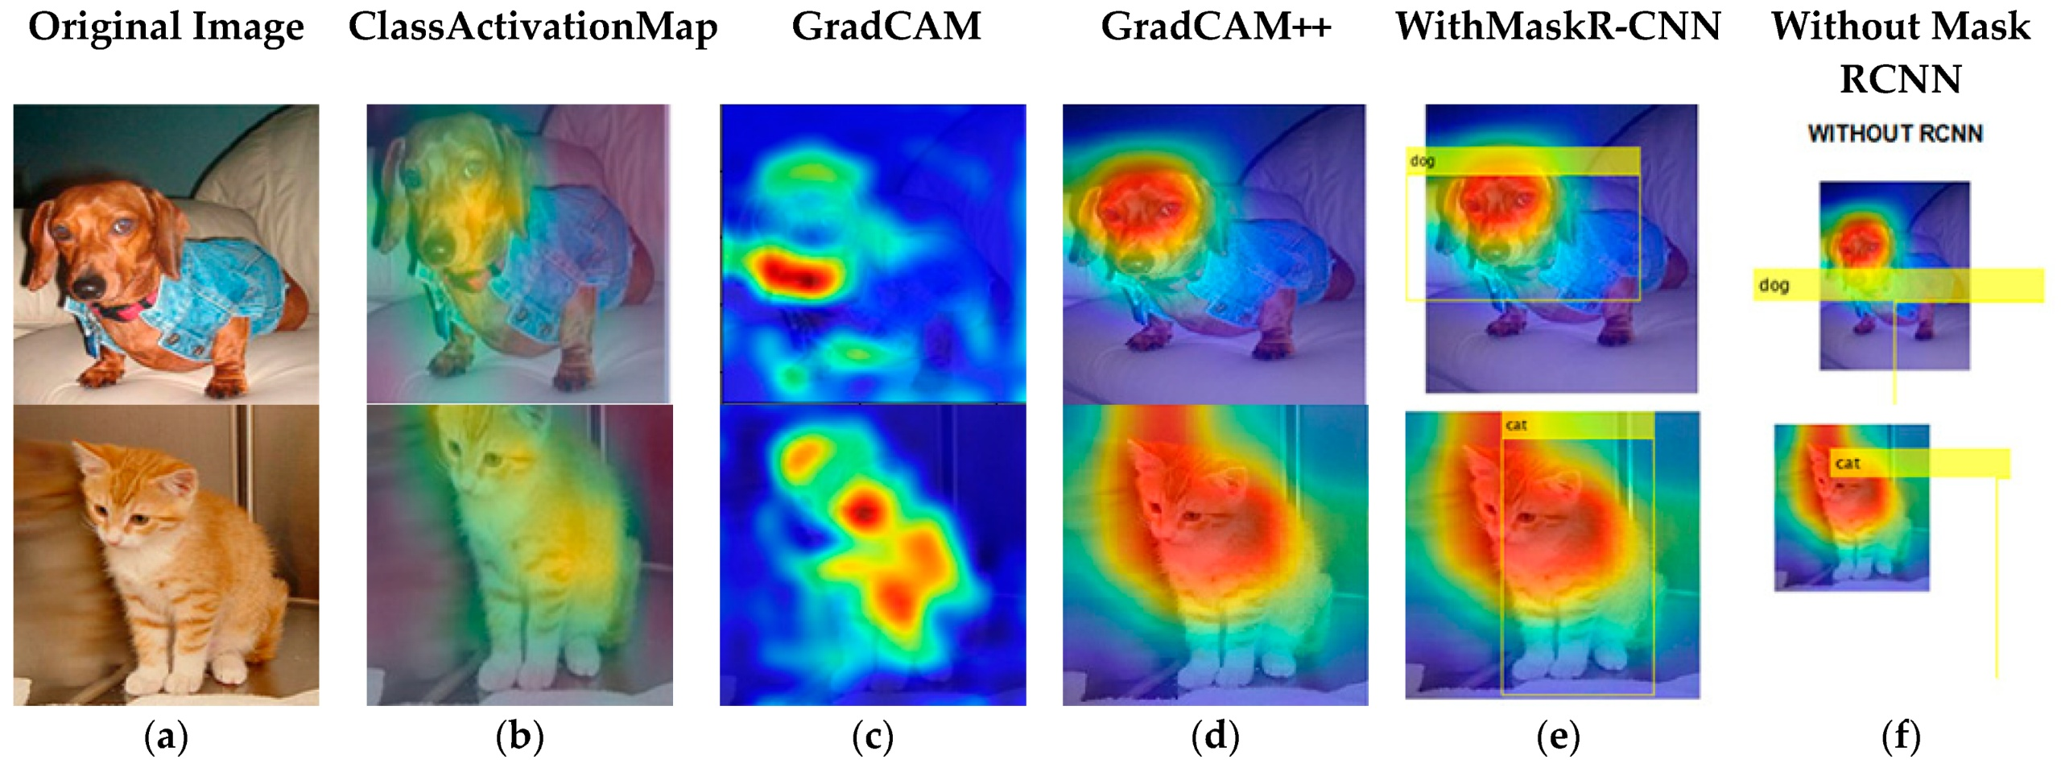
12
Suggestions for Future Work
Expand dataset size for better generalization
Employ ensemble methods to minimize false negatives
Explore lightweight architectures to lower computational costs
Incorporate interpretability methods (ex. Grad-CAM) for better clinical adoption

Slide 22






13
Work Distribution
Researching State of Art models
Preprocessing for ViT model and fine tuning on dataset
Reporting and evaluation with real world example images
Data loading
Preprocessing
Data exploration
Report and documentation
Explore the supervised learning algorithm for the task
Using VGG and CNN architecture to classify the binary labeled data
Reporting and evaluation aligned with others
Sandeep
Jessica
Jane / Yi-Chen
Explore the unsupervised learning algorithms
Develop Autoencoder and VAE models
Reporting
Explored state of the art models
Preprocessing for EfficientNet model and fine tuning
Report and evaluation
Model Comparison and evaluation
Reporting
Diego
Vincent
Arcan

