Slide 1
Computing Systems
Jessica Hill
Summer 2022
Onish Computing Workshop

Slide 2
Discussion Topics
Types of computing systems
Hardware – primary components
Software – the OS
Considerations for research
Overall Goals
Better understand the computing systems all around us to facilitate their incorporation into our daily research

Slide 3
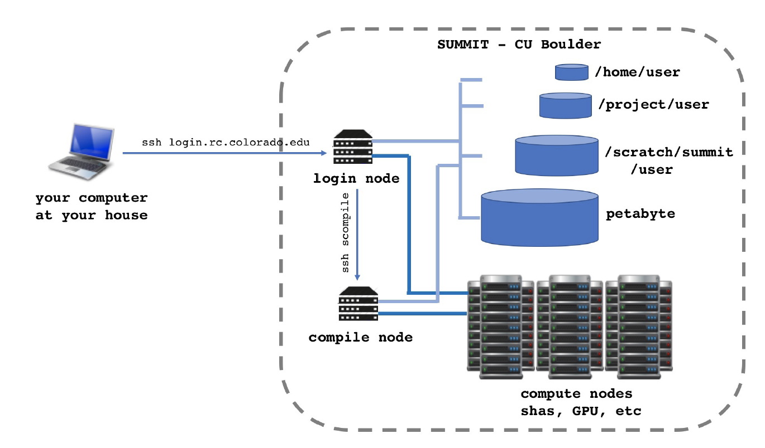
There are many different types of computing systems to fit various needs
- based on size
Supercomputer
Mainframe computers
Minicomputers
Personal computers
Notes:
Supercomputers:
Powerful computers which can process large amounts of data and do a great amount of computation quickly.
They are made up of interconnects, I/O systems (input/output systems), memory, and processor cores.
Unlike traditional computers, supercomputers use more than 1 CPU. CPUs are grouped into compute nodes (comprising a CPU or group of CPUs and a memory block). Supercomputers can contain hundreds of nodes, and with interconnect communication capabilities these nodes can collaborate on solving problems. Nodes also use interconnects to communicate with I/O systems like data storage and networking. I/O systems transfer information between computer main memory and the outside world.
An example is the Summit high performance computing system.
Mainframe computers:
High performance computer used for large information processing jobs.
They have large amounts of memory and processors that allow them to process massive amounts of calculations and transactions simultaneously in real time.
The mainframe is critical to commercial databases and transaction servers but they are also used in research.
An example of mainframe usage is within banking institutions which use mainframes to host their database of customer accounts allowing transactions to occur from any ATM location worldwide.
Minicomputers:
A mid-range computer that is intermediate in size, power, speed, storage capacity, etc., between a mainframe and a PC
This usually describes small to midsize servers.
A server is a computer that provides information to other computers on a network.
Whenever you use the Internet, you're looking at something that's stored on a server. Our lab uses a local file server to store and share files internally. Servers are very common in research applications.
Personal computers (PC)
PCs use a single processor/CPU
Modern CPUs however are multi-core processes (mine has 8). The CPU core is the actual processing unit. So, more cores means more processing power.

Slide 4
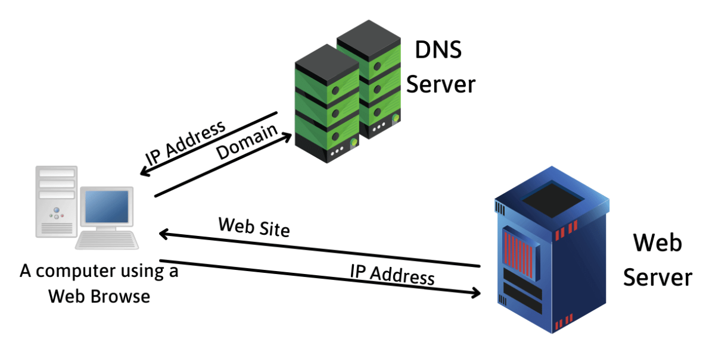
There are many different types of computing systems to fit various needs
- based on size
Supercomputer
Mainframe computers
Minicomputers
Personal computers
Servers
Notes:
A server is a computer that serves up or delivers information to other computers/devices on a network, either over the internet or a local network. Whenever you use the Internet, you're looking at something that's stored on a server.
Servers use a specialized system of disks called RAID (Redundant Array Of Inexpensive Disks); many hard drives storing the same information, so if one breaks the server uses another disk. They also have tons of RAM and many CPUs, allowing servers to handle thousands of requests for data.
You write a web address (like youtube.com for example) into your browser and hit enter.
This will first convert the web address into an IP address using a DNS (domain name system) server. (A DNS server is a computer server that contains a database of public IP addresses and their associated hostnames).
Then the IP will get sent to the Web server storing the site.
The web server will receive your request via a port and send back the website information.
Your browser will use this information to construct the website.
Our lab uses a local file server to store and share files internally.

Slide 5
There are many different types of computing systems to fit various needs
- based on data handling capability
Analogue Computers
Digital Computers
Hybrid
Handle analogue data
(continuous, non-discrete)
Handles only the binary input 0 and 1
(discrete data)
Notes:
Analogue Computer:
Designed to process analogue data.
Continuous data that changes continuously and cannot have discrete values is called analogue data.
An analogue computer is used where we don’t need exact values or need approximate values such as speed, temperature, pressure etc. It can directly accept the data from the measuring device without first converting it into numbers and codes. It measures the continuous changes in physical quantity. It gives output as a reading on a dial or scale. For example speedometer, mercury thermometer, etc.
Digital Computer:
Digital computers are designed in such a way that it can easily perform calculations and logical operations at high speed.
It takes raw data as an input and processes it with programs stored in its memory to produce the final output. It only understands the binary input 0 and 1, so the raw input data is converted to 0 and 1 by the computer and then it is processed by the computer to produce the result or final output.
All modern computers, like laptops, desktops including smartphones are digital computers.
Hybrid Computer:
The hybrid computer is a combination of both analog and digital computers.
Hybrid computers are fast like an analog computer and have memory, and accuracy like a digital computer. So, it has the ability to process both continuous and discrete data.
Used in specialized applications where both analog and digital data is required to be processed. A processor which is used in petrol pumps that converts the measurements of fuel flow into quantity and price is an example of a hybrid computer.

Slide 6
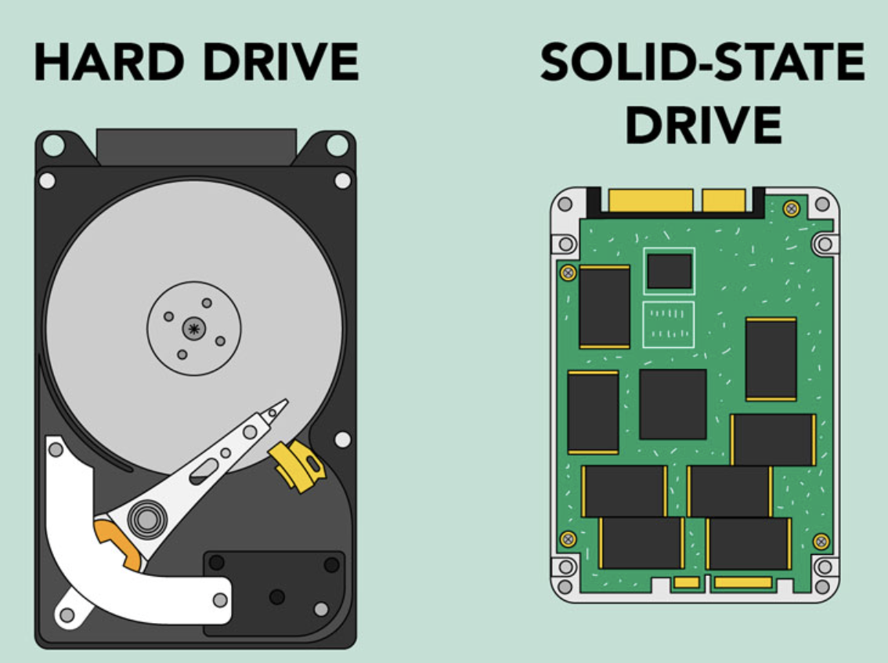
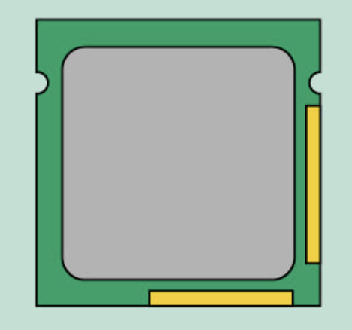
The primary internal hardware which are important to consider when working with computers
Speed
CPU
Storage Drive
RAM
Short-term memory (volatile)
(Dynamic) DRAM
Measured in MB and GB
Short-term memory (volatile)
The CPU cache memory
(Static) SRAM
Long-term memory (non-volatile)
https://www.youtube.com/watch?v=p3q5zWCw8J4
Notes:
A computer's memory architecture is broken down into three aspects:
1) The cache
The cache is the innermost memory unit. When running, your computer uses the cache as a sort of playground for data calculations and procedures. The electrical pathways to the cache are the shortest, making data access almost instantaneous. However, the cache is very small, so its data is constantly being overwritten.
CPU cache memory is just a really fast type of memory. The CPU cache stands at the top of the computer memory hierarchy, being the fastest. It is also the closest to where the central processing occurs, being a part of the CPU itself.
2) The memory
The memory is the middle ground. You may know it as RAM (Random Access Memory). This is where your computer stores data related to the programs and processes that are actively running. Access to RAM is slower than access to the cache, but only negligibly so.
RAM (random access memory; specifically, DRAM (D for dynamic)) is your system's short-term memory. Whenever your computer performs calculations, it temporarily stores the data in the RAM until it is needed. This short-term memory disappears when the computer is turned off. If you're working on a document, spreadsheet, or other type of file, you'll need to save it to avoid losing it. When you save a file, the data is written to the hard drive, which acts as long-term storage. RAM is measured in megabytes (MB) or gigabytes (GB). The more RAM you have, the more things your computer can do at the same time. If you don't have enough RAM, you may notice that your computer is sluggish when you have several programs open. You can add extra RAM to your computer to improve performance.
DRAM (dynamic) vs SRAM (static)
Cache memory is a form of Static RAM (SRAM), while your regular system RAM is known as Dynamic RAM (DRAM). Static RAM can hold data without needing to be constantly refreshed, unlike DRAM, which makes SRAM ideal for cache memory.
3) The data or storage drive
The data drive is where everything else is stored for permanence. It's where all of your programs, configuration files, documents, music files, movie files, and everything else is kept. When you want to access a file or run a program, the computer needs to load it from the data drive and into RAM.
The storage drive is the primary storage area where your software, documents, and other files are stored. The hard drive is long-term storage, which means the data is still saved even if you turn the computer off or unplug it. When you run a program or open a file, the computer copies some of the data from the hard drive onto the RAM. When you save a file, the data is copied back to the hard drive. The faster the hard drive, the faster your computer can start up and load programs. Computers either have a hard disk drive (HDD) or a solid state drive (SDD).
SSD vs HDD
The hard disk drive contains a spinning platter with a thin magnetic coating. A "head" moves over the platter, writing 0's and 1's as tiny areas of magnetic North or South on the platter. To read the data back, the head goes to the same spot, notices the North and South spots flying by, and so deduces the stored 0's and 1’s. The HDD is slower than SSD, but cheaper.
SSDs use a type of memory called "flash memory," which is similar to RAM and Flash drives (USBs). But, unlike RAM, which clears its data whenever the computer powers down, the data on an SSD persists even when it loses power. SSDs use a grid of electrical cells to send and receive data quickly. These grids are separated into sections called "pages," and these pages are where data is stored. Pages are clumped together to form "blocks." SSDs are called "solid-state" because they have no moving parts.
SSDs can only write to empty pages in a block. In HDDs, data can be written to any location on the plate at any time, and that means that data can be easily overwritten. SSDs can't directly overwrite data in individual pages. They can only write data to empty pages in a block. When enough pages in a block are marked as unused, the SSD commits the entire block's worth of data to memory, erases the entire block, then re-commits the data from memory back to the block while leaving the unused pages blank.

Slide 7
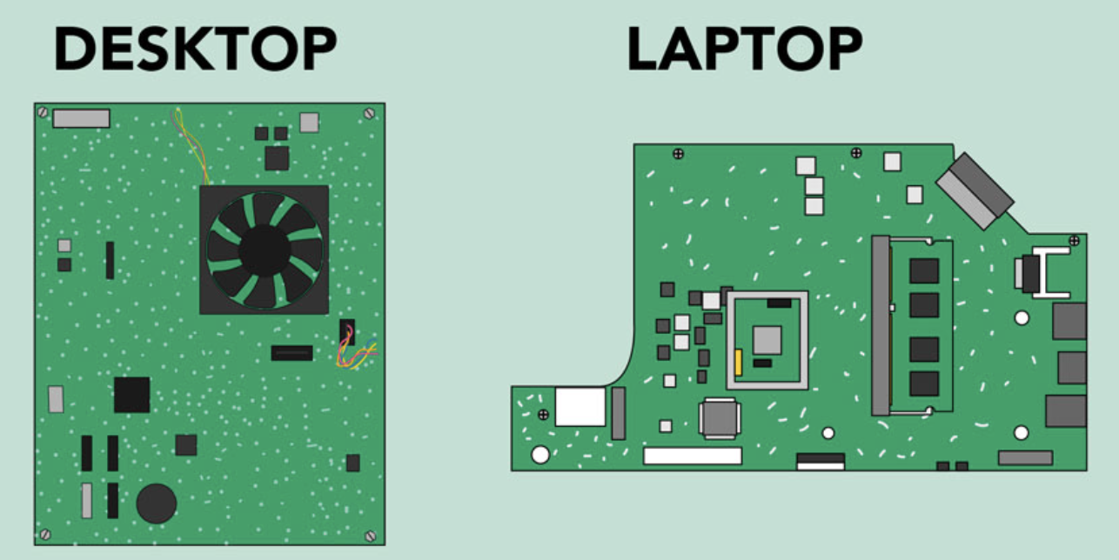
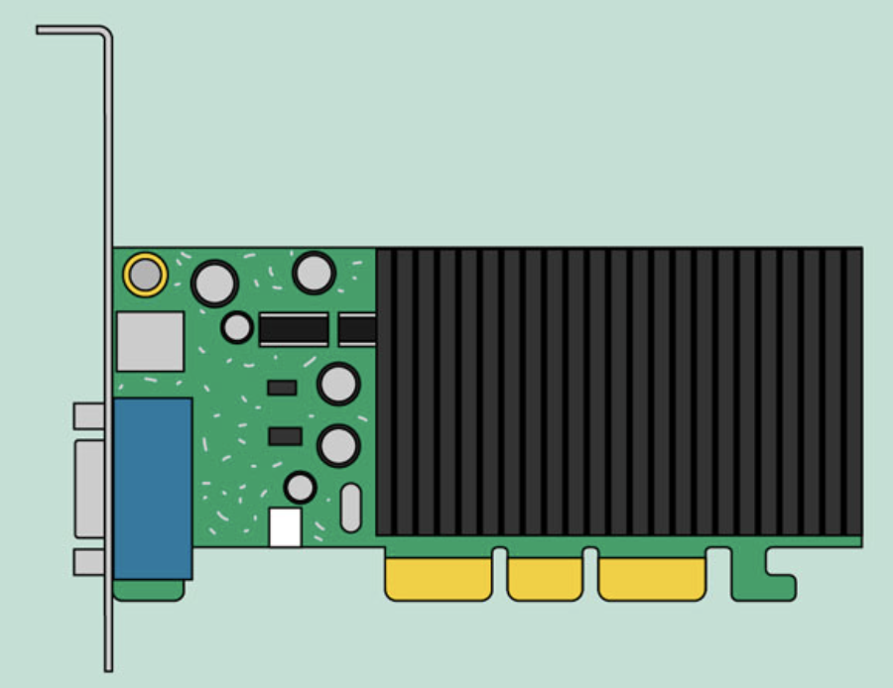
The primary internal hardware which are important to consider when working with computers
Motherboard
CPU
GPU
Measured in MHz/GHz ‘clock speed’
Understands machine language (0s and 1s)
Designed for parallel processing
Graphics/video rendering
Main circuit board
Communicates between components
Notes:
The motherboard is the computer's main circuit board. It's a thin plate that holds the CPU, memory, connectors for the hard drive and optical drives, expansion cards to control the video and audio, and connections to your computer's ports (such as USB ports). The motherboard connects directly or indirectly to every part of the computer.
The central processing unit (CPU), also called a processor, is located inside the computer case on the motherboard. The CPU handles the core processing tasks in a computer—the literal computation that drives every single action/command in a computer system. Computers work through the processing of binary data, or ones and zeroes. To translate that information into the software, graphics, animations, and every other process executed on a computer, those ones and zeroes must work through the logical structure of the CPU. That includes the basic arithmetic, logical functions (AND, OR, NOT) and input and output operations. The CPU is the brain, taking information, calculating it, and moving it where it needs to go. A processor's speed or clock speed is measured in megahertz (MHz), or millions of instructions per second; and gigahertz (GHz), or billions of instructions per second. A faster processor can execute instructions more quickly. Within every CPU, there are a few standard components, which include the following: Core(s) and Cache
CPU Core(s): The central architecture of the CPU is the “core,” where all computation and logic happens. Each CPU-core can execute an independent set of instructions from the computer. A core typically functions through what is called the “instruction cycle,” where instructions are pulled from memory (fetch), decoded into processing language (decode), and executed through the logical gates of the core (execute). Initially, all CPUs were single-core, but with the proliferation of multi-core CPUs, we’ve seen an increase in processing power.
Cache: Cache is super-fast memory built either within the CPU or in CPU-specific motherboards to facilitate quick access to data the CPU is currently using. Since CPUs work so fast to complete millions of calculations per second, they require ultra-fast (and expensive) memory to do it—memory that is much faster than hard drive storage or even the fastest RAM.
The GPU (graphics processing unit) is designed for parallel processing. The GPU is used in a wide range of applications, including graphics and video rendering. Without a GPU, you wouldn't be able to see things on your monitor, play games, watch movies, or even flick through a Powerpoint presentation. Although they’re best known for their capabilities in gaming, GPUs are becoming more popular for use in creative production and artificial intelligence (AI). GPUs are similar in function to CPU: they contain cores, memory, and other components. Instead of emphasizing context switching to manage multiple tasks, GPU acceleration emphasizes parallel data processing through a large number of cores. These cores are usually less powerful individually than the core of a CPU. Most computers have a GPU built into the motherboard (integrated) instead of having a separate GPU (discrete). However, if you like playing graphics-intensive games, you can add another GPU to one of the expansion slots to get better performance. GPUs come with a specific set of instructions to follow, and integrated GPUs rely on the systems RAM and CPU while discrete (or standalone) GPUs have their own memory and processing power allowing them to fulfill high processing requirements of visual experience. Thus, the discreet GPU will deliver more power than an integrated GPU and can be used for high-level gaming, video editing, 3D model rendering, and other computationally intensive tasks. A side effect being, that some modern GPUs require hundreds of watts to run.

Slide 8
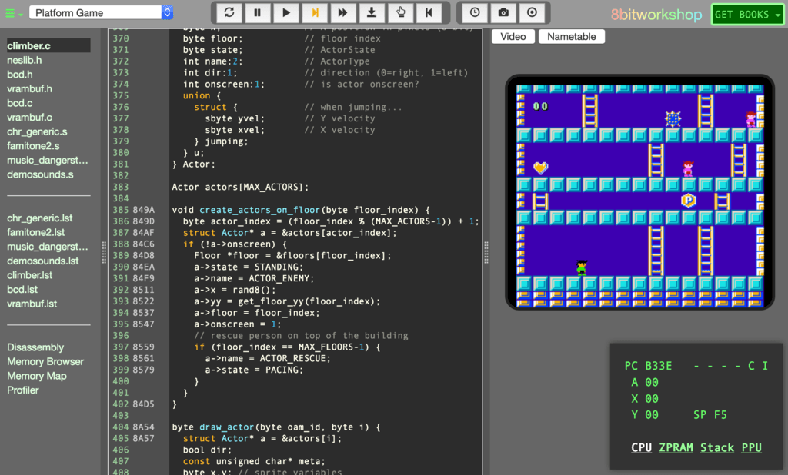
The primary internal hardware which are important to consider when working with computers
CPU
GPU
RAM
Storage Drive
Notes:
Putting it together

Slide 9
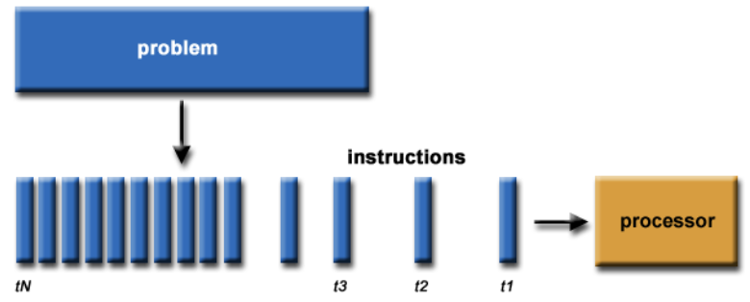
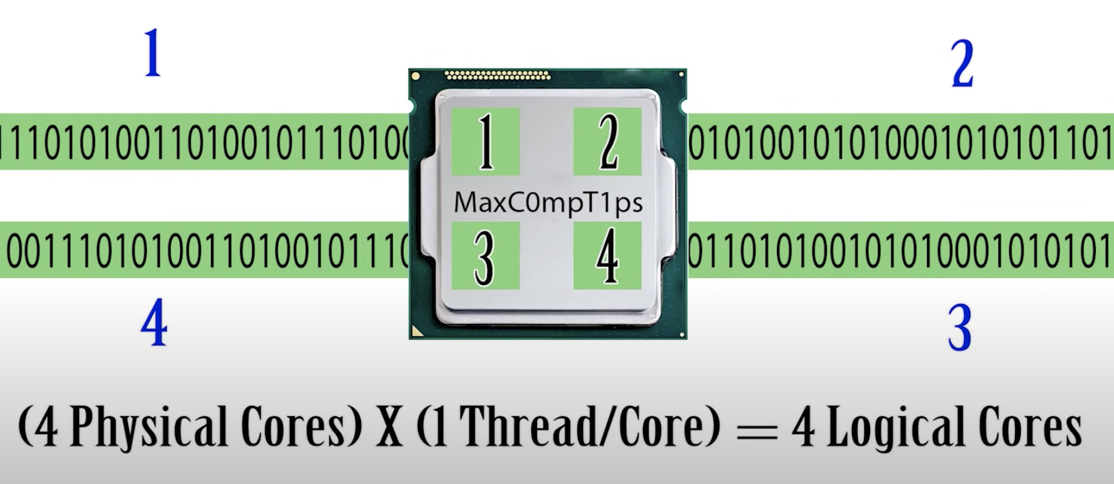
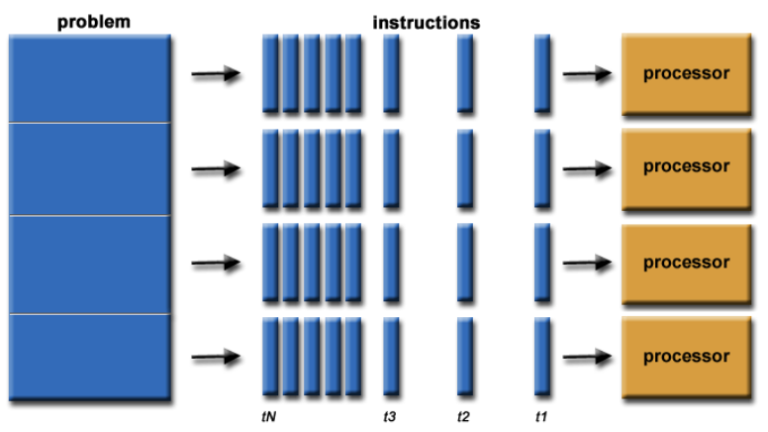
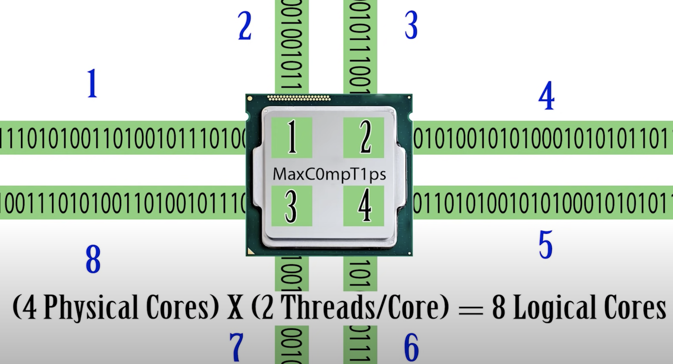
We can pass instructions to the computer in a few different ways
Serial programming
Parallel programming
Notes:
Serial Programming
Serial programming is the default method of code execution. Serial code is run sequentially; meaning, only one instruction is processed at a time.
Parallel Programming
Parallel programming involves breaking up code into smaller tasks or chunks that can be run simultaneously.
Threads (virtual or logical cores)
Threads are a series of programmed instructions that allow a CPU core to appear to be split into 2 cores.
i.e., 2 cores/4 threads (threads > cores)
Each core can then take on 2 threads of instructions
Utilizing multiple threads per core helps utilize the CPU more efficiently (less down time with improved scheduling)!
Resources:
https://researchcomputing.princeton.edu/support/knowledge-base/parallel-code
How can you determine if your CPU is capable of multithreading?

Slide 10
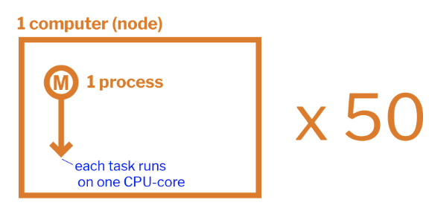
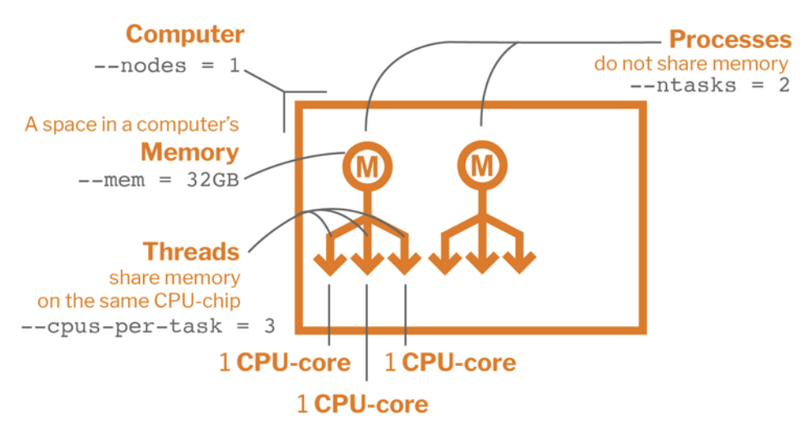
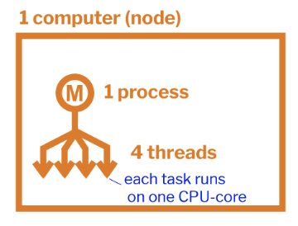
Improve computing efficiency with parallelism
Key diagram
An array job which runs 50 identical tasks of one process on one node
A distributed memory job which runs on three nodes, each node with two different processes, and each process with one thread
Job which runs on one node, with one process that consists of four threads
Notes:
Parallel computing is a type of computation in which many calculations or processes are carried out simultaneously. Large problems can often be divided into smaller ones, which can then be solved at the same time.
Parallel computing is closely related to concurrent computing, they are frequently used together and often conflated, though the two are distinct: it is possible to have parallelism without concurrency, and concurrency without parallelism (such as multitasking by time-sharing on a single-core CPU).
In parallel computing, a computational task is typically broken down into several, often many, very similar sub-tasks that can be processed independently and whose results are combined afterwards, upon completion.
In contrast, in concurrent computing, the various processes often do not address related tasks; when they do, as is typical in distributed computing, the separate tasks may have a varied nature and often require some inter-process communication during execution.
Parallel computers can be roughly classified according to the level at which the hardware supports parallelism (i.e., multi-core and multi-processor computers (single machine), or compute clusters (multiple computers, sometimes also with multiple processers and cores).
4 basic types of parallel programing:
1) Each task in a job can be run completely independently of other tasks. In other words, the program runs a bunch of copies of the same task, but each copy has different input parameters. No communication required between tasks, which is what makes it easy to implement.
2) Shared-memory parallelism is when tasks are run as threads on separate CPU-cores of the same computer. In other words, a single program can access many cores on one machine. As the name "shared-memory parallelism" implies, the CPU-cores share memory because they are on the same computer and all have access to the same memory card. Due to the shared memory, a light level of communication is required between the cores working on each task. Since multiple threads are used to complete a job, shared-memory parallelism is often also referred to as multithreading.
3) Distributed-memory parallelism generally refers to running tasks as multiple processes that do not share the same space in memory. While this can technically happen on one computer, a more intuitive way to understand distributed-memory parallelism is to consider tasks that are run on different computers, as those tasks more obviously have their own memory. At some point, the process on one computer needs to communicate with the processes on other computers in order to complete its calculations. This is one of the more complicated types of parallelism, since it requires a high level of communication between different tasks to ensure that everything runs properly. Since multiple processes are needed to complete a job, distributed-memory parallelism is often referred to as multiprocessing.
4) Accelerator Parallelism uses different types of computer hardware, such as Graphical Processing Units (GPUs) and Field-Programmable Gate Arrays (FPGAs), to simply do computations faster than any CPU chip is able to. A CPU, for example, can have tens of processing cores, but a GPU has thousands.
https://researchcomputing.princeton.edu/support/knowledge-base/parallel-code

Slide 11
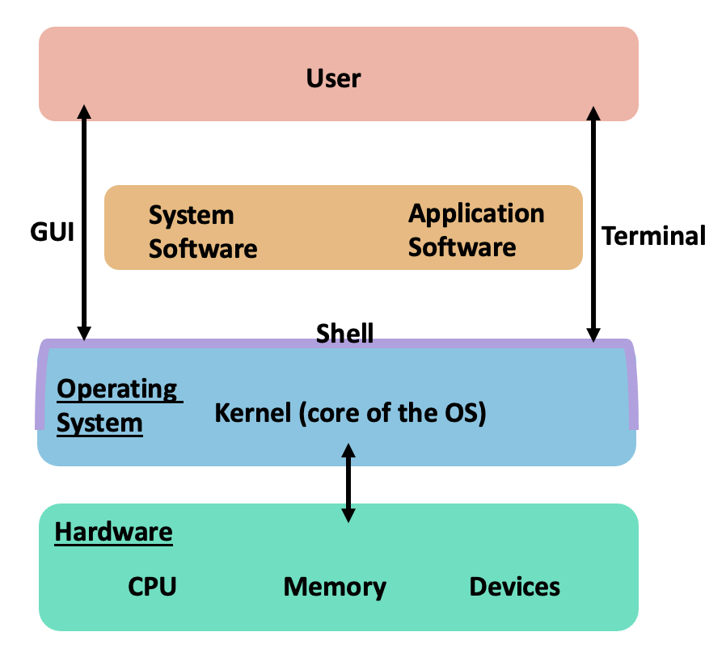
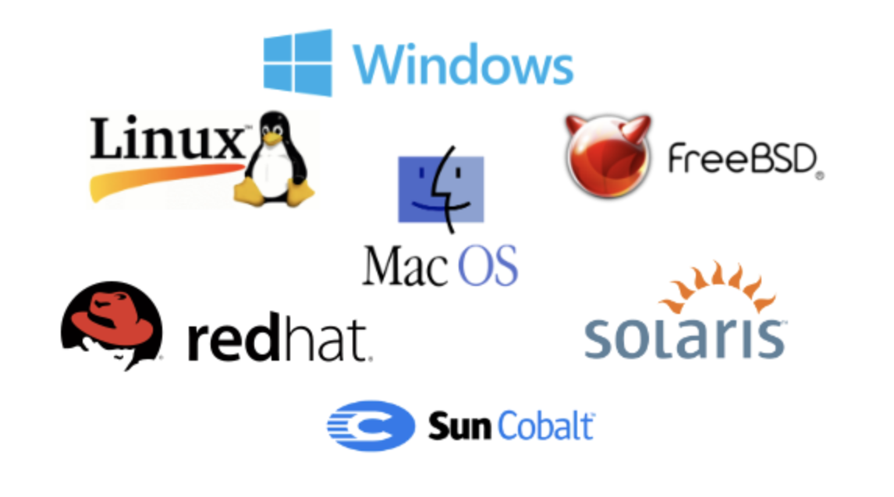
The operating system is the most important software on a computer, allowing us to interact with our computer and its components
https://www.youtube.com/watch?v=26QPDBe-NB8
Notes:
The OS manages the computer's memory and processes, as well as all the software and hardware. Most of the time, there are several different computer programs running at the same time, and they all need to access your computer's CPU, memory, and storage. The operating system coordinates all of this to make sure each program gets what it needs. The OS also allows you to communicate with the computer without knowing how to speak the computer's language.
The top most layer of the OS is the shell. Modern OS use a graphical user interface, or GUI (type of shell). A GUI lets you use your mouse to click icons, buttons, and menus, and everything is clearly displayed on the screen using a combination of graphics and text. In fact, most of the applications or programs we run on our computers are GUI applications. This wasn't always the case though. When computers were first developed, all user interactions occurred by typing on the keyboard into a text interface. Some OS, like LINUX, maintain this text based interface through the terminal emulator, or terminal (type of shell). By typing into the terminal, we can interact with the shell. The shell is a program that will take our text input and pass it to the kernel.
The kernel is the heart of all OS (the inner most layer). It is the piece of software that interacts the closest with the hardware, and the rest of the OS sits on top of it. A Kernel can access various computer resources like the CPU, I/O devices and other resources. It acts as a bridge or interface between the user and the resources of the system.
The Kernel is responsible for low-level tasks such as:
Resource management: It is the duty of a Kernel to share the resources between various process in such a way that there is uniform access to the resources by every process.
Memory management: Every process needs some memory space. So, memory must be allocated and deallocated for its execution. All this memory management is done by a Kernel.
Device management: Kernel manages the allocation of peripheral devices.
Task management
Resources:
https://www.geeksforgeeks.org/kernel-in-operating-system/

Slide 12
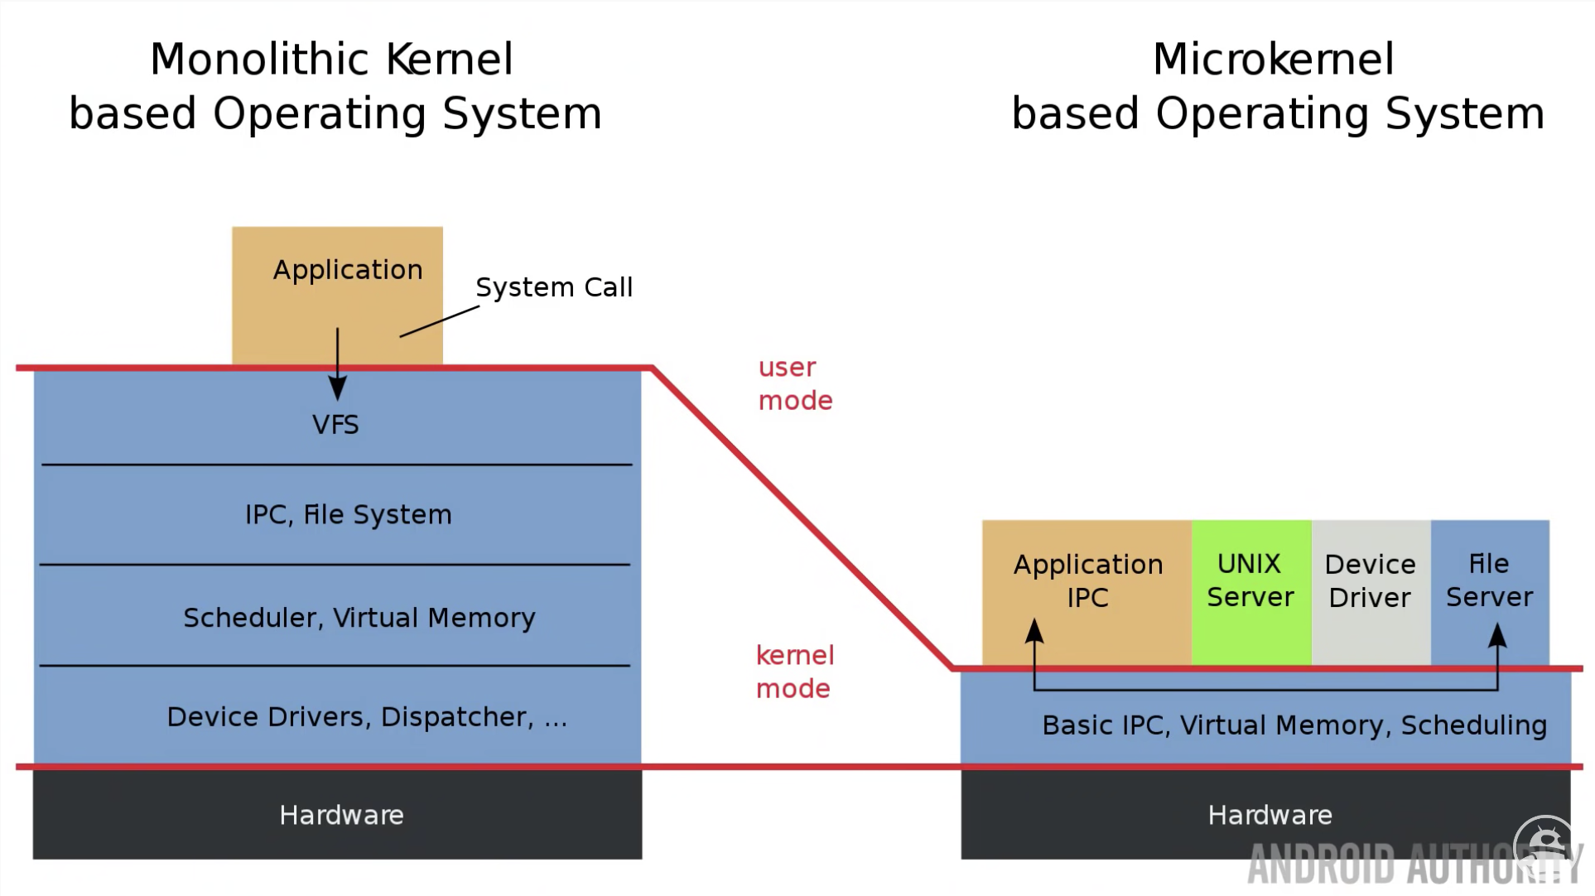
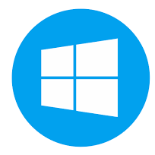
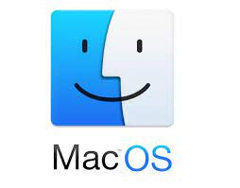
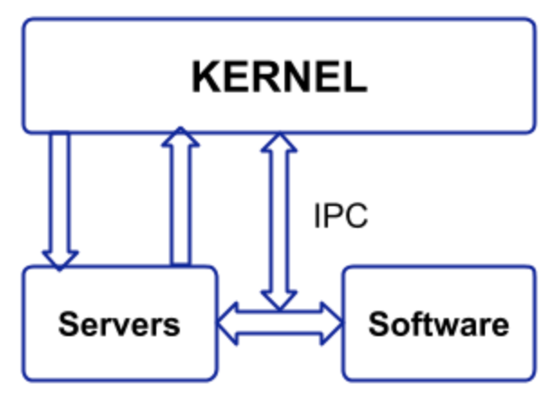
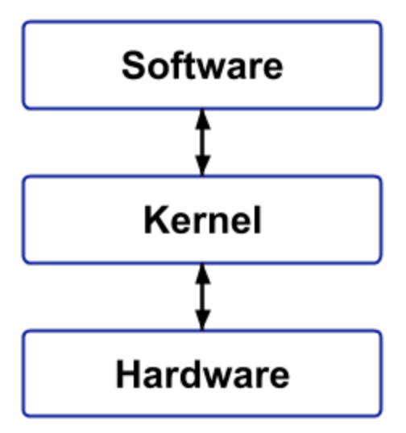
There are five types of Kernel, though most Kernels fall into one of three types
Hybrid Kernel
Notes:
There are 5 types of Kernel. Though, in general, most kernels fall into one of three types: monolithic, microkernel, and hybrid.
Linux is a monolithic kernel, while macOS (XNU) and Windows use hybrid kernels.
1. Monolithic Kernels
All OS services operate in the kernel space (i.e., user services and kernel services are implemented in the same memory space). So different memory for user services and kernel services aren’t used in this case. This increases the size of the kernel and subsequently the OS, but makes the execution of a process faster as there is no separate User vs Kernel space.
Advantages:
Good performance
Provides CPU scheduling, memory scheduling, and file management only through System Calls.
Disadvantages:
Dependencies between system components and lines of code are in millions
Failure of a service leads to the failure of the entire system.
The OS needs to be modified if there is addition of a new service.
2. Microkernel
This type has a minimalist approach along with virtual memory and thread scheduling. The user services and kernel services are implemented into different spaces (i.e., we use User Space and Kernel Space). This reduces the size of the Kernel, and in turn the OS. Communication is done through message parsing and that reduces the speed of execution.
IPC (inter process communication)
Advantages:
More stable
New services can be easily added
Disadvantages:
Huge amounts of System Calls and context switches
Communication reduces overall execution time
3. Hybrid Kernel
With the speed and design of a monolithic kernel and the modularity and stability of a microkernel, this type is a combination of monolithic and micro kernel. Some services like network stack and file systems are run in Kernel space in order to reduce performance overhead. Though, it runs kernel code as servers in the user-space.
Advantages:
Combination of monolithic and micro kernel
Disadvantages:
4. Nano Kernel
This type offers hardware abstraction without system services. Due to micro kernels also not having system services, these two have become analogous to each other. The code of the kernel is very small and the Kernel supports nanosecond clock resolution.
Advantages:
Offer hardware abstractions without system services
Disadvantages:
Is used less due to being similar to micro kernels
5. Exokernel
This kernel follows an end-to-end principle with least hardware abstractions. It handles the allocation of physical resources to applications. Separation of resource protection from management allows us to perform application-specific customization.
Advantages:
Least hardware abstractions
Disadvantages:
More work for application developers
Has a complex design

Slide 13
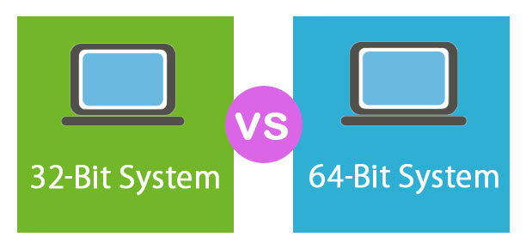
32-bit vs 64-bit system architecture, what is it?
CPU
Software Program
OS
Driver
x86
x86-32
x64
x86-64
2n (n = the number of binary digits)
2⁸ = 256 total values, for range 0-255
2¹⁶ = 65,653
2³² = 4,294,967,296
2⁶⁴ = 18,446,744,073,709,551,616
→ 4GB
On (1)
Off (0)
→ 16 GB
Notes:
In the computer world, 32-bit and 64-bit refer to the type of CPU, OS, driver, software program, etc. (hardware and software), that utilize that particular architecture.
When downloading software, there is the option to download software as a 32-bit version or a 64-bit version.
The difference does matter because the two were programmed for separate systems.
--------
32-bit hardware and software are often referred to as x86 or x86-32.
64-bit hardware and software are often referred to as x64 or x86-64.
x86 is the name of the architecture that it's built to run on (the name comes from a series of old Intel processors, the names of which all ended in 86, The first of which was the 8086). Although x86 was originally a 16-bit architecture, the version in use today is the 32-bit extension.
--------
32-bit systems utilize data in 32-bit pieces, while 64-bit systems utilize data in 64-bit pieces.
The 2 types of CPUs (i.e., 32-bit and 64-bit processors), tell us how much memory a processor can access from a CPU register. The CPU register stores memory addresses, which is how the processor accesses data from RAM. One bit in the register can reference an individual byte in memory, so a 32-bit system can address a maximum of 4 GB (4,294,967,296 bytes) of RAM. A 64-bit register can theoretically reference 18,446,744,073,709,551,616 bytes, or 17,179,869,184 GB (16 exabytes) of memory. This is several million times more than an average workstation would need to access. What’s important is that a 64-bit computer (which means it has a 64-bit processor) can access more than 4 GB of RAM. If a computer has 8 GB of RAM, it better have a 64-bit processor. Otherwise, at least 4 GB of the memory will be inaccessible by the CPU.
Advantages of a 64-bit system compared to the original 32-bit system
In general, the more data that can be processed at once, the faster the system can operate. A 64-bit processor can handle 64 bits of data at once, which allows it to compute information faster regardless of the processor's clock speed (the number of cycles your CPU executes per second, measured in GHz).
64-bit processors can come in dual-core, quad-core, six-core, and eight-core versions. Multiple cores allow for an increased number of calculations per second that can be performed, which can increase the processing power and help make a computer run faster. Software programs that require many calculations to function smoothly can operate faster and more efficiently on the multi-core 64-bit processors.
Again, the 64-bit system uses significantly greater amounts of physical memory (i.e., more than the 4 GB allowed by a 32-bit machine). It allows for more memory usage because, with 32-bit processors, only 2³² addresses of RAM can be accessed (all 32-digit binary numbers). This restriction means the processor uses a much lower amount of memory than 64-bit processors, which can read double the digits 2⁶⁴. With every additional digit, the maximum number of addresses that can be accessed doubles, too, allowing for much more memory than a 32-bit processor.
A 32-bit system can access 2³² different memory addresses, (i.e 4 GB of RAM or physical memory).
A 64-bit system can access 2⁶⁴ different memory addresses, (i.e actually 18-Quintillion bytes of RAM). Any amount of memory greater than 4 GB can be easily handled by it.
With 64-bit processors having a larger bit size and therefore the ability to calculate bigger numbers, the computer also ends up dealing with everything at a much more precise level than a 32-bit computer. Pixels on your screen, for example, can be colored and placed more accurately than pixels on a 32-bit computer.
64-Bit and 32-Bit Operating Systems
In the past, most computers were built on a 32-bit architecture, hence their OSs were designed to run on a 32-bit processor. However, most new processors are based on the 64-bit architecture and support 64-bit OS. These processors are also fully compatible with 32-bit OS.
All editions of Windows 11 and most editions of Windows 10, Windows 8, Windows 7, and Windows Vista are available in 64-bit format. Of the editions of Windows XP, only Professional is available in 64-bit. All editions of Windows, from XP up to 10, are available in 32-bit.
Every Mac operating system since v10.8 (Mountain Lion) has been 64-bit.
Like Windows, Linux can be 32-bit or 64-bit. You can see which you're running with the lscpu command.
Why does it matter?
So that you install the right kinds of software and device drivers!
When given the option between downloading a 32-bit or 64-bit version, a 64-bit software program is the better choice. However, it wont run at all if you’re say on a 32-bit version of Windows.
Many 32-bit programs will work with a 64-bit processor and OS, but some older 32-bit programs may not function properly, or at all, due to limited or no compatibility.
Incompatibilities can also occur with device drivers since hardware devices require the exact version to be installed for it to interface with the software (i.e., 64-bit drivers are necessary for a 64-bit OS, and 32-bit drivers for a 32-bit OS).
A computer with a 64-bit processor can have a 64-bit or 32-bit version of an OS installed. However, with a 32-bit OS, the 64-bit processor would not run at its full capability.

Slide 14
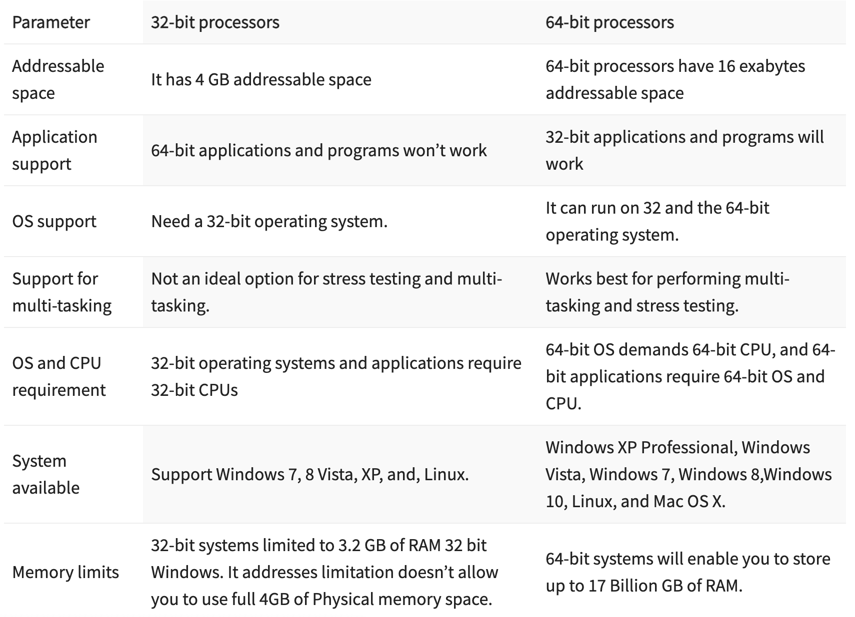
32-bit vs 64-bit system architecture, what is it?
CPU
Software Program
OS
Driver
x86
x86-32
x64
x86-64
On (1)
Off (0)
Notes:
In the computer world, 32-bit and 64-bit refer to the type of CPU, OS, driver, software program, etc. (hardware and software), that utilize that particular architecture.
When downloading software, there is the option to download software as a 32-bit version or a 64-bit version.
The difference does matter because the two were programmed for separate systems.
--------
32-bit hardware and software are often referred to as x86 or x86-32.
64-bit hardware and software are often referred to as x64 or x86-64.
x86 is the name of the architecture that it's built to run on (the name comes from a series of old Intel processors, the names of which all ended in 86, The first of which was the 8086). Although x86 was originally a 16-bit architecture, the version in use today is the 32-bit extension.
--------
32-bit systems utilize data in 32-bit pieces, while 64-bit systems utilize data in 64-bit pieces.
The 2 types of CPUs (i.e., 32-bit and 64-bit processors), tell us how much memory a processor can access from a CPU register. The CPU register stores memory addresses, which is how the processor accesses data from RAM. One bit in the register can reference an individual byte in memory, so a 32-bit system can address a maximum of 4 GB (4,294,967,296 bytes) of RAM. A 64-bit register can theoretically reference 18,446,744,073,709,551,616 bytes, or 17,179,869,184 GB (16 exabytes) of memory. This is several million times more than an average workstation would need to access. What’s important is that a 64-bit computer (which means it has a 64-bit processor) can access more than 4 GB of RAM. If a computer has 8 GB of RAM, it better have a 64-bit processor. Otherwise, at least 4 GB of the memory will be inaccessible by the CPU.
Advantages of a 64-bit system compared to the original 32-bit system
In general, the more data that can be processed at once, the faster the system can operate. A 64-bit processor can handle 64 bits of data at once, which allows it to compute information faster regardless of the processor's clock speed (the number of cycles your CPU executes per second, measured in GHz).
64-bit processors can come in dual-core, quad-core, six-core, and eight-core versions. Multiple cores allow for an increased number of calculations per second that can be performed, which can increase the processing power and help make a computer run faster. Software programs that require many calculations to function smoothly can operate faster and more efficiently on the multi-core 64-bit processors.
Again, the 64-bit system uses significantly greater amounts of physical memory (i.e., more than the 4 GB allowed by a 32-bit machine). It allows for more memory usage because, with 32-bit processors, only 2³² addresses of RAM can be accessed (all 32-digit binary numbers). This restriction means the processor uses a much lower amount of memory than 64-bit processors, which can read double the digits 2⁶⁴. With every additional digit, the maximum number of addresses that can be accessed doubles, too, allowing for much more memory than a 32-bit processor.
A 32-bit system can access 2³² different memory addresses, (i.e 4 GB of RAM or physical memory).
A 64-bit system can access 2⁶⁴ different memory addresses, (i.e actually 18-Quintillion bytes of RAM). Any amount of memory greater than 4 GB can be easily handled by it.
With 64-bit processors having a larger bit size and therefore the ability to calculate bigger numbers, the computer also ends up dealing with everything at a much more precise level than a 32-bit computer. Pixels on your screen, for example, can be colored and placed more accurately than pixels on a 32-bit computer.
64-Bit and 32-Bit Operating Systems
In the past, most computers were built on a 32-bit architecture, hence their OSs were designed to run on a 32-bit processor. However, most new processors are based on the 64-bit architecture and support 64-bit OS. These processors are also fully compatible with 32-bit OS.
All editions of Windows 11 and most editions of Windows 10, Windows 8, Windows 7, and Windows Vista are available in 64-bit format. Of the editions of Windows XP, only Professional is available in 64-bit. All editions of Windows, from XP up to 10, are available in 32-bit.
Every Mac operating system since v10.8 (Mountain Lion) has been 64-bit.
Like Windows, Linux can be 32-bit or 64-bit. You can see which you're running with the lscpu command.
Why does it matter?
So that you install the right kinds of software and device drivers!
When given the option between downloading a 32-bit or 64-bit version, a 64-bit software program is the better choice. However, it wont run at all if you’re say on a 32-bit version of Windows.
Many 32-bit programs will work with a 64-bit processor and OS, but some older 32-bit programs may not function properly, or at all, due to limited or no compatibility.
Incompatibilities can also occur with device drivers since hardware devices require the exact version to be installed for it to interface with the software (i.e., 64-bit drivers are necessary for a 64-bit OS, and 32-bit drivers for a 32-bit OS).
A computer with a 64-bit processor can have a 64-bit or 32-bit version of an OS installed. However, with a 32-bit OS, the 64-bit processor would not run at its full capability.

Slide 15
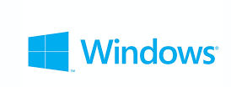
Each operating system offers something different and has different benefits for each user
For PCs
5%
15%
80%
80%
20%
For servers
Notes:
The most common OS are Apple, Windows, and Linux
For PCs, windows hold the majority market share.
While for servers, LINUX holds the majority market share.
Everyday OS vs Server OS
An everyday OS will be able to run programs like MS Word, PowerPoint, Excel, your favorite video games, etc. It enables applications that make browsing the web and checking emails easy. It also uses LAN (local area networks - A collection of devices connected together in one physical location, such as a building, office, or home) and Bluetooth connections and is cheaper than a server OS.
Server OS, on the other hand, are expensive, enable unlimited user connections, have a greater memory capacity, and act as universal servers for web, emails, and databases. A server OS can handle multiple desktops as it is optimized for a network instead of catering to a single user

Slide 16
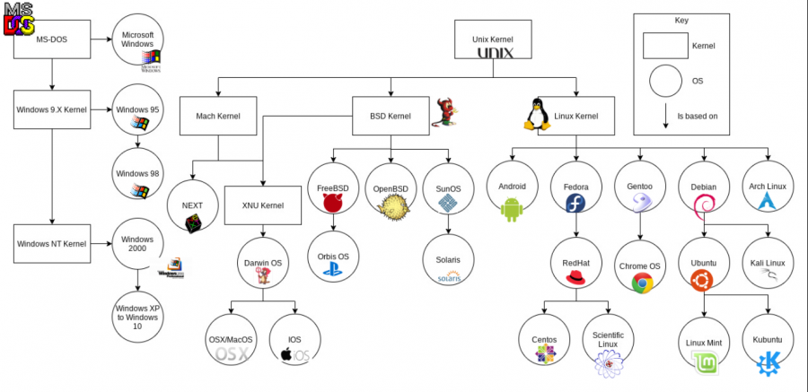
Each operating system offers something different and has different benefits for each user
Notes:
The Windows OS originated from MS-DOS. Windows is the default OS for most people, in large part because it is usually the first OS people are exposed to. It is great for the general user, allowing people to use basic applications, surf the web, etc. However, it is considered to be less customizable, secure, and with a lower performance compared with the other 2. Windows is also not open source, meaning its source code isn’t publicly available.
LINUX and the MacOS are both derived from the operating system UNIX.
UNIX was developed by AT&T's Bell Laboratories in 1969 by Ken Thompson and Dennis Ritchie and their team. It was a proprietary OS.
LINUX was born out of the work from Richard Stallman and Linus Torvalds.
LINUX is not one operating system but rather a family of systems that come in a variety of flavors, also called distributions or distros. Currently, more than 300 Linux distros are actively maintained. There are commercially backed distributions, such as Fedora (Red Hat), openSUSE (SUSE) and Ubuntu (Canonical Ltd.), and entirely community-driven distributions, such as Debian, Slackware, Gentoo and Arch Linux. Most distributions come ready to use and pre-compiled for a specific instruction set, while some distributions are distributed mostly in source code form and compiled locally during installation. Some of the Linux distributions are known to be the most secure and stable OSs out there. They're used in key spheres such as banking, finance, government, and military.

Slide 17
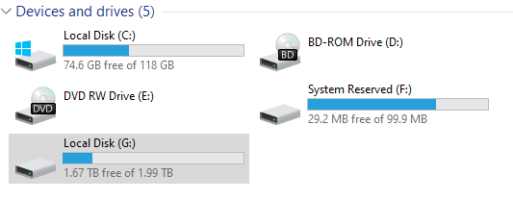
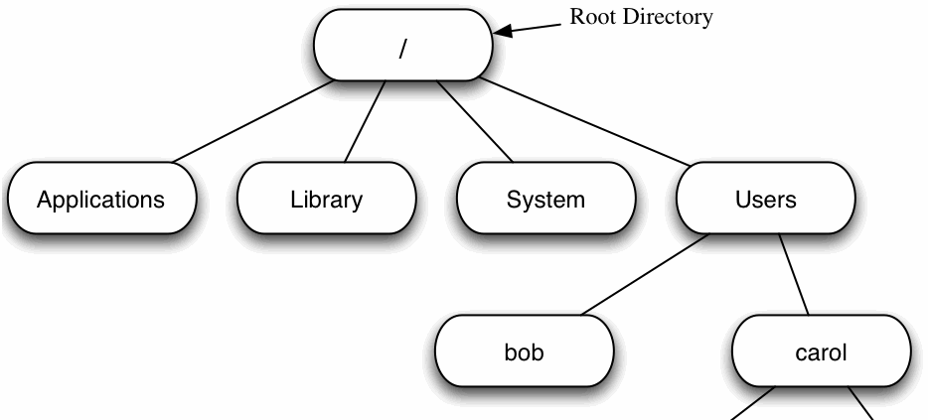
What are some key differences between these OS in terms of design, features, and user experience?
File Systems
Notes:
File systems:
The way Windows organizes files is different from the way Mac and GNU/Linux do.
Windows uses "drives". They're usually a C and D drive that store all the computer files, and separate drives for external devices such as CDs, USBs, and so on.
Mac and GNU/Linux have a similar file system that comes from UNIX. In these OSs there are no drives – everything in the computer is considered a file (even external devices) and all files are organized in directories that descend from a single root directory. The directory structure is formed as a tree that has a unique root.
This doesn't necessarily make much of a difference for the end user, but is something to keep in mind if you're used to navigating one type of file system or the other.

Slide 18
What are some key differences between these OS in terms of design, features, and user experience?
Shells
Notes:
Shells:
The shell is the layer of programming that understands and executes the commands a user enters. It is the connector to the OS.
As the outer layer of an operating system, a shell can be contrasted with the kernel, the operating system's inmost layer or core of services.
Both Linux and Mac have Bash (bourne again shell) as their default shell. Though Mac recently adopted the Z shell (zsh) as their default. The Z shell is a new and improved iteration of bash.
On the other hand, Windows has its own shell that uses a different syntax. Its default is the command prompt (CMD). Better alternatives to the command prompt are the power shell (which can also be run on Linux and Mac OS) and Windows subsystem for Linux (WSL).
PowerShell is a cross-platform task automation solution made up of a command-line shell, a scripting language, and a configuration management framework.
Install a complete Ubuntu terminal environment in minutes on Windows with Windows Subsystem for Linux (WSL). Access the Linux terminal on Windows, develop cross-platform applications, and manage IT infrastructure without leaving Windows.

Slide 19
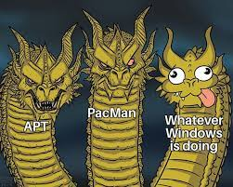
What are some key differences between these OS in terms of design, features, and user experience?
Package Managers
Notes:
Package managers
Mac and GNU/Linux come with package managers installed by default. A package manager is a piece of software that allows you to install, update, and uninstall programs from the terminal, just by entering a few commands. They're super helpful, especially when you're installing and uninstalling things constantly, as it's much more efficient to install programs through package managers than manually.
Mac's package manager is called homebrew.
On GNU/Linux, the default package manager depends on the distro. For example, Ubuntu comes with APT, Arch comes with Pacman, and so on.
Windows doesn't come with a default package manager. If you want one, you need to install it first. One of the package managers available for Windows is Chocolatey.

Slide 20
What are some key differences between these OS in terms of design, features, and user experience?
Security and Stability
Ease of use
Hardware quality and compatibility
Notes:
Security and stability
Some Linux distros are considered the most secure and stable ones nowadays. The fact that the code is available to everyone isn't a security threat as you may think at first – but rather it's an advantage. Bugs can be identified and worked on quicker, and when a security breach is identified lots of people can work on it and propose fixes.
Windows, on the other hand, is considered the least secure and stable of the three. Given that it's the most popular OS, most malware is developed to attack Windows OS too.
Ease of use
Windows and Mac are really simple and user-friendly OSs. Regarding GNU/Linux, it depends on the distro you choose. As mentioned, distros like Ubuntu are practically as easy as Windows or Mac, and others like Arch are intended for advanced computer users.
Hardware quality and compatibility
When it comes to hardware, only Apple has direct responsibility for the computers that the OS runs on. And Apple's hardware is some of the best out there.
As a company, Apple is focused on providing top quality products, so their newest computers tend to be the ones with best performance all across the market.
Given that Apple designs and develops both hardware and software, it's possible that the compatibility between the machine and the OS is tuned finer than with Windows or GNU/Linux.
On the Windows and GNU/Linux side, hardware quality is completely up to what the user decides or can afford to buy. The good thing here is that you can install the OS wherever you want.
This is particularly cool when thinking about installing lightweight Linux distros on older computers that can't handle the requirements of bigger and more consuming OSs like Windows.

Slide 21
How can we leverage this information in our daily research?
1) Become more comfortable with incorporating computing tools into our daily research
2) Choose more appropriate computing tools for the task
3) Bolster our trouble shooting skills

Slide 22
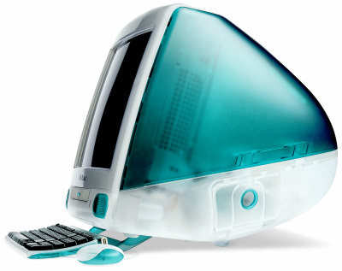
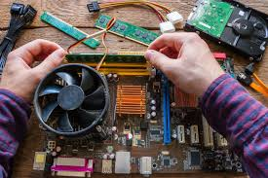
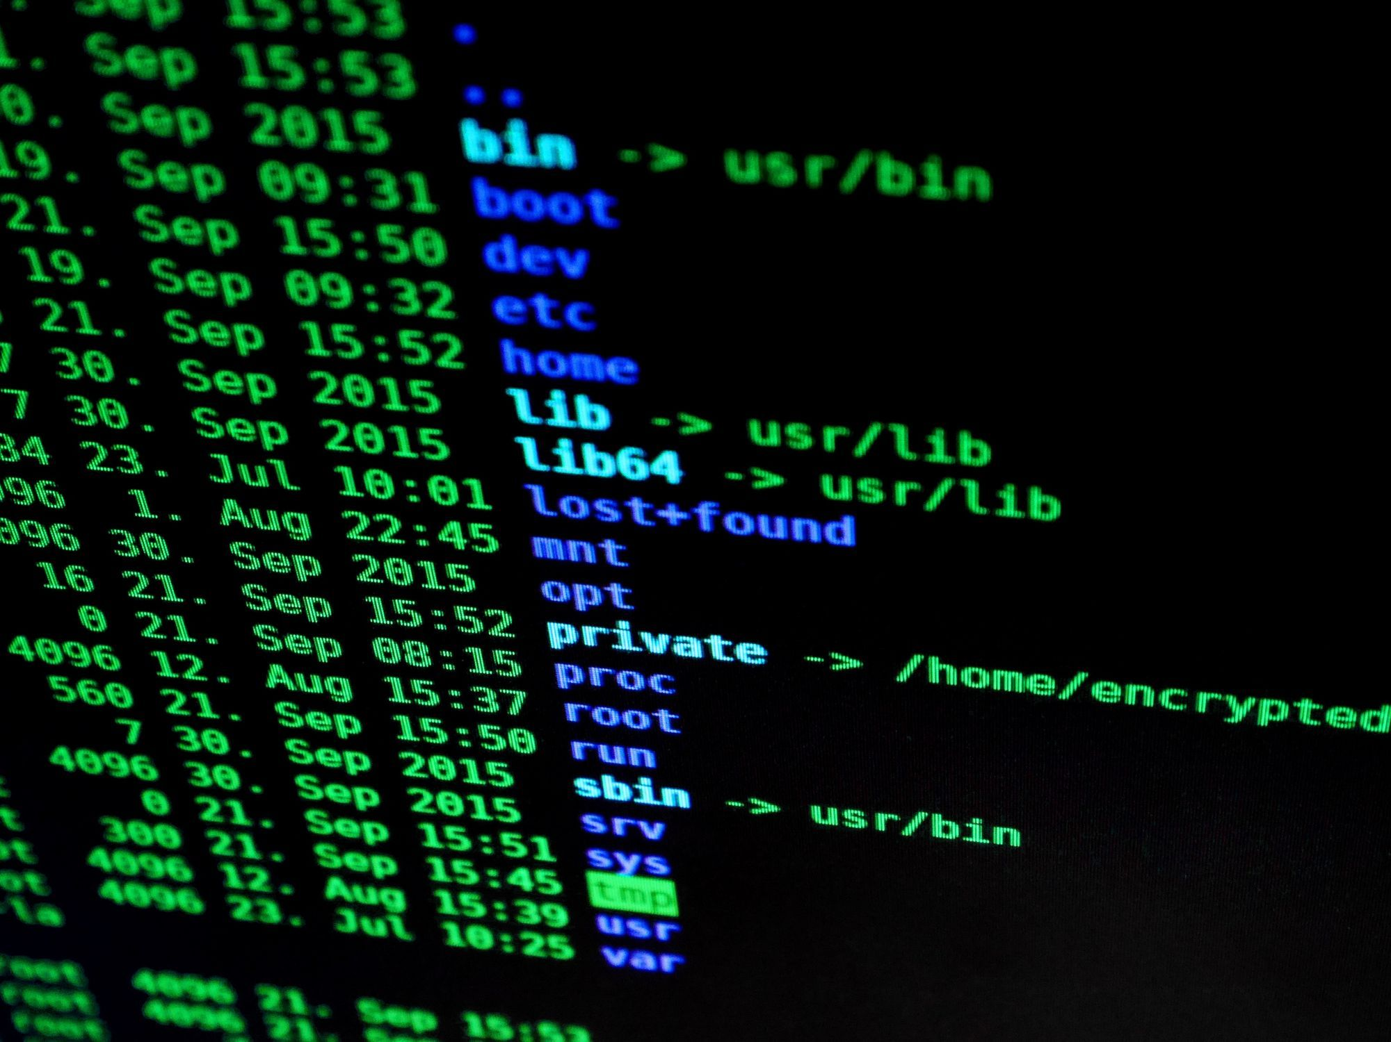
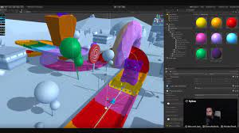
Many different types of computers
Made up of a core set of components
Allowing us to interface with our computer
Complete desired tasks
Questions?

