Slide 1
Welcome to the Onish Summer Computing Workshop 2022!
1 - 1:30 pm Jessica Hill - Intro Computing Systems and Hardware
1:30 - 2 pm Andrew Moore - Programming Languages and Their Usages
2 - 2:30 pm David King - Installation and Package Management
2:30 - 3 pm Robert Williams - Working on GitHub
after 3pm Mixer – stay for light snacks!

Slide 2
Programming Languages and their Uses
Andrew Moore
ONISH Computing Workshop 2022
Notes:
Mention QR codes

Slide 3
How do we “talk” to computers?
Humans are much more capable of abstract thought than computers.
Computers can only follow simple instructions of 1s and 0s
We use programming languages to bridge the gap between how we think as humans and how computers “think”.
Notes:
Humans are quite good at abstraction, while computers work only on instructions of 1s and 0s

Slide 4
Machine Code
First 16 digits of pi in Binary
Bytes in Hexadecimal
0011 0001 0100 0001
0101 1001 0010 0110
0101 0011 0101 1000
1001 0111 1001 0011
1F 20 01 0F 1A 0B 10 11
1B 1C 0D 32 05 17 12 1F
13 43 0C 1D 07 1B 04 13
10 21 D7 72 53 12 3B 4F
One Byte:
01101010

Slide 5
Understandable to Humans ->
High Level
Languages
Assembly Code
Machine Code
<- “Understandable” to Computers
Notes:
Explain abstraction

Slide 6
A Simple Program…
*
**
***
****
*****
Print:

Slide 7
x86 Assembly
From rosettacode.org

Slide 8
Fortran
From rosettacode.org

Slide 9
Java
From rosettacode.org

Slide 10
Python
OR
From rosettacode.org

Slide 11
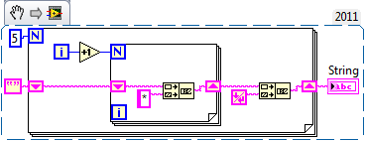
LabView
From rosettacode.org
Notes:
Rosettacode as a resource.

Slide 12
=
Compilers and Assemblers
for i in range(1,6):
print ‘*’ * i
mov eax, 0x2
add eax, 0x4
sub eax, ebx
000110101001110010010101001010001010010010010100100100101010101010100101010111001001010111001010010001010111

Slide 13
Assemblers
Assemblers work “simply”:
In assembly, we are essentially writing instructions for the CPU.
The assembler only needs to encode those instructions into binary.
mov eax, 0x5F
B8 5F 00 00 00
If you want to learn more… LiveOverflow: How a CPU works and Intro to Assembler
Notes:
When writing assembly code, we are giving instructions to the cpu line by line
TEAL: mov instruction (opcode) moves a constant into eax
PINK: constant to be moved
Gray: Bytes reserved for 32 bit total constant
Youtube Channel: Live Overflow

Slide 14
Compilers
The assembler creates multiple object code files, which are machine code that contain individual pieces and libraries contained in the code
A simplified view of the C compiler, multiple steps are needed to generate the assembly code from source.
Object Code
Source Code
Compiler
Optimized
Assembly Code
Assembler
Object Code
Object Code
Text is not SVG - cannot display
More about Compilation and Linking in C… FSU Ted Baker Notes
Notes:
Simplified View of the C compiler
Remember to click through, explain object code as puzzle pieces
Speed of Compilation

Slide 15
Linking
A VERY simplified view of Linking in C. Generated object code and libraries are combined to create executable code.
Object Code
Object Code
Linker
Executable Code
Object Code
More about Compilation and Linking in C… FSU Ted Baker Notes
Notes:
Very Simplified view of the C linker

Slide 16
Modern Languages
High level programming languages allow us to write instructions for computers using a syntax that is best suited to our applications.
Almost every language that you or I use today is an explicitly high-level language.
Some may give access to low-level features within them.
Since most modern languages are high-level languages…
What sets them apart from each other?
Notes:
High Level Programming Languages allow us to communicate with computers using a syntax that is best suited for our applications.
What sets them apart: Interpreted vs. Compiled

Slide 17
Compiled Languages
Compiled Languages follow roughly the same structure as the previous C example
Fast
Can be more difficult to develop
Ex: C, C++, Go
Source Code
Compiler
Assembler
Executable Code
Notes:
Development with strict compilers can ensure you are writing good code.

Slide 18
Interpreted Languages
Interpreted Languages
Are not compiled and instead read line-by-line using an interpreter
Much slower performance
Faster to develop
Ex: Python, R, Ruby
Line 1
Line 2
Source Code
Interpreter
Code Output
Line 3
Notes:
Can improve compatability

Slide 19
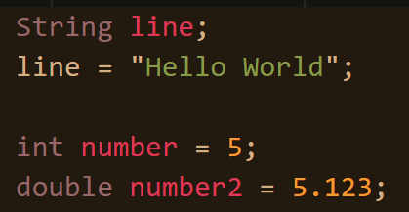
Statically vs. Dynamically Typed
Java (Statically Typed)
Python (Dynamically Typed)
Notes:
Static: Types checked at Compile Time
Dynamic: Types checked at runtime

Slide 20
Java
Python

Slide 21
Statically Typed
Types checked at compile-time.
Will not compile if there are errors regarding types
Very fast
Functions/Methods must return only one type

Slide 22
Dynamically Typed
Types checked at runtime
Speed is compromised
Functions can return multiple values of different types
Generally easier to program in -> Faster Development

Slide 23
Data Languages
Python, R, MATLAB
Excel at working with data and the visualization of that data
Python
MATLAB
R

Slide 24
Python and R
Both have excellent documentation and free resources that make them accessible to learn for anyone.
Open Source
Syntax is very approachable and being interpreted languages makes them easy and fast to develop in

Slide 25
Packages, Packages, Packages
Packages account for most of the utility of both R and Python.

Slide 26
Made With Scikit-Image

Slide 27
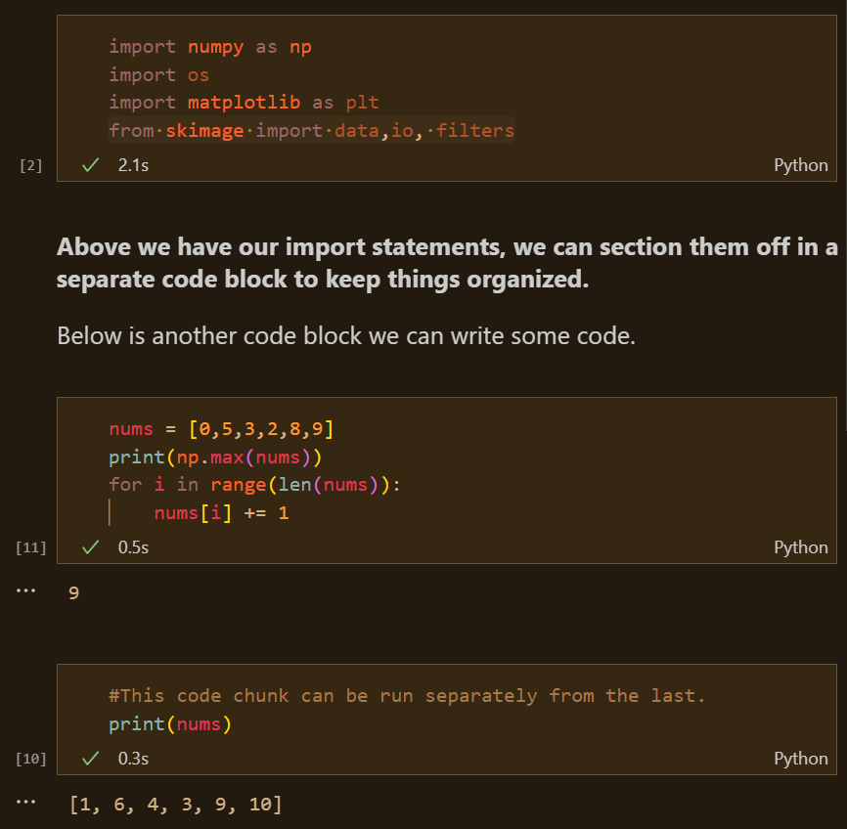
Jupyter Notebooks
Jupyter Notebooks allow for workflows to be easily built, explained, and shared
Code is run in chunks, and each step of a workflow can be built and run separately
Available for many languages, but Python is the most popular.

Slide 28
The Heavy Lifters/The Big Boys
Java, C++, C, Rust
Compiled Languages provide the speed and efficiency that cannot be achieved by interpreted languages.
C is the basis for many python packages
Meaning the functions in these packages are written with speedy code

Slide 29
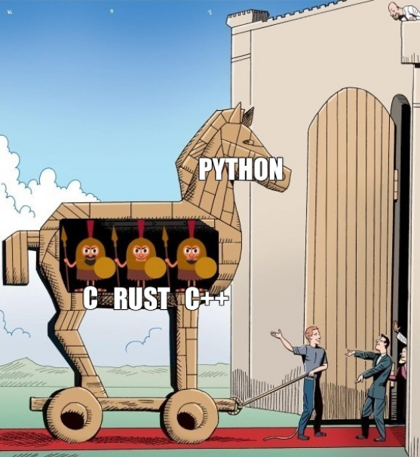

Slide 30
Java
FIJI/ImageJ are written in Java
Many powerful image processing tools are also based in Java
May be a good choice if you want to develop plugins for apps such as Fiji
SciJava works to bundle popular science java libraries

Slide 31
Rust
As fast or faster than C in most applications
And is memory safe
Incredible community and documentation
Libraries like Rust-Bio provide everything needed for bioinformatics work
Companies such as 10X Genomics are using rust to build extremely efficient tools for applications such as single cell sequencing
Nature: Why Scientists are turning to Rust
Notes:
NOT a beginner language

Slide 32
Learning Resources
Python: Python Tutorial, Python for Data Science
R: Swirl: Learn R in R, Intro to R
Java: LearnJavaOnline
Rust: "The Book“, RustBio
C: Learn-C
F#: Learn F Sharp, BioFSharp

Slide 33
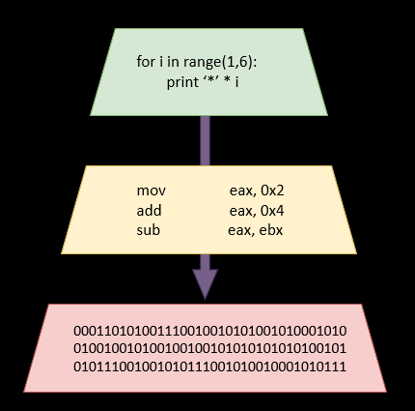
Takeaways
Computers receive instructions through machine code, compilers and assemblers are used to convert human-readable code to machine code
Most modern, general-purpose languages can do most things, use the one that you are most comfortable with and which has the tools needed for your application
By using a combination of compiled and interpreted languages, we can create programs that are both easy to develop and have excellent performance
Questions?

Slide 35
Understandable to Humans ->
High Level
Languages
Assembly Code
Machine Code
<- “Understandable” to Computers
Notes:
Explain abstraction

Slide 36
Object-Oriented vs. Functional

Slide 37
