Slide 1


Shopping Safe Online Guide
By: Jessica Stovall
Online shopping is convenient, in that you can shop around, find the best prices, and have your packages delivered right to your doorstep without ever having to leave the comfort of your own home. But getting a great deal online involves more than just getting the lowest price.
Before you embark on an online shopping spree, make sure you’re not leaving yourself at risk.
Here are 12 savvy online shopping tips to help you keep your information out of the hands of people who are scammers.

Slide 2
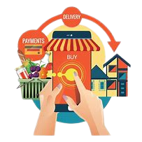






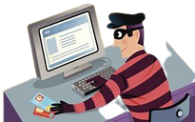






Shopping Safe Online Guide
Don't Shop When Using Public WiFi
always use a private and secure internet connection whenever
you're shopping online Public WiFi is not secure—
USE a private secure home network or a VPN
Is the site secure?
If the website URL starts with HTTPS rather than HTTP and has a padlock beside the name, that means that the security certificate is valid.
use familiar websites
If you already know the store, shopping their online store is very safe. Always shop from sites you know and trust.
Avoid offers that seem “too good to be true”
Any e-store that promises too much at too low a price is suspicious. If the price is too low, consider whether the merchant came by the items legally

Slide 3

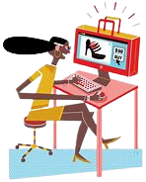


Shopping Safe Online Guide
Always check the company’s shipping terms.
Look to see if they provide tracking and insurance. Understand what carriers they use, and be particularly cautious if the item won’t be shipped within 10 days.
If you are buying a Gift Card, read the Terms and Conditions
If the gift card is for someone else, be sure the store is legitimate, that the person uses the store, and that there are no hoops they will have to jump through.
Use Strong and Unique Passwords
If you're creating an account with the retailer (instead of checking out as a guest), make sure you use a strong and unique password. This will make your account harder for hackers and scammers to access.
Use a Password Manager
Password managers help you securely store your passwords, so you don't have to remember them all or write them down somewhere. Some password managers also allow you to access your passwords from all of your devices, making having secure accounts easier.

Slide 4

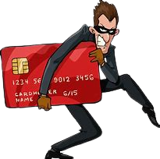


Shopping Safe Online Guide
Get into the habit of checking your bank statements
if you get into the habit of checking your bank statements, you’ll spot inconsistencies far sooner.
Don’t recognize a transaction? Make sure you get in touch with your bank as soon as possible. To be as safe as possible, use the telephone number that’s listed on the back of your debit or credit card.
Beware When Shopping on Classified Websites
.
One of the riskiest places to shop is on classified websites, such as Craigslist, OfferUp, and Facebook Marketplace. Although there are plenty of genuine sellers on these platforms, there are also a lot of scammers.
Use a Credit Card or PayPal
Do not use a debit card or check as these do not have the same security protections in place for you should a problem arise.
Credit card purchases limit your liability to no more than $50 of unauthorized charges if your financial information is stolen, and the money in your bank account is untouched. Most debit cards do not offer this protection – and even when they do, you’re the one out of funds in the meantime.
Complain Loud and Proud
Don't be embarrassed if you get taken for a ride while online shopping. Instead, get very mad. Complain to the seller. If you don't get satisfaction, report it to the Federal Trade Commission, your state's attorney general, even the FBI.

