Slide 1
Epi 510: Introduction to R #10 ggplot & more Tidyverse
Jeff Stanaway

Slide 2


Slide 3
Before we get started
library("gapminder")
library("tidyverse")
gapminder
# A tibble: 1,704 x 6
country continent year lifeExp pop gdpPercap
<fct> <fct> <int> <dbl> <int> <dbl>
1 Afghanistan Asia 1952 28.8 8425333 779
2 Afghanistan Asia 1957 30.3 9240934 821
3 Afghanistan Asia 1962 32.0 10267083 853
4 Afghanistan Asia 1967 34.0 11537966 836
5 Afghanistan Asia 1972 36.1 13079460 740
6 Afghanistan Asia 1977 38.4 14880372 786
7 Afghanistan Asia 1982 39.9 12881816 978
8 Afghanistan Asia 1987 40.8 13867957 852
9 Afghanistan Asia 1992 41.7 16317921 649
10 Afghanistan Asia 1997 41.8 22227415 635

Slide 4

ggplot2 package
The ggplot2 library contains functions that allow you to build up complex graphics using a relatively small set of building blocks:
Geoms
Aesthetics
Scales
Facets
Themes
Guides
Coordinates
NOTE: the online documentation for ggplot2 is fantastic, and lays all the functions out in terms of these building blocks: http://ggplot2.tidyverse.org/reference/
Notes:
Geoms – type of plot (scatterplot, bar chart, etc.)
Aesthetics = what data you’re plotting
Scales = x, y axis each with particular scales
Facets = allow you to make small subplots
Themes = prebuilt themes that have background colors, etc.
Guides = legend
Coordinates =

Slide 5
Geoms
Geoms are essentially the type of plot:
Scatter plot: geom_point()
Line plot: geom_line()
Box plots: geom_boxplot()
Histograms: geom_histogram()
Density plot: geom_density()
Error bars: geom_errorbar()
Text: geom_text()
Polygons: geom_polygon()
and many more…

Slide 6
Aesthetics
Aesthetics refer to mapping different elements of the data to different features of a geom:
Specify using aes()
Not all aesthetics are meaningful for all geoms (e.g., shape makes sense for a point geom, but not a line geom)
x position
y position
labels
color (border color)
fill (fill color)
shape
line type
size
transparency

Slide 7
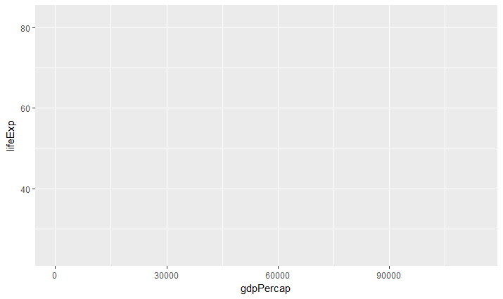
Basic syntax
The ggplot() function is used to initialize the plot, specify the data, and set the overall aesthetic
Here we're telling ggplot() to use the gapminder data frame, and map gdpPercap to the x-axis, and lifeExp to the y-axis
ggplot(gapminder, aes(x = gdpPercap, y = lifeExp))
Notes:
Aes stands for aesthetics

Slide 8
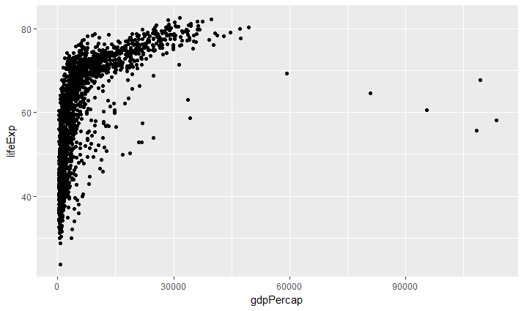
Adding geoms
To plot data we add a geom that specifies how the data should be plotted
ggplot(gapminder, aes(x = gdpPercap, y = lifeExp)) + geom_point()
Notes:
Empty paranthesis at end of code means you don’t need to give geom any more information to plot – it inherits aesthetics from previously defined aesthetics
Each subargument of ggplot command is separated by + sign
If you need to spread graph commands over multi lines of code, make sure + is last symbol of line, NOT first symbol of line – r won’t keep reaching the code if it is first symbol

Slide 9
Exercise
Use ggplot to make a scatter plot with year on the x-axis and lifeExp on the y-axis

Slide 10
geom_jitter()
Change the geom_point to geom_jitter
Notes:
Geom_jitter() – makes scatterplot where it adds a small amount of random noise to the data – helps visually. It takes away slightly from the precision, but allows for readability. If you don’t need exact precision, this works well.
If publishing with this, have to note the plot is jittered. He doesn’t recommend publishing with jittered data.

Slide 11

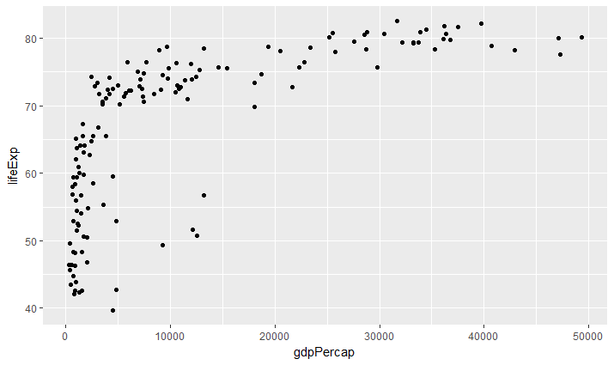
Using dplyr and ggplot together
Use chaining to manipulate and plot data in one shot
gapminder %>% filter(year==2007) %>% ggplot(aes(x = gdpPercap, y = lifeExp)) + geom_point()
Notes:
Dplyr & ggplot work really well together
Don’t have to note gapminder in ggplot code above because you are piping the gapminder data into ggplot

Slide 12
Exercise
Combine your previous ggplot command with filter to plot life expectancy by year for only countries in the Americas

Slide 13
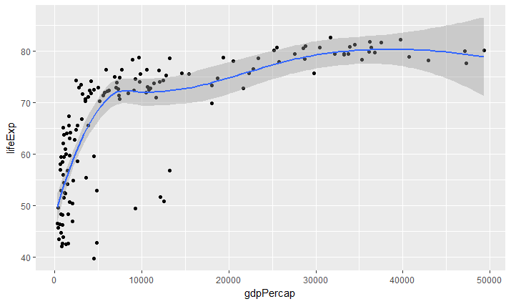
Adding geoms
We can add multiple geoms
gapminder %>% filter(year==2007) %>% ggplot(aes(x = gdpPercap, y = lifeExp)) + geom_point() + geom_smooth()
Notes:
Ggplot allows us to overlay plots to make complex graphics
Geom_smooth – fits a smooth line to data points
Not a formal statistic, if you wanted that you’d use a regression, but useful for exploratory and diagnostic plots.
Error message when using geom_smooth – it’s ok, it’s telling you what smoother it’s choosing to use.

Slide 14
Exercise
Update your plot of life expectancy by year, to a geom_smooth()

Slide 15
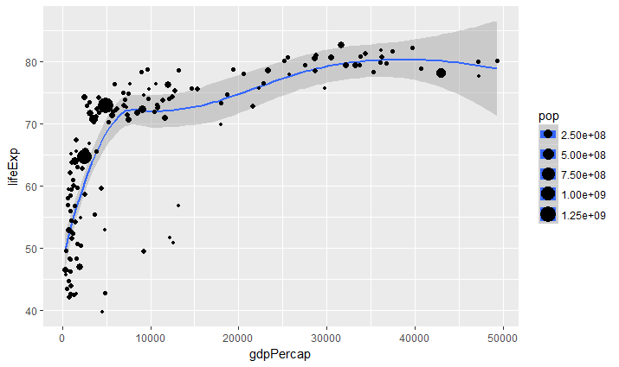
Adding aesthetics
We can add multiple aesthetics
gapminder %>% filter(year==2007) %>%
ggplot(aes(x = gdpPercap, y = lifeExp, size = pop)) + geom_smooth() + geom_point()
Notes:
Size of dots are = to population

Slide 16
Exercise
Update your plot of life expectancy by year, to add the aesthetic size = pop

Slide 17
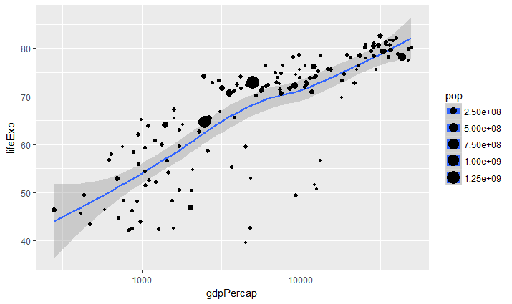
Controlling scale
There are many options for controlling how a plot maps data values to the visual values of an aesthetic
gapminder %>% filter(year==2007) %>%
ggplot(aes(x = gdpPercap, y = lifeExp, size = pop)) +
geom_smooth() + geom_point() + scale_x_log10()
Notes:
Log transforms stretches open lower end of range and compresses upper end of range to better show data. (look at graph on slide 15)

Slide 18
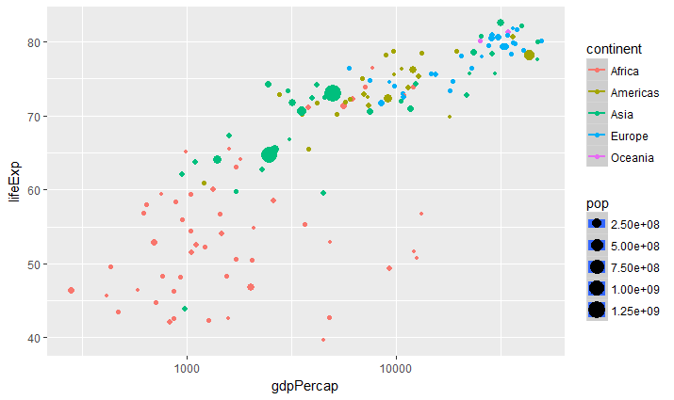
geom & aesthetic pairings
Not all geoms can use all aesthetics
gapminder %>% filter(year==2007) %>%
ggplot(aes(x = gdpPercap, y = lifeExp, size = pop, color = continent)) +
geom_smooth() + geom_point() + scale_x_log10()
Notes:
This got rid of smooth line.

Slide 19
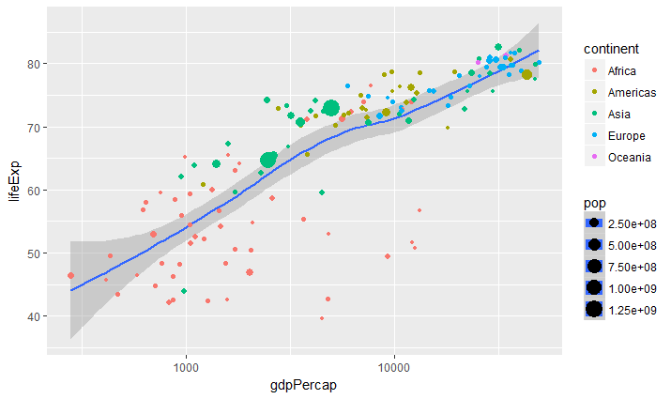
Inheriting aesthetics
Aesthetics specified in initial ggplot() call are “inherited” by each geom
It’s also possible to specify aesthetics that are specific to a particular geom
gapminder %>% filter(year==2007) %>%
ggplot(aes(x = gdpPercap, y = lifeExp)) + geom_smooth() + geom_point(aes(color = continent, size = pop)) + scale_x_log10()
Notes:
If something isn’t working, try to change order of geoms. Sometimes the order causes issues.

Slide 20
Exercise
Add an aesthetic to the geom_jitter so that points are color-coded by country, and move the size aesthetic from the base function to the geom_jitter

Slide 21
Exercise
Add geom_line(aes(color=country))

Slide 22
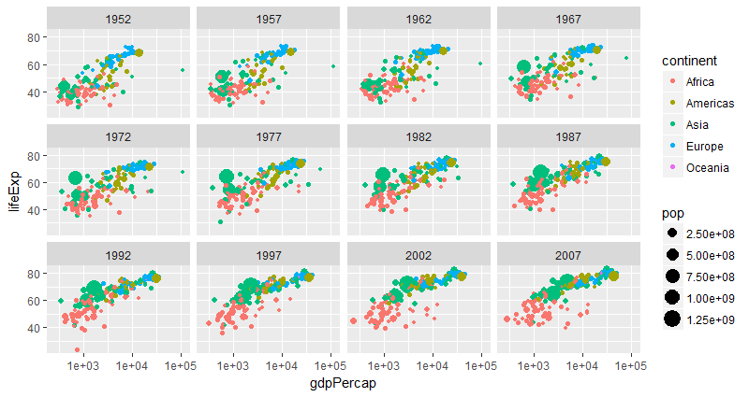
Faceting
Instead of (or in addition to) encoding certain variables with an aesthetic, we can also facet on that variable, which creates separate plots for each level of that variable:
ggplot(gapminder, aes(x = gdpPercap, y = lifeExp)) +
geom_point(aes(color = continent, size = pop)) + scale_x_log10() + facet_wrap(~year)

Slide 23
Exercise
Starting with the code from your previous plot… 1) remove the filter and the geom_smooth, and 2) add "+ facet_wrap(~continent) + guides(color = FALSE)"
Notes:
Saying guides(color=FALSE) means you don’t want a legend for color aesthetic.

Slide 24
Visualizing summary statistics
Aesthetics specified in initial ggplot() call are “inherited” by each geom
It’s also possible to specify aesthetics that are specific to a particular geom
gapminder %>% filter(year==2007) %>%
ggplot(aes(x = gdpPercap, y = lifeExp)) + geom_smooth() + geom_point(aes(color = continent, size = pop)) + scale_x_log10()

Slide 25
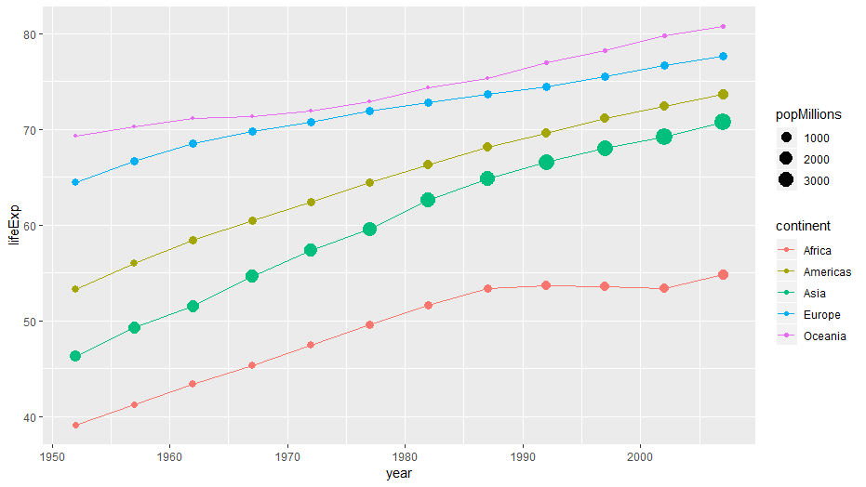
Visualizing summary statistics
Let's update the plot you've been building to plot trends in life expectancy. Instead of plotting country-level data, we'll plot mean life expectancy by continent and year
gapminder %>% group_by(continent, year) %>%
summarize(lifeExp = mean(lifeExp), popMillions = sum(pop/1000000)) %>%
ggplot(aes(x = year, y = lifeExp, color=continent)) +
geom_line() + geom_point(aes(size = popMillions))
Notes:
popMillions – population / 1 million, so pop is displayed in millions
Group_by

Slide 26
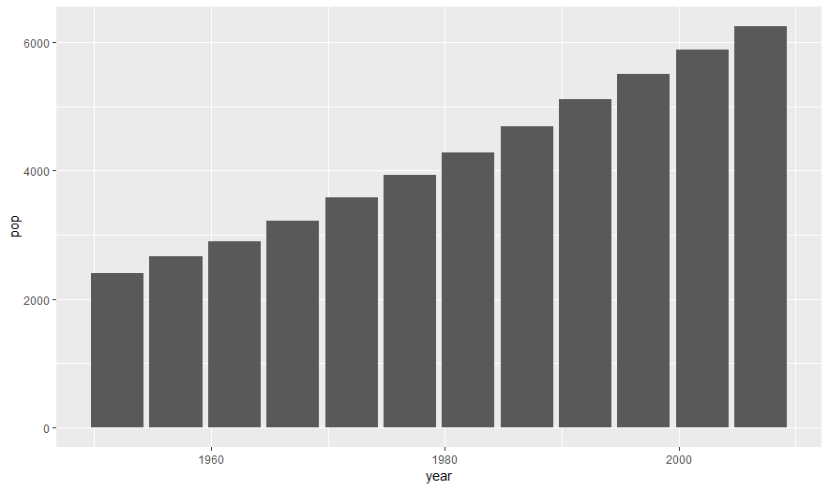
Visualizing summary statistics with bar graphs
Let’s make a barplot showing the total population by year
gapminder %>% group_by(year) %>% summarize(pop = sum(pop/1000000)) %>%
ggplot(aes(x = year, y = pop)) + geom_col()

Slide 27
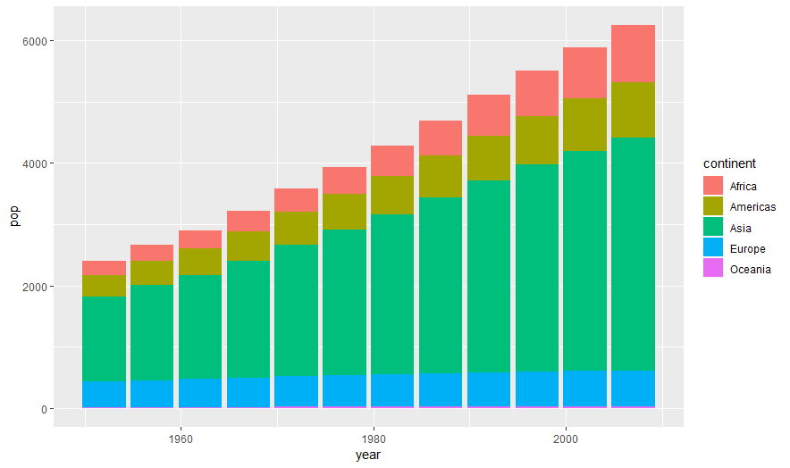
Visualizing summary statistics with bar graphs
Let’s make a barplot showing the total population by continent & year
gapminder %>% group_by(continent, year) %>% summarize(pop = sum(pop/1000000)) %>%
ggplot(aes(x = year, y = pop, fill=continent)) + geom_col()
Notes:
Fill is the fill color for shading in a large area

Slide 28
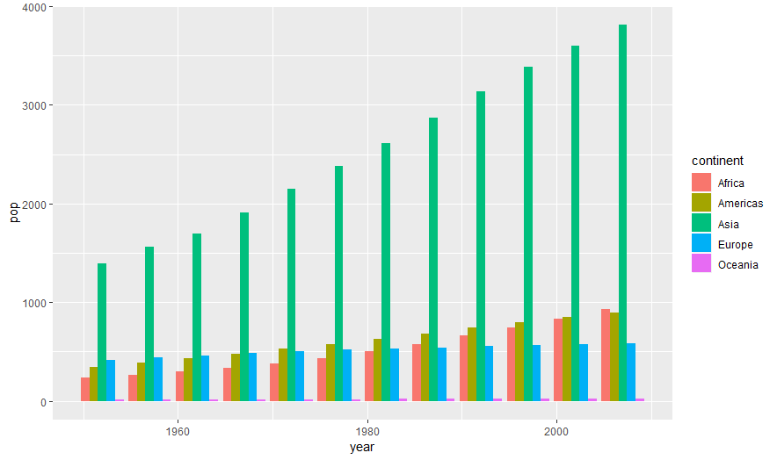
Visualizing summary statistics with bar graphs
Let’s make a barplot showing the total population by continent & year
gapminder %>% group_by(continent, year) %>% summarize(pop = sum(pop/1000000)) %>%
ggplot(aes(x = year, y = pop, fill=continent)) + geom_col(position="dodge")
Notes:
Position = ”dodge – this unstacks bars and puts each bar next to each other s

Slide 29
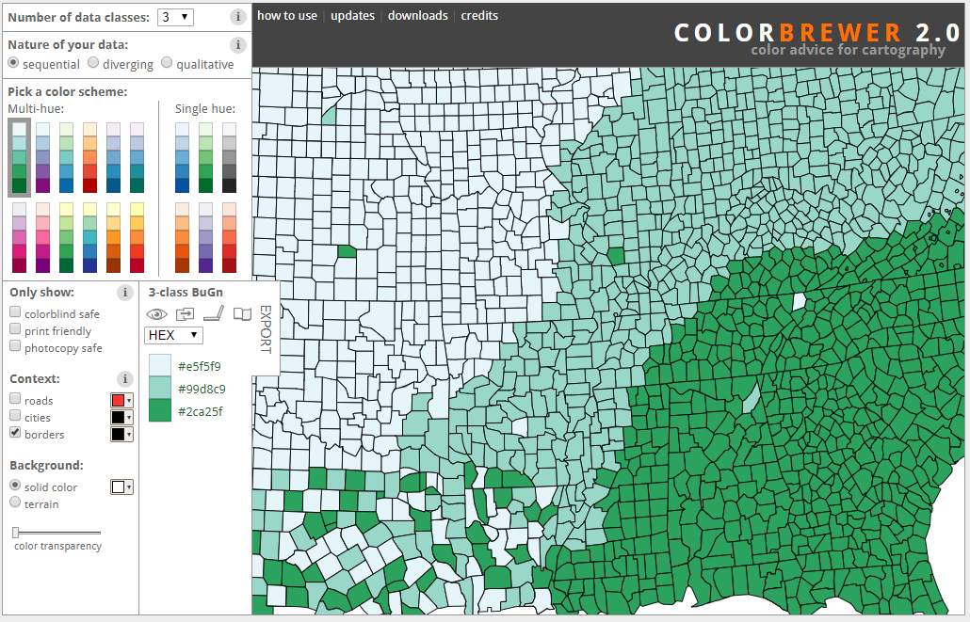

ColorBrewer
Online tool to help people select good color schemes for graphics (colorbrewer2.org)
Developed by Cynthia Brewer, geographer at Penn State
Notes:
Wes Anderson package for beautiful color packages
Colorbrewer has colors based on type of data –quant, qual, diverging, etc.

Slide 30
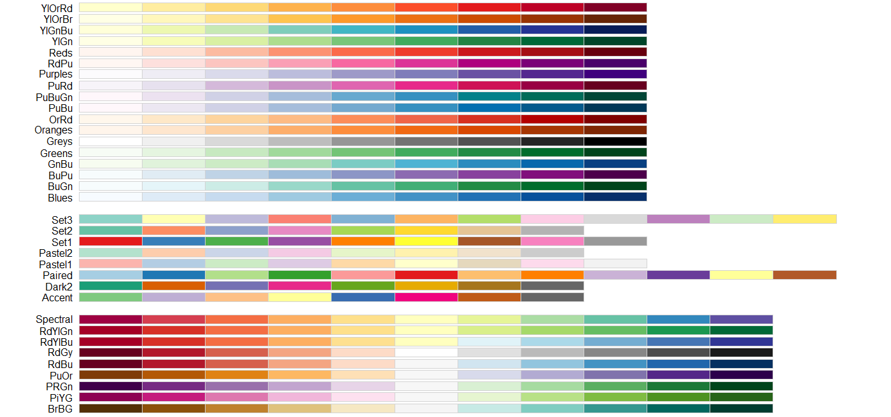
ColorBrewer palettes
ColorBrewer palettes are implemented in R through RColorBrewer library and available in ggplot

Slide 31
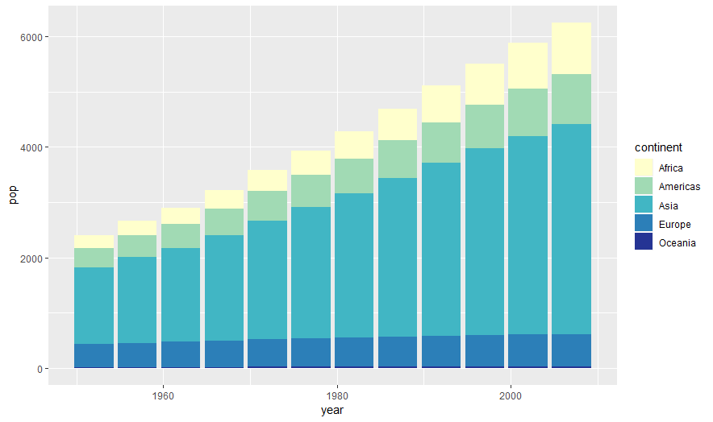
Using ColorBrewer palettes I
Let’s change the color scheme of our bar graph of population by year
gapminder %>% group_by(continent, year) %>% summarize(pop = sum(pop/1000000)) %>%
ggplot(aes(x = year, y = pop, fill=continent)) + geom_col() + scale_fill_brewer(palette = "YlGnBu")
Notes:
Scale_color_brewer for non-fill scales

Slide 32
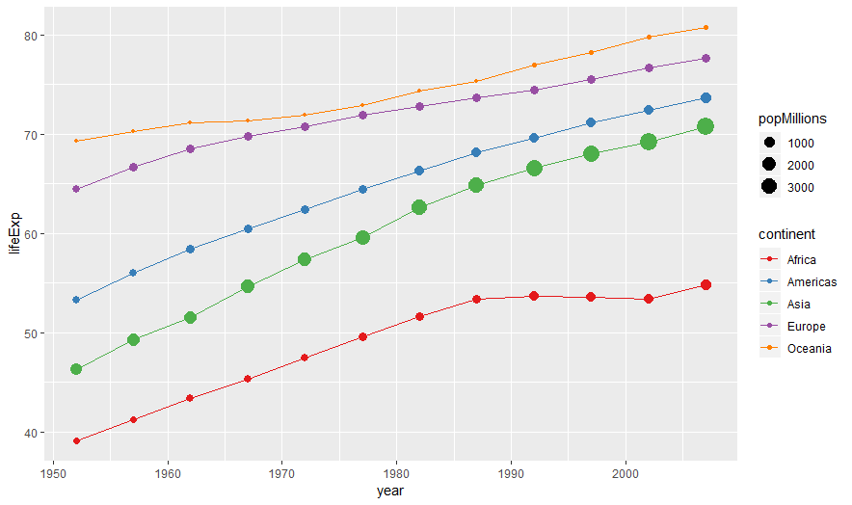
Using ColorBrewer palettes II
Let’s change the color scheme of our line plot of life expectancy by year
gapminder %>% group_by(continent, year) %>%
summarize(lifeExp = mean(lifeExp), popMillions = sum(pop/1000000)) %>%
ggplot(aes(x = year, y = lifeExp, color=continent)) + geom_line() + geom_point(aes(size = popMillions)) + scale_color_brewer(palette = "Set1")

Slide 33
ggplot themes
ggplot comes with built-in themes that change the overall look of the plots
MANY more themes are available in add-on libraries (e.g. ggthemes, ggthemr)
Notes:
Journal specific themes exist (lancet, etc.)

Slide 34
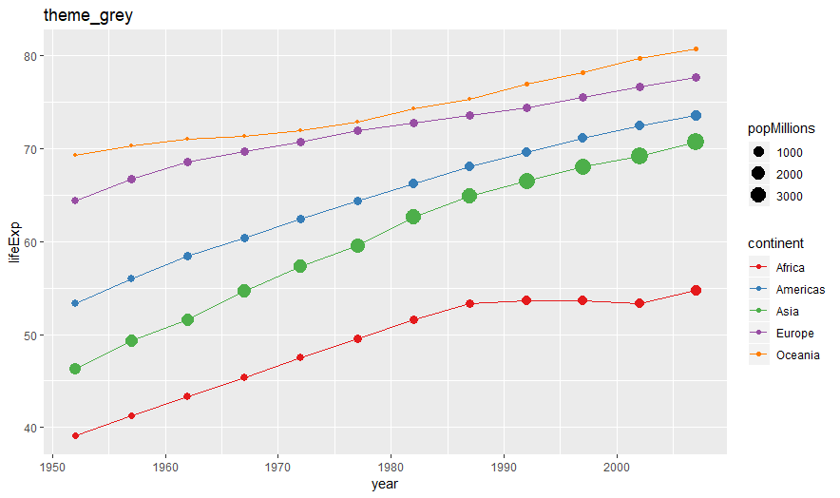
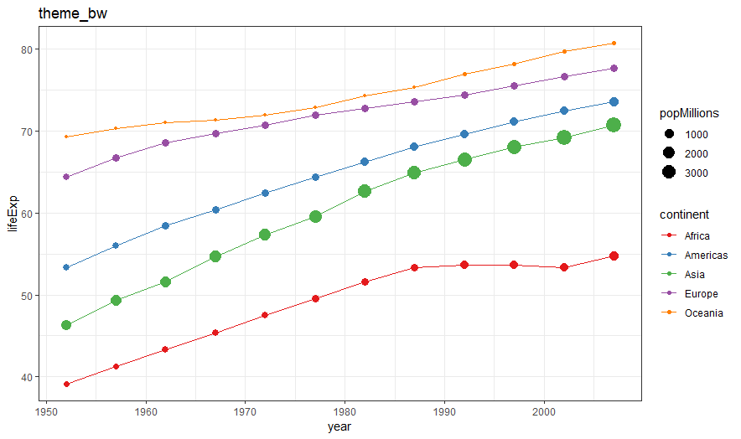
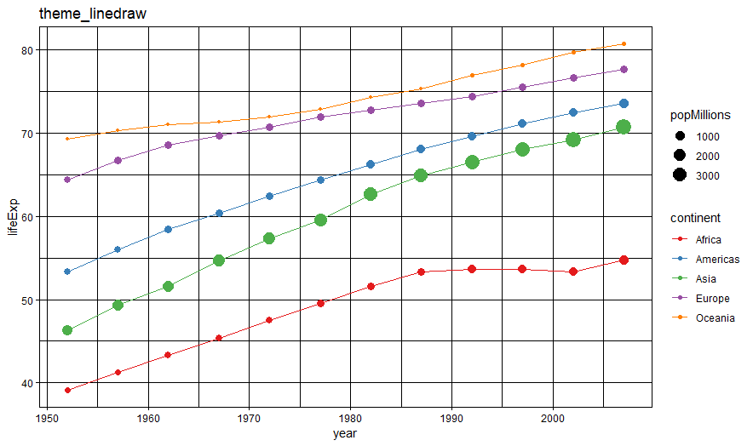
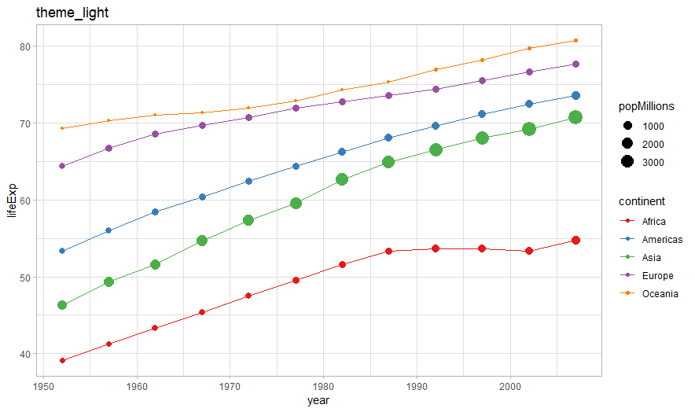
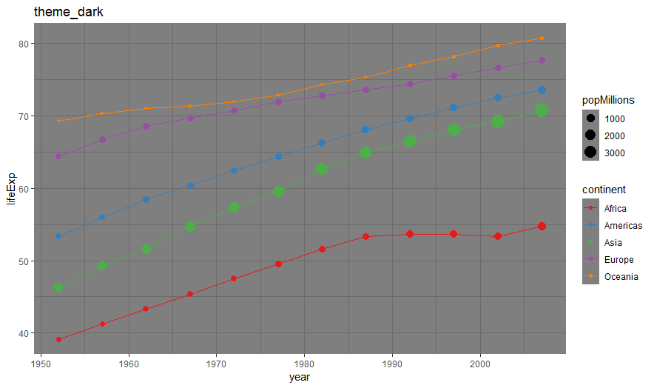
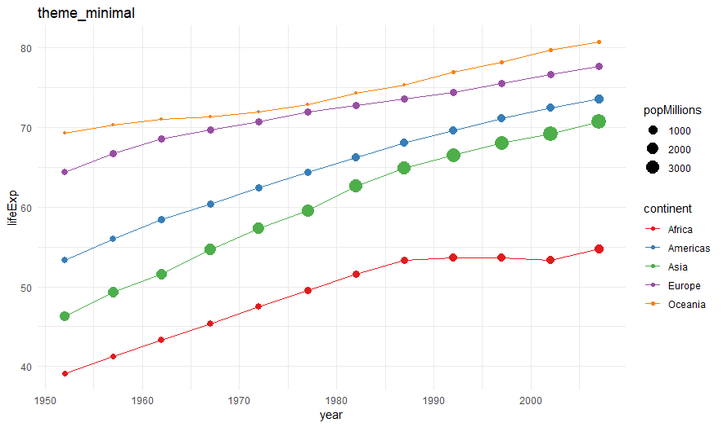
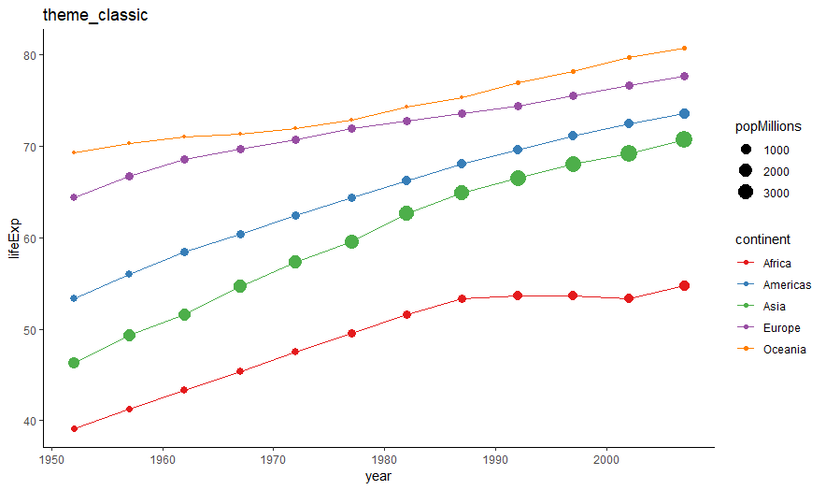
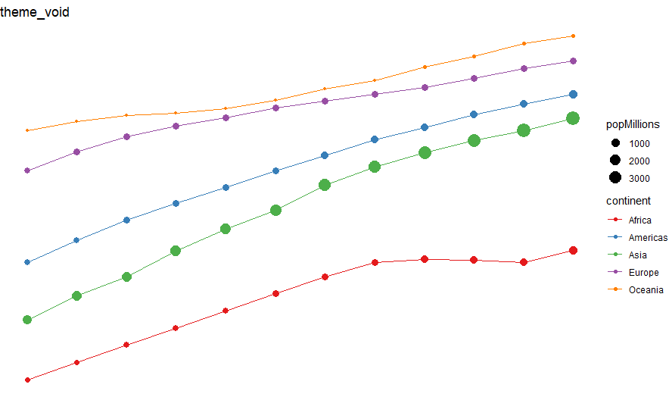
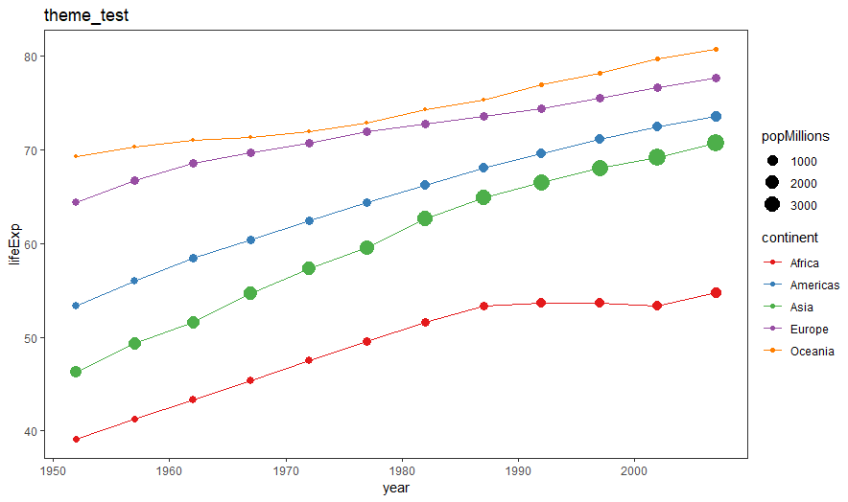

Slide 35
Example
We want to understand the relationship between GDP and life expectancy for each continent and visualize the temporal evolution of these variables
toPlot <- gapminder %>% group_by(continent, year) %>%
summarize(lifeExp = mean(lifeExp), gdpPercap = mean(gdpPercap), pop = sum(pop/1000000))
head(toPlot, n=10)
# A tibble: 10 x 5
# Groups: continent [2]
continent year lifeExp gdpPercap pop
<fct> <int> <dbl> <dbl> <dbl>
1 Africa 1952 39.1 1253 238
2 Africa 1957 41.3 1385 265
3 Africa 1962 43.3 1598 297
4 Africa 1967 45.3 2050 335
5 Africa 1972 47.5 2340 380
6 Africa 1977 49.6 2586 433
7 Africa 1982 51.6 2482 499
8 Africa 1987 53.3 2283 575
9 Africa 1992 53.6 2282 659
10 Africa 1997 53.6 2379 744

Slide 36
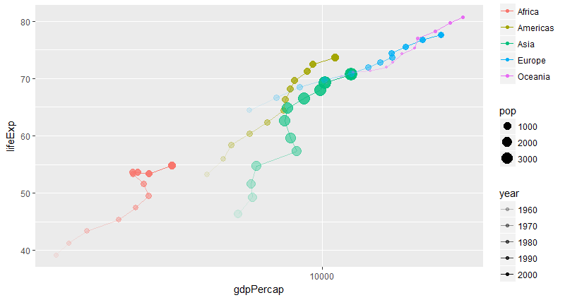
Example
We want to understand the relationship between GDP and life expectancy for each continent and visualize the temporal evolution of these variables
(plotCmd <- ggplot(toPlot, aes(x = gdpPercap, y = lifeExp, color = continent, alpha = year)) +
geom_point(aes(size = pop)) + geom_path() + scale_x_log10())
Notes:
Alpha is transparency. You can use it based on values in your data or you can specify a fixed alpha. It’s often useful if you have a lot of data points to set your alpha to ~20% (alpha = .2) for better visualization.
-can also use transparency to indicate weight instead of the size command. (ex: alpha = population, year, etc.)
Geom_path() – similar to geom_line. It connects points with a line, but geom_line connects points in order they appear in x axis, but geom_path connects the lines in order they appear in data set. Good for connecting by year, in this case.
To assign plot to an object, wrap in paranthesis. you can sequentially build a plot without continuing to retype all code. Can go back and add labels, etc.

Slide 37
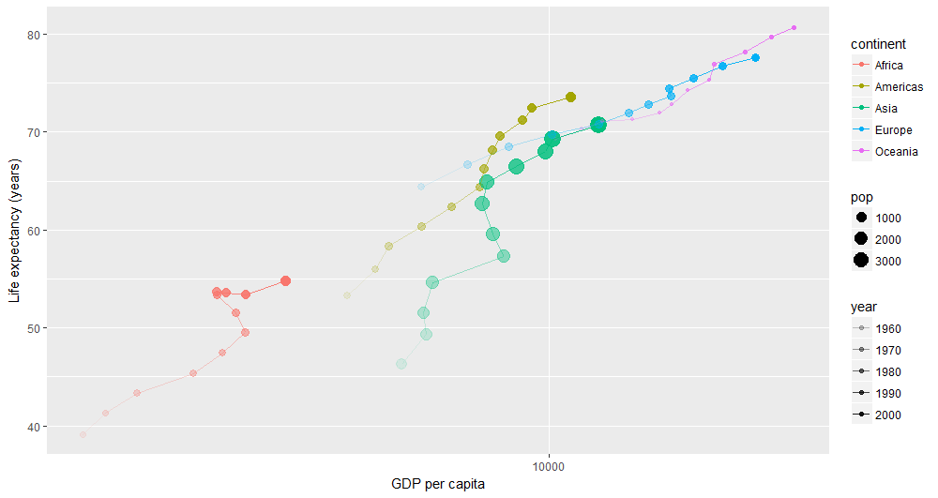
Building on code assigned to an object
plotCmd + xlab("GDP per capita") + ylab("Life expectancy (years)")

Slide 38
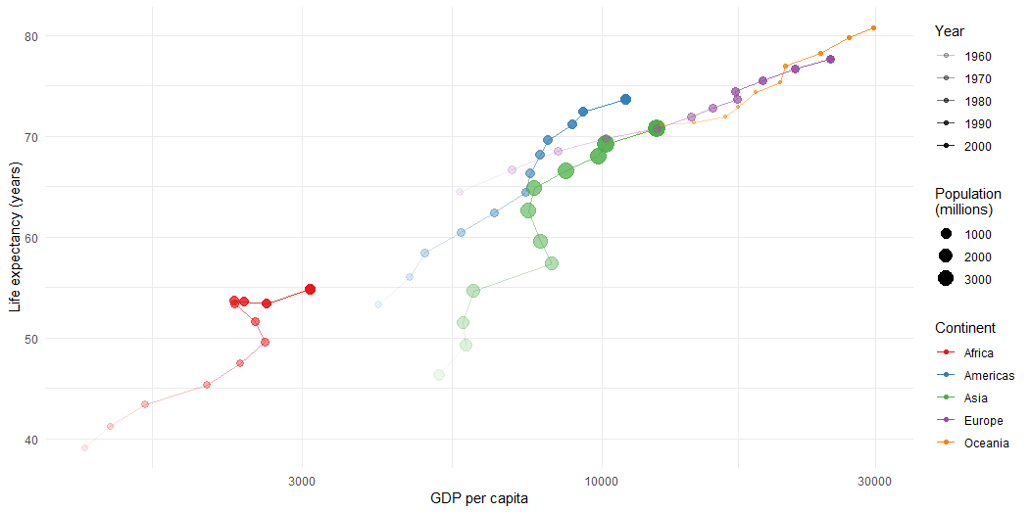
Building on code assigned to an object
plotCmd + xlab("GDP per capita") + ylab("Life expectancy (years)") + theme_minimal() + scale_color_brewer(palette = "Set1", name = "Continent") + scale_alpha(name = "Year") + scale_size(name = "Population \n(millions)")
Notes:
\n puts words following on new line

Slide 39
Cheat sheets
Notes:
most packages have cheat sheets, can be helpful to print out

Slide 40
Cheat sheets

Slide 41
Questions?
https://uw.iasystem.org/survey/205065

