Slide 1
Epi 510: Introduction to R #10 Survey data analysis
EPI 510
Jeff Stanaway, MPH PhD

Slide 2
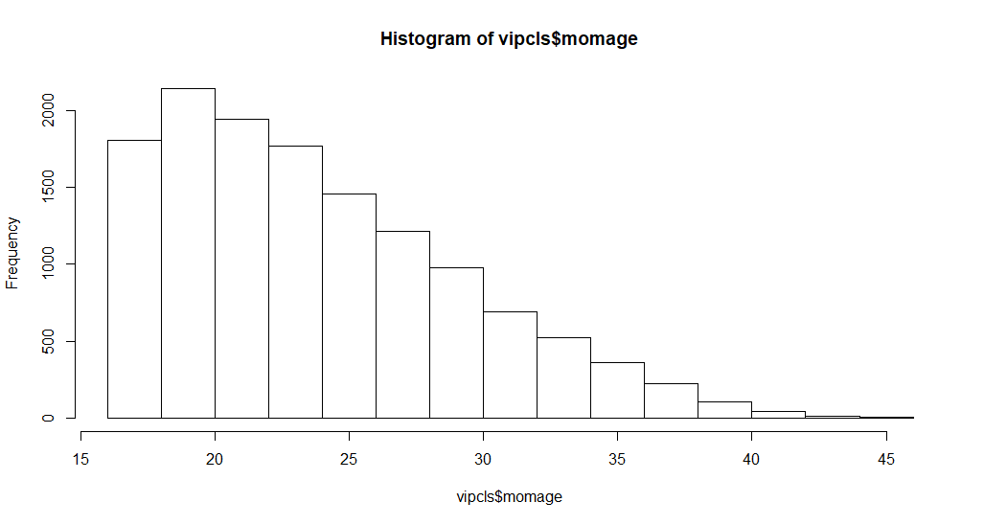
Histograms
hist(vipcls$momage)

Slide 3
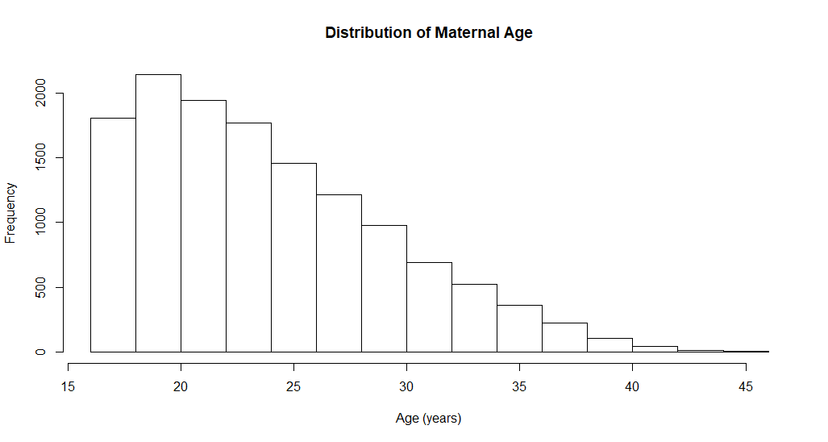
Histograms
hist(vipcls$momage, xlab = "Age (years)", main = "Distribution of Maternal Age")

Slide 4
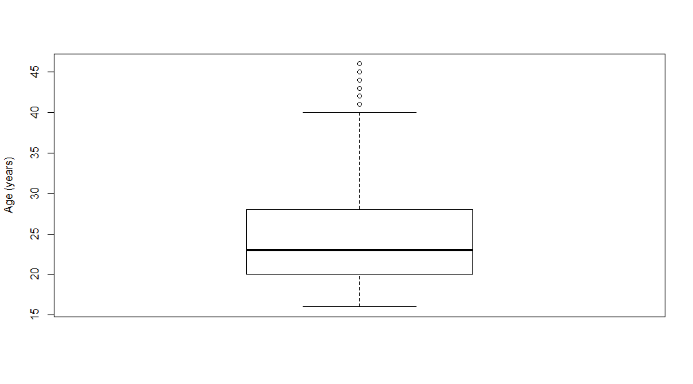
Boxplots
boxplot(vipcls$momage, ylab = "Age (years)")

Slide 5
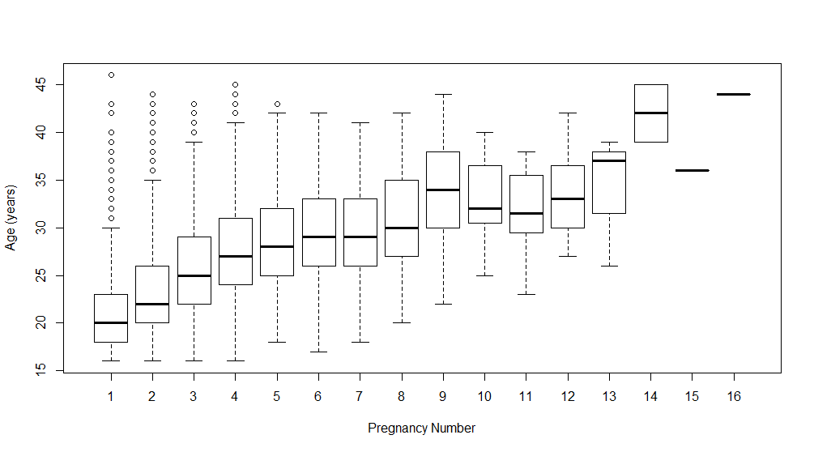
Boxplots
boxplot(vipcls$momage ~ vipcls$pregnum,
ylab = "Age (years)", xlab = "Pregnancy Number")

Slide 6
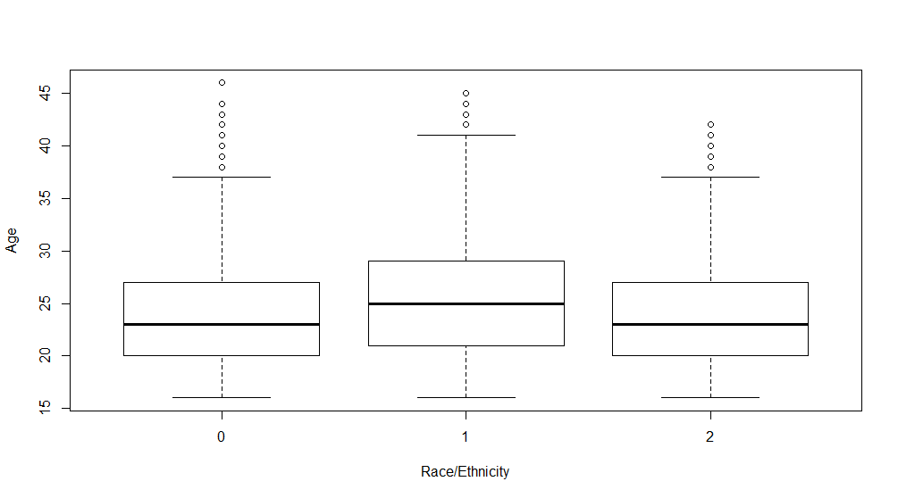
Boxplots
boxplot(vipcls$momage ~ vipcls$raceth, ylab="Age", xlab="Race/Ethnicity“)

Slide 7
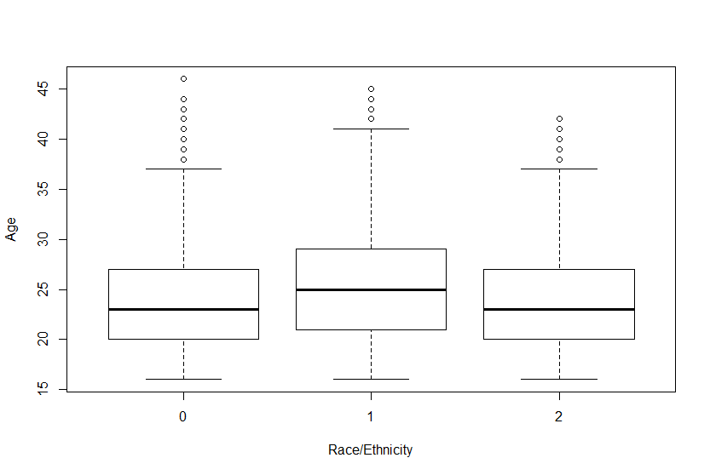
Boxplots
boxplot(vipcls$momage ~ vipcls$raceth, ylab="Age", xlab="Race/Ethnicity“)
Two ways to label the x-axis:
We can specify the labels as an option in the boxplot command
We can convert raceth to a labelled factor variable

Slide 8
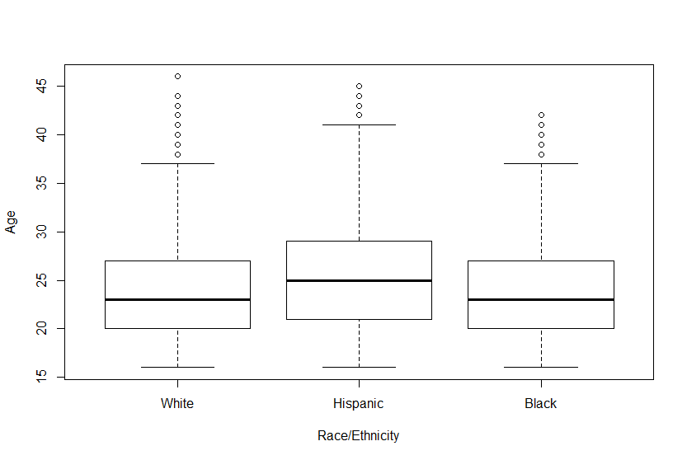
Boxplots
boxplot(vipcls$momage ~ vipcls$raceth, ylab="Age", xlab="Race/Ethnicity", names=c("White", "Hispanic", "Black"))

Slide 9
Boxplots
vipcls$raceth <- factor(vipcls$raceth, levels = c(0:2),
labels = c("White", "Hispanic", "Black"))
boxplot(vipcls$momage ~ vipcls$raceth, ylab="Age", xlab="Race/Ethnicity“)

Slide 10
Survey analysis background
Prepping BRFSS data
Survey analysis functions

Slide 11
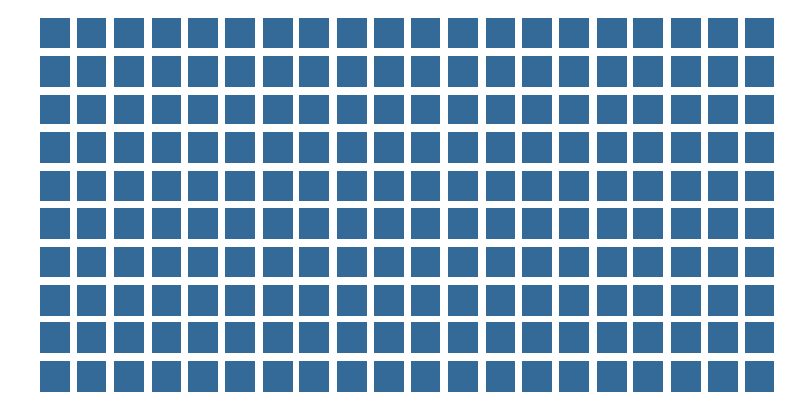
Take a population…

Slide 12
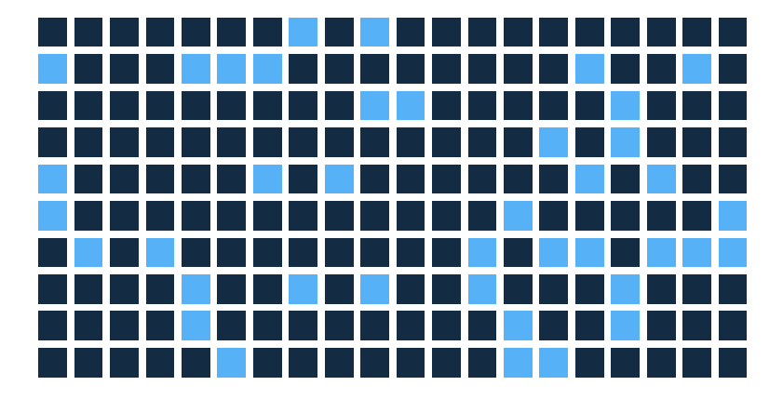
Simple random sample
Each individual has equal probability of being included in sample

Slide 13
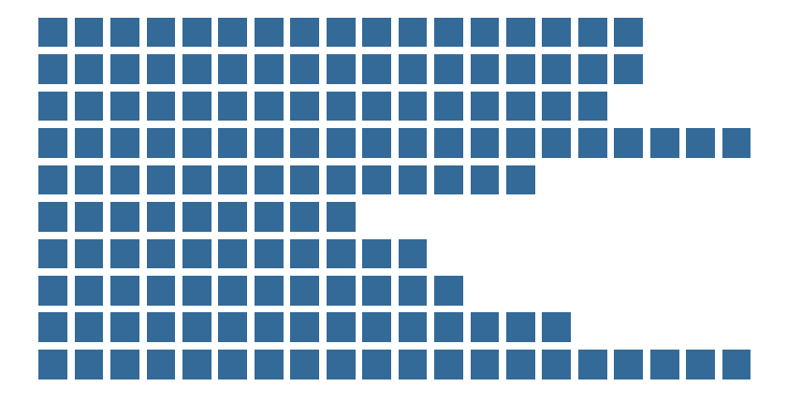
What if the population falls into groups?
Each row may represent a county, a state, an age group, etc.

Slide 14
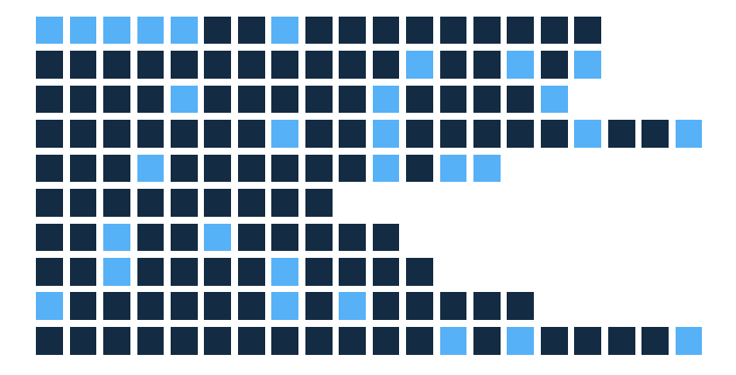
Simple random sample
SRS may result in under-sampling or over-sampling different groups
Result is being under- or over-powered in different groups -- inefficient

Slide 15
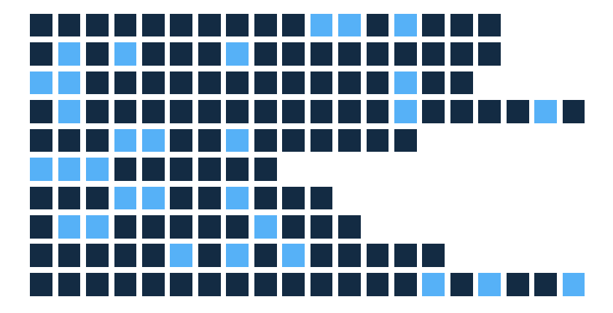
Stratified random sampling
Can take a random sample within each group (stratum) (e.g. sample x people within each state)

Slide 16
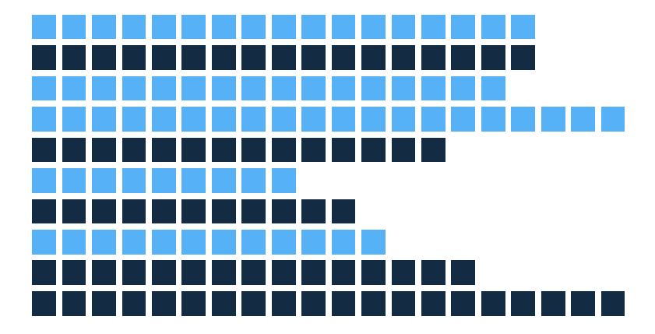
Cluster sampling
What if groups are similar, but physically distant, and need to limit travel to reduce study cost?
Randomly select some groups (clusters) to sample from (e.g. NHANES samples select counties)

Slide 17
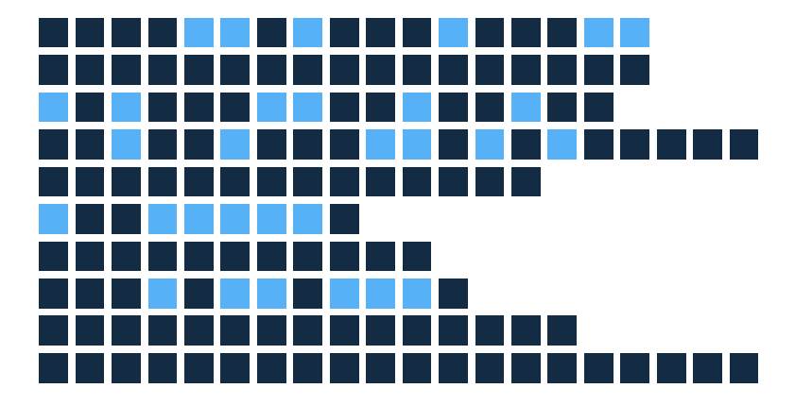
Cluster sampling
After randomly selecting clusters, randomly select individuals from within the selected clusters (e.g. randomly select individuals from within selected counties)

Slide 18
Examples:
Simple random sampling:
Randomly sample 10,000 households across Washington state
Stratified random sampling:
Randomly sample 300 households from each of the 39 counties in Washington state
Cluster sampling:
Randomly select 20 counties
Randomly select 500 households from within each of the 20 counties

Slide 19
Sampling design implications
Stratified and clustered sampling designs can offer increased statistical efficiency or lower cost
But samples no longer are representative of broader population
Need to use information about sample design and larger population to correct estimates

Slide 20
Core idea
Any given individual that was sampled, i, had some probability of being sampled = π_{i}
Individual i therefore represents l/π_{i} individuals in the population
l/π_{i} is the sampling weight
Put another way, the sampling weight is simply the number of individuals in the population who are being represented by a given individual in the sample

Slide 21


survey package
Description: “Analysis of Complex Survey Samples”
Written by Thomas Lumley (former PhD student and faculty member in UW Biostats program)
install.packages("survey")
library("survey")
http://r-survey.r-forge.r-project.org/svybook/index.html

Slide 22
Survey analysis background
Prepping BRFSS data
Survey analysis functions
X

Slide 23
Import BRFSS data
# Read in BRFSS data (import SAS xport file)
brfssRaw <- read_xpt(paste0(dataDir, "LLCP2017.XPT"))
glimpse(brfssRaw)
Observations: 450,016
Variables: 358
$ `_STATE` <dbl> 1, 1, 1, 1, 1, 1, 1, 1, 1, 1, 1, 1, 1, 1, 1, 1, 1, 1, 1, 1, 1, 1, 1, 1, 1, 1, 1, 1, ...
$ FMONTH <dbl> 1, 1, 1, 1, 1, 1, 1, 1, 1, 1, 1, 1, 1, 1, 1, 1, 1, 1, 1, 1, 1, 2, 2, 2, 2, 2, 2, 2, ...
$ IDATE <chr> "01302017", "01122017", "01102017", "02082017", "01302017", "01302017", "01052017", ...
$ IMONTH <chr> "01", "01", "01", "02", "01", "01", "01", "02", "01", "01", "01", "01", "01", "01", ...
$ IDAY <chr> "30", "12", "10", "08", "30", "30", "05", "02", "24", "12", "03", "15", "09", "04", ...
$ IYEAR <chr> "2017", "2017", "2017", "2017", "2017", "2017", "2017", "2017", "2017", "2017", "201...
$ DISPCODE <dbl> 1100, 1100, 1100, 1200, 1100, 1100, 1100, 1100, 1100, 1100, 1100, 1100, 1100, 1100, ...
$ SEQNO <chr> "2017000001", "2017000002", "2017000003", "2017000004", "2017000005", "2017000006", ...
$ `_PSU` <dbl> 2.017e+09, 2.017e+09, 2.017e+09, 2.017e+09, 2.017e+09, 2.017e+09, 2.017e+09, 2.017e+...
$ CTELENM1 <dbl> 1, 1, 1, 1, 1, 1, 1, 1, 1, 1, 1, 1, 1, 1, 1, 1, 1, 1, 1, 1, 1, 1, 1, 1, 1, 1, 1, 1, ...
$ PVTRESD1 <dbl> 1, 1, 1, 1, 1, 1, 1, 1, 1, 1, 1, 1, 1, 1, 1, 1, 1, 1, 1, 1, 1, 1, 1, 1, 1, 1, 1, 1, ...
$ COLGHOUS <dbl> NA, NA, NA, NA, NA, NA, NA, NA, NA, NA, NA, NA, NA, NA, NA, NA, NA, NA, NA, NA, NA, ...
$ STATERE1 <dbl> 1, 1, 1, 1, 1, 1, 1, 1, 1, 1, 1, 1, 1, 1, 1, 1, 1, 1, 1, 1, 1, 1, 1, 1, 1, 1, 1, 1, ...
$ CELLFON4 <dbl> 2, 2, 2, 2, 2, 2, 2, 2, 2, 2, 2, 2, 2, 2, 2, 2, 2, 2, 2, 2, 2, 2, 2, 2, 2, 2, 2, 2, ...
$ LADULT <dbl> NA, NA, NA, NA, NA, NA, NA, NA, NA, NA, NA, NA, NA, NA, NA, NA, NA, NA, NA, NA, NA, ...
$ NUMADULT <dbl> 1, 2, 2, 1, 1, 1, 2, 1, 2, 2, 1, 1, 1, 1, 2, 1, 1, 1, 1, 1, 1, 1, 1, 3, 1, 1, 1, 1, ...
$ NUMMEN <dbl> 0, 1, 1, 0, 0, 1, 1, 0, 1, 1, 0, 0, 0, 0, 1, 0, 1, 0, 0, 0, 1, 0, 0, 2, 0, 0, 1, 0, ...
$ NUMWOMEN <dbl> 1, 1, 1, 1, 1, 0, 1, 1, 1, 1, 1, 1, 1, 1, 1, 1, 0, 1, 1, 1, 0, 1, 1, 1, 1, 1, 0, 1, ...
$ SAFETIME <dbl> NA, NA, NA, NA, NA, NA, NA, NA, NA, NA, NA, NA, NA, NA, NA, NA, NA, NA, NA, NA, NA, ...

Slide 24
Notice anything wrong here?
glimpse(brfssRaw)
Observations: 450,016
Variables: 358
$ `_STATE` <dbl> 1, 1, 1, 1, 1, 1, 1, 1, 1, 1, 1, 1, 1, 1, 1, 1, 1, 1, 1, 1, 1, 1, 1, 1, 1, 1, 1, 1, ...
$ FMONTH <dbl> 1, 1, 1, 1, 1, 1, 1, 1, 1, 1, 1, 1, 1, 1, 1, 1, 1, 1, 1, 1, 1, 2, 2, 2, 2, 2, 2, 2, ...
$ IDATE <chr> "01302017", "01122017", "01102017", "02082017", "01302017", "01302017", "01052017", ...
$ IMONTH <chr> "01", "01", "01", "02", "01", "01", "01", "02", "01", "01", "01", "01", "01", "01", ...
$ IDAY <chr> "30", "12", "10", "08", "30", "30", "05", "02", "24", "12", "03", "15", "09", "04", ...
$ IYEAR <chr> "2017", "2017", "2017", "2017", "2017", "2017", "2017", "2017", "2017", "2017", "201...
These are all either double or character variables, but the content appears to be integers
Dataset was created by SAS, which doesn’t have an integer type (only numeric & character)
`_STATE` is an awfully strange variable name
R does not allow variable names to start with an underscore, but SAS does
read_xpt is being literal and trying to import the data as-is

Slide 25
Let’s fix things
Option 1: coerce variable types and change disallowed names
Option 2: save to .csv and read back in
read.csv will convert variable types when importing and rename variables with disallowed names
If the problem only affected a few variables, then option 1 would likely be more desirable
Option 2 is perhaps a bit of hack, but it works flawlessly, and is a far easier fix given the number of variables in our dataset

Slide 26
# Save data to a .csv file
write.csv(brfssRaw, paste0(dataDir, "LLCP2017.csv"), row.names = FALSE)
# Read the .csv file back in
brfss <- read.csv(paste0(dataDir, "LLCP2017.csv"))

Slide 27
cbind(names(brfssRaw), names(brfss))
[,1] [,2]
[1,] "_STATE" "X_STATE"
[2,] "FMONTH" "FMONTH"
[3,] "IDATE" "IDATE"
[4,] "IMONTH" "IMONTH"
[5,] "IDAY" "IDAY"
[6,] "IYEAR" "IYEAR"
[7,] "DISPCODE" "DISPCODE"
[8,] "SEQNO" "SEQNO"
[9,] "_PSU" "X_PSU"
[10,] "CTELENM1" "CTELENM1"
[11,] "PVTRESD1" "PVTRESD1"
[12,] "COLGHOUS" "COLGHOUS"
[13,] "STATERE1" "STATERE1"
[14,] "CELLFON4" "CELLFON4"
[15,] "LADULT" "LADULT"
[16,] "NUMADULT" "NUMADULT"
[17,] "NUMMEN" "NUMMEN"
[18,] "NUMWOMEN" "NUMWOMEN"
[19,] "SAFETIME" "SAFETIME"
[20,] "CTELNUM1" "CTELNUM1"

Slide 28
glimpse(brfss)
Observations: 450,016
Variables: 358
$ X_STATE <int> 1, 1, 1, 1, 1, 1, 1, 1, 1, 1, 1, 1, 1, 1, 1, 1, 1, 1, 1, 1, 1, 1, 1, 1, 1, 1, 1, 1, 1...
$ FMONTH <int> 1, 1, 1, 1, 1, 1, 1, 1, 1, 1, 1, 1, 1, 1, 1, 1, 1, 1, 1, 1, 1, 2, 2, 2, 2, 2, 2, 2, 2...
$ IDATE <int> 1302017, 1122017, 1102017, 2082017, 1302017, 1302017, 1052017, 2022017, 1242017, 1122...
$ IMONTH <int> 1, 1, 1, 2, 1, 1, 1, 2, 1, 1, 1, 1, 1, 1, 1, 1, 1, 1, 1, 1, 1, 2, 2, 2, 2, 2, 2, 2, 2...
$ IDAY <int> 30, 12, 10, 8, 30, 30, 5, 2, 24, 12, 3, 15, 9, 4, 5, 11, 30, 10, 30, 11, 25, 8, 21, 6...
$ IYEAR <int> 2017, 2017, 2017, 2017, 2017, 2017, 2017, 2017, 2017, 2017, 2017, 2017, 2017, 2017, 2...
$ DISPCODE <int> 1100, 1100, 1100, 1200, 1100, 1100, 1100, 1100, 1100, 1100, 1100, 1100, 1100, 1100, 1...
$ SEQNO <int> 2017000001, 2017000002, 2017000003, 2017000004, 2017000005, 2017000006, 2017000007, 2...
$ X_PSU <int> 2017000001, 2017000002, 2017000003, 2017000004, 2017000005, 2017000006, 2017000007, 2...
$ CTELENM1 <int> 1, 1, 1, 1, 1, 1, 1, 1, 1, 1, 1, 1, 1, 1, 1, 1, 1, 1, 1, 1, 1, 1, 1, 1, 1, 1, 1, 1, 1...
$ PVTRESD1 <int> 1, 1, 1, 1, 1, 1, 1, 1, 1, 1, 1, 1, 1, 1, 1, 1, 1, 1, 1, 1, 1, 1, 1, 1, 1, 1, 1, 1, 1...
$ COLGHOUS <int> NA, NA, NA, NA, NA, NA, NA, NA, NA, NA, NA, NA, NA, NA, NA, NA, NA, NA, NA, NA, NA, N...
$ STATERE1 <int> 1, 1, 1, 1, 1, 1, 1, 1, 1, 1, 1, 1, 1, 1, 1, 1, 1, 1, 1, 1, 1, 1, 1, 1, 1, 1, 1, 1, 1...
$ CELLFON4 <int> 2, 2, 2, 2, 2, 2, 2, 2, 2, 2, 2, 2, 2, 2, 2, 2, 2, 2, 2, 2, 2, 2, 2, 2, 2, 2, 2, 2, 2...
$ LADULT <int> NA, NA, NA, NA, NA, NA, NA, NA, NA, NA, NA, NA, NA, NA, NA, NA, NA, NA, NA, NA, NA, N...
$ NUMADULT <int> 1, 2, 2, 1, 1, 1, 2, 1, 2, 2, 1, 1, 1, 1, 2, 1, 1, 1, 1, 1, 1, 1, 1, 3, 1, 1, 1, 1, 2...

Slide 29
# Make a table showing the number of variables by their type
table(sapply(brfss, typeof))
double integer logical
7 347 4
# Let's see how many names changed
table(names(brfssRaw)==names(brfss))
FALSE TRUE
82 276
# Convert all names to lower case (personal preference)
names(brfss) <- tolower(names(brfss))

Slide 30
# TAKE A SUBSET OF VARIABLES & RESTRICT TO WASHINGTON STATE (STATE = 53)
clean <- brfss[brfss$x_state==53, c("x_state", "x_psu", "x_ststr", "x_llcpwt",
"sex", "x_ageg5yr", "x_age65yr", "x_bmi5",
"cvdinfr4", "x_rfchol1", "poorhlth")]
# CLEAN UP CODING, MAKE LABELLED FACTORS, CLEAN UP VARIABLE NAMES HERE
# (SEE CODE FOR THIS LECTURE FOR THE CODE I RAN HERE)

Slide 31
Setting up the survey design
We need to define the survey design so R understands how to weigh the data
Use svydesign function (same idea as svyset in Stata)
fpc is finite population correction variable; may or may not be present
id1 represents clusters, id2 represents individuals sampled within cluster (e.g. id = ~county + person_id)
# Stratified random sample; PSUs represented by rows
design <- svydesign(data = data, id = ~1, strata = strataVar, weights = wtVar, fpc = fpcVar)
# Stratified random sample; PSUs defined by variable
design <- svydesign(data = data, id = psuVar, strata = strataVar, weights = wtVar, fpc = fpcVar)
# Clustered sampling
design <- svydesign(data = data, id = ~id1 + id2, weights = wtVar, fpc = fpc1 + fpc2)

Slide 32
Setting up the survey design
### SET UP SURVEY DESIGN ###
# Set options for allowing a single observation per stratum
options(survey.lonely.psu = "adjust")
# Create survey design
bd <- svydesign(data = clean, id=~psu, strata = ~ststr, weight = ~llcpwt, nest = TRUE)
# Take a look at the design (for more details: summary(brfssD))
bd
Stratified Independent Sampling design (with replacement)
svydesign(data = clean, id = ~psu, strata = ~ststr, weight = ~llcpwt, nest = TRUE)
"~" indicates that the variable is part of the data included in the survey design. We'll use this notation throughout survey package functions.

Slide 33
Survey analysis background
Prepping BRFSS data
Survey analysis functions
X
X

Slide 34
Descriptive statistics: one-way frequency tables
svytable = survey tables
svytable(~var, designObject)
svytable(~sex, bd)
sex
Male Female
2861843 2913422
sexTab <- svytable(~sex, bd)
prop.table(sexTab)
sex
Male Female
0.4955344 0.5044656
cbind(sexTab, prop.table(sexTab))
sexTab
Male 2861843 0.4955344
Female 2913422 0.5044656

Slide 35
Descriptive statistics: one-way frequency tables
ageTab <- svytable(~age, bd)
cbind(ageTab, prop.table(ageTab))
ageTab
Age 18 to 24 679944.0 0.11960412
Ages 25 to 29 463902.4 0.08160178
Ages 30 to 34 594024.7 0.10449066
Ages 35 to 39 501805.6 0.08826906
Ages 40 to 44 445566.3 0.07837639
Ages 45 to 49 426869.9 0.07508765
Ages 50 to 54 477320.9 0.08396212
Ages 55 to 59 469609.2 0.08260562
Ages 60 to 64 488433.4 0.08591684
Ages 65 to 69 381020.9 0.06702267
Ages 70 to 74 310117.6 0.05455058
Ages 75 to 79 207702.1 0.03653539
Age 80 or older 238637.9 0.04197710

Slide 36
Let’s compare weighted & unweighted age distribution
# To get table of weighted age distribution: prop.table(ageTab))
# To get table of unweighted age distribution: prop.table(table(clean$age))
(agePropCompare <- cbind(prop.table(table(clean$age)), prop.table(ageTab))*100)
[,1] [,2]
Age 18 to 24 5.881902 11.960412
Ages 25 to 29 5.115031 8.160178
Ages 30 to 34 6.035276 10.449066
Ages 35 to 39 6.694785 8.826906
Ages 40 to 44 5.766871 7.837639
Ages 45 to 49 6.633436 7.508765
Ages 50 to 54 7.661043 8.396212
Ages 55 to 59 9.930982 8.260562
Ages 60 to 64 11.219325 8.591684
Ages 65 to 69 11.119632 6.702267
Ages 70 to 74 9.302147 5.455058
Ages 75 to 79 6.572086 3.653539
Age 80 or older 8.067485 4.197710

Slide 37
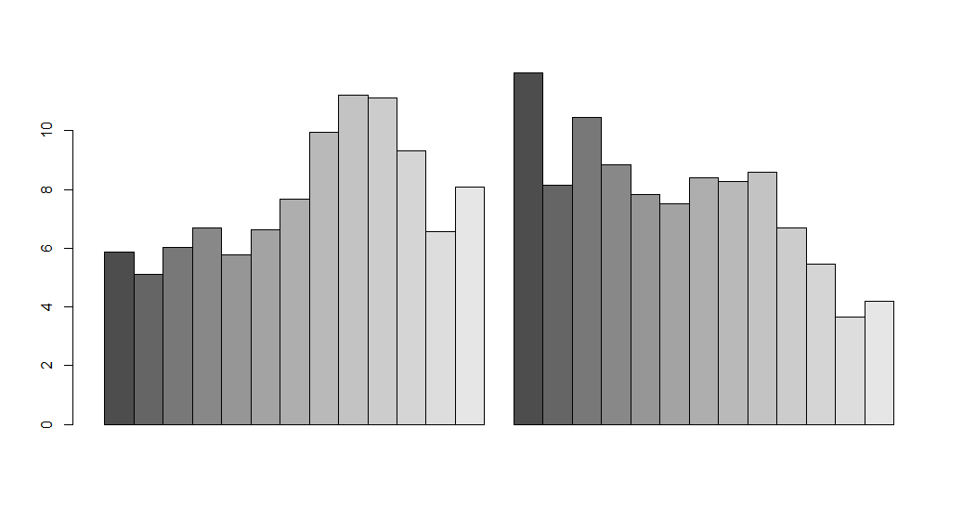
Let’s compare weighted & unweighted age distribution
# Create bar plot to compare age distributions;
# beside = FALSE (default) creates stacked bars; we want beside = TRUE
barplot(agePropCompare, beside = TRUE)

Slide 38
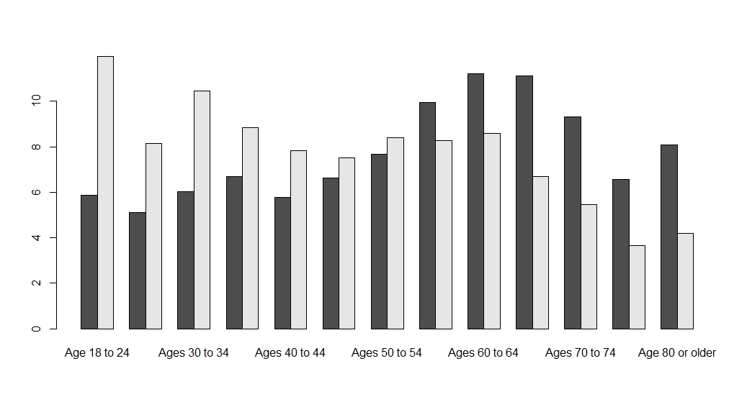
Let’s compare weighted & unweighted age distribution
# We have tables and rows mixed; use t() to transpose
barplot(t(agePropCompare), beside = TRUE)

Slide 39
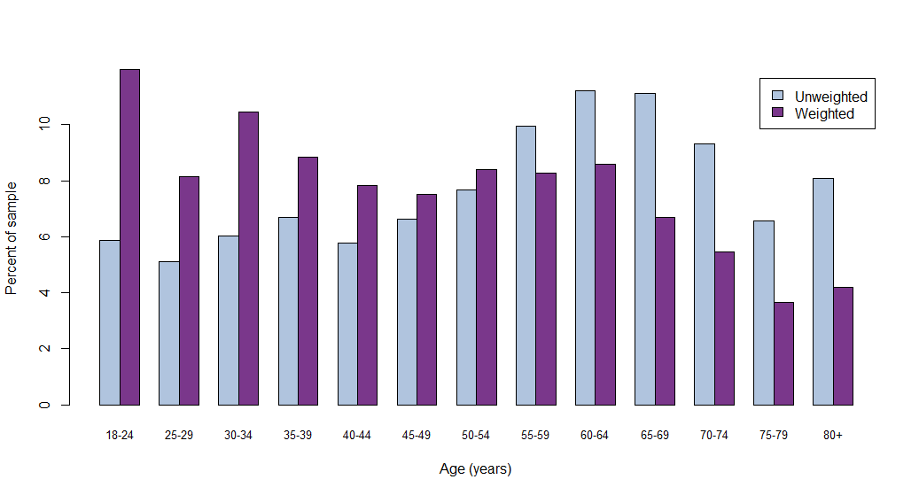
Let’s compare weighted & unweighted age distribution
# Add options to make pretty
barplot(t(agePropCompare), beside = TRUE, col = c("lightsteelblue", "mediumorchid4"),
xlab = "Age (years)", ylab = "Percent of sample", legend = c("Unweighted", "Weighted"),
names.arg = c("18-24", paste(seq(25,75,5), seq(29,79,5), sep="-"), "80+"), cex.names=0.8)

Slide 40
Descriptive statistics: crosstabs
We can use svytable to also produce crosstabs
# Two-way frequency tables: sex & high cholesterol
svytable(~sex + highChol, design = bd)
highChol
sex Yes No
Male 788493.8 1577167.8
Female 735509.3 1694524.5
# chi-squared tests
svychisq(~sex + highChol, design = bd, statistic="Chisq")
Pearson's X^2: Rao & Scott adjustment
data: svychisq(~sex + highChol, design = bd, statistic = "Chisq")
X-squared = 14.367, df = 1, p-value = 0.005928

Slide 41
Descriptive statistics: crosstabs
svytable(~age + highChol + sex, design = bd)
, , sex = Male
highChol
age Yes No
Age 18 to 24 19191.46 191871.09
Ages 25 to 29 15377.85 145289.20
Ages 30 to 34 35338.53 182965.17
Ages 35 to 39 43839.02 156050.58
Ages 40 to 44 49706.90 135710.27
Ages 45 to 49 69272.96 122652.27
Ages 50 to 54 88090.26 134867.25
Ages 55 to 59 84185.82 127298.81
Ages 60 to 64 111508.69 117183.28
Ages 65 to 69 88064.58 90110.17
Ages 70 to 74 84444.68 62432.75
Ages 75 to 79 47161.42 39104.32
Age 80 or older 40236.11 45741.76
, , sex = Female
highChol
age Yes No
Age 18 to 24 13211.87 158881.40
Ages 25 to 29 13512.11 130201.84
Ages 30 to 34 20657.86 188486.37
Ages 35 to 39 26270.00 164471.45
Ages 40 to 44 44814.36 152863.94
Ages 45 to 49 47773.19 148071.32
Ages 50 to 54 72475.75 155199.11
Ages 55 to 59 95970.60 137524.92
Ages 60 to 64 105752.67 128899.11
Ages 65 to 69 86657.48 103445.08
Ages 70 to 74 84881.67 67240.67
Ages 75 to 79 57897.21 52012.96
Age 80 or older 56854.55 74061.77

Slide 42
Summary statistics
# means and SEs
svymean(~bmi, design = bd, na.rm = TRUE)
mean SE
bmi 27.533 0.0732
svymean(~poorHealthDays, design = bd, na.rm = TRUE)
mean SE
poorHealthDays 10.416 0.2225
# quantiles
svyquantile(~bmi, design = bd, na.rm = TRUE,
quantiles = c(0, 0.1, 0.25, 0.5, 0.75, 0.9, 1))
0 0.1 0.25 0.5 0.75 0.9 1
bmi 12.48 21.02 23.4 26.57 30.55 35.19 81.37
svyquantile(~poorHealthDays, design = bd, na.rm = TRUE, quantiles = c(0, 0.1, 0.25, 0.5, 0.75, 0.9, 1))
0 0.1 0.25 0.5 0.75 0.9 1
poorHealthDays 1 1 2 5 15 30 30

Slide 43
Totals
svytotal calculates totals of numeric variables and counts for factor and logical variables
svytotal(~poorHealthDays, design = bd, na.rm = TRUE)
total SE
poorHealthDays 15956947 460142
svytotal(~heartAttack, design = bd, na.rm = TRUE)
total SE
heartAttackYes 216641 11292
heartAttackNo 5551735 38034
svytable(~heartAttack, design = bd)
heartAttack
Yes No
216640.6 5551734.6

Slide 44
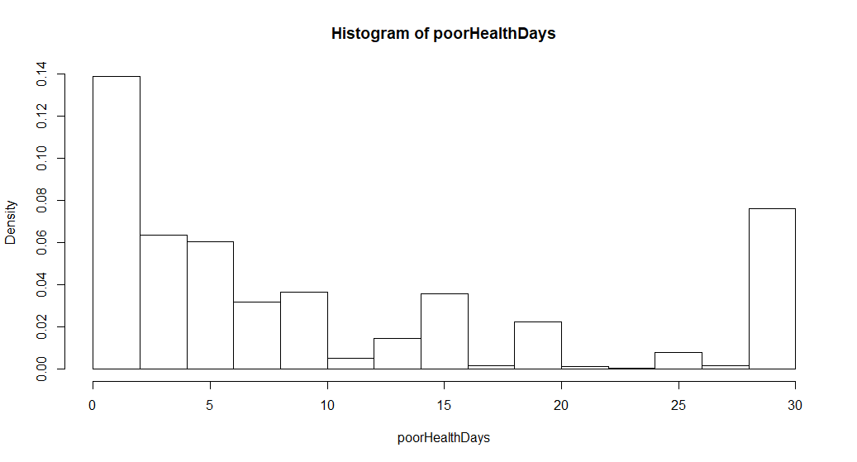
Histograms
svyhist(~poorHealthDays, design = bd, breaks = seq(0,30,2))

Slide 45
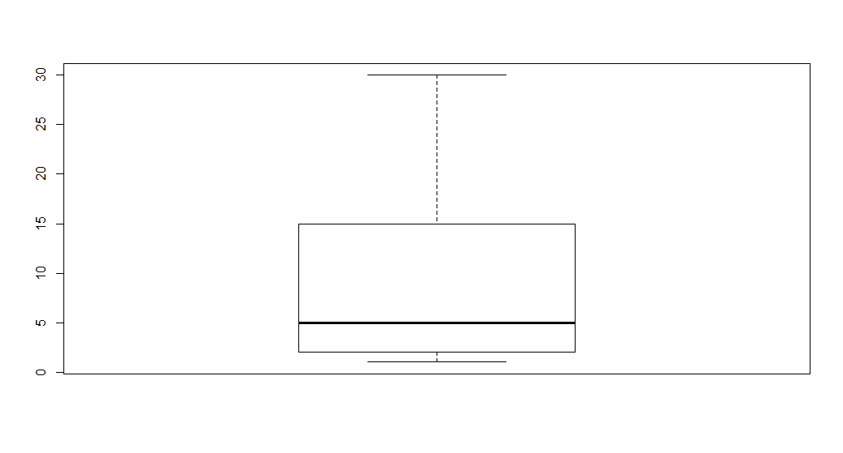
Boxplots (univariate)
svyboxplot(poorHealthDays~1, design = bd)

Slide 46
Statistics by group: means
svyby allows you to produce estimates by levels of a variable
You need to specify the function (FUN) that you want to run by group
svyby(~poorHealthDays, by = ~age, design = bd, FUN = svymean, na.rm = TRUE)
age poorHealthDays se
Age 18 to 24 Age 18 to 24 6.351816 0.4896909
Ages 25 to 29 Ages 25 to 29 8.119721 0.8744103
Ages 30 to 34 Ages 30 to 34 8.395120 0.6953921
Ages 35 to 39 Ages 35 to 39 9.339076 0.7051641
Ages 40 to 44 Ages 40 to 44 10.241933 0.7957237
Ages 45 to 49 Ages 45 to 49 9.997704 0.7413120
Ages 50 to 54 Ages 50 to 54 11.941591 0.7758719
Ages 55 to 59 Ages 55 to 59 12.873278 0.8052780
Ages 60 to 64 Ages 60 to 64 12.805824 0.6739353
Ages 65 to 69 Ages 65 to 69 12.806653 0.8137256
Ages 70 to 74 Ages 70 to 74 13.304276 0.8226426
Ages 75 to 79 Ages 75 to 79 15.174291 1.0261939
Age 80 or older Age 80 or older 16.260106 1.2566394

Slide 47
Statistics by group: totals
Change function option to FUN = svytotal
svyby(~poorHealthDays, by = ~age, design = bd, FUN = svytotal, na.rm = TRUE)
age poorHealthDays se
Age 18 to 24 Age 18 to 24 1384133.3 146713.60
Ages 25 to 29 Ages 25 to 29 1028939.0 151877.45
Ages 30 to 34 Ages 30 to 34 1406611.5 161815.76
Ages 35 to 39 Ages 35 to 39 1237281.8 134618.20
Ages 40 to 44 Ages 40 to 44 1360987.8 148190.83
Ages 45 to 49 Ages 45 to 49 1026347.5 108092.02
Ages 50 to 54 Ages 50 to 54 1587368.8 155030.51
Ages 55 to 59 Ages 55 to 59 1711107.0 166627.48
Ages 60 to 64 Ages 60 to 64 1600942.9 138179.39
Ages 65 to 69 Ages 65 to 69 1139921.4 112413.01
Ages 70 to 74 Ages 70 to 74 874007.7 82395.42
Ages 75 to 79 Ages 75 to 79 601055.3 73478.61
Age 80 or older Age 80 or older 785588.9 110460.57

Slide 48
Statistics by group: percentiles
Change function option to FUN = svyquantile
svyby(~poorHealthDays, by = ~age, design = bd, FUN = svyquantile, na.rm = TRUE, quantiles=c(0.25, 0.5, 0.75), keep.var = FALSE)
age statistic1 statistic2 statistic3
Age 18 to 24 Age 18 to 24 2 3 8
Ages 25 to 29 Ages 25 to 29 2 5 12
Ages 30 to 34 Ages 30 to 34 2 5 10
Ages 35 to 39 Ages 35 to 39 2 5 14
Ages 40 to 44 Ages 40 to 44 2 5 15
Ages 45 to 49 Ages 45 to 49 2 5 15
Ages 50 to 54 Ages 50 to 54 3 7 20
Ages 55 to 59 Ages 55 to 59 2 10 25
Ages 60 to 64 Ages 60 to 64 3 10 20
Ages 65 to 69 Ages 65 to 69 3 9 20
Ages 70 to 74 Ages 70 to 74 4 10 25
Ages 75 to 79 Ages 75 to 79 4 14 30
Age 80 or older Age 80 or older 4 15 30

Slide 49
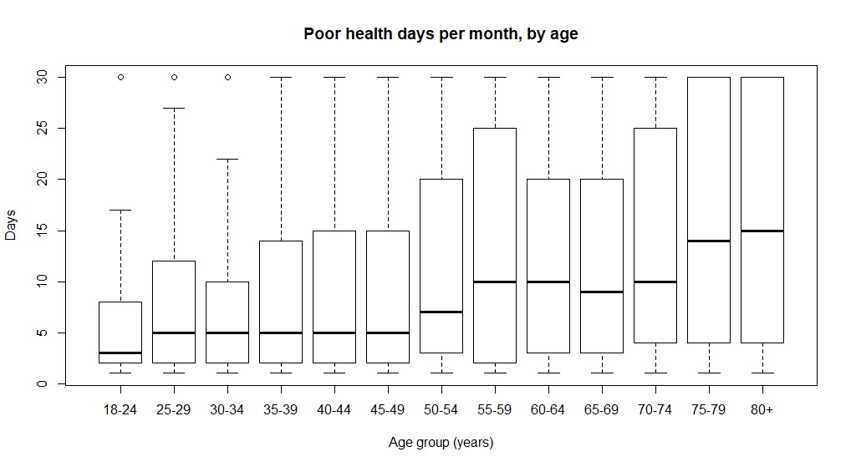
Boxplots by group
svyboxplot(poorHealthDays~age, design = bd,
xlab = "Age group (years)", ylab = "Days",
main = "Poor health days per month, by age",
names = c("18-24", "25-29", "30-34", "35-39", "40-44", "45-49", "50-54",
"55-59", "60-64", "65-69", "70-74", "75-79", "80+"), cex.names=0.8)

Slide 50
t-tests
svyby(~poorHealthDays, by = ~age65, design = bd, FUN = svymean, na.rm = TRUE)
age65 poorHealthDays se
Yes Yes 14.015594 0.4876765
No No 9.711253 0.2467334
svyttest(poorHealthDays ~ age65, design = bd, na.rm = TRUE)
Design-based t-test
data: poorHealthDays ~ age65
t = -7.8723, df = 3298, p-value = 4.684e-15
alternative hypothesis: true difference in mean is not equal to 0
95 percent confidence interval:
-5.375989 -3.232695
sample estimates:
difference in mean
-4.304342

Slide 51
Subsetting the data
Because data are within survey design object, we can’t use typical indexing notation to subset our data
survey package provides subset function that can be combined with other survey functions
svytotal(~poorHealthDays, subset(bd, sex=="Male"), na.rm = TRUE)
total SE
poorHealthDays 6751819 309285
svytotal(~poorHealthDays, subset(bd, sex=="Male" & age65=="Yes"), na.rm = TRUE)
total SE
poorHealthDays 1534034 137578

Slide 52
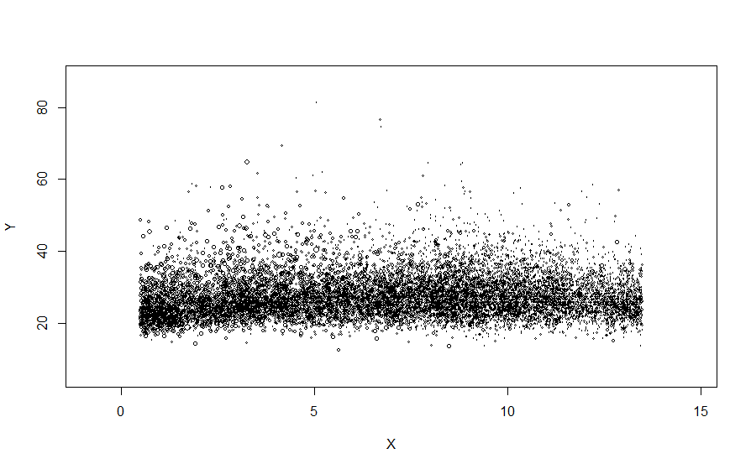
Survey-weighted scatter plots
Since each data point represents a different number of people, we want to be able to give each point the appropriate visual weight
svyplot offers several options to do so
svyplot(bmi ~ jitter(as.numeric(age), amount = .5), design = bd)

Slide 53
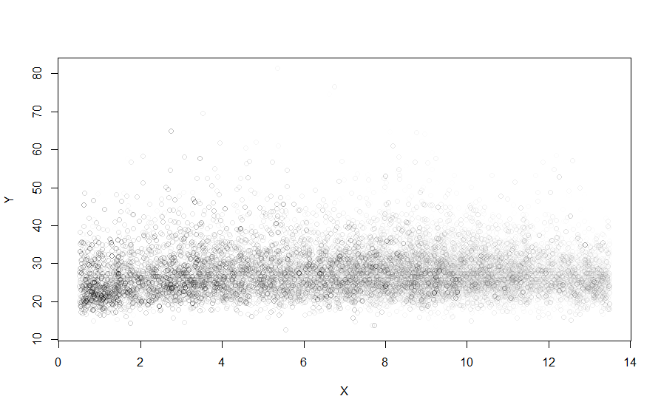
Survey-weighted scatter plots
Since each data point represents a different number of people, we want to be able to give each point the appropriate visual weight
svyplot offers several options to do so
svyplot(bmi ~ jitter(as.numeric(age), amount = .5), design = bd, style = "transparent")

Slide 54
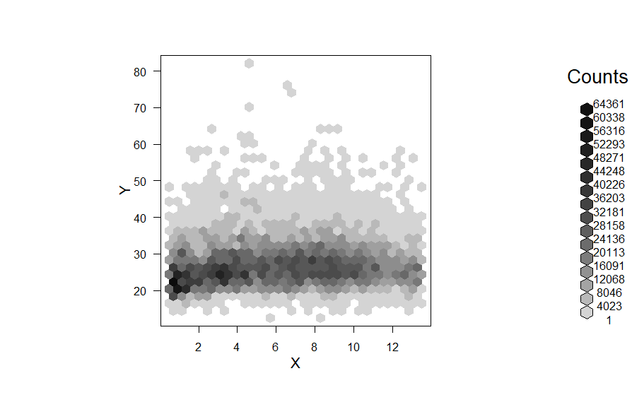
Survey-weighted scatter plots
Since each data point represents a different number of people, we want to be able to give each point the appropriate visual weight
svyplot offers several options to do so
svyplot(bmi ~ jitter(as.numeric(age), amount = .5), design = bd, style = "grayhex")
Note: requires the hexbin package

Slide 55
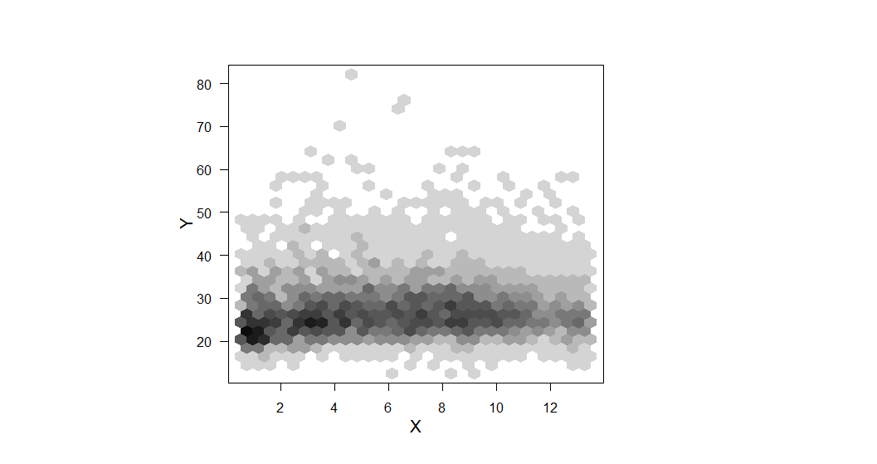
Survey-weighted scatter plots
Since each data point represents a different number of people, we want to be able to give each point the appropriate visual weight
svyplot offers several options to do so
svyplot(bmi ~ jitter(as.numeric(age), amount = .5), design = bd, style = "grayhex“, legend = FALSE)
Note: requires the hexbin package

Slide 56
Survey-weighted linear regression
svyglm function works very much like standard glm
Specify design instead of data
linMod <- svyglm(poorHealthDays ~ age, design = bd)
cbind(coef(linMod), confint(linMod))
2.5 % 97.5 %
(Intercept) 6.351816 5.3920396 7.311593
ageAges 25 to 29 1.767905 -0.1964024 3.732212
ageAges 30 to 34 2.043304 0.3760405 3.710568
ageAges 35 to 39 2.987260 1.3041029 4.670417
ageAges 40 to 44 3.890117 2.0589165 5.721317
ageAges 45 to 49 3.645888 1.9042586 5.387518
ageAges 50 to 54 5.589775 3.7918640 7.387687
ageAges 55 to 59 6.521462 4.6742180 8.368706
ageAges 60 to 64 6.454008 4.8198548 8.088161
ageAges 65 to 69 6.454837 4.5937189 8.315954
ageAges 70 to 74 6.952460 5.0758085 8.829111
ageAges 75 to 79 8.822475 6.5929845 11.051966
ageAge 80 or older 9.908290 7.2640482 12.552532

Slide 57
Survey-weighted logistic regression
svyglm function works very much like standard glm
Specify design instead of data
logitMod <- svyglm(highChol01 ~ age, family=quasibinomial(link = "logit"), design = bd)
exp(cbind(coef(logitMod), confint(logitMod)))
2.5 % 97.5 %
(Intercept) 0.09238231 0.05748638 0.1484611
ageAges 25 to 29 1.18934773 0.64491651 2.1933816
ageAges 30 to 34 1.63180816 0.93811113 2.8384674
ageAges 35 to 39 2.36770276 1.39295187 4.0245585
ageAges 40 to 44 3.53682248 2.10947849 5.9299553
ageAges 45 to 49 4.68612067 2.80360487 7.8326754
ageAges 50 to 54 5.99193987 3.62711175 9.8986042
ageAges 55 to 59 7.37850261 4.49139505 12.1214679
ageAges 60 to 64 9.55826560 5.83706810 15.6517690
ageAges 65 to 69 9.75379846 5.95353316 15.9798529
ageAges 70 to 74 14.10667299 8.58834900 23.1707192
ageAges 75 to 79 12.50441443 7.53052258 20.7635497
ageAge 80 or older 8.77119038 5.30209749 14.5100653

Slide 58
Survey analysis background
Prepping BRFSS data
Survey analysis functions
X
X
X

