Slide 1
Epi 510: Introduction to R II
Fall 2022
Jeff Stanaway, MPH PhD

Slide 2
Data structures
Summary statistics & frequency tables
Basic data creation and modification
Reading & exploring the data
Getting started
Missing values and data types
Getting help
X

Slide 3
Basic data types in R
Computers can store data in different ways, as numbers, character strings and other options.
Pay attention to data types because this often determines which R functions will work with a certain data element.
To access documentation for data types in R, you can use the ? operator (e.g. ?numeric).

Slide 4
Numeric data
Numbers are stored in R as numeric. Within this, numeric variables can be of the types: integer or double
The two types of numerics differ in their precision.
integer: stores whole number without a decimal
double: stores numeric value with up to 16 decimal places
In addition to missing, numeric variables have two additional special values they can assume as a result of arithmetic operations.
impossible values are stored as NaN (Not a Number)
infinite values are stored as Inf (Infinite)

Slide 5
Character data
Sequences of alphanumeric characters, often called strings, are stored as type character. These are denoted by quotes in R code.
print("a")
## [1] "a"
If quotes are absent, R will assume you are referencing an object.
print(a)
## Error in print(a): object 'a' not found

Slide 6
Logical data
Binary (0/1) variables are often stored as type logical. Logicals take the values TRUE or FALSE.
If you have a numeric variable that is coded 0/1, you can easily convert this into a logical using the as.logical() function.
as.logical(c(0, 1, 0, 0))
## [1] FALSE TRUE FALSE FALSE

Slide 7
Factor data
Data with multiple category levels can be stored as type factor. Factors are integer values with associated character labels (called levels). You don’t need to deal with the integer values, just view and manipulate the labels.
You can convert a numeric variable to a factor using the factor() function.
sex
[1] 1 1 2
factor(sex, levels = c(1, 2), labels = c("Female", "Male"))
[1] Female Female Male
Levels: Female Male

Slide 8
Determining the data type
To find out what the type of data element is, use typeof().
typeof(5.576)
## [1] "double"
typeof("Hello!")
## [1] "character"
To test if the data type is what you think it is, use the is. family of functions.
is.numeric(5)
## [1] TRUE
is.integer(5.0)
## [1] FALSE
is.character("Isn't coding fun?")
## [1] TRUE

Slide 9
Coercion
Convert between types using as. family of functions

Slide 10
Missing values
Missing values in R are stored as NA (Not available).
To check whether a value is missing, use the function is.na().
is.na(x)
## [1]TRUE
x==NA
## [1] NA

Slide 11
Data structures
Summary statistics & frequency tables
Basic data creation and modification
Reading & exploring the data
Getting started
Missing values and data types
Getting help
X
X

Slide 12
Objects
Objects are how we store information (e.g. data, functions) in R
They have three components:
Name
Value
Properties (class, dimension, etc.)

Slide 13
Assignment operator
We create objects using an assignment operator (either <- or =) to assign contents to a name
x <- 1
x
## [1] 1

Slide 14
Object names
Rules:
Start with letter (a-z, A-Z)
Other characters may be letters (a-z, A-Z), digits (0-9), underscores(_), and periods(.)
Common conventions:
snake_case_with_underscores
periods.instead*
camelCase
*Very common in R, uncommon in most languages, disallowed in many languages (e.g. Stata & SAS)

Slide 15
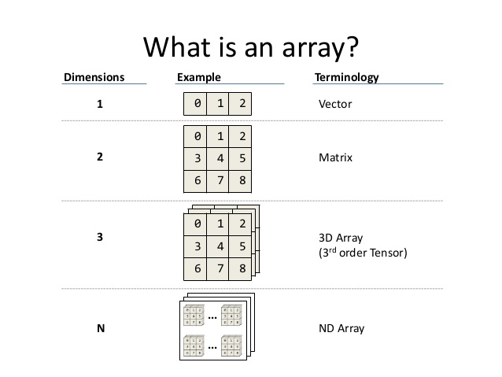
Vectors, matrices, and arrays
A vector is an ordered collection of values that are of the same basic type (e.g. integer).
Image Source: https://www.slideshare.net/mikeranderson/2013-1114-enter-thematrix/10

Slide 16
Creating vectors
Can be created manually using the combine function c():

Slide 17
Creating vectors
Numeric sequences with seq() or :
Repeat elements of vector with rep()

Slide 18
Vectors, matrices, and arrays
A matrix is essentially a two-dimensional vector of values that are of the same basic type (e.g. integer).
They are usually created by assigning dimensions to a vector:
Image Source: https://www.slideshare.net/mikeranderson/2013-1114-enter-thematrix/10

Slide 19
Vectors, matrices, and arrays
An array is essentially an n-dimensional vector of values that are of the same basic type (e.g. integer).
No further discussion of arrays in this course
Image Source: https://www.slideshare.net/mikeranderson/2013-1114-enter-thematrix/10

Slide 20
Vectors, matrices, and arrays require all contents to be of a single type
Therefore don't work well for general dataset storage, in which we typically store a mix of data types (e.g. numeric and character)

Slide 21
Data frames
A data frame stores data in spreadsheet-like form (analogous to a dataset in Stata).
They consist of columns (variables) and rows (observations), where each column contains only one data type and each row can contain many data types.
class(vipcls)
## [1] "data.frame"

Slide 22
Data frames
A data frame can be constructed by combining vectors

Slide 23
Lists
A list stores a collection of other data structures (e.g., matrices, vectors, data frames, etc.)
They are most often created by functions as a way to return a collection of outputs.
For now, just know they exist – we’ll return to these in a few weeks

Slide 24
Checking the class of an R object
R offers a LOT of flexibility in objects compared to Stata (and SAS). This flexibility can be very helpful BUT it can also cause issues!
If your code is not working as you expect, try checking what kind of object you’re working with (called the object class) or printing the object to see what it contains.
class(mydf)
## [1] "data.frame"
class(myvec)
## [1] "numeric" myvec
## [1] 1 1 1 1

Slide 25
Data structures
Summary statistics & frequency tables
Basic data creation and modification
Reading & exploring the data
Getting started
Missing values and data types
Getting help
X
X
X

Slide 26
Clearing the workspace
Sometimes you want to clear everything first
Can be important to prevent old definitions getting confused
This command removes all user generated functions and objects
rm(list=ls())

Slide 27
Reading in data: csv files
.csv files contain tabular data that are usually loaded as a data frame with the read.csv() function:
vipcls <- read.csv("C:/epi510/r/vipcls.csv")
By default, read.csv() converts anything that’s not obviously a numeric or logical to a factor. Often, we want these variables to be characters instead, so to change this behavior, set the stringsAsFactors option to FALSE:
vipcls <- read.csv("C:/epi510/r/vipcls.csv", stringsAsFactors = FALSE)

Slide 28
File paths
Must use forward slashes:
Right | → | "C:/path/to/your/directory/"
Wrong | → | "C:\path\to\your\directory\"
Can be either absolute:
or relative to the current directory
vipcls <- read.csv("C:/epi510/r/data/vipcls.csv")
setwd("C:/epi510/r/data")
vipcls <- read.csv("vipcls.csv")

Slide 29
Reading in data: tips
Know if the first row has a header row with variable names
Files created by other programs may have variable names that are not compatible with R (e.g. spaces in column headers from Excel)
Know if the file has comments or other garbage (do you need to skip rows to get to the actual data?)
Know how missing data are coded and replace with NAs

Slide 30
Read in vipcls.csv
rm(list=ls())
setwd("C:/epi510/r/data")
vipcls <- read.csv("vipcls.csv")

Slide 31
Determine the resulting object class
class(vipcls)
## [1] "data.frame"

Slide 32
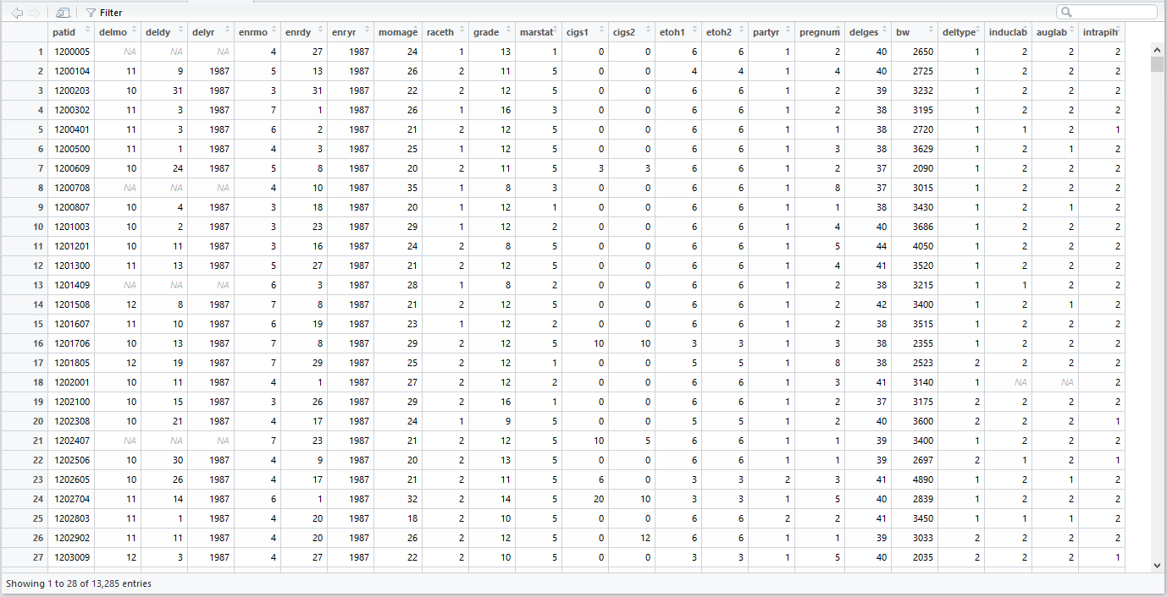
Viewing the data
Similar to Stata, RStudio has a data viewer.
View(vipcls)
[Demo]

Slide 33
Viewing the data
Another way to get a look at the data is using the function head(). By default, this functions prints the first 6 rows of the data frame. Optional argument, n, allows you to specify the number of rows to print. Function tail() prints the last n rows of the data frame in the same way.
head(vipcls, n=2)
patid delmo deldy delyr enrmo enrdy enryr momage raceth grade marstat cigs
1 1200005 -1 -1 -1 4 27 1987 24 1 13 1 0
2 1200104 11 9 1987 5 13 1987 26 2 11 5 0
cigs2 etoh1 etoh2 partyr pregnum delges bw deltype induclab auglab intrapih
0 6 6 1 2 40 2650 1 FALSE 2 2
0 4 4 1 4 40 2725 1 FALSE 2 2

Slide 34
Exercise
Use tail() to prints the last 5 rows of vipcls.

Slide 35
Data frame information
A number of useful functions can give you information about the data frame’s contents and structure.
> dim(vipcls) # gives the number of rows & columns
[1] 13285 23
> nrow(vipcls) # gives the number of rows
[1] 13285
> ncol(vipcls) # gives the number of columns
[1] 23

Slide 36
Data frame information
A number of useful functions can give you information about the data frame’s contents and structure.
> names(vipcls) # lists the variable names
[1] "patid" "delmo" "deldy" "delyr" "enrmo" "enrdy"
[7] "enryr" "momage" "raceth" "grade" "marstat" "cigs1"
[13] "cigs2" "etoh1" "etoh2" "partyr" "pregnum" "delges"
[19] "bw" "deltype" "induclab" "auglab" "intrapih"

Slide 37
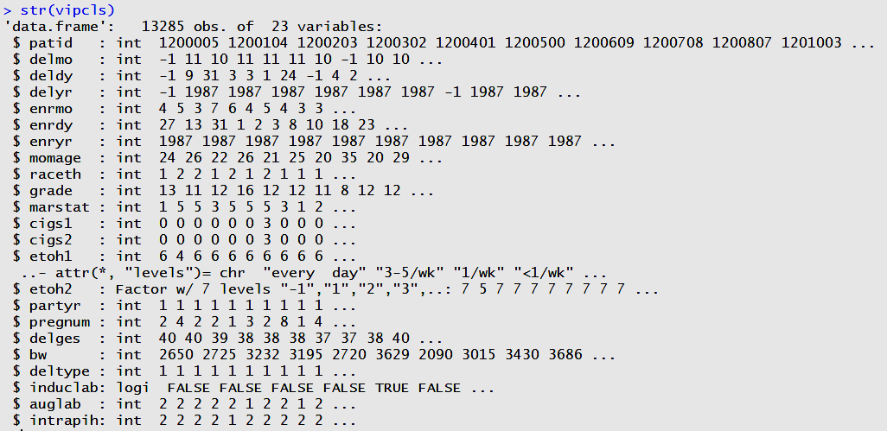
Data frame information
The str() function summarizes the structure of the object, giving the class, dimensions, variable names, data types and a data preview.

Slide 38
Data structures
Summary statistics & frequency tables
Basic data creation and modification
Reading & exploring the data
Getting started
Missing values and data types
Getting help
X
X
X
X

Slide 39
Summary statistics
R has many functions for calculating summary statistics:
Other useful commands: var(), median(), min(), max(), range(), sum(), table()
> mean(vipcls$momage)
[1] 24.31298
> sd(vipcls$momage)
[1] 5.536978
> quantile(vipcls$momage, c(0, 0.1, 0.25, 0.5, 0.75, 0.9, 1))
0% 10% 25% 50% 75% 90% 100% -1 18 20 23 28 32 46

Slide 40
Summary statistics
Let's deal with missing values
> vipcls[vipcls==-1] <- NA
> mean(vipcls$momage)
[1] NA
> sd(vipcls$momage)
[1] NA
> quantile(vipcls$momage, c(0, 0.1, 0.25, 0.5, 0.75, 0.9, 1))
Error in quantile.default(vipcls$momage[vipcls$pregnum == 1], c(0, 0.1, : missing values and NaN's not allowed if 'na.rm' is FALSE

Slide 41
Summary statistics
The default for most R functions is to retain missing values.
We need to override this default to get sensible results
> mean(vipcls$momage, na.rm = TRUE)
[1] 24.32061
> sd(vipcls$momage, na.rm = TRUE)
[1] 5.520354
> quantile(vipcls$momage, c(0, 0.1, 0.25, 0.5, 0.75, 0.9, 1) , na.rm = TRUE)
0% 10% 25% 50% 75% 90% 100% 15 18 20 23 28 32 46

Slide 42
Exercise
Find the mean and standard deviation of birthweight

Slide 43
Summary statistics
The summary() function is analogous to command summarize in Stata.
summary(vipcls)
Output includes the number of NAs, basic summary statistics for numeric variables, and frequency in each level for factors/logicals.

Slide 44
Summary() output
> summary(vipcls)
patid delmo deldy delyr enrmo
Min. :1200005 Min. : 1.000 Min. : 1.00 Min. :1984 Min. : 1.000
1st Qu.:5269709 1st Qu.: 3.000 1st Qu.: 8.00 1st Qu.:1986 1st Qu.: 3.000
Median :7076300 Median : 6.000 Median :16.00 Median :1987 Median : 7.000
Mean :6380925 Mean : 6.458 Mean :15.67 Mean :1987 Mean : 6.452
3rd Qu.:7578503 3rd Qu.: 9.000 3rd Qu.:23.00 3rd Qu.:1988 3rd Qu.: 9.000
Max. :9500406 Max. :12.000 Max. :31.00 Max. :1989 Max. :12.000
NA's :610 NA's :610 NA's :610 NA's :20
enrdy enryr momage raceth grade
Min. : 1.00 Min. :1984 Min. :15.00 Min. :0.000 Min. : 0.00
1st Qu.: 8.00 1st Qu.:1985 1st Qu.:20.00 1st Qu.:0.000 1st Qu.:10.00
Median :15.00 Median :1986 Median :23.00 Median :1.000 Median :12.00
Mean :15.51 Mean :1986 Mean :24.32 Mean :1.062 Mean :11.52
3rd Qu.:23.00 3rd Qu.:1987 3rd Qu.:28.00 3rd Qu.:2.000 3rd Qu.:12.00
Max. :31.00 Max. :1989 Max. :46.00 Max. :2.000 Max. :27.00
NA's :20 NA's :20 NA's :4 NA's :30
marstat cigs1 cigs2 etoh1 etoh2
Min. :1.000 Min. : 0 Min. : 0.00 Min. :1.00 Min. :1.000
1st Qu.:1.000 1st Qu.: 0 1st Qu.: 0.00 1st Qu.:6.00 1st Qu.:6.000
Median :2.000 Median : 0 Median : 0.00 Median :6.00 Median :6.000
Mean :2.883 Mean : 4 Mean : 3.07 Mean :5.57 Mean :5.674
3rd Qu.:5.000 3rd Qu.: 3 3rd Qu.: 2.00 3rd Qu.:6.00 3rd Qu.:6.000
Max. :5.000 Max. :92 Max. :70.00 Max. :6.00 Max. :6.000
NA's :12 NA's :1 NA's :1 NA's :2 NA's :3
partyr pregnum delges bw deltype
Min. : 0.00 Min. : 1.000 Min. :23.00 Min. : 143 Min. :1.000
1st Qu.: 1.00 1st Qu.: 1.000 1st Qu.:38.00 1st Qu.:2956 1st Qu.:1.000
Median : 1.00 Median : 2.000 Median :39.00 Median :3295 Median :1.000
Mean : 1.26 Mean : 2.642 Mean :39.07 Mean :3268 Mean :1.208
3rd Qu.: 1.00 3rd Qu.: 3.000 3rd Qu.:41.00 3rd Qu.:3630 3rd Qu.:1.000
Max. :200.00 Max. :16.000 Max. :70.00 Max. :6549 Max. :2.000
NA's :223 NA's :473 NA's :649
induclab auglab intrapih
Min. :1.000 Min. :1.000 Min. :1.000
1st Qu.:2.000 1st Qu.:1.000 1st Qu.:2.000
Median :2.000 Median :2.000 Median :2.000
Mean :1.909 Mean :1.649 Mean :1.929
3rd Qu.:2.000 3rd Qu.:2.000 3rd Qu.:2.000
Max. :2.000 Max. :2.000 Max. :2.000
NA's :465 NA's :462 NA's :338

Slide 45
Summary() output
> summary(vipcls$momage)
Min. 1st Qu. Median Mean 3rd Qu. Max. NA's 15.00 20.00 23.00 24.32 28.00 46.00 4

Slide 46
Exercise
Summarize birthweight

Slide 47
Frequency tables
To create a one-way or two-way freqency table, use the table() function. Use optional argument, deparse.level=2, to print the variable names with the table.

Slide 48
Frequency tables
Note that NAs are excluded from the table. Another optional argument, useNA=“ifany” or useNA=“always”, will include NAs in the table.

Slide 49
Proportion tables
Unfortunately, the table() function does not offer options for calculating proportions. For this, we can use prop.table(). By default, cell proportions are produced.

Slide 50
Proportion tables
If you would prefer to see percentages, you can accomplish this by multiplying the table by 100.

Slide 51
Proportion tables
To get row percentages, use margin=1.
prop.table(tableA, margin=1)*100 #row percents
##
## FALSE TRUE
## white 87.3 12.7
## hispanic 88.7 11.3
## black 87.4 12.6

Slide 52
Proportion tables
To get column percentages, use margin=2.
prop.table(tableA, margin=2)*100 #column percents
##
## FALSE TRUE
## white 31.6 33.0
## hispanic 30.6 28.1
## black 37.8 39.0

Slide 53
Data structures
Summary statistics & frequency tables
Basic data creation and modification
Reading & exploring the data
Getting started
Missing values and data types
Getting help
X
X
X
X
X

Slide 54
Indexing
An index is direction to R to only use specific elements of an object. Indexing is the primary way to create a subset in base R.
vipcls$momage[1:10]
## [1] 24 26 22 26 21 25 20 35 20 29
vipcls$momage[3:7]
## [1] 22 26 21 25 20

Slide 55
Indexing
We can also provide R with an index for a data frame. We need to tell R both which rows and which columns we are interested in. Note that the row index comes before the comma and the column index comes after the comma.
vipcls[1, 9:16]
## raceth grade marstat cigs1 cigs2 etoh1 etoh2 partyr
## 1 1 13 1 0 0 6 6 1

Slide 56
Indexing
We can also ask for all of one dimension, for example, all columns for a partcular row. We do this by leaving the column specification blank.
vipcls[1, ]
## patid delmo deldy delyr enrmo enrdy enryr momage raceth grade marstat
## 1 1200005 -1 -1 -1 4 27 1987 24 1 13 1
## cigs1 cigs2 etoh1 etoh2 partyr pregnum delges bw deltype induclab
## 1 0 0 6 6 1 2 40 2650 1 2
## auglab intrapih
## 1 2 2
Alternately, we could specify all rows of a column leaving the row specification blank.
vipcls[ , 8]
## [1] 24 26 22 26 21 25 20 35 20 29 24 21 28 21 23 29 25 27 29 24
## [ reached getOption("max.print") -- omitted 13265 entries ]

Slide 57
Conditional subsetting
We’ll now look at how to use indexing to create conditional subsets. Ultimately, we can use this way of indexing to subset data based on one or more conditions. Subsets can be assigned to a new object. . .
vipcls2 <- vipcls[vipcls$raceth=="hispanic",]
or conditionally recoded
vipcls$momage[vipcls$momage==15] <- NA

Slide 58
Conditional subsetting
Summary stats for maternal age among first-time mothers?
> mean(vipcls$momage[vipcls$pregnum==1], na.rm = TRUE)
[1] 20.81749
> sd(vipcls$momage[vipcls$pregnum==1], na.rm = TRUE)
[1] 4.027764
> quantile(vipcls$momage[vipcls$pregnum==1], c(0, 0.1, 0.25, 0.5, 0.75, 0.9, 1) , na.rm = TRUE)
0% 10% 25% 50% 75% 90% 100% 15 17 18 20 23 26 46

Slide 59
Exercise
What are the values of patid in rows 5 through 10?

Slide 60
Logical expressions
Logical expressions are code segments that instruct R to check whether a statement is true and return a logical value (TRUE or FALSE). Like Stata, testing equality in R is done with the special operator, ==, as follows.
vipcls$patid[1]==1200005
## [1] TRUE
Other logical operators are:
>, >=, <, <=, !, &, |

Slide 61
Creating columns
Create new columns using assignment operator:
> vipcls$bwLbs <- vipcls$bw / 453.592
> vipcls$index <- 1:nrow(vipcls)
> head(vipcls, n=10)
patid delmo deldy delyr enrmo enrdy enryr momage raceth grade marstat cigs1 cigs2 etoh1 etoh2 partyr pregnum delges bw deltype induclab auglab intrapih bwLbs index
1 1200005 NA NA NA 4 27 1987 24 1 13 1 0 0 6 6 1 2 40 2650 1 2 2 2 5.842255 1
2 1200104 11 9 1987 5 13 1987 26 2 11 5 0 0 4 4 1 4 40 2725 1 2 2 2 6.007602 2
3 1200203 10 31 1987 3 31 1987 22 2 12 5 0 0 6 6 1 2 39 3232 1 2 2 2 7.125346 3
4 1200302 11 3 1987 7 1 1987 26 1 16 3 0 0 6 6 1 2 38 3195 1 2 2 2 7.043775 4
5 1200401 11 3 1987 6 2 1987 21 2 12 5 0 0 6 6 1 1 38 2720 1 1 2 1 5.996578 5
6 1200500 11 1 1987 4 3 1987 25 1 12 5 0 0 6 6 1 3 38 3629 1 2 1 2 8.000582 6
7 1200609 10 24 1987 5 8 1987 20 2 11 5 3 3 6 6 1 2 37 2090 1 2 2 2 4.607665 7
8 1200708 NA NA NA 4 10 1987 35 1 8 3 0 0 6 6 1 8 37 3015 1 2 2 2 6.646943 8
9 1200807 10 4 1987 3 18 1987 20 1 12 1 0 0 6 6 1 1 38 3430 1 2 1 2 7.561862 9
10 1201003 10 2 1987 3 23 1987 29 1 12 2 0 0 6 6 1 4 40 3686 1 2 2 2 8.126246 10

Slide 62
Modifying columns
Similarly, modify columns using assignment operator:
> summary(vipcls$delges)
Min. 1st Qu. Median Mean 3rd Qu. Max.
23.00 38.00 39.00 39.07 41.00 70.00
> vipcls$delges[vipcls$delges > 53] <- 53
> summary(vipcls$delges)
Min. 1st Qu. Median Mean 3rd Qu. Max.
23.00 38.00 39.00 39.07 41.00 53.00

Slide 63
Modifying columns: missing values
Replace values that correspond to missing with NAs
> summary(vipcls$delmo)
Min. 1st Qu. Median Mean 3rd Qu. Max.
-1.000 3.000 6.000 6.116 9.000 12.000
> vipcls$delmo[vipcls$delmo==-1] <- NA
> summary(vipcls$delmo)
Min. 1st Qu. Median Mean 3rd Qu. Max. NA's
1.000 3.000 6.000 6.458 9.000 12.000 610
To recode a value across the entire dataframe, use the following syntax.
vipcls[vipcls==-1] <- NA # Works for numeric variables
vipcls[vipcls=="-1"] <- NA # Works for character or factor variables

Slide 64
Exercise
Set mother’s age (momage) of 15 or less to missing (i.e. to NA)

Slide 65
Recoding binary variables to logicals
Now we know enough to convert a binary variable found in vipcls to a more useful coding scheme.
vipcls$induclab[vipcls$induclab==2] <- 0 # change 2's to 0's
vipcls$induclab <- as.logical(vipcls$induclab) # convert to logical

Slide 66
Putting things together to recode factors in vipcls
We can also recode multi-level categorical variables, like etoh2, to be more intuitive and useful for our subsequent analyses.
vipcls$etoh2 <- factor(vipcls$etoh2,
levels = 1:6,
labels=c("every day", "3-5/wk", "1/wk","<1/wk", "<1/month", "never")) # convert to factor
levels(vipcls$etoh2) # check levels
## [1] "every day" "3-5/wk" "1/wk" "<1/wk" "<1/month" "never"

Slide 67
Removing columns
You can remove a single column by assigning it to NULL:
You can alternatively code as
> names(vipcls)
[1] "patid" "delmo" "deldy" "delyr" "enrmo" "enrdy" "enryr" "momage" "raceth" "grade" "marstat" "cigs1"
[13] "cigs2" "etoh1" "etoh2" "partyr" "pregnum" "delges" "bw" "deltype" "induclab" "auglab" "intrapih"
> vipcls$patid <- NULL
> names(vipcls)
[1] "delmo" "deldy" "delyr" "enrmo" "enrdy" "enryr" "momage" "raceth" "grade" "marstat" "cigs1" "cigs2"
[13] "etoh1" "etoh2" "partyr" "pregnum" "delges" "bw" "deltype" "induclab" "auglab" "intrapih"
> vipcls[,"patid"] <- NULL
> names(vipcls)
[1] "delmo" "deldy" "delyr" "enrmo" "enrdy" "enryr" "momage" "raceth" "grade" "marstat" "cigs1" "cigs2"
[13] "etoh1" "etoh2" "partyr" "pregnum" "delges" "bw" "deltype" "induclab" "auglab" "intrapih"

Slide 68
Removing columns
This also allows us to remove multiple columns at once:
> names(vipcls)
[1] "patid" "delmo" "deldy" "delyr" "enrmo" "enrdy" "enryr" "momage" "raceth" "grade" "marstat" "cigs1"
[13] "cigs2" "etoh1" "etoh2" "partyr" "pregnum" "delges" "bw" "deltype" "induclab" "auglab" "intrapih"
> vipcls[,c("patid", "delmo", "deldy", "delyr")] <- NULL
> names(vipcls)
[1] "enrmo" "enrdy" "enryr" "momage" "raceth" "grade" "marstat" "cigs1" "cigs2" "etoh1" "etoh2"
[12] "partyr" "pregnum" "delges" "bw" "deltype" "induclab" "auglab" "intrapih"

Slide 69
Keeping columns
We can flip what we just did to keep selected columns:
> vipcls <- vipcls[, c("enrmo", "enrdy", "enryr", "momage", "raceth", "grade", "marstat")]
> names(vipcls)
[1] "enrmo" "enrdy" "enryr" "momage" "raceth" "grade" "marstat"

Slide 70
Sorting: order()
The order() function gives you the indices of a vector according to the rank
order of the values of that vector:

Slide 71
Sorting: order()
We can use this to sort rows of a data frame by index:

Slide 72
Sorting: order()
Can also be used to sort multiple variables

Slide 73
Data structures
Summary statistics & frequency tables
Basic data creation and modification
Reading & exploring the data
Getting started
Missing values and data types
Getting help
X
X
X
X
X
X

Slide 74
Built-in help files
Documentation for R functions can be accessed from R and RStudio using the ? operator (e.g. ?names).
Help Section Describes
Description Usage Arguments Details Value Examples
What the function does
Syntax for how to call the function
Options for controlling function behavior More detail on function behavior
What the function returns
Working code using the function

Slide 75
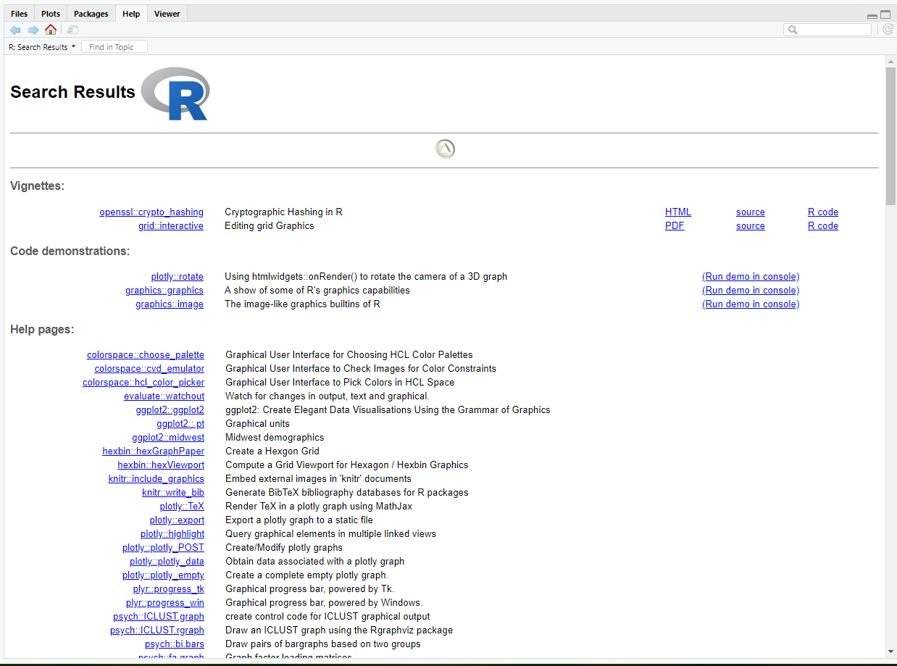
Built-in help files
Search documentation when you don't know the function name with ??
??graph

Slide 76
CRAN
Comprehensive R Archive Network (CRAN) is a network of servers around the world that store identical, up-to-date, versions of code and documentation for R.
Accessing CRAN:
Go to website and search for package.
Search the internet for package name and “CRAN”(e.g. “ggplot2 CRAN”).
https://cran.r-project.org/

Slide 77
Webpages and forums
When will help files not be helpful?
You don’t not know the name of the function that you need
Function help file is confusing or doesn’t seem to explain your problem
You’re looking for a new package
What now? Try searching the internet for:
what you are trying to do (e.g. “conditionally select rows in R”)
quote the text of an error (e.g. “Error in sum(”a“,”a“) : invalid ‘type’ (character) of argument”)

Slide 78
Webpages and forums
This will often bring you to:
R instructional pages (like Quick-R)
Programming forums such as StackExchange and StackOverflow
Important culture note: Before posting a question on these forums, read and understand the community guidelines! Posts asking for answers to homework problems are widely frowned upon and may violate academic integrity rules.

Slide 79
More information on help
More places to look for help: https://www.r-project.org/help.html
https://support.rstudio.com/hc/en-us/articles/200552336-Getting-Help-with-R https://support.rstudio.com/hc/en-us

Slide 80
Data structures
Summary statistics & frequency tables
Basic data creation and modification
Reading & exploring the data
Getting started
Missing values and data types
Getting help
X
X
X
X
X
X
X

