Slide 1
EPI 510: Introduction to R # Repeating things
Jeff Stanaway, MPH PhD

Slide 2
for loops
apply functions

Slide 3
Repeating things
Repetition is common in statistical programming
Importing and appending multiple files
Applying a similar modification to many variables
Running a similar analysis or producing a similar graph for many variables
Doing something for each level of a categorical variable

Slide 4
Repetition example
In the last class we looked at importing and appending year-specific files:
What would we do if we had to append hundreds or thousands of files?!
# Read in the data files
year1984 <- read.csv(paste0(dataDir, "vipcls1984.csv"))
year1985 <- read.csv(paste0(dataDir, "vipcls1985.csv"))
year1986 <- read.csv(paste0(dataDir, "vipcls1986.csv"))
year1987 <- read.csv(paste0(dataDir, "vipcls1987.csv"))
year1988 <- read.csv(paste0(dataDir, "vipcls1988.csv"))
year1989 <- read.csv(paste0(dataDir, "vipcls1989.csv"))
# Append them into a single data frame using rbind
yearAppend <- rbind(year1984, year1985, year1986, year1987, year1988, year1989)

Slide 5
This manual, cut & paste approach to repetition is slow and error-prone, and impractical with many repetitions

Slide 6
Abstracting repetition
# Rearrange the code above to simplify abstraction
yearAppend <- NULL
year1984 <- read.csv(paste0(dataDir, "vipcls1984.csv"))
yearAppend <- rbind(yearAppend, year1984)
year1985 <- read.csv(paste0(dataDir, "vipcls1985.csv"))
yearAppend <- rbind(yearAppend, year1985)
year1986 <- read.csv(paste0(dataDir, "vipcls1986.csv"))
yearAppend <- rbind(yearAppend, year1986)
year1987 <- read.csv(paste0(dataDir, "vipcls1987.csv"))
yearAppend <- rbind(yearAppend, year1987)
year1988 <- read.csv(paste0(dataDir, "vipcls1988.csv"))
yearAppend <- rbind(yearAppend, year1988)
year1989 <- read.csv(paste0(dataDir, "vipcls1989.csv"))
yearAppend <- rbind(yearAppend, year1989)

Slide 7
Abstracting repetition
# Let’s simplify this by nesting read.csv within the rbind
yearAppend <- NULL
yearAppend <- rbind(yearAppend, read.csv(paste0(dataDir, "vipcls1984.csv")))
yearAppend <- rbind(yearAppend, read.csv(paste0(dataDir, "vipcls1985.csv")))
yearAppend <- rbind(yearAppend, read.csv(paste0(dataDir, "vipcls1986.csv")))
yearAppend <- rbind(yearAppend, read.csv(paste0(dataDir, "vipcls1987.csv")))
yearAppend <- rbind(yearAppend, read.csv(paste0(dataDir, "vipcls1988.csv")))
yearAppend <- rbind(yearAppend, read.csv(paste0(dataDir, "vipcls1989.csv")))

Slide 8
Abstracting repetition
yearAppend <- NULL
yearAppend <- rbind(yearAppend, read.csv(paste0(dataDir, "vipcls1984.csv")))
yearAppend <- rbind(yearAppend, read.csv(paste0(dataDir, "vipcls1985.csv")))
yearAppend <- rbind(yearAppend, read.csv(paste0(dataDir, "vipcls1986.csv")))
yearAppend <- rbind(yearAppend, read.csv(paste0(dataDir, "vipcls1987.csv")))
yearAppend <- rbind(yearAppend, read.csv(paste0(dataDir, "vipcls1988.csv")))
yearAppend <- rbind(yearAppend, read.csv(paste0(dataDir, "vipcls1989.csv")))
# Read in the data files
yearAppend <- NULL # need to first create an empty object to append to
for (y in 1984:1989) {
yearAppend <- rbind(yearAppend, read.csv(paste0(dataDir, "vipcls", y, ".csv")))
}

Slide 9
Abstracting repetition
# Read in the data files
yearAppend <- NULL
for (y in 1984:1989) {
yearAppend <- rbind(yearAppend, read.csv(paste0(dataDir, "vipcls", y, ".csv")))
}
Create a sequence of numbers from 1984 to 1989
Loop over that sequence, creating an object “y” containing the current number in the above sequence
1st iteration: y = 1984
2nd iteration: y = 1985 …
n^{th} iteration: y = 1989

Slide 10
Exercise
There are five GBD Child Mortality datasets, each covering one decade:
gbdChildMortality_1970s.csv
…
gbdChildMortality_2010s.csv
Use a for loop to append these five datasets to make a single dataset comprising data from 1970 through 2010, inclusive

Slide 11
Exercise: Appending files with loops

Slide 12
for() loops
So, we've appended these files and now we want to make histograms to look at the distribution of each variable
# We could do this manually…
hist(yearAppend[,1]) # make a histogram of all rows of the 1st variable of yearAppend
hist(yearAppend[,2]) # make a histogram of all rows of the 2nd variable of yearAppend
hist(yearAppend[,3]) # make a histogram of all rows of the 3rd variable of yearAppend
…
hist(yearAppend[,n]) # etc… through to the last variable (note: n is a placeholder)
# Or, we can use a for loop…
for (x in 1:ncol(yearAppend)) {
hist(yearAppend[,x])
}

Slide 13
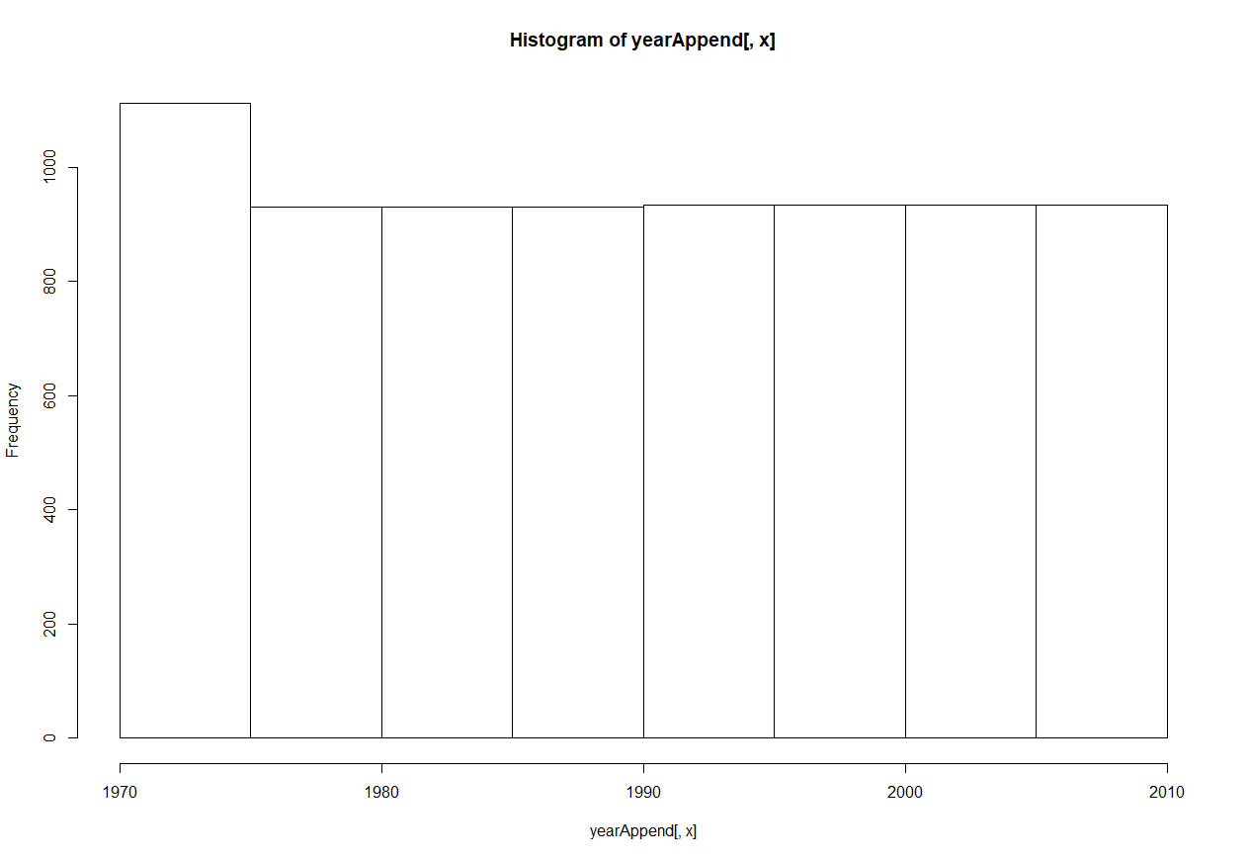
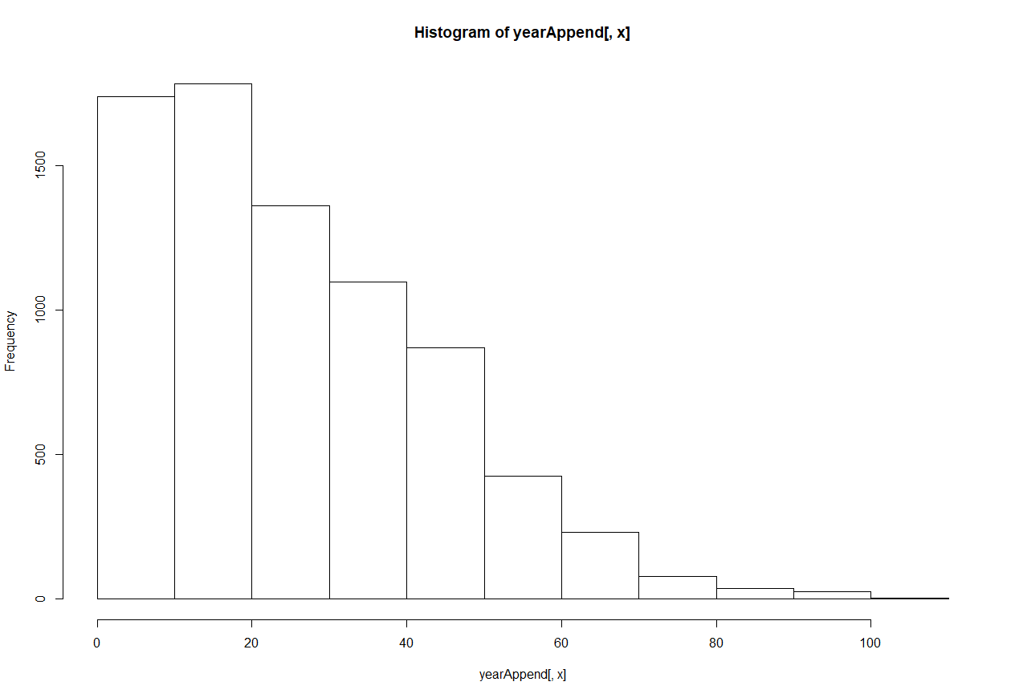
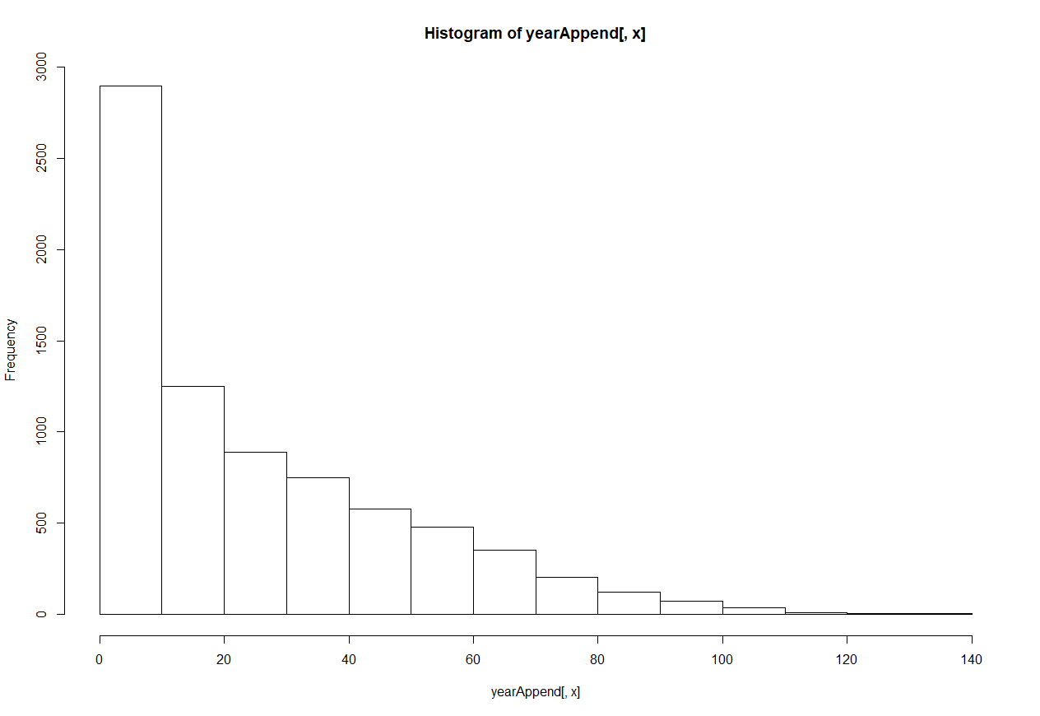
for() loops
# Or, we can use a for loop…
for (x in 1:ncol(yearAppend)) {
hist(yearAppend[,x])
}
Great, this works. But the plot titles are useless!!!

Slide 14
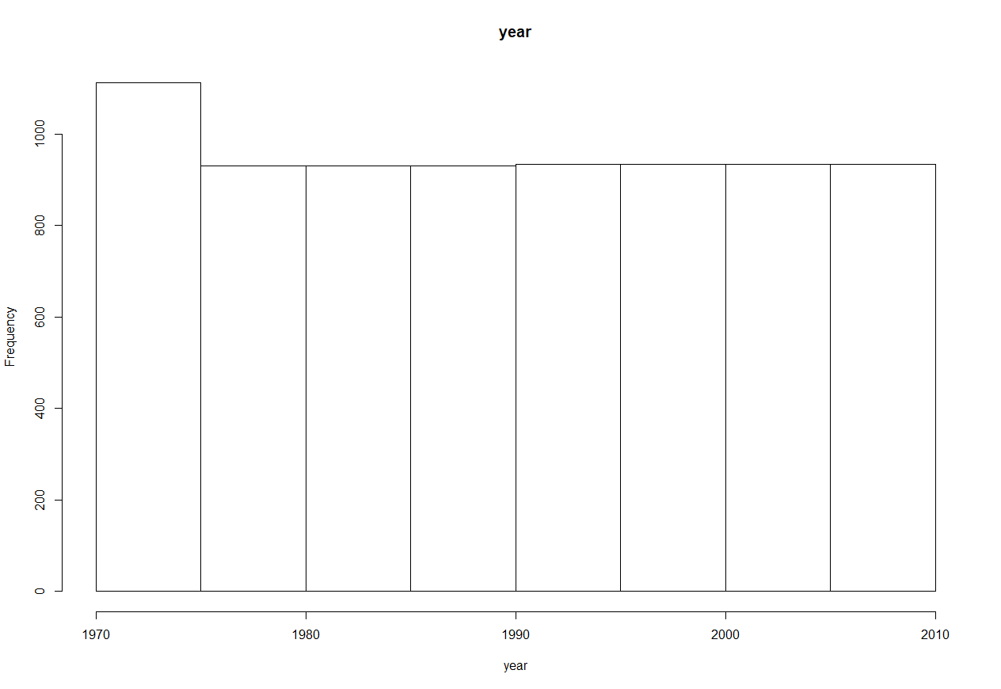
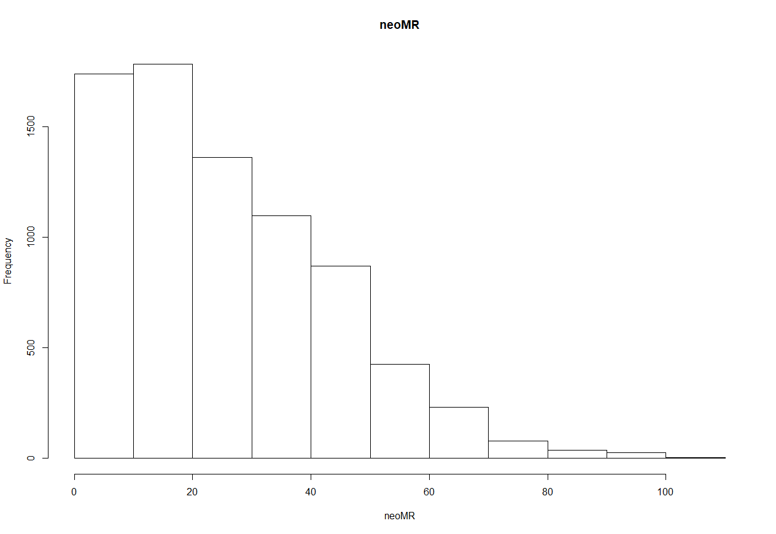
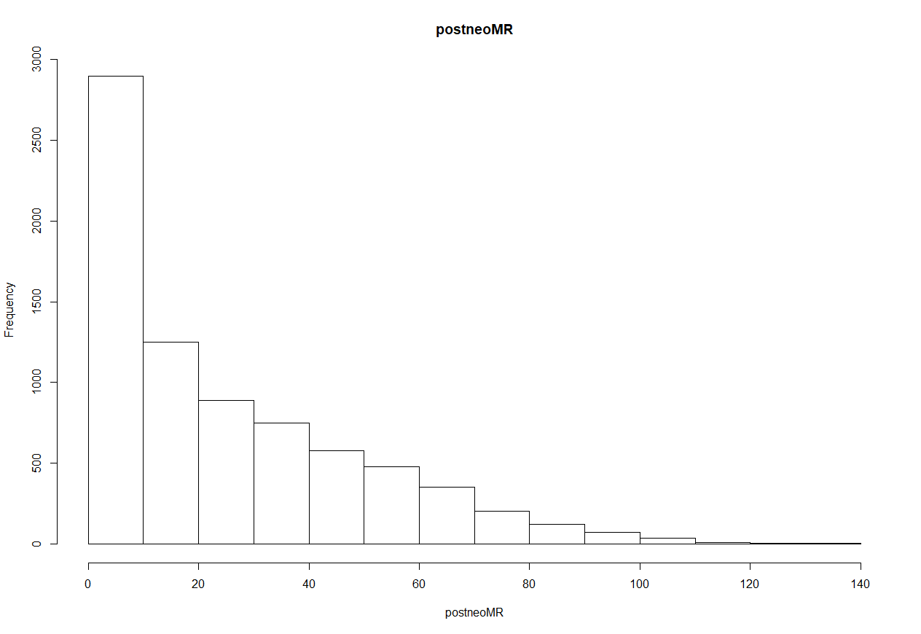
for() loops
# Let's add a main title and x-axis label based on the variable's name
for (x in names(yearAppend)) {
hist(yearAppend[,x], main = x, xlab = x)
}

Slide 15
Exercise: for() loops
Use a for() loop to loop over all numeric variables (columns 4:n)
Within the loop, find the mean of the variable
Use the mean() function with the na.rm = TRUE option
Hint: by default, this will not print anything out and will run silently. Instead, wrap the mean() function inside a print function
e.g. print(mean(x, na.rm = TRUE))

Slide 16
Exercise: for() loops

Slide 17
Exercise: for() loops

Slide 18
for loops
apply functions
X

Slide 19
apply family of functions
Collection of functions in base R that allow us to manipulate slices of data and repeat functions
The family includes apply, lapply , sapply, vapply, mapply, rapply, & tapply
Loops vs apply functions:
Most things that can be done with apply functions could also be done with loops
Most people find loops to be more intuitive
apply functions are typically more parsimonious and are sometimes dramatically faster
apply functions can be nested in ways that loops cannot

Slide 20
apply family of functions
Why are we learning this?!
Strong preference among the R community for apply functions
Some of this preference stems from performance differences (or perceived/historical performance differences)
Much of the preference is stylistic or aesthetic
You will see these functions used commonly in other people’s code and when you look for coding solutions online
Common Q/A on stack exchange:
Q. How do I make this for loop do x in R?
A. Don’t. You should be using lapply.
That’s all to say that you will encounter these functions often!

Slide 21
apply family of functions
A word on expectations…
Understand the functions conceptually
Be able to use for simple cases, with the aid of help files, web tutorials, etc.
I don’t expect detailed understanding or the ability to implement without help or the ability to implement complex cases

Slide 22
lapply
lapply = list apply
Description: “lapply returns a list of the same length as X, each element of which is the result of applying FUN to the corresponding element of X.”
Totally self-explanatory, no?

Slide 23
lapply
# Let's create some simple data
x <- data.frame(cbind(1:10, rnorm(n = 10), rpois(n=10, lambda = 5)))
# Name our variables
names(x) <- c("id", "random", "count")
# Print the data frame to see what we made
x
id random count
1 1 0.2828292 5
2 2 1.5936683 4
3 3 -0.2174204 5
4 4 -0.8538664 4
5 5 -1.0967502 6
6 6 -0.1170344 9
7 7 -1.1005583 5
8 8 1.2388612 7
9 9 0.5838598 4
10 10 0.1301664 4

Slide 24
lapply
x
id random count
1 1 0.2828292 5
2 2 1.5936683 4
3 3 -0.2174204 5
4 4 -0.8538664 4
5 5 -1.0967502 6
6 6 -0.1170344 9
7 7 -1.1005583 5
8 8 1.2388612 7
9 9 0.5838598 4
10 10 0.1301664 4
# Apply mean to each element of x
lapply(x, mean)
$id
[1] 5.5
$random
[1] 0.04437552
$count
[1] 5.3

Slide 25
lapply
# Let's save the output and see what we have
laExample <- lapply(x, mean)
str(laExample)
List of 3
$ id : num 5.5
$ random: num 0.0444
$ count : num 5.3
laExample$id
[1] 5.5
lapply always returns a list, in which each element contains the output of the function for a corresponding element of the input
e.g. each element corresponds to the output for a single variable in the input data frame
It returns a list because some functions return complex output that can't be reduced to a vector or matrix

Slide 26
lapply
Let’s use lapply to find the mean of all variables of vipcls
We can read this line of code as saying “create an object called “meanList” that contains a list that contains the results of applying the function “mean” to each element of yearAppend”
meanList <- lapply(yearAppend, mean)

Slide 27
lapply
We can inspect the structure of the results to see what happened
# Explore output
str(meanList)
List of 12
$ iso : num NA
$ country : num NA
$ gbdRegion : num NA
$ year : num 1990
$ neoMR : num 25.6
$ postneoMR : num 25.3
$ age1_5MR : num 27
$ under5MR : num 74.2
$ neoDeaths : num 24632
$ postneoDeaths: num 18874
$ age1_5Deaths : num 18929
$ under5Deaths : num 62435

Slide 28
lapply
Let’s use lapply to find the mean of all variables of vipcls
We can read this line of code as saying “create an object called “vipclsMean” that contains a list that contains the results of applying the function “mean” to each element of vipcls”
vipclsMean <- lapply(vipcls, mean)

Slide 29
lapply
We can inspect the structure of the results to see what happened
# Explore output
str(vipclsMean)
List of 27
$ patid : num 6380925
$ delmo : num NA
$ deldy : num NA
$ delyr : num NA
$ enrmo : num NA
$ enrdy : num NA
$ enryr : num NA
$ momage : num NA
$ raceth : num 1.06
$ grade : num NA
$ marstat : num NA
$ cigs1 : num NA
$ cigs2 : num NA
$ etoh1 : num NA
$ etoh2 : num NA
$ partyr : num NA
$ pregnum : num 2.64
$ delges : num NA
$ bw : num NA
$ deltype : num NA
$ induclab : num NA
$ auglab : num NA
$ intrapih : num NA
$ lbw : num NA
$ lbw2 : num NA
$ intrapih1: num NA
$ induclab1: num NA

Slide 30
lapply
We’ll need to deal with missing values
Syntax changes some if we want to add options like na.rm
## Repeat but add na.rm option
# Calculating mean of all variables
vipclsMean2 <- lapply(vipcls, mean, na.rm = T)
# A flexible approach that allows you to define a custom function
vipclsMean2 <- lapply(vipcls, function(x) {mean(x, na.rm = TRUE)})
Define the function to call
Indicate the name of the object to be used in the function call

Slide 31
lapply
We can inspect the structure of the results to see what happened
# Explore output
str(vipclsMean2)
List of 23
$ patid : num 6380925
$ delmo : num 6.46
$ deldy : num 15.7
$ delyr : num 1987
$ enrmo : num 6.45
$ enrdy : num 15.5
$ enryr : num 1986
$ momage : num 24.3
$ raceth : num 1.06
$ grade : num 11.5
$ marstat : num 2.88
$ cigs1 : num 4
$ cigs2 : num 3.07
$ etoh1 : num 5.57
$ etoh2 : num 5.67
$ partyr : num 1.26
$ pregnum : num 2.64
$ delges : num 39.1
$ bw : num 3268
$ deltype : num 1.21
$ induclab: num 1.91
$ auglab : num 1.65
$ intrapih: num 1.93

Slide 32
lapply & sapply
Why do we get a list here instead of a vector?
Some functions return complex output that can't be reduced to a vector or matrix
Returning a list ensures that the target object can actually hold whatever lapply returns
In this case, our results could be simplified to a vector
sapply = lapply with simplified output (if simplification is possible)
vipclsMean3 <- sapply(vipcls, mean, na.rm = TRUE)
str(vipclsMean3)
Named num [1:23] 6.38e+06 6.46 1.57e+01 1.99e+03 6.45 ...
- attr(*, "names")= chr [1:23] "patid" "delmo" "deldy" "delyr" ...

Slide 33
sapply
Let’s display the contents:
vipclsMean3
patid delmo deldy delyr enrmo enrdy enryr
6.380925e+06 6.457988e+00 1.567148e+01 1.986745e+03 6.452092e+00 1.551044e+01 1.986296e+03
momage raceth grade marstat cigs1 cigs2 etoh1
2.432201e+01 1.062025e+00 1.151528e+01 2.883372e+00 3.999925e+00 3.070310e+00 5.569676e+00
etoh2 partyr pregnum delges bw deltype induclab
5.673844e+00 1.259531e+00 2.642379e+00 3.906423e+01 3.268387e+03 1.207977e+00 1.909516e+00
auglab intrapih
1.649224e+00 1.928555e+00

Slide 34
sapply
Extend the example to produce a table of means and SDs
meanSd <- data.frame(cbind(
sapply(vipcls, mean, na.rm = TRUE),
sapply(vipcls, sd, na.rm = TRUE)))
names(meanSd) <- c("Mean", "SD")

Slide 35
sapply
meanSd
Mean SD
patid 6.380925e+06 2.101849e+06
delmo 6.457988e+00 3.449452e+00
deldy 1.567148e+01 8.844028e+00
delyr 1.986745e+03 1.283996e+00
enrmo 6.452092e+00 3.440602e+00
enrdy 1.551044e+01 8.639060e+00
enryr 1.986296e+03 1.258592e+00
momage 2.432201e+01 5.519585e+00
raceth 1.062025e+00 8.326959e-01
grade 1.151528e+01 2.275645e+00
marstat 2.883372e+00 1.859183e+00
cigs1 3.999925e+00 8.420206e+00
cigs2 3.070310e+00 6.762946e+00
etoh1 5.569676e+00 9.020825e-01
etoh2 5.673844e+00 7.374732e-01
partyr 1.259531e+00 2.636928e+00
pregnum 2.642379e+00 1.672527e+00
delges 3.906423e+01 2.620975e+00
bw 3.268387e+03 5.825261e+02
deltype 1.207977e+00 4.058765e-01
induclab 1.909516e+00 2.868846e-01
auglab 1.649224e+00 4.772315e-01
intrapih 1.928555e+00 2.575769e-01
Extend the example to produce a table of means and SDs

Slide 36
tapply
Description: “Apply a function to each cell of a ragged array, that is to each (non-empty) group of values given by a unique combination of the levels of certain factors.”
Imagine that we want to apply a function to an object separately for each level of another variable:
e.g. What is the mean of momage for each level of pregnum?
tapply(vipcls$momage, vipcls$pregnum, mean, na.rm = TRUE)
1 2 3 4 5 6 7 8 9 10
20.82053 23.42487 25.65873 27.30883 28.73005 29.47294 29.74299 30.66667 33.77358 32.87500
11 12 13 14 15 16
31.93750 33.57143 34.00000 42.00000 36.00000 44.00000

Slide 37
tapply
Extend the example to produce a table of counts, means and SDs
momageByPregnum <- data.frame(cbind(
tapply(vipcls$momage, vipcls$pregnum, function(x) {length(na.omit(x))}),
tapply(vipcls$momage, vipcls$pregnum, mean, na.rm = TRUE),
tapply(vipcls$momage, vipcls$pregnum, sd, na.rm = TRUE)))
names(momageByPregnum) <- c("N", "Mean", "SD")

Slide 38
tapply
Extend the example to produce a table of means and SDs
momageByPregnum
N Mean SD
1 3828 20.82053 4.026620
2 3627 23.42487 4.826907
3 2646 25.65873 4.969199
4 1483 27.30883 5.035673
5 852 28.73005 4.902086
6 425 29.47294 4.844745
7 214 29.74299 4.739636
8 105 30.66667 4.854947
9 53 33.77358 5.642018
10 16 32.87500 4.145278
11 16 31.93750 4.106397
12 7 33.57143 5.191568
13 3 34.00000 7.000000
14 2 42.00000 4.242641
15 1 36.00000 NA
16 1 44.00000 NA

Slide 39
Choosing loops or apply functions
Functions in R can return a value. Some functions also do other things: plot graphics, save files, etc. These “other things” are called side effects.
As a general rule:
Use loops when you are running functions to produce “side effects”
Use apply functions in other cases where you can make them work
A more important rule:
Don’t stress too much about this unless it matters (e.g. your loop is taking way too long)

Slide 40
for loops
apply functions
X
X

