Slide 1


Slide 2
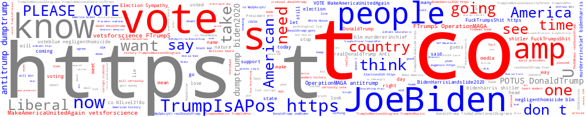
Predicting the 2024 Presidential Election Outcome
Project 4 – Machine Learning
ASU Data Analytics Course

Slide 3






Meet the team:
Jessica Bourbon
Syed Shahid
Stephanie Souza
Elisabeth Trujillo

Slide 4
Introduction:
Welcome to the Predicting the 2024 Presidential Election Outcome project! This ambitious endeavor combines a wealth of data sources to forecast one of the most significant political events of our time. By harnessing the power of historical demographics, economic indicators, and social media trends, we aim to develop a robust machine learning model that predicts the outcome of the 2024 U.S. presidential election. Our approach integrates data from the U.S. Census, the Bureau of Economic Analysis, and Twitter (X) to build a predictive model that captures the multifaceted nature of electoral dynamics.

Slide 5
Project Overview:
This project seeks to explore and analyze diverse datasets spanning from 2008 to 2020 to inform predictions about the upcoming 2024 presidential election. The core of our methodology involves:
Exploratory Data Analysis (EDA): Conducting individual analyses of demographic, economic, and social media data to uncover insights and trends.
Data Integration: Combining insights from all three data sources to enhance the predictive power of our model.
Model Development: Training and optimizing a machine learning model that utilizes combined data to predict election outcomes.
Performance Evaluation: Assessing the model's accuracy and making iterative improvements to ensure high performance.

Slide 6
The Data:
Collection: CSV datasets as well as API calls were used to obtain source data for the project.
Sentiment Analysis – Kaggle.com
Demographic Analysis – US Census website
Economic Analysis – US Bureau of Economic Analysis
Cleaning: Python language in either Jupyter Notebook/Labs or Visual Studio Code editors. Libraries used include pandas, numpy, matplotlib, seaborn, natural language tool kit, and wordcloud.
Storage/Organization: PostgreSQL was used to store the tables from the 3 datasets, which were joined to prepare the final dataset used for the machine learning model.
Visualizations: In addition to the in-code visualization, a series of Tableau dashboard and story were prepared.

Slide 7
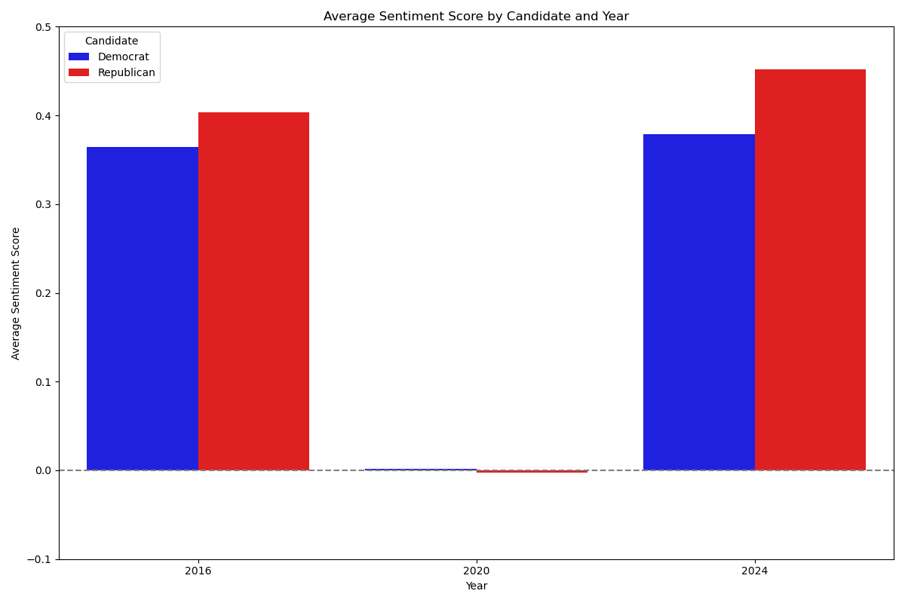
Sentiment Analysis (EDA):
2016: Republican 0.40, Democrat 0.36
2020: Republican -0.002, Democrat 0.002
2024: Republican 0.45, Democrat 0.38
Noticeably more neutral in 2020
General apathy with everything else going on (COVID, etc)?
Very similar results for 2016 & 2024
Spoiler alert?

Slide 8
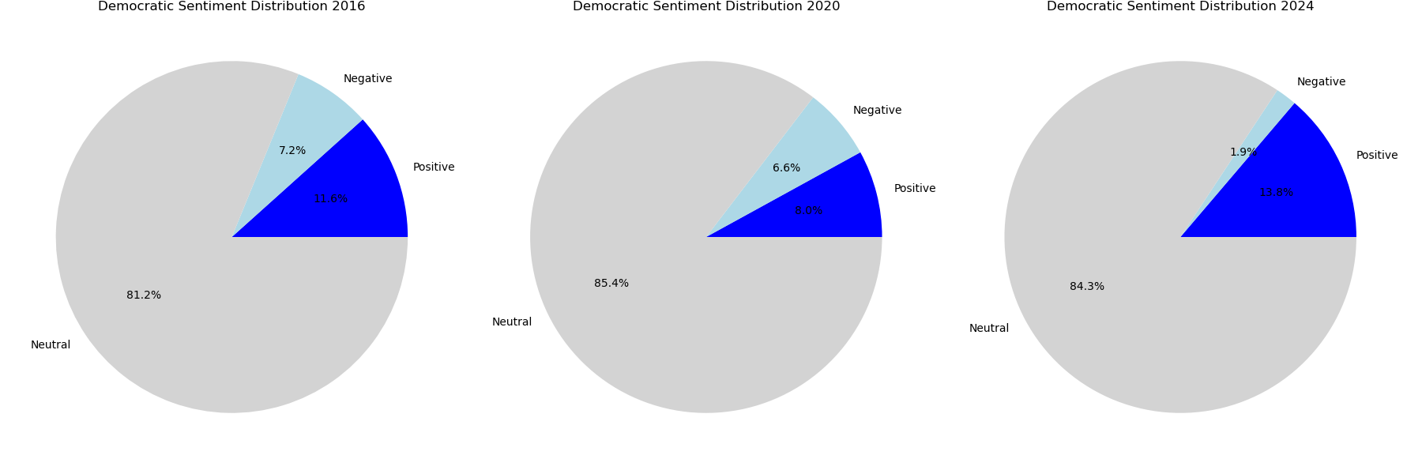
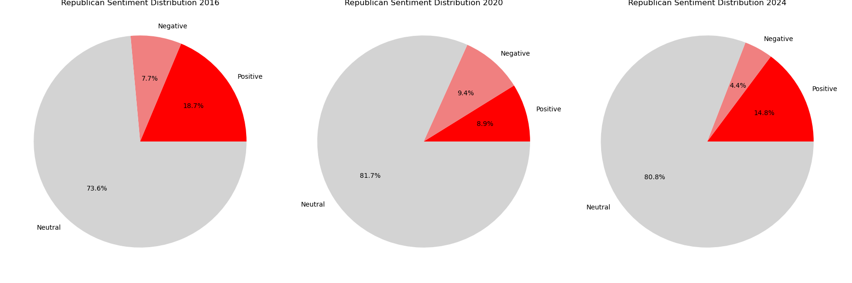
Noticeably more neutral in 2020
Artifact of data?
nearly equal % of positive and negative posts
Overall, social media authors are largely neutral in their posts
When opinionated, more enthusiastic with sentiment about Republican party vs Democrat

Slide 9
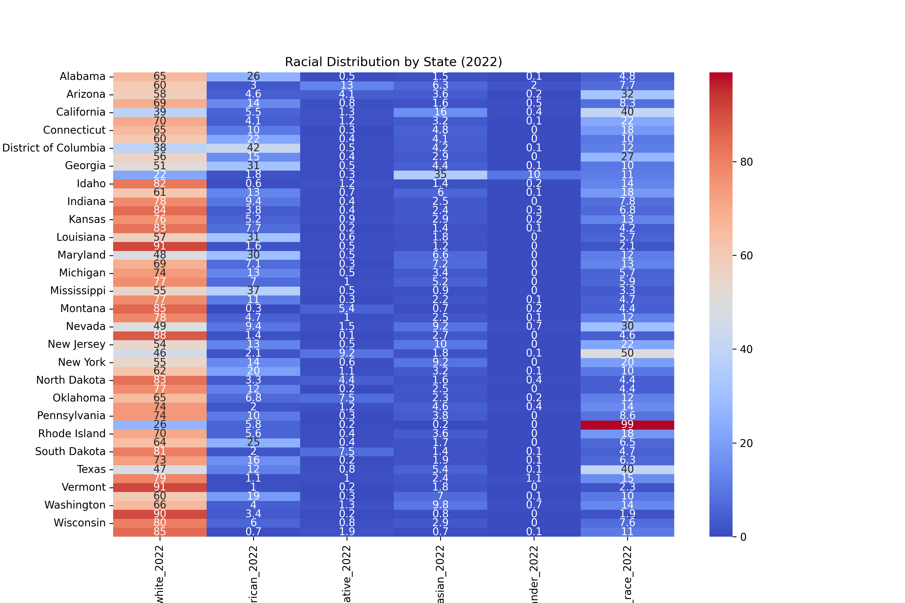
Demographic Analysis (EDA):
Racial Distribution in Election Years:
The largest percentage identifies as White, though this has seen a gradual decrease over the years.
The next consistently higher groups identify as Black/African-American or Hispanic/Latino(any Race).

Slide 10
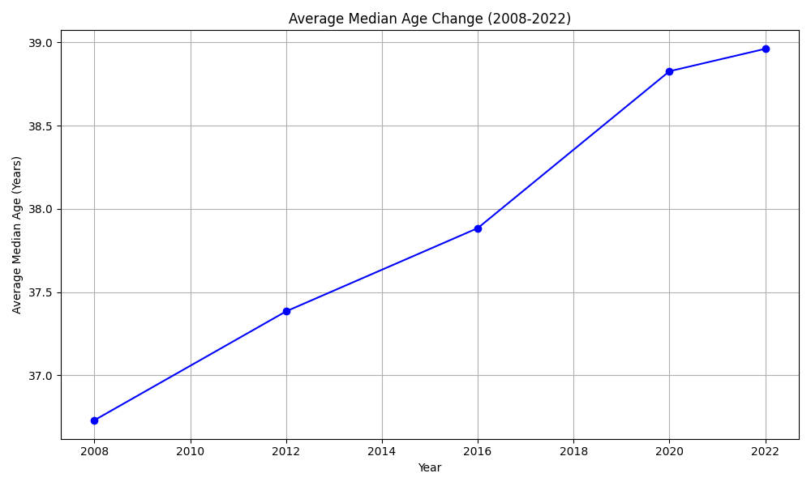
Age Distribution in Election Years:
Median Age: Remains consistently between 30 and 40 years across recent election years, showing gradual growth.
Age Distribution: Percentages at the extremes of the age spectrum are relatively low, with most values clustering in the middle age range.

Slide 11
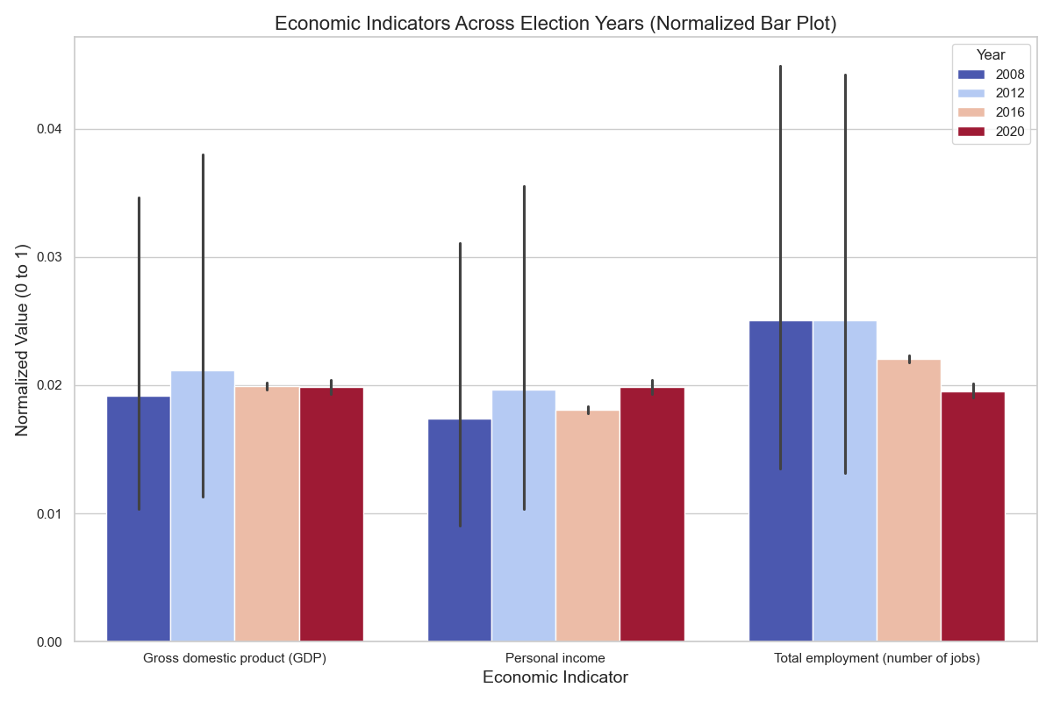
Economic Analysis (EDA):
Analysis on economic indicators like GDP, personal income, and employment changed from 2008 to 2020.
You can observe any economic growth or decline in specific states.

Slide 12
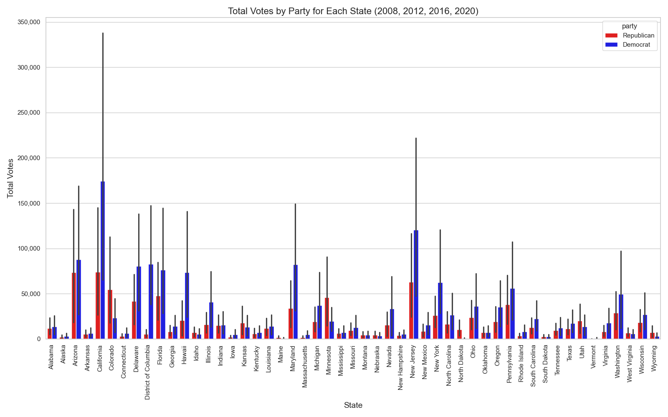
Analysis on states with higher GDP tend to vote in elections.
We can check whether wealthier states lean towards certain candidates or political parties.

Slide 13


So Who Will Win the 2024 Election? Place your bets…
Tableau Story
https://public.tableau.com/views/PresidentialPrediction2024/Story1?:language=en-US&publish=yes&:sid=&:redirect=auth&:display_count=n&:origin=viz_share_link

Slide 14
Machine Learning Model:
Model 1: Linear Regression
Pros – Simple, Useful with 2 option results – clearly defined, Clear discrimination between data
Cons – Requires significant data cleaning and preparation, Less flexible interpretations
Model 2: TensorFlow
Pros – 100% predicative accuracy
Cons – Doesn’t manage Null values well

Slide 15
Machine Learning Model:
Model 3: Random Forest
Pros – 100% predictive accuracy
Cons – Significant data preparation, Optimization challenges, Low trust in result
Model 4: Decision Tree
Pros – Highlights importance of individual features, Handles diverse data better
Cons – Challenges with unbalanced data (significant difference in our datasets), Feature bias

Slide 16
So Who Will Win the 2024 Election? Place your bets…

Slide 17

So Who Will Win the 2024 Election? Place your bets…

Slide 18
Next Steps, if we had more time….
Source Data – find data for all topics for all years
Model Optimization – explore other methods (i.e. ensemble method) and adjust features in dataset

Slide 19
Questions?

