Slide 1
Group 3
Inspectorate of Education,
Are changes in learning results predictable
Casper van Tongeren
Jessica Bormann
Sophie Elting

Slide 2
Our understanding

Slide 3
The Inspectorate of Education has requested us to investigate whether changes in learning results are predictable by school characteristics and learning results of previous years.
Situation
Inspectorate of Education has data of about 6500 primary schools in total. Yearly they do about 2000 investigations at schools, of which about 300 are quality-risk related.
It is impossible to inspect all these schools thoroughly. Therefore the Inspectorate would like to allocate their capacity efficiently.
Thee current approach: Inspectors decide based on a risk model with multiple indicators which schools require further analysis.
Complication
The Inspectorate currently does not have a predictive model to predict which schools are at risk.
The Inspectorate wants to adjust this process into a predictive model, since the risk factors are not perfect. They get a fair amount, but they do not get all variance. The inspectorate wants to improve risk scores over the years.
Request
Investigate whether test results can be predicted based on data of previous years to see if it can be added as an indicator to the risk model
The main question that we are about to answer with this report is the following: Can we predict future changes in learning results?
If so, how far ahead in the future can we predict?
And, which indicators should they be looking at?
For example, some schools are performing well but after a year start to perform worse. Therefore it is interesting to dive deeper into and try to predict the change in learning results.
In this report, we decided to take an approach that works with the data we got from the Inspectorate and tried to fit different models.

Slide 4
Predicting learning results of primary schools

Slide 5
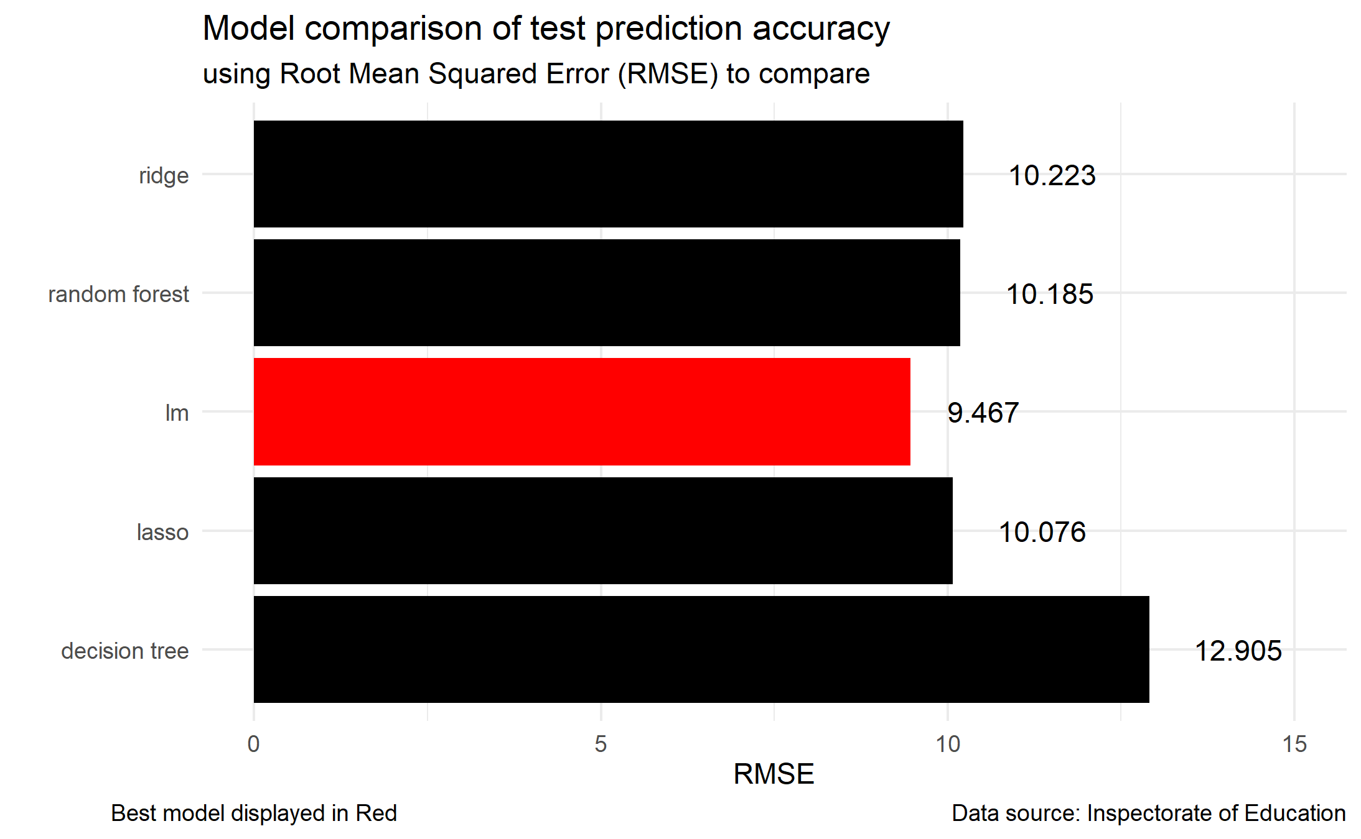
We found that a forward stepwise linear model gave the best prediction for data in the future.
Key takeaways
Changes in the learning results are best predicted with the linear model.
It should be kept in mind while interpreting these results that a few of the assumptions of linear modelling were violated (see R code for more specific information).
Recommendations
Use variables from the linear model to predict future learning results.

Slide 6
Assessing which variables best predict future learning results in primary schools

Slide 7
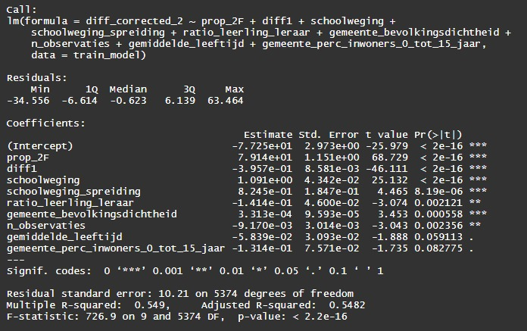
Corrected differences in future learning results were best predicted by variables such as results in previous years.
Key takeaways
When correcting for schoolweging the three most important predictor variables are related to current or previous school assessments (prop_2F, diff1 & schoolweging).
More dense populated areas tend to perform better over time (gemeente_bevolkingsdichtheid).
Having not enough teachers in a school can negatively affect future test results.
Recommendations
Look at trends over time when trying to predict future learning results.
Monitor schools in smaller municipalities more closely.
Monitor schools with a teacher shortage or with too many students more closely.

Slide 8
How many years into the future can we predict learning results?

Slide 9
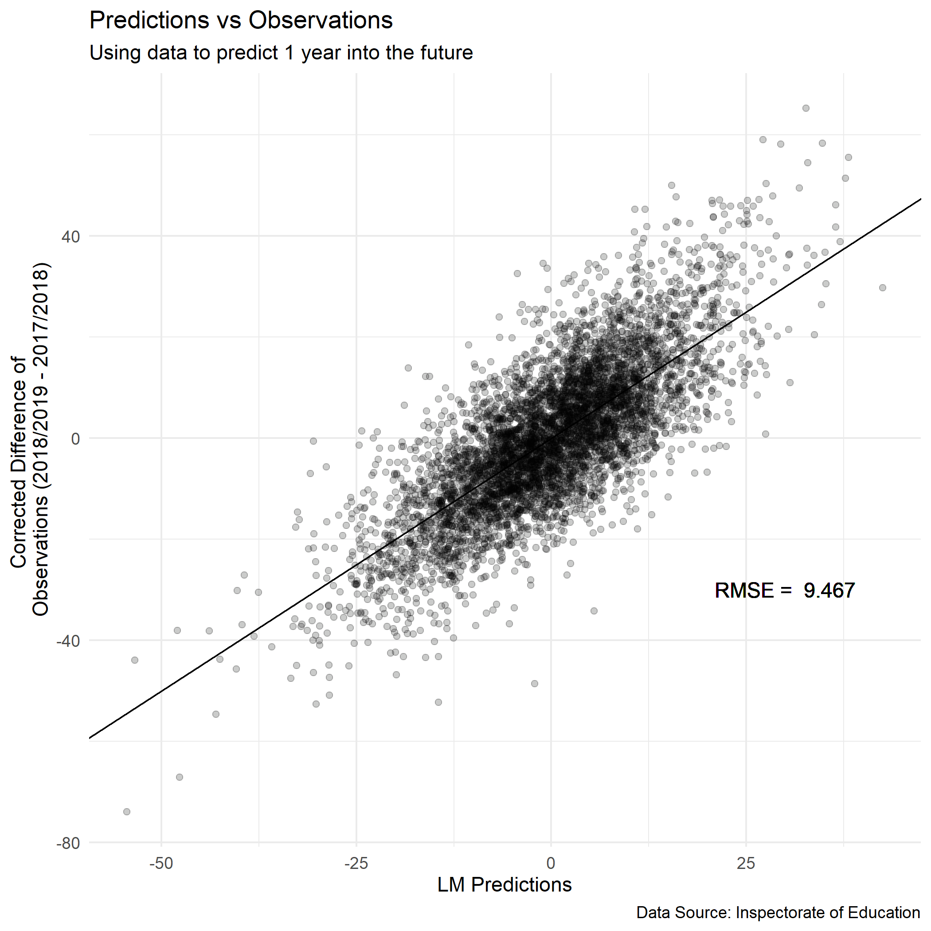
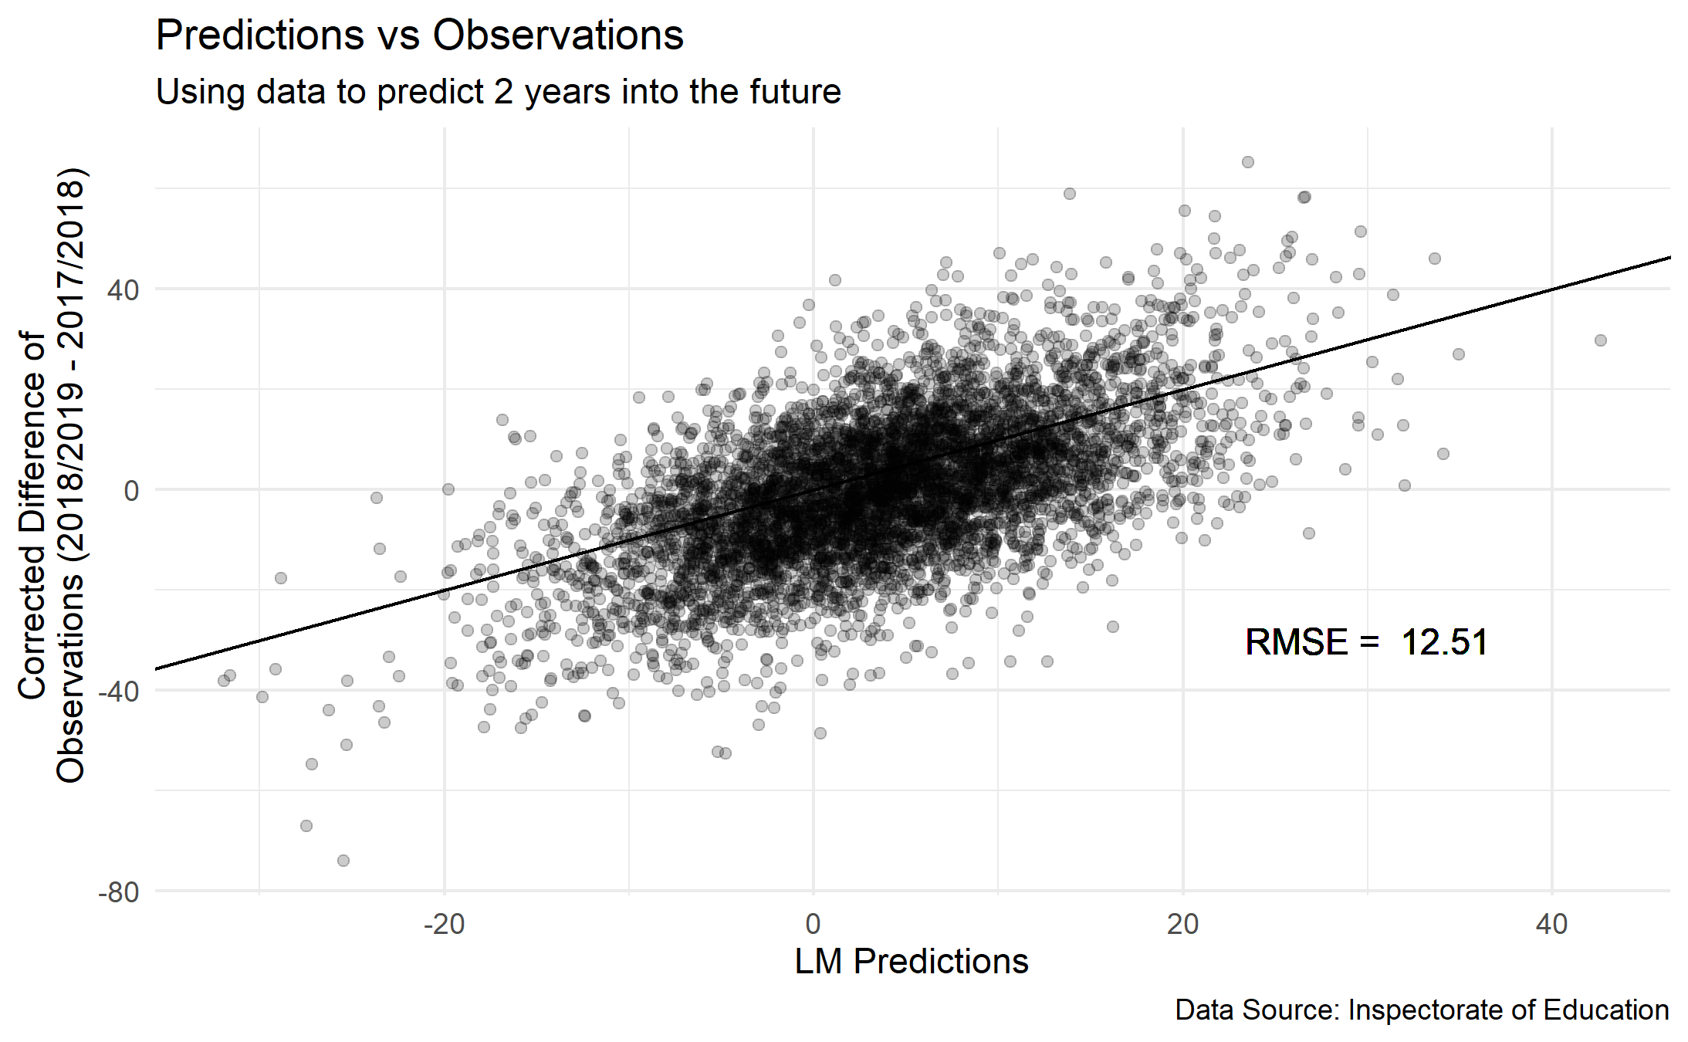
Using a model to predict 1 year ahead gave better predictions compared to predicting 2 years ahead.
Key takeaway
The addition of difference scores with the year before significantly increased the prediction accuracy.
Recommendation
Use historic data to more effectively predict future test scores.

