Slide 1
EDLD 610 Final Project
Jessica Canfield & Woocheol Kim

Slide 2
About the data
Marketing Professor Conor Henderson’s sports dataset
5 sports, 15 years (2000-2015)
NFL, NBA, MLB, NHL, & NCAA
→ 4,080 rows, 9 variables
Marketing & Sports
Sponsorship
Sports games as consumer goods
Can match with other location specific consumer goods data

Slide 3
About our journey
We are exploring the relationship between attendance & ticket price in four US major sports leagues & the relationship between attendance and home wins in five major leagues including NCAA football.
A more specific goal of our project is to find how the relationship between attendance and ticket price changes before & after the 2009 financial crisis.
Tidying messy data was more than halfway done for us. We believe the codes we’ve learned during the class such as mutate, group_by, summarize, ggplot and much more keep our project going smoothly.

Slide 4
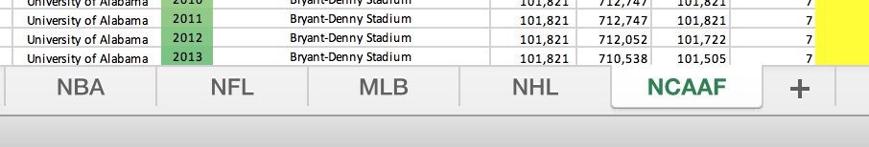
Challenges along the way
We got stuck from the beginning…
We had no idea how to combine five tabs into one
bind_tabs()?

Slide 5
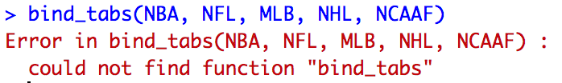
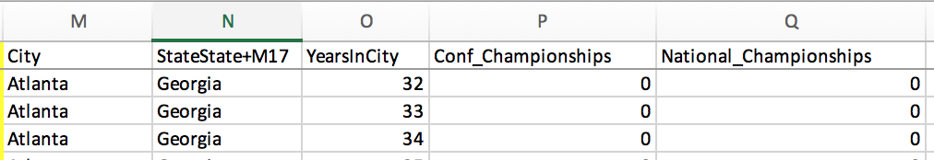
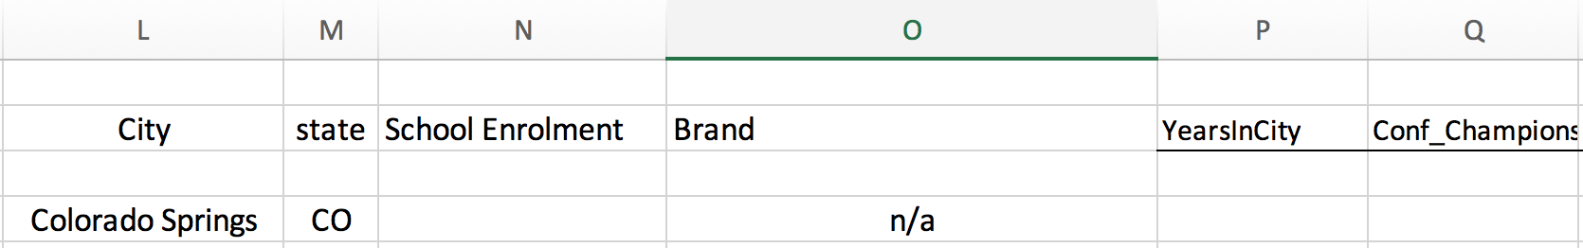
Challenges along the way
No, There is not anything like bind_tabs…
We had another problem that some of the columns in each tab are inconsistent.

Slide 6
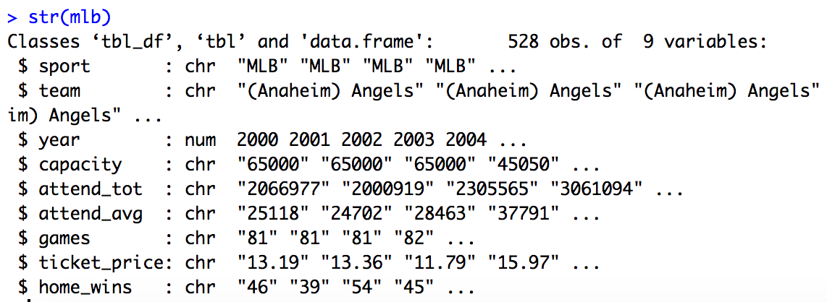
Challenges along the way: character → numeric
Another challenge we faced was the type of observations.
There were many character variables that should have been numeric variables. (e.g. attend_avg, ticket_price)

Slide 7
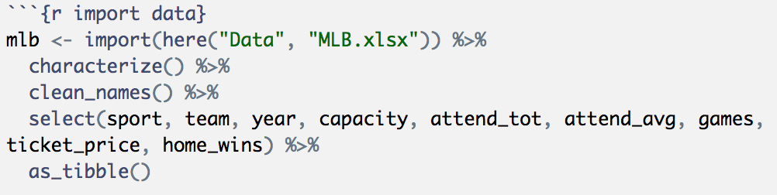
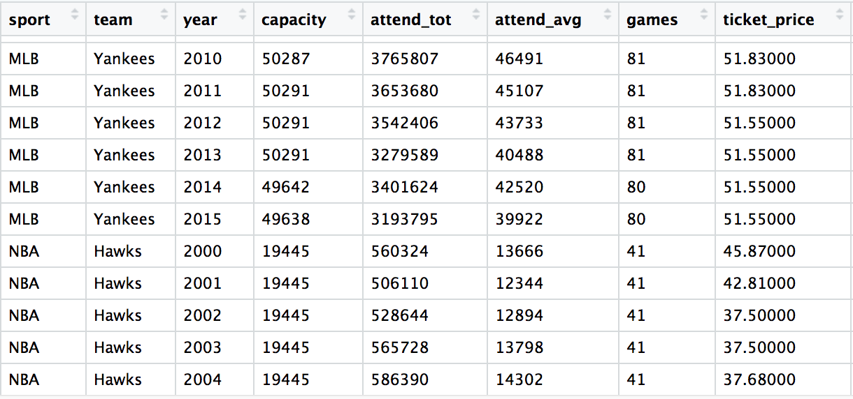
Victories & things to celebrate
We created new five files and choose common variables we are going to use. Then, we merged using bind_rows.
It took a little while, but it worked well. We finally made it tidy!

Slide 8
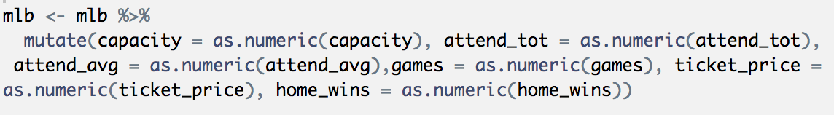
Victories & things to celebrate
We successfully changed the character variables to numeric variables using as.numeric.
We did it before we ran bind_rows. We are ready to move on.

Slide 9
Challenges we are still facing
As we analyze our dataset, we find ourselves still having issues. We are going to find the relationship between attendance and home wins. However, the number of games in each league is all different. Thus, we need to create a new variable using mutate.
There is another issue to be addressed. An objective of our project is to find the effect of financial crisis on attendance as an aspect of ticket price. We need to figure out how to filter ‘3 years average before 2009 (2007-2009)’ and ‘3 years average after 2009(2010-2012)’.

Slide 10
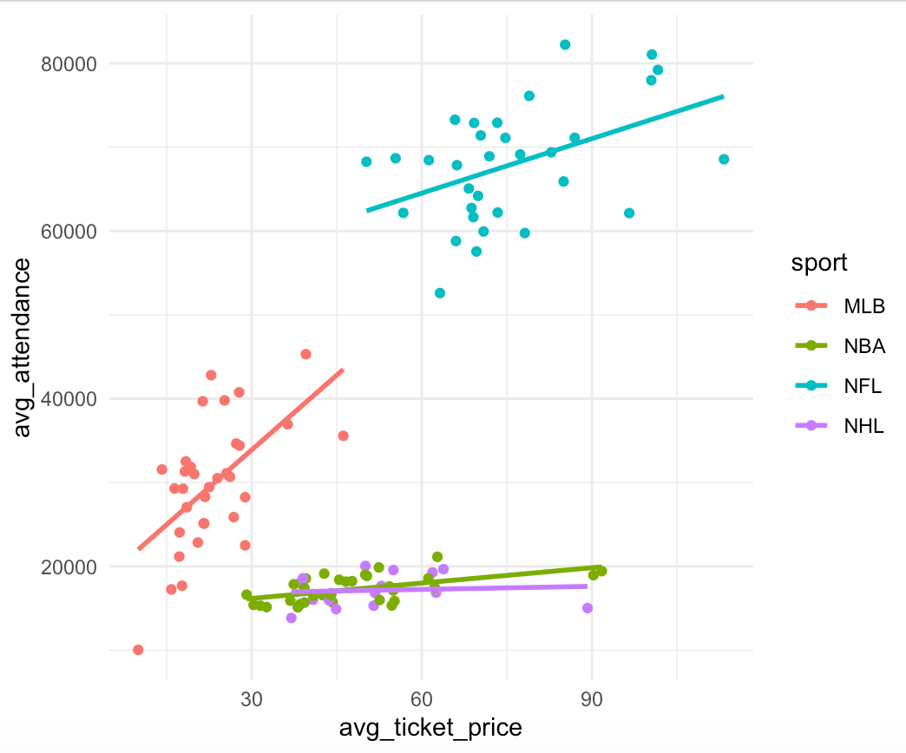
Substantive findings/interpretations
Demand drives price increase
Avg. Price has a positive relationship with Avg. attendance in all four leagues. A Conventional wisdom that price increase reduces demand is not true in US major sports.
The rich get richer and the poor get poorer. For example, Avg. ticket price of Red Sox is $46.14 while Avg. ticket price of Expos is $9.97. In NFL, Cowboys, Patriots, Giants and Jets charge more than $100 in average and all but Patriots are on top5 in attendance.

Slide 11
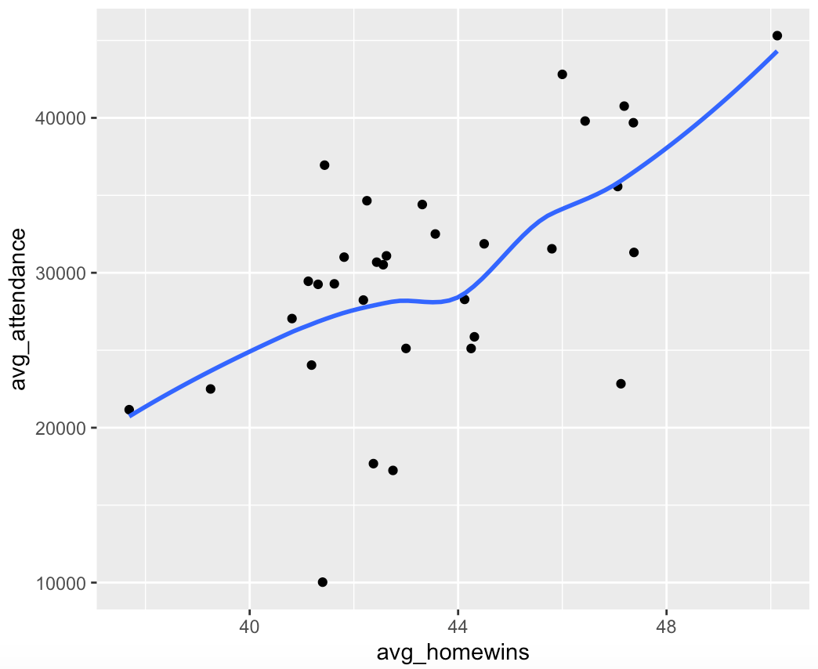
Substantive findings/interpretations
2. Win is considered the best marketing strategy but it is not always the case.
In MLB, fans are generally sensitive to win. The more home games teams win, the more fans they bring in.
Pictures in NBA and NHL are somewhat different. But look similar to the one in MLB.
Notes:
facet by sports

Slide 12
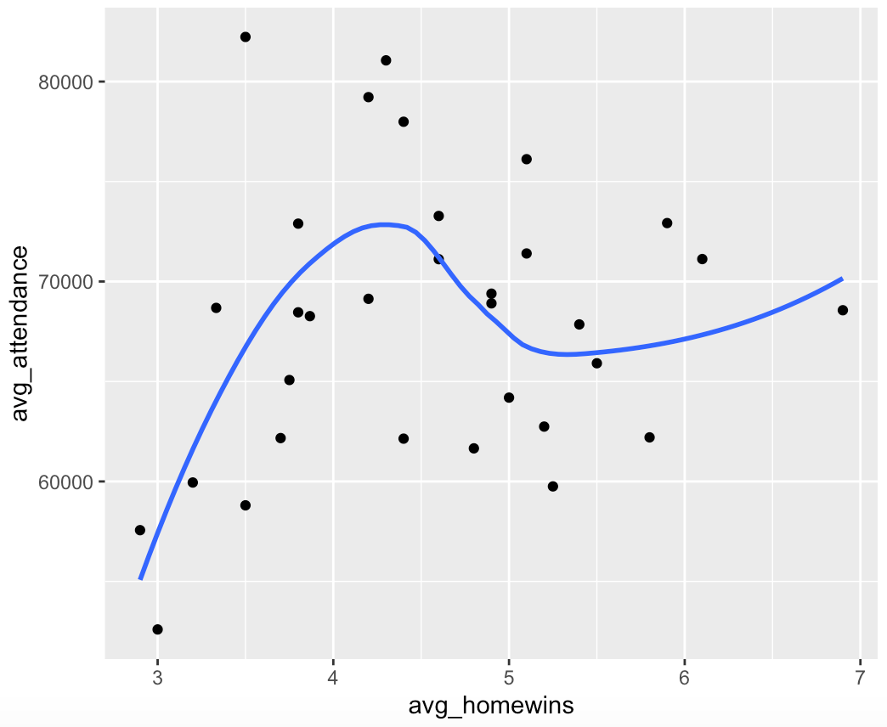
Substantive findings/interpretations
2. Win is considered the best marketing strategy but it is not always the case.
It seems NFL fans do not care too much about win. For example, Redskins win only 3.5 home games in average but average attendance is on top of the league.
We assume this is because each NFL team has only 8 home games. Every game is important. Also, attendance depends on each team’s fan base.

Slide 13
Next R hurdle to tackle…
To find out the effect of price and win on attendance,
We may have to use the function of multiple regression like this:
Avg. Attendance = α + β1*Avg.price + β2*Avg.homewins + ℇ
Continuing this project with more marketing related data that is less tidy

