Slide 1
Data Analyst_Assignment CHEN YANYAN

Slide 2
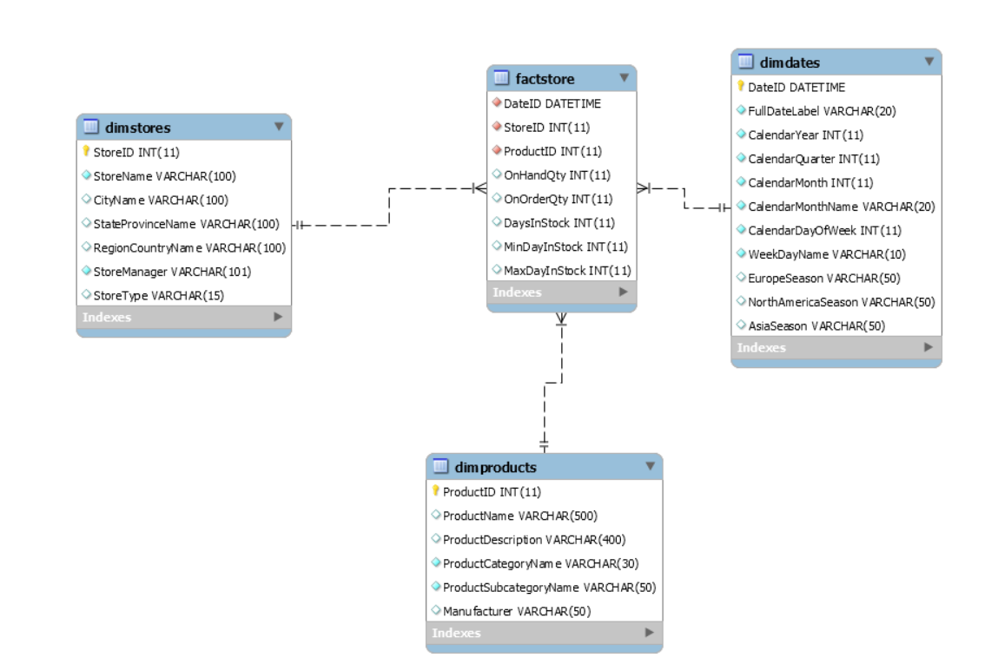
Database Setup
OLAP database with fact table: factstore.
Store ID with 227 not existed in dimstores which caused foreign key violation.
When uploading combined factstore data, the information with storeID=227 is omitted.

Slide 3
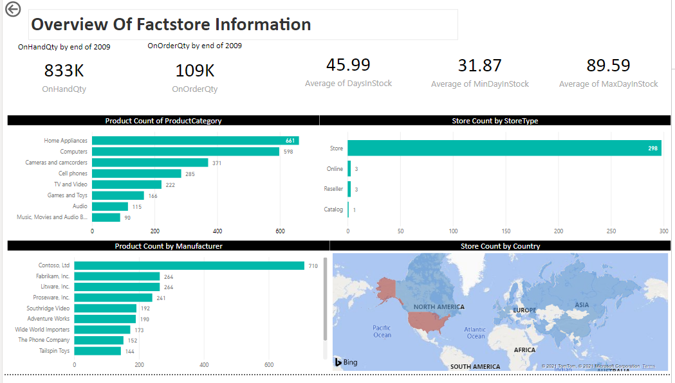
PowerBI_Overview of Factstore Information
Dataset Summarized:
Inventory data collected weekly.
Mainly store type: store
Mainly business region: US
Mainly Manufacturer: Contoso

Slide 4
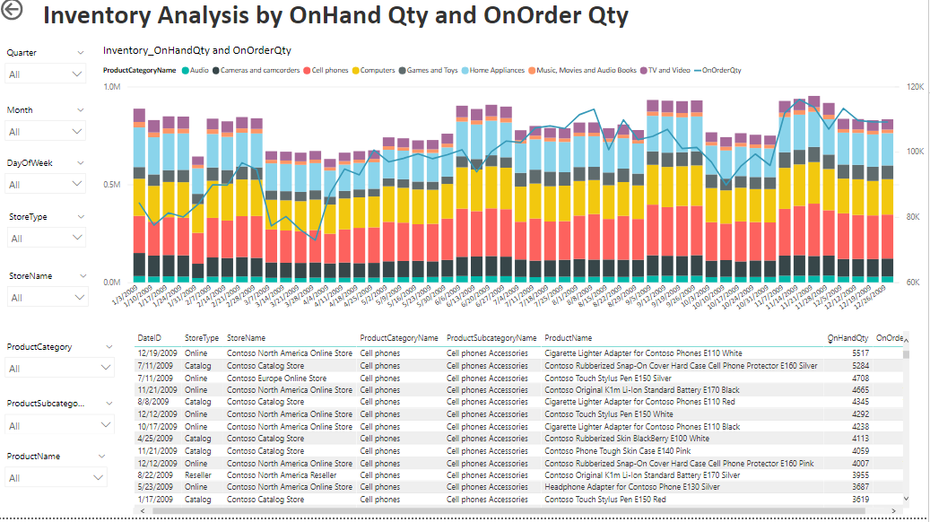
PowerBI_Overview of Analysis of Onhand&OnOrder
Summary plot can be drawn down by different levels to fulfill different users 'requirement
Overview summary:
Product category Cellphone/home appliance/Computer occupied most of all stocks.
Months Jan/Feb/Jun/Sept/Nov had higher stock amount, which needs to explore more to understand the reason.
Onorder Qty was rising over the year 2009 and no correlation found with onHandQty.

Slide 5
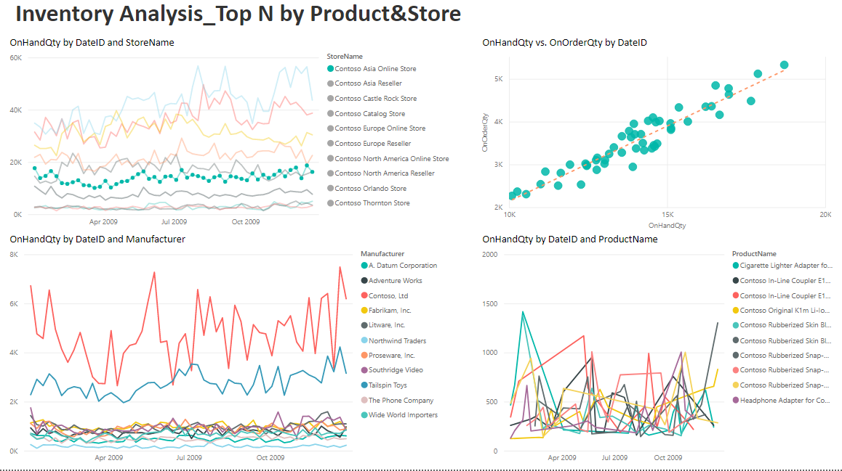
Top N product &store by OnhandQty
Stores with Top N OnhandQty
Positive Correlation found between OnHandQty vs. OnOrderQt
Those TopN stores contributed to the majority of total onHandQty.
No obvious pattern found for OnHandQty vs. Product Name.
Products manufactured by contoso had the most OnHandQty, which is consistent with that consoto is the largest supplier for all products in the stock.

Slide 6
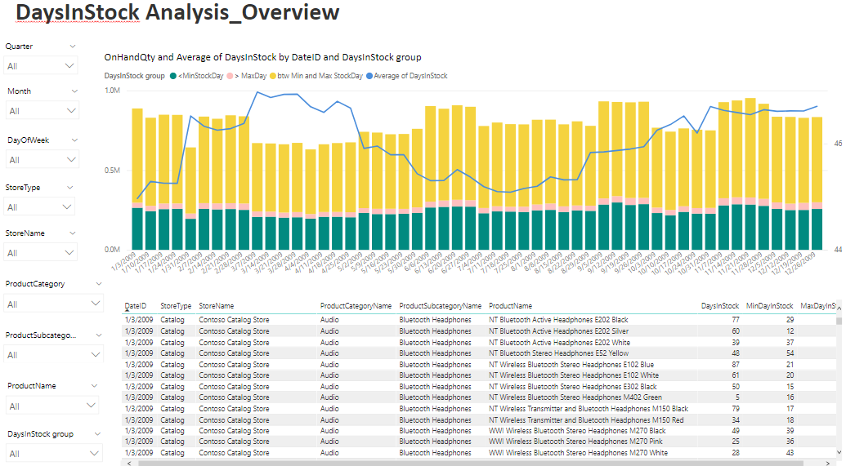
PowerBI_Overview of Analysis of DayInStock
Summary plot can be drawn down by different levels to fulfill different users 'requirement
Overview summary:
OnhandQty
Most onhand qty belonged to btw Min and Max Stock day group.
Over the year 2009, each stockday group percentage is similarly stable.

Slide 7
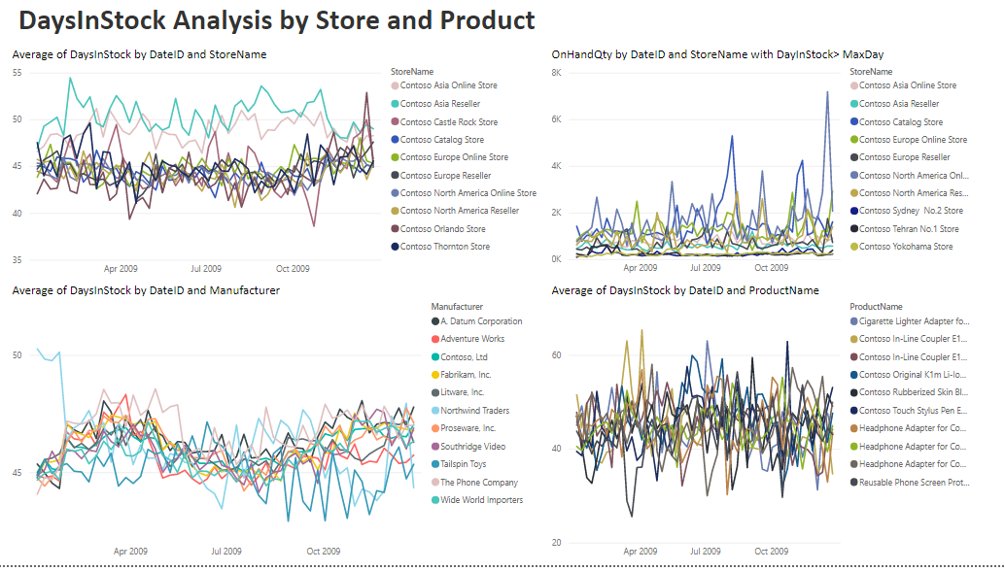
Top N product &store by DayInStock
Only find the top 2 stores by avg of DaysInStock had much higher value than other stocks.
No other obvious pattern found from other variables.

