Slide 1
The Ultimate Frisbee Game
Bella Nikom | Maja Svanberg

Slide 2
The game
Inform users about the rules and terminology of Ultimate Frisbee
The user will experience a simulated frisbee point
Correct answer advances user up the field
Incorrect answer results in a turnover and the opponents advancing up the field
Animations will show the user the outcome of each answer

Slide 3
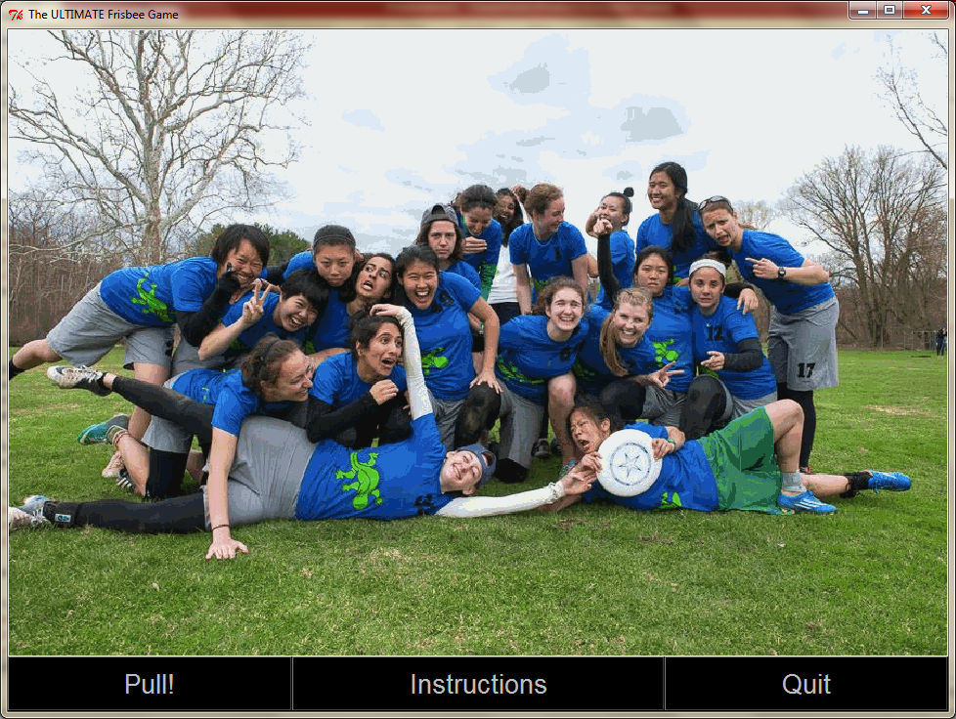
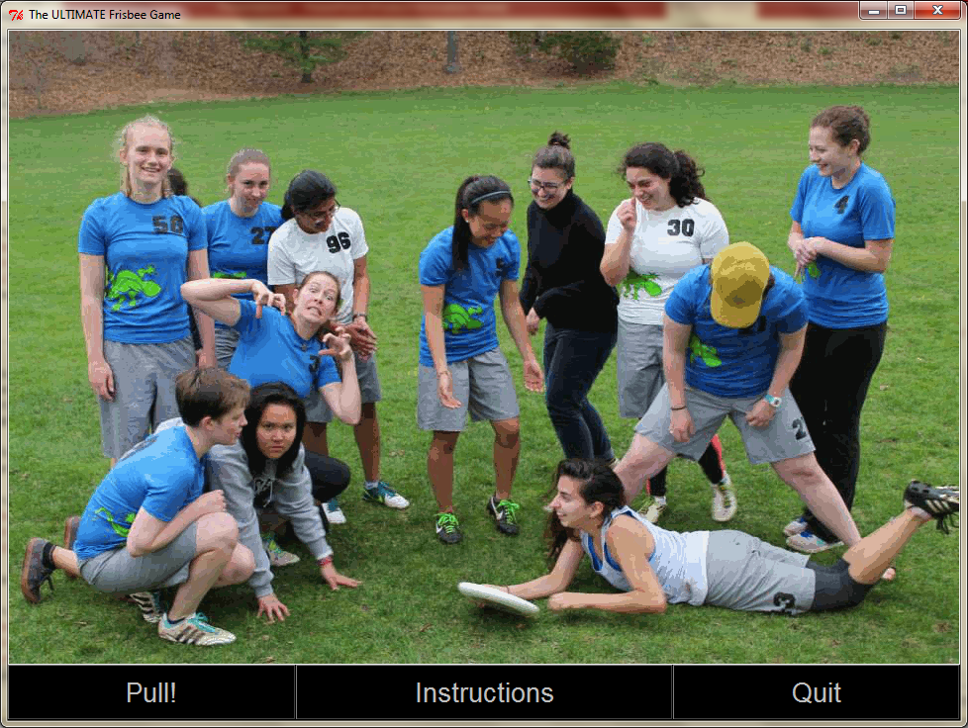

Slide 4
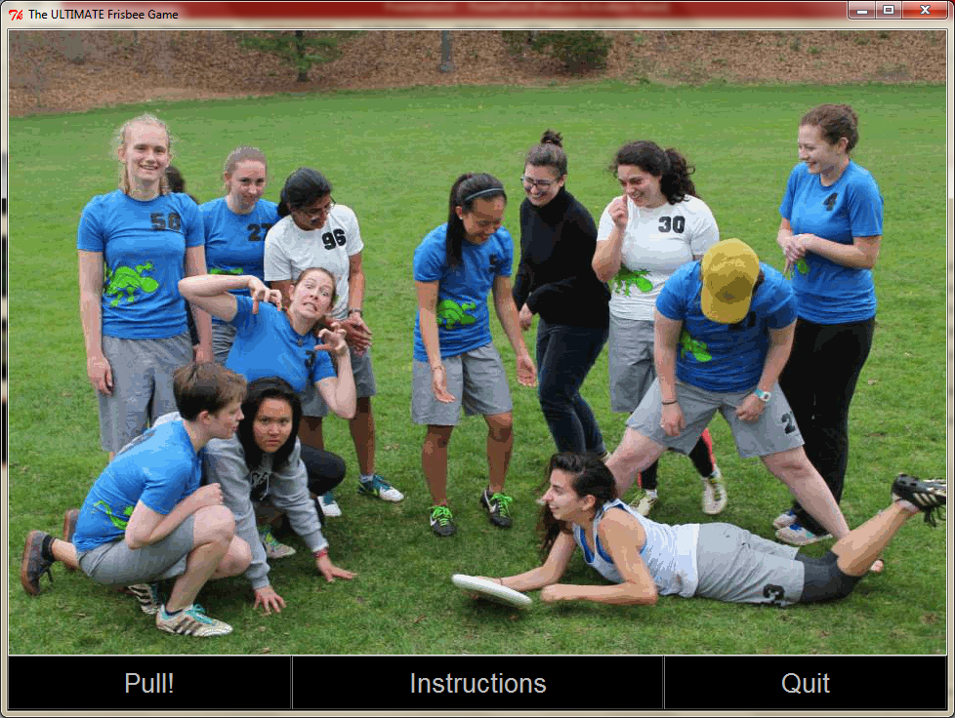
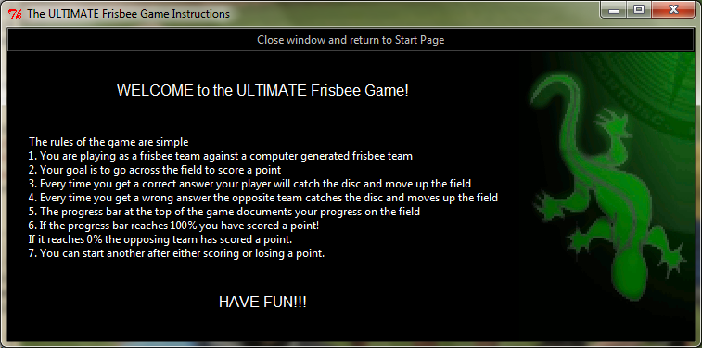

Slide 5
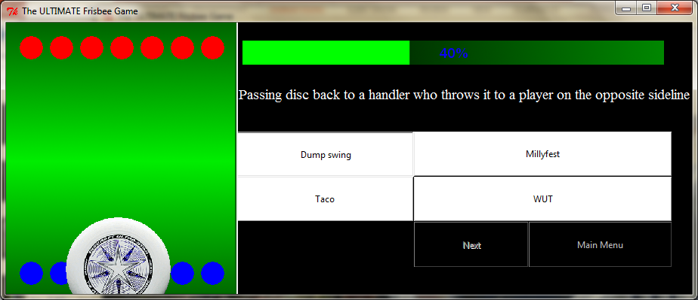

Slide 6
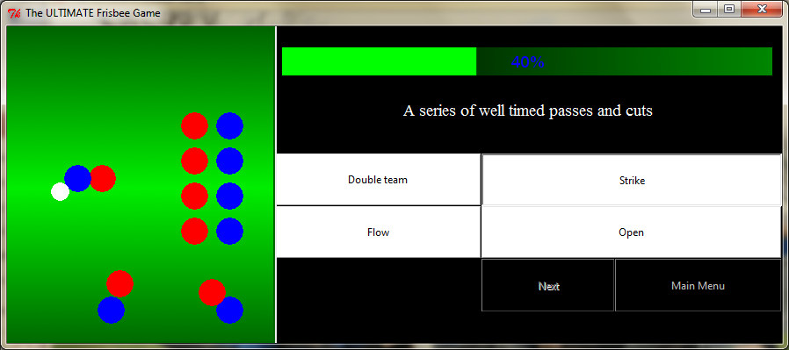
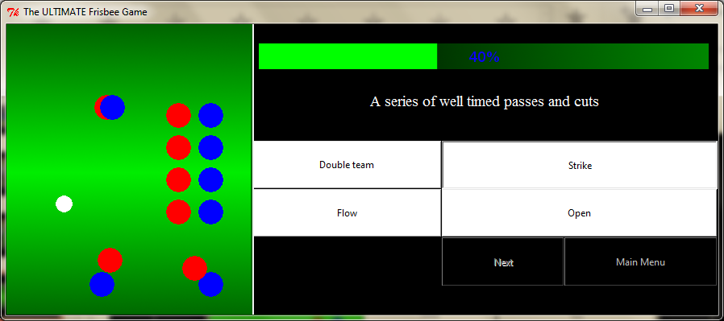
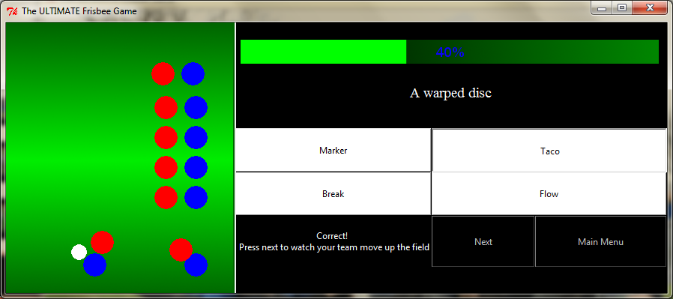

Slide 7
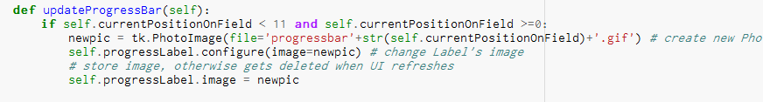

Slide 8
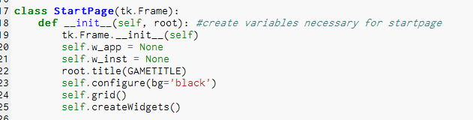
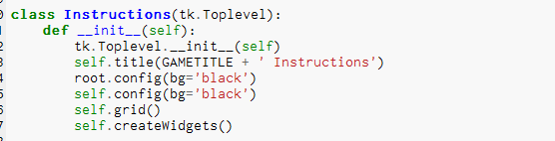
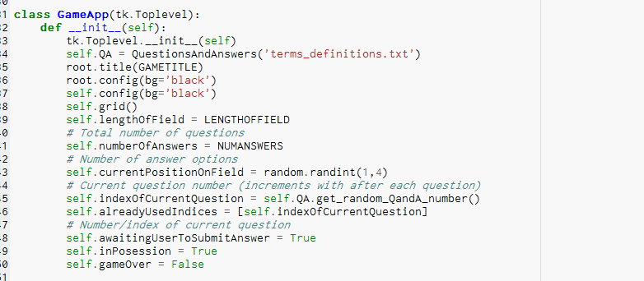
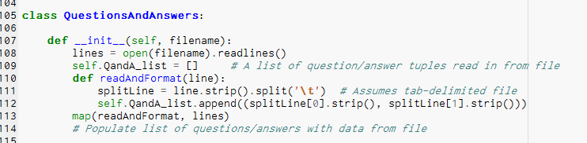

Slide 9
Animation Classes
Disc
BigDisc
Players
CutterO
BadCutterO
CutterD
BadCutterD

Slide 10
Challenges
Transition mac/Windows
Programming with multiple files

