Slide 1
Bike Sharing Prediction
Fangfang Lee
Regression & Multivariate Statistics

Slide 2

Background
Bike sharing systems are new generation of traditional bike rentals where whole process from membership, rental and return back has become automatic. Through these systems, user is able to easily rent a bike from a particular position and return back at another position. Today, there exists great interest in these systems due to their important role in traffic, environmental and health issues. Apart from interesting real world applications of bike sharing systems, the characteristics of data being generated by these systems make them attractive for the research. Opposed to other transport services such as bus or subway, the duration of travel, departure and arrival position is explicitly recorded in these systems. This feature turns bike sharing system into a virtual sensor network that can be used for sensing mobility in the city. Hence, it is expected that most of important events in the city could be detected via monitoring these data.

Slide 3
Variables
Since it might be interesting to know what factors affect the number of bike shares, we want to predict the number of shares based on 15 independent variables:
instant: record index
dteday: date
Season: season of the year (1: spring, 2: summer, 3: fall, 4: winter)*
Yr: year (0: 2011, 1:2012)*
Mnth: month (1 to 12, January to December)
Hr: hour (0 to 23)
Holiday : whether it’s holiday or not (1 if holiday, 0 if not)*
Weekday: day of the week
Workingday: whether the day is a work day or not*
Weathersit: weather situation*
Temp: Normalized temperature in Celsius
Atemp: Normalized feeling temperature in Celsius
Hum: Normalized humidity.
windspeed: Normalized wind speed. The values are divided to 67
casual: count of casual users
registered: count of registered users
Cnt(outcome): count of total rental bikes including both casual and registered
Notes:
- 1: Clear, Few clouds, Partly cloudy, Partly cloudy
- 2: Mist + Cloudy, Mist + Broken clouds, Mist + Few clouds, Mist
- 3: Light Snow, Light Rain + Thunderstorm + Scattered clouds, Light Rain + Scattered clouds
- 4: Heavy Rain + Ice Pallets + Thunderstorm + Mist, Snow + Fog

Slide 4
Hypothesis
The number of bike share will be high when the weather is nice, warm, and dry, and when it is not a holiday.
Therefore, predictors that will contribute to the model the most are: temp, atemp, hum, windspeed, season, holiday, weathersit, month

Slide 5
Data engineering/processing
No missing value
Categorical variables are either:
Dummy-coded (eg. Holiday, workingday)
Not-yet dummy coded (eg. season), and needed to be dummy-coded
Notes:
Because there are four seasons, we will need three dummy variables to represent the four seasons

Slide 6
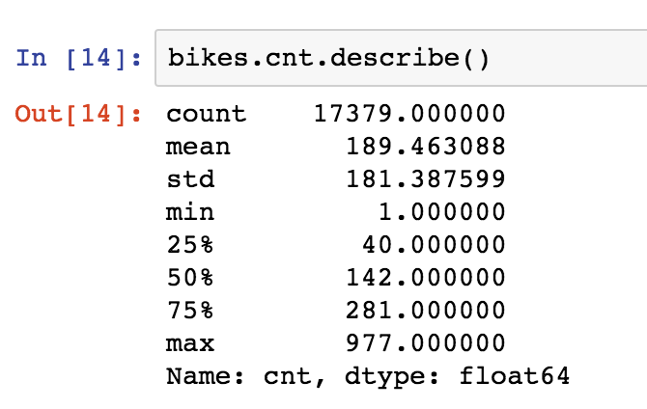
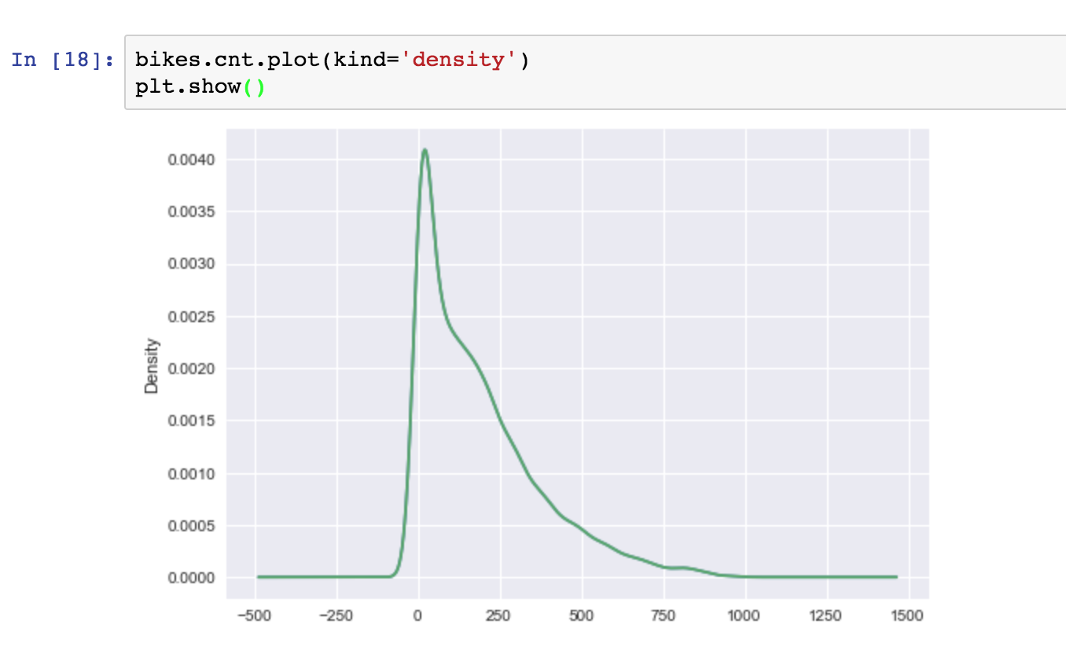
Exploratory Data Analysis

Slide 7
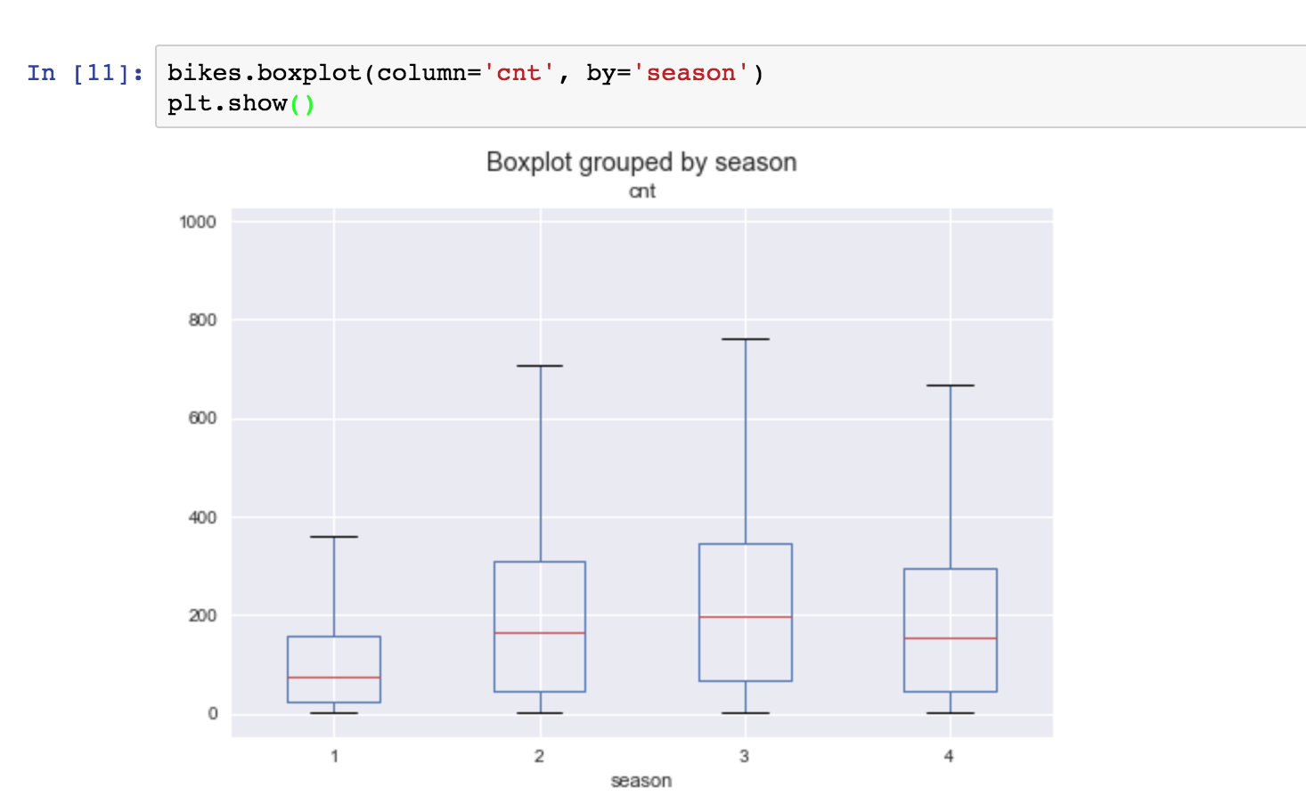
Exploratory Data Analysis

Slide 8
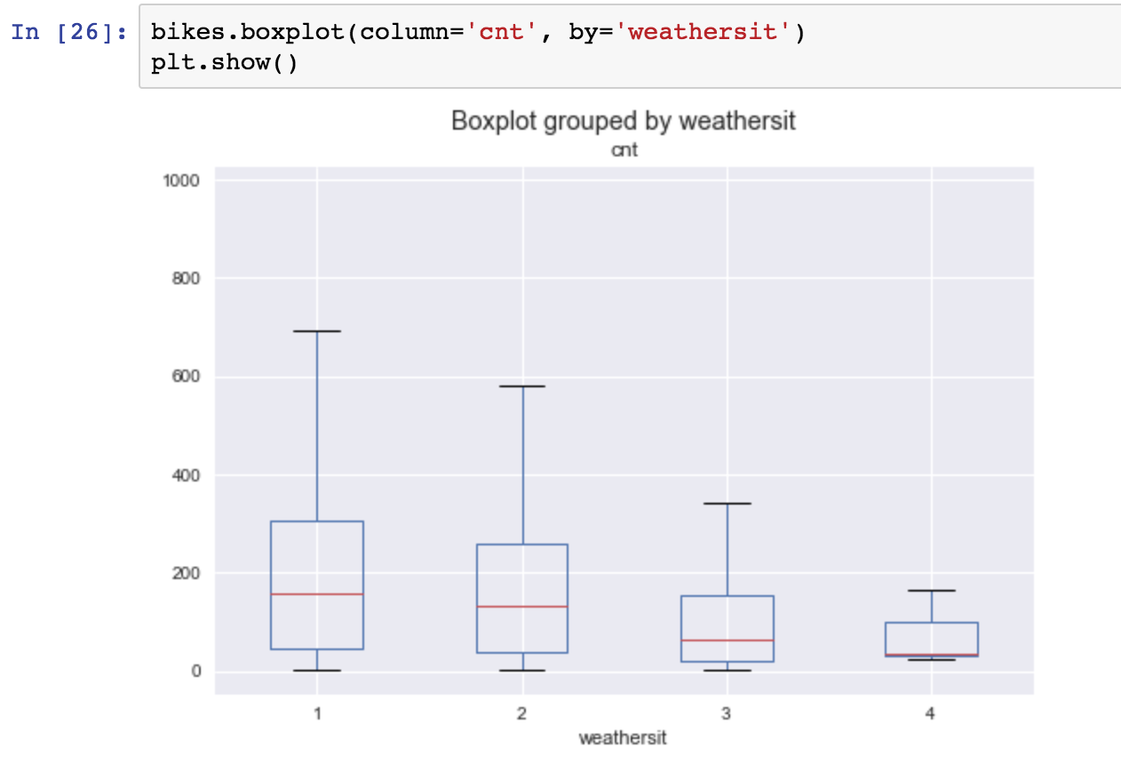
Exploratory Data Analysis

Slide 9
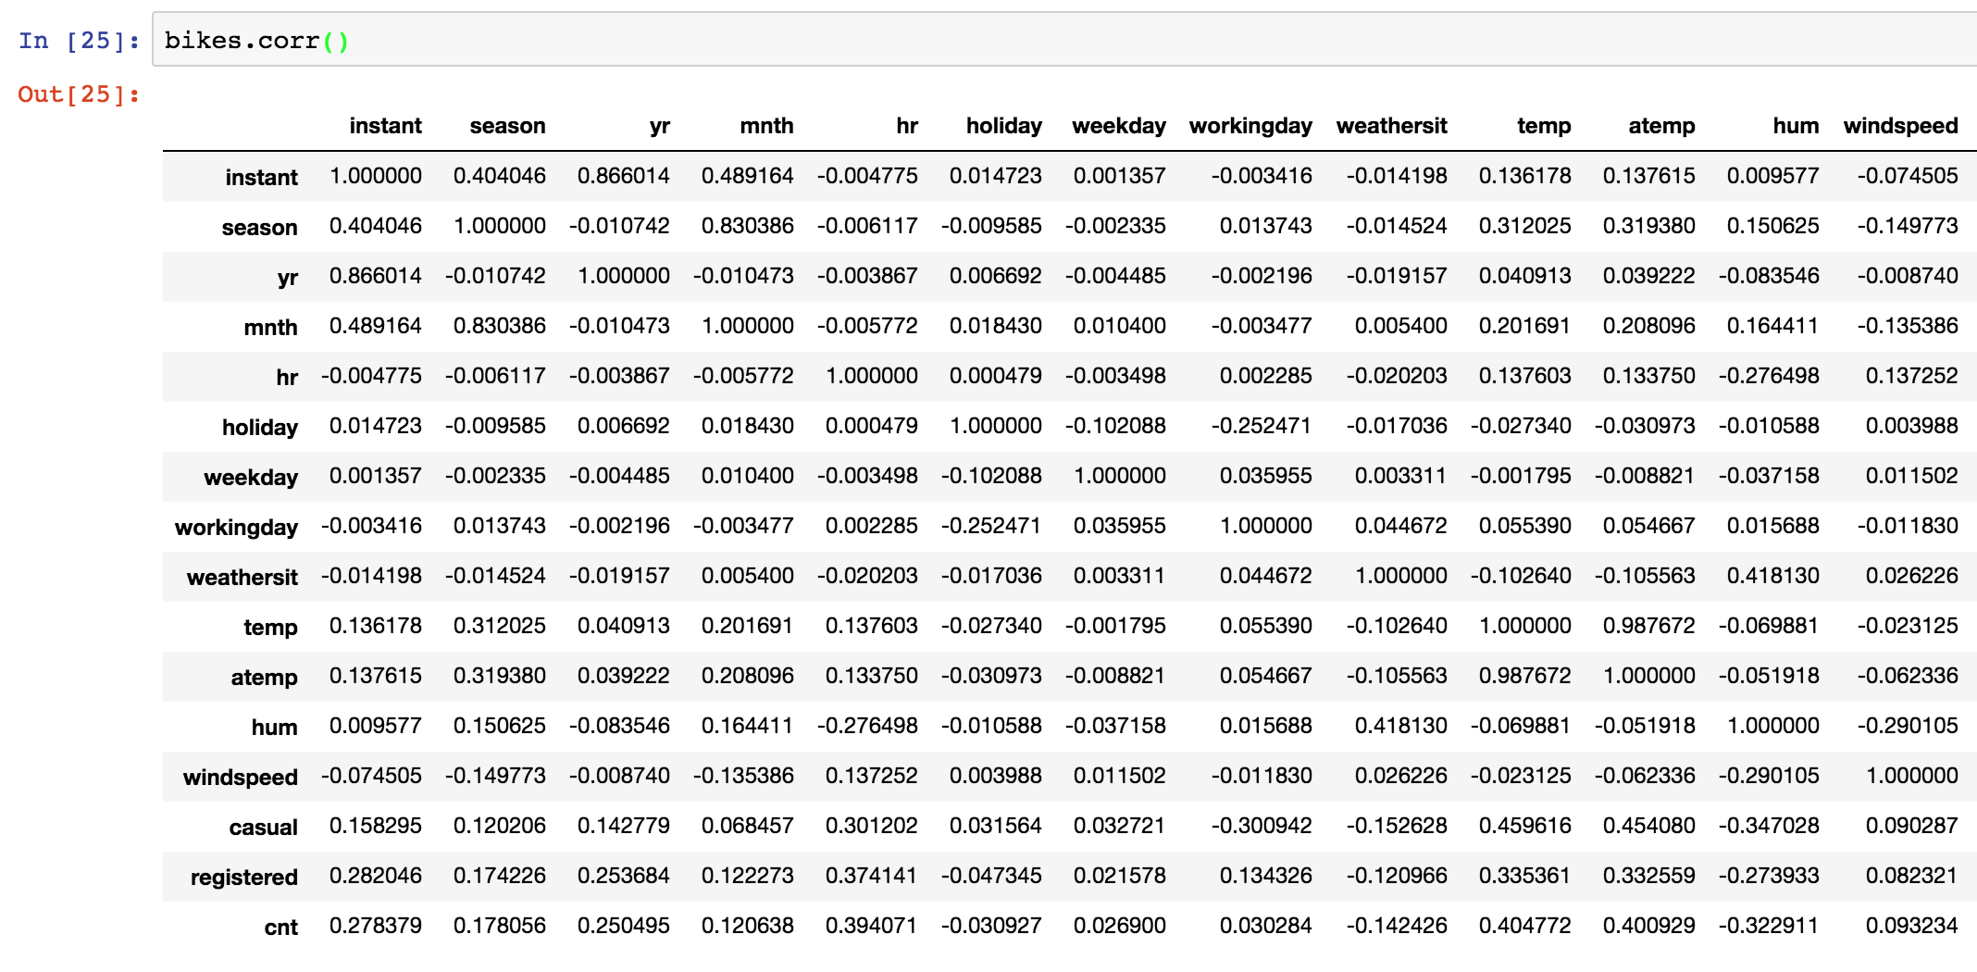
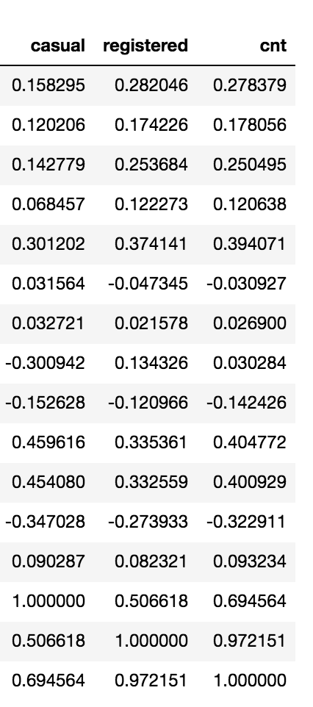
Exploratory Data Analysis
Notes:
Temp and atemp have .98 correlation, so there’s a high possibility that these two are colinear

Slide 10
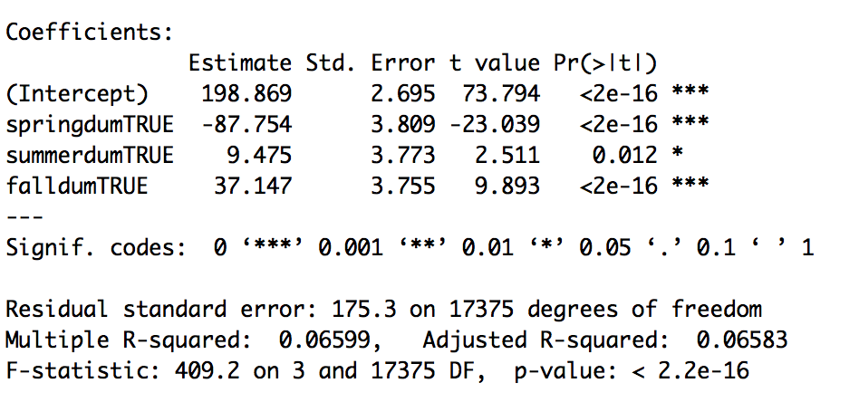
Model 1: Dummy Variable as predictor
Dummy coding ’season’ and run a linear regression with the resulted three dummy variables.
Interpretation of coefficients: dummy coding season k-1 with k = 4. In this case, winter is the intercept. The intercept is interpreted as the amount increase (198.87) in bike rental as the season is winter. The coef springTRUE is interpreted as the decrease in bike rental (-87.75) in bike rental as the season is spring.

Slide 11
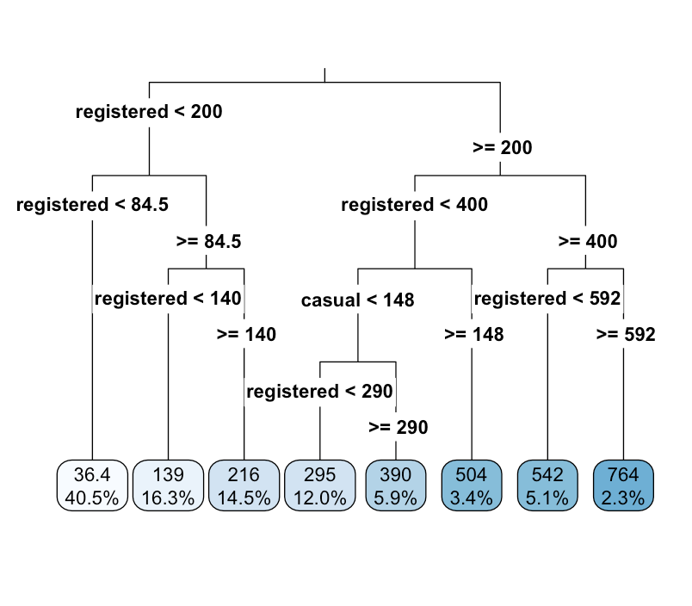
Model 2: Decision Tree

Slide 12
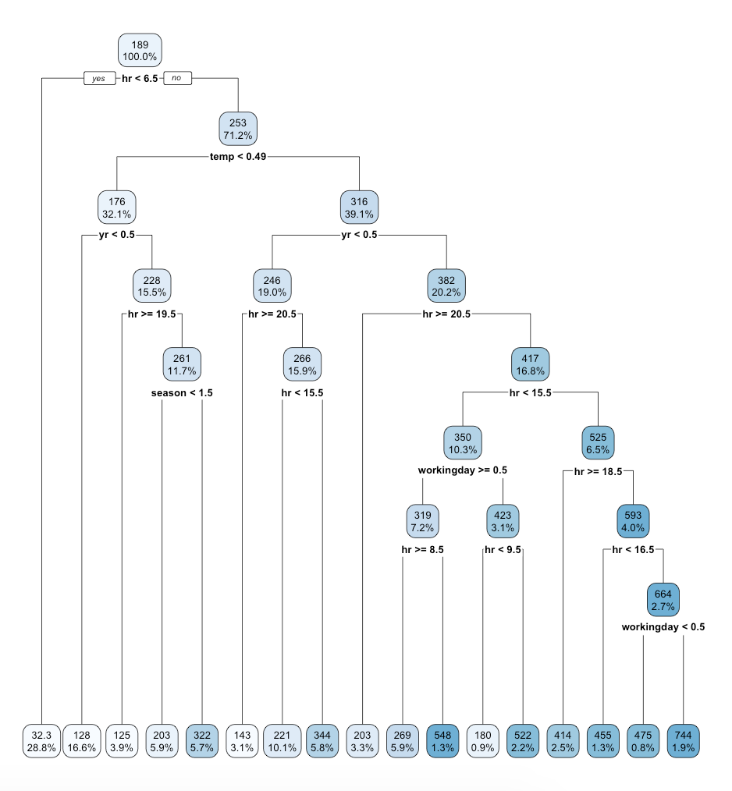
Model 2: Decision Tree con’t
Notes:
The most predictive variable is hour of the day. When the hour is less 6:30 am, the number of bike counts would be 32.3

Slide 13
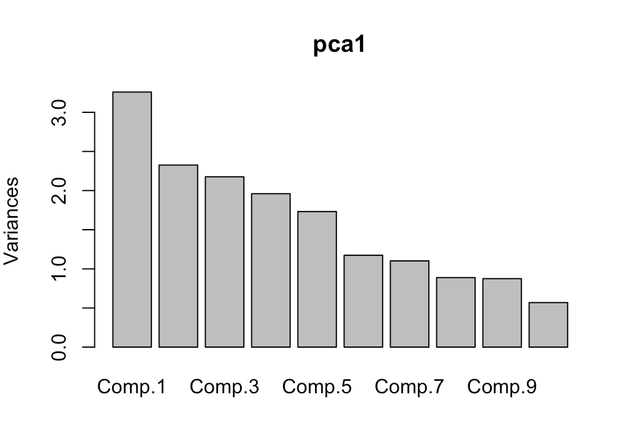
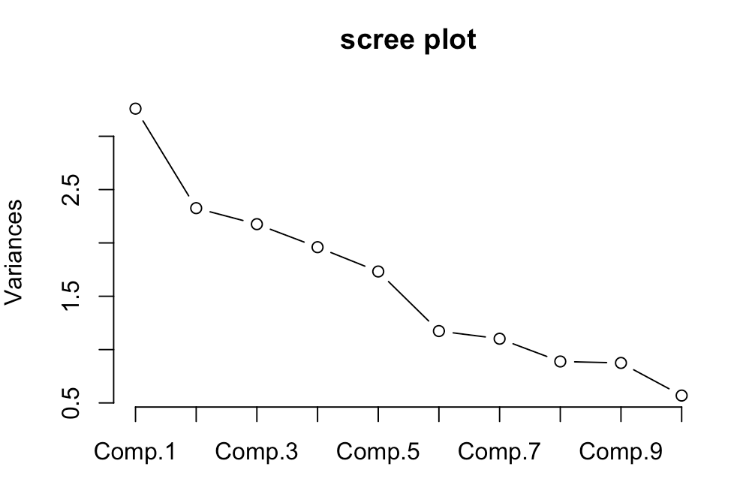
Model 3: PCA
PCA or EFA for dimensionality reduction

Slide 14
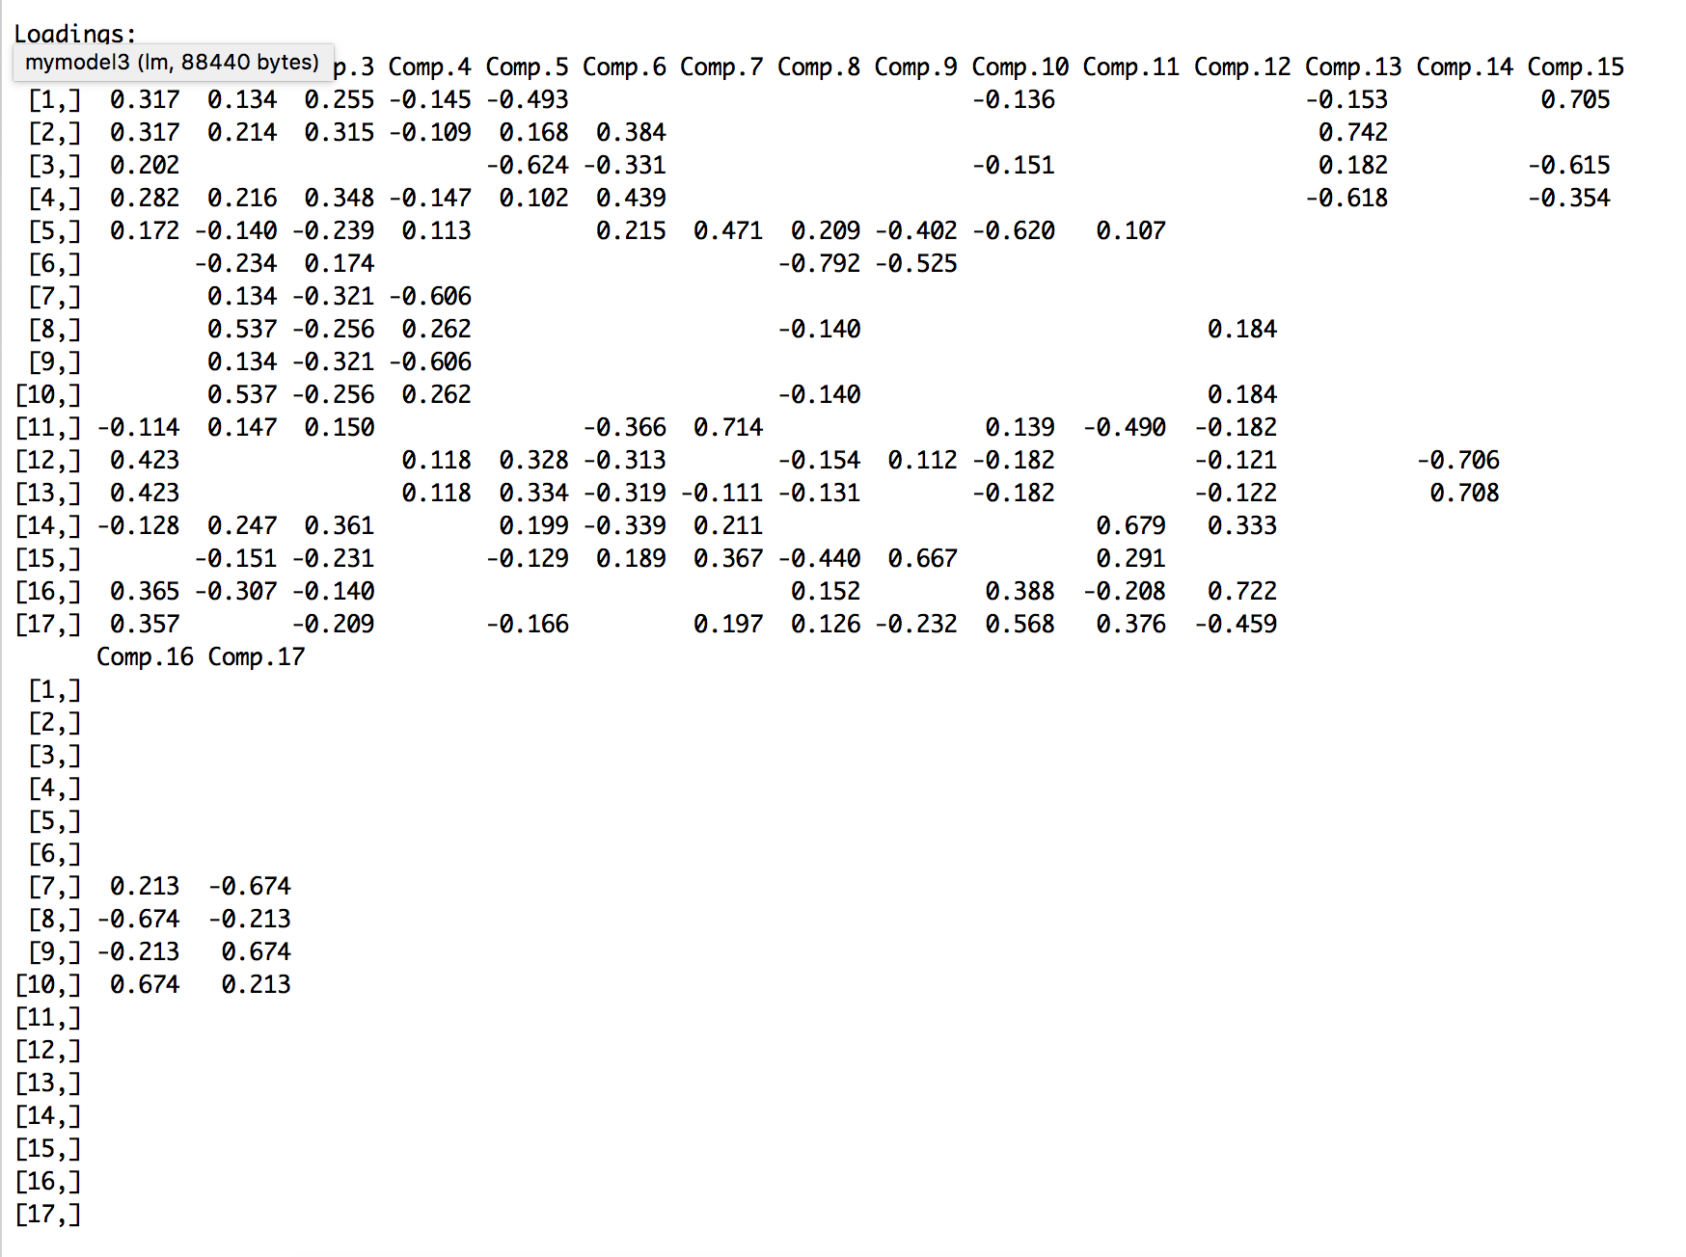
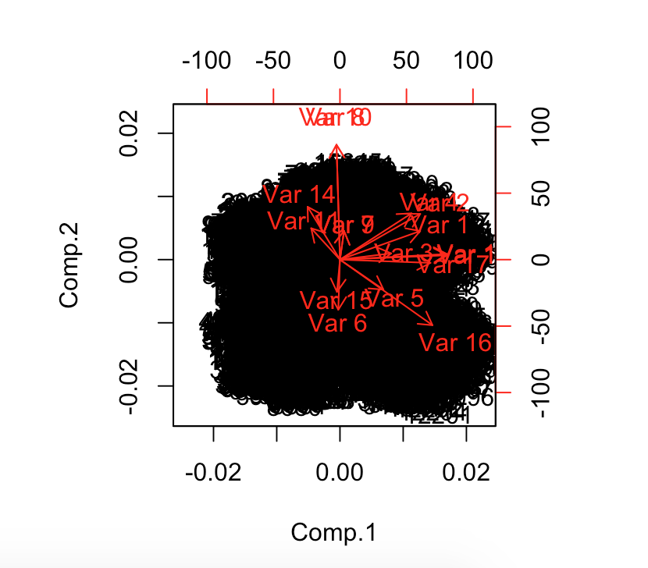
Model 3: PCA con’t

Slide 15
Limitation/Future direction
Try predicting causal and registered users separately
Tree based methods provide weak prediction. Could try random forest for lowering variance.
Variables need extensive recoding when conducting multiple regression

