Slide 1
Online News Popularity
Fangfang Lee
Notes:
The articles were published by Mashable (www.mashable.com) and their content as the rights to reproduce it belongs to them. Hence, this dataset does not share the original content but some statistics associated with it. The original content be publicly accessed and retrieved using the provided urls.

Slide 2
INTRODUCTION
Goal—Use classification algorithm to predict whether an online news article published by Mashable will be popular or not depending on number of shares.
Variables–58 features, including: day of the week the article is published, number of stop words, average number of keywords etc. Response: popular or not depending on number of shares.
Why? Advertisement media could potentially decide where to invest depending on whether a particular article receives popularity.

Slide 3
The Dataset
No missing value; however, some misinformation is present
39644 rows
46 continuous features
13 categorical features
1 continuous target variable (number of shares) → turned into binary categorical variable (whether the article is popular or not popular)

Slide 4
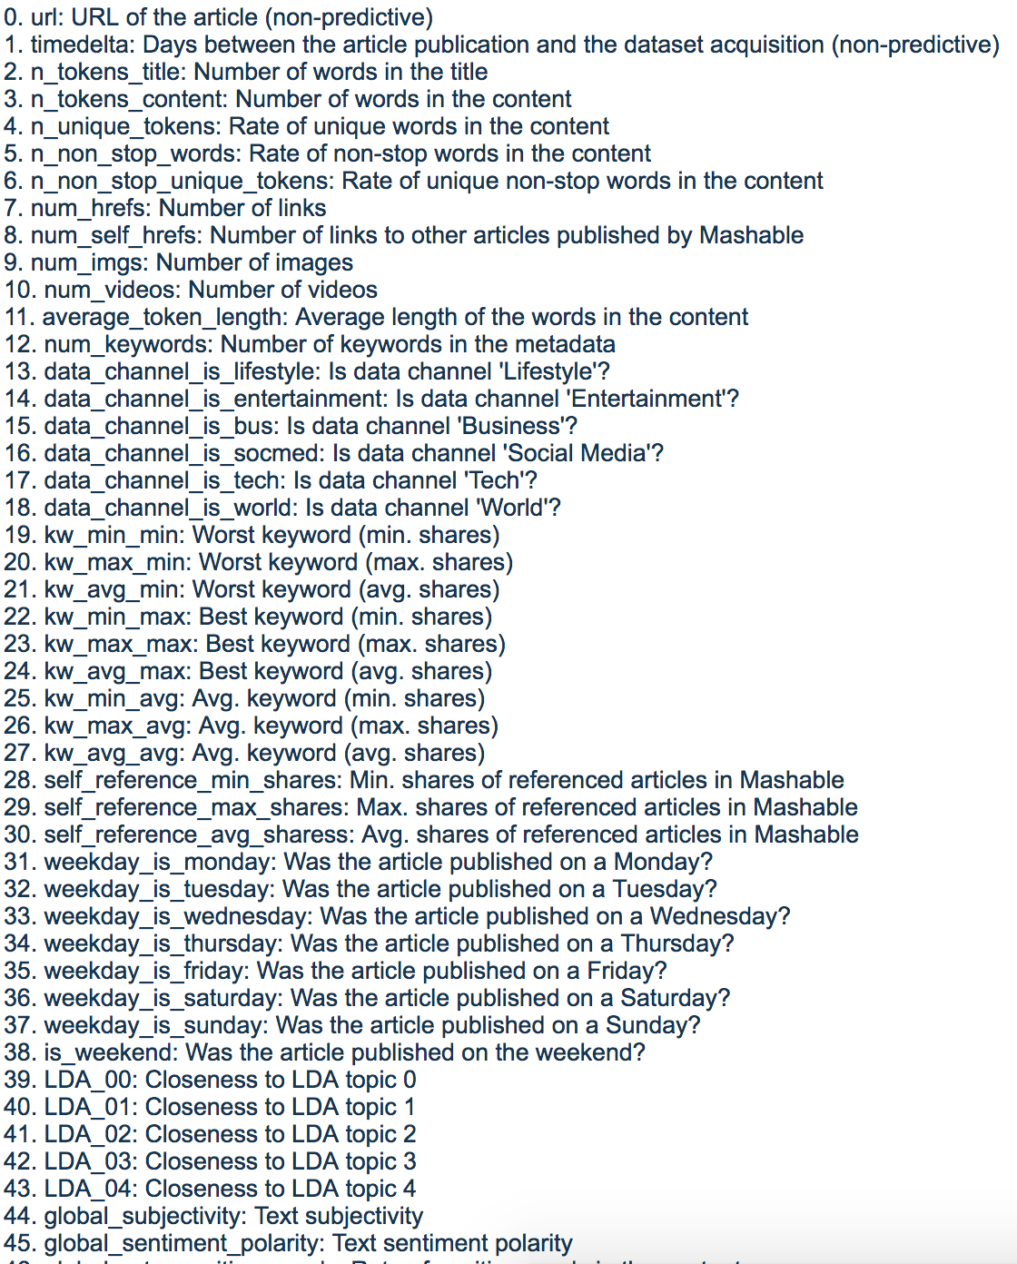

Slide 5
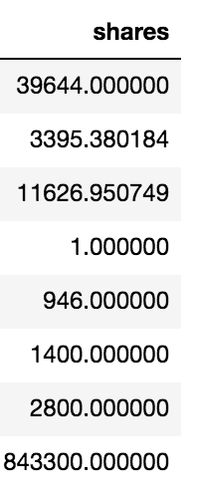
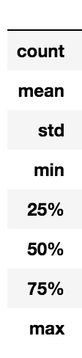
EDA
Notes:
Mean of the shares column: 3395.38 Median of the shares column: 1400
Skewness of popularity shares: 33.9638848757 Kurtosis of popularity shares: 1832.67265716mn: 1400.0 Max value in the shares column 843,300
Populatory Shares appears to be a right-skewed
distribution (mean to the right of the median) with quite a long right tail.
Skewness of popularity shares: 33.9638848757 Kurtosis of popularity shares: 1832.67265716

Slide 6
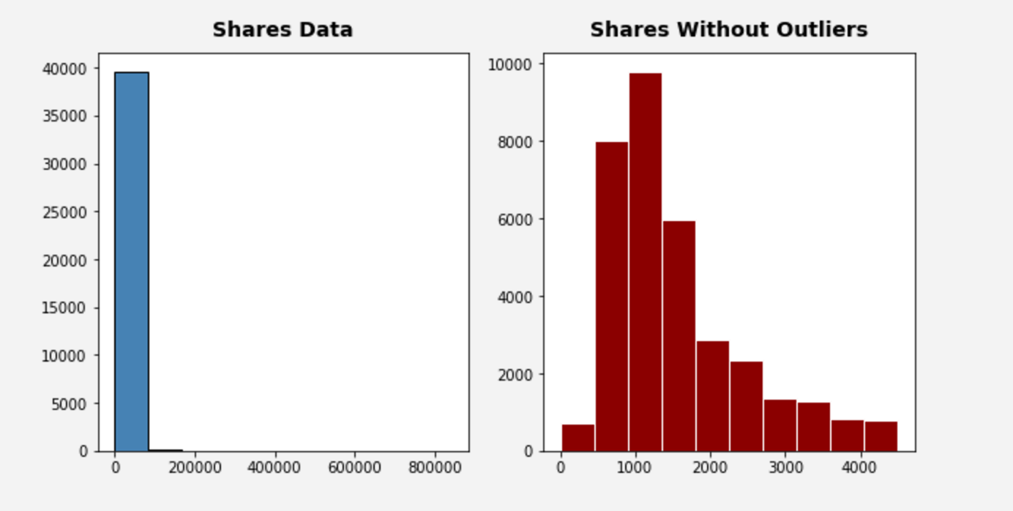
EDA—Visualization
Notes:
The number of shares is highly variant in the dataset with a minimum of 0 shares to a maximum of 843300 shares. The median is 1400, n = 39644.
Populatory Shares appears to be a right-skewed
distribution (mean to the right of the median) with quite a long right tail.

Slide 7


Slide 8


Slide 9
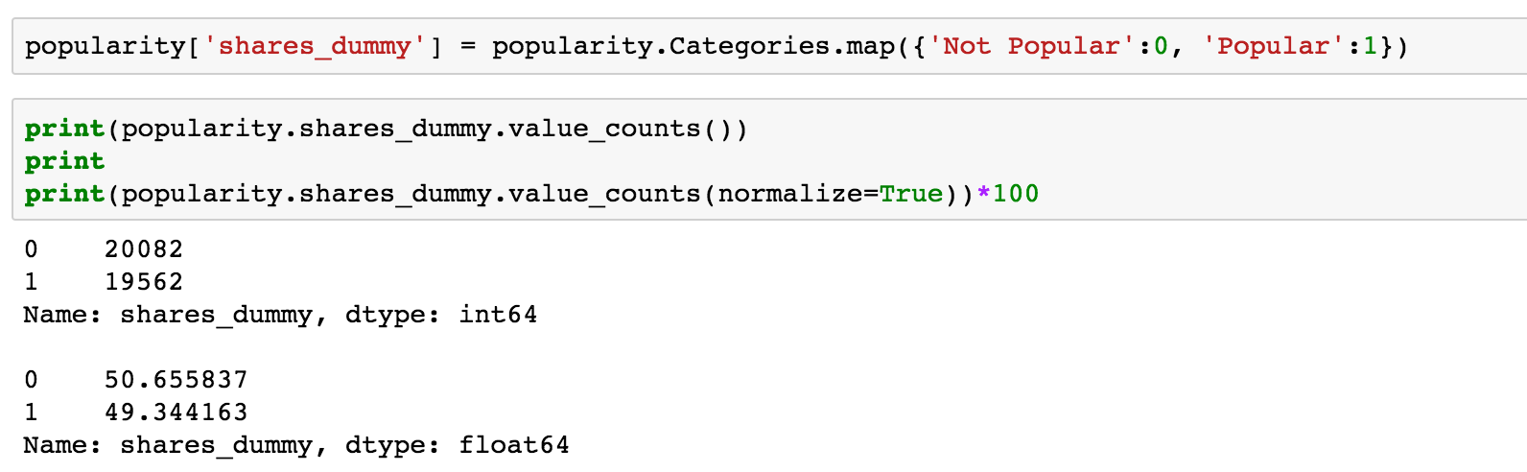
Logistic Regression
Notes:
LDA: will only work well with continuous variables, it classifies the dataset into different groups. LDA The Latent Dirichlet Allocation algorithm was applied to all Mashable texts (known before publication) in order to first identify the five top relevant topics and then measure the closeness of each articles to such topics.

Slide 10
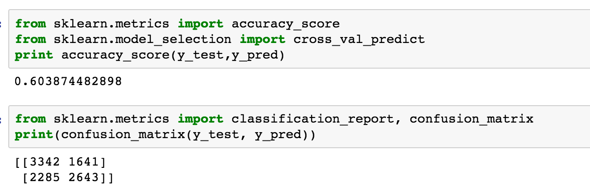
Logistic Regression

Slide 11
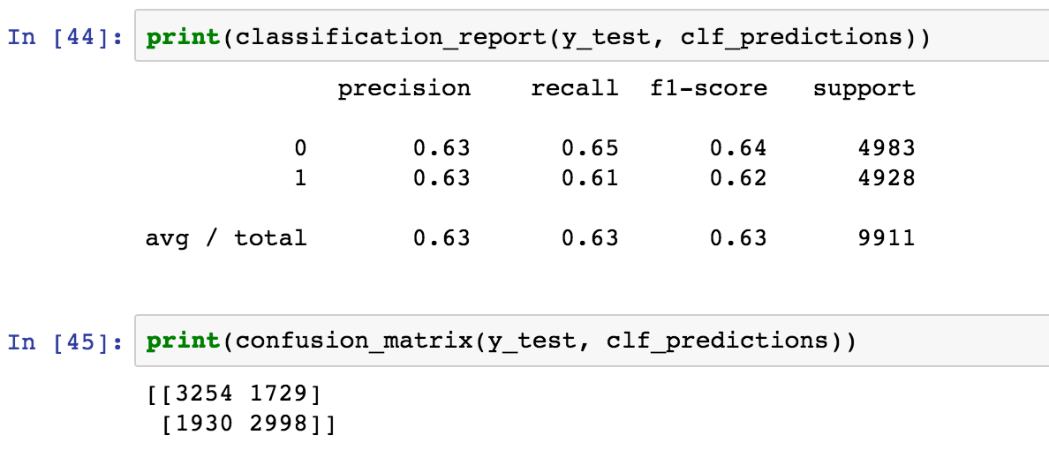
Decision Tree
Notes:
Confusion matrix comes out to 0.627
Recall :
F Score: This is a weighted average of the true positive rate (recall) and precision.

Slide 12
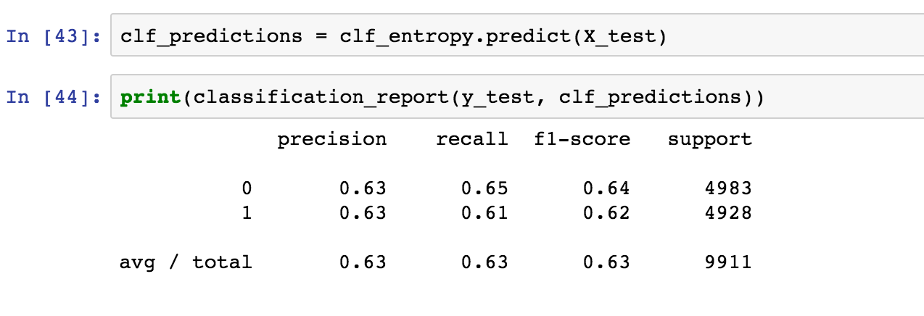
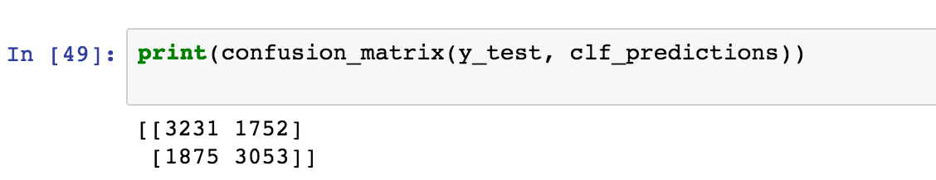
Decision Tree – with Entropy
Notes:
Entropy is the sum of the probability of each label times the log probability of that same label
Entropy on the other hand is a measure of impurity (the opposite). It is defined for a binary classwith values a/b as
Entropy = - p(a)*log(p(a)) - p(b)*log(p(b))
With entropy the accuracy improved to 0.634

Slide 13
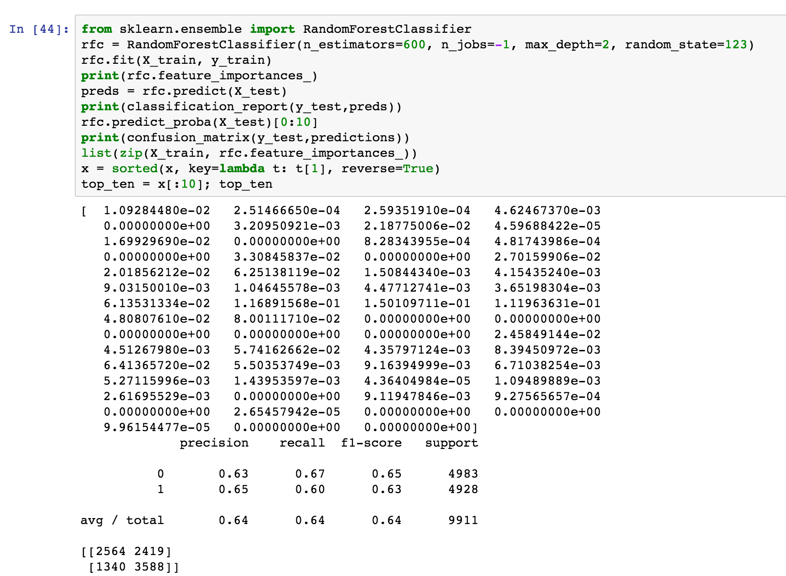
Random Forest

Slide 14
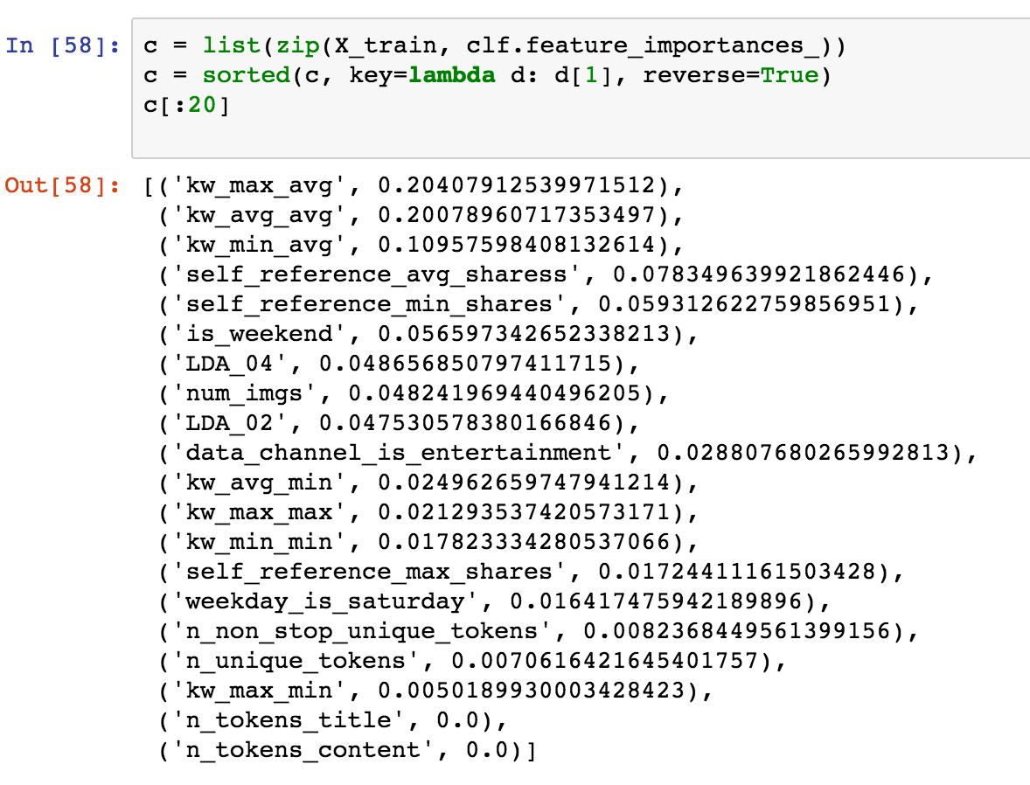
Random Forest

Slide 15
Future Steps
Perform feature selections using algorithm such as PCA or Fisher Criterion
Test the dataset on different models such as SVM or Naive Bayes

