Slide 1
Analyzing and visualizing fungal OTU data with FUNGuild
PDSB Project Proposal
Jessica Hoch

Slide 2
The problem
The data
The tools
No package that streamlines fungal data management and visualization
Fungal OTU table
Functional group table
Sample metadata
FUNGuild
Python
R
Notes:
currently, I am completing a project which aims to characterize plant root-associated fungal communities in NYC and explore how they contribtue to green roof perfomance.
I am using a bioinformatic tool called FUNGuild which assigns fungal OTUs to functional groups. However, there is no package that streamlines data management, statistics, and visualization (relative abundance figures, NMDS plots)
For this project, I will use a table of fungal operational taxonomic units (OTUs) generated from ITS sequence data.

Slide 3
The novelty
The goal
This method will streamline data organization and visualization for fungal functional groups
Produce a Python library documenting this workflow and figures
Notes:
The novelty
This method will streamline data organization, statistics (Bray-Curtis similarity/ANOSIM), and data visualization (NMDS plots, relative abundance figures) for fungal taxonomic data.
The goal
Produce an Python library documenting this workflow (OTU table transformation, difference matrix, statistics, visualization), and figures

Slide 4
Progress
Load data: FUNGuild output, ITS OTU table
Merge data: merge FUNGuild and OTU table by common field (ID)
Collapse data: generate DF of guilds and counts for each sample
Transpose + add metadata
Visualize: create relative abundance figures

Slide 5
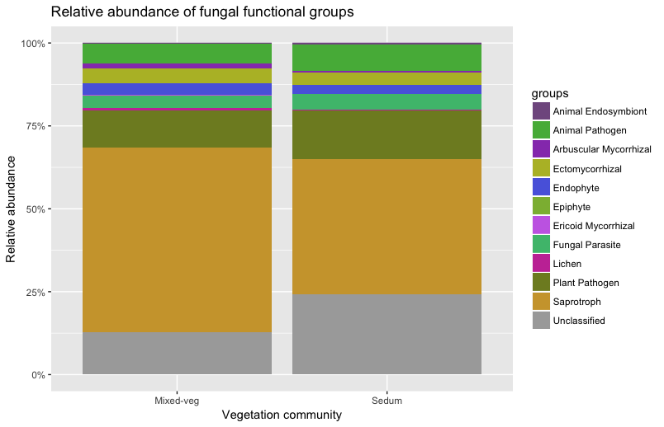

Slide 6
Next steps
Apply workflow in Python

