Slide 1

An Analysis of the Political Landscape of Reddit
Project 1: July 23, 2019
Jarred Brouhard • Scott Fleishman • Jessica Lai • Hakeem Salami

Slide 2
Main Question What is the political landscape of Reddit?
Additional Questions
Does Reddit lean in a particular direction in politics?
Are left-leaning or right-leaning Redditors more politically engaged on Reddit?
Are we seeing one side influence general political subreddits?
How do the subreddits of Democratic presidential candidates compare to current polling data?

Slide 3
What Is Reddit?
According to Wikipedia:
“Reddit is an American social news aggregation, web content rating, and discussion website. Registered members submit content to the site such as links, text posts, and images, which are then voted up or down by other members.”
Reddit is made up of many subreddits, each focusing on
a specific topic.

Slide 4
Glossary | Terms to Know
Subreddit : A forum on Reddit focusing on a specific topic
Post : A submission to Reddit
Upvote Ratio : The percentage of upvotes from all votes on the submission
Score : Number of upvotes minus downvotes for the submission
Comments : Comments made on the post
Author : User who created post
Controversial : Posts that are close to a 50% upvote / downvote ratio

Slide 5
Part 1 Exploring the Engagement of Each Political Party’s Reddit Activity Overview: - Focus on right-leaning & left-leaning - Determine 5 subreddits to analyze for each side - Pull top 100 posts (by score) for each - Create bubble visualizations summarizing each subreddit’s engagement level by Score, Upvote Ratio and Comments

Slide 6
First, How Do We Determine Top 5 Subreddits for Each Side? Steps Taken: - Pull list of subreddits used by Reddit bot “userleansbot” - Use pandas to pull subscriber count for each subreddit - Sort by subscriber count and determine the top 5 subreddits for each party - Supplemental research to reach final decision

Slide 7
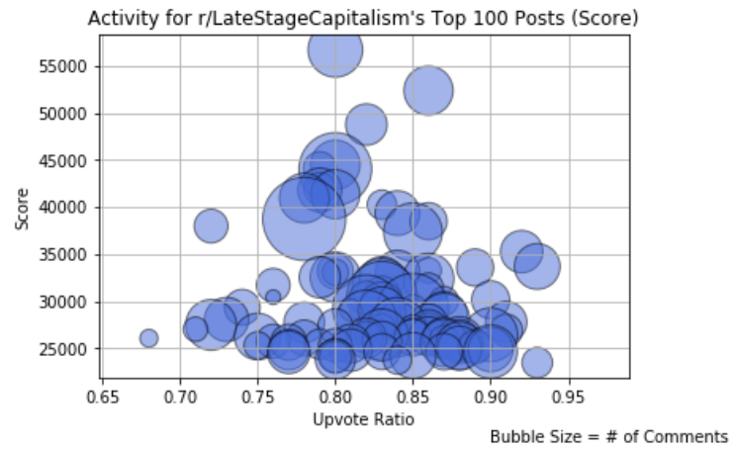
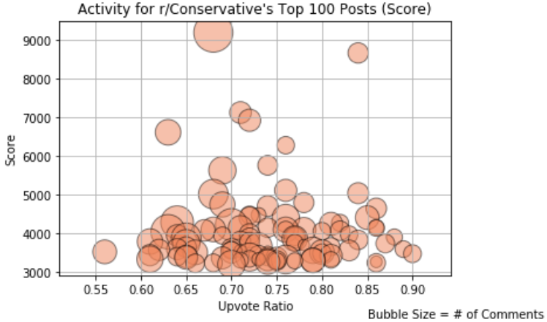


#1 Subreddit for Each Side (Subscribers)
r/LateStageCapitalism (463k) & r/Conservative (235k)

Slide 8
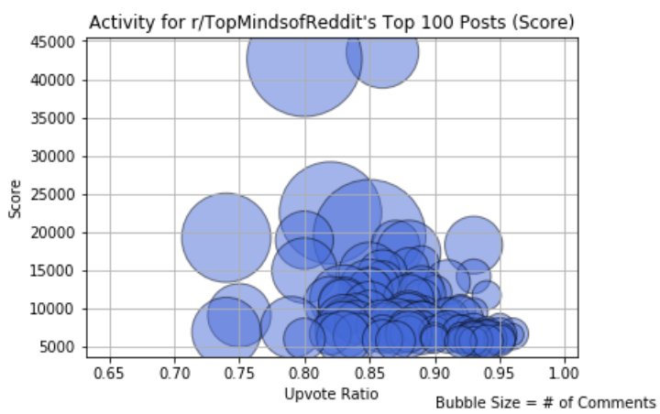
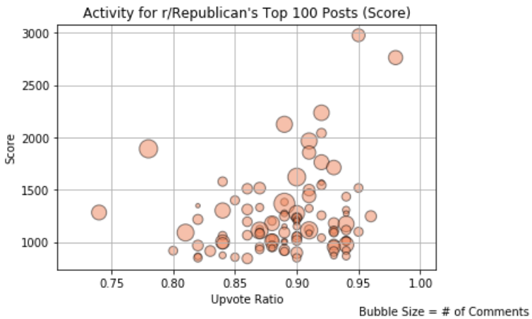


#2 Subreddit for Each Side (Subscribers)
r/TopMindsofReddit (207k) & r/Republican (86.8k)

Slide 9
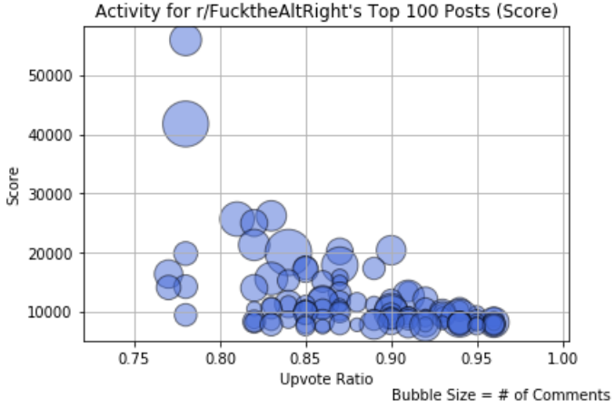
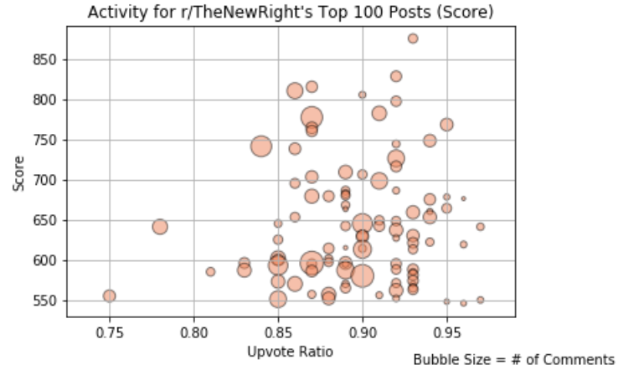


#3 Subreddit For Each Side (Subscribers)
r/FucktheAltRight (122k) & r/TheNewRight (30.6k)

Slide 10
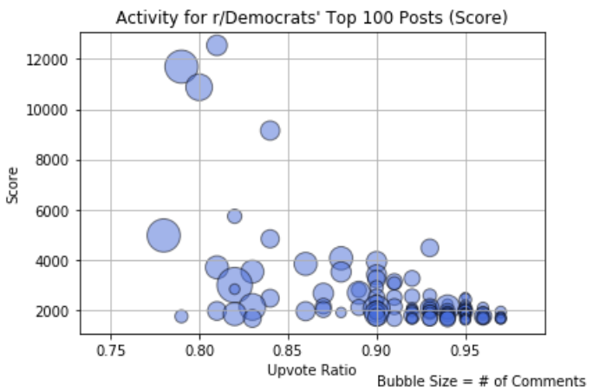
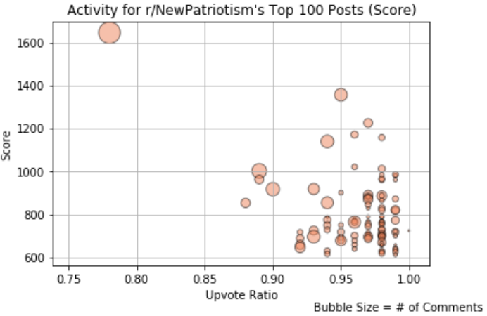


#4 Subreddit For Each Side (Subscribers)
r/Democrats (99.3k) & r/NewPatriotism (22k)

Slide 11
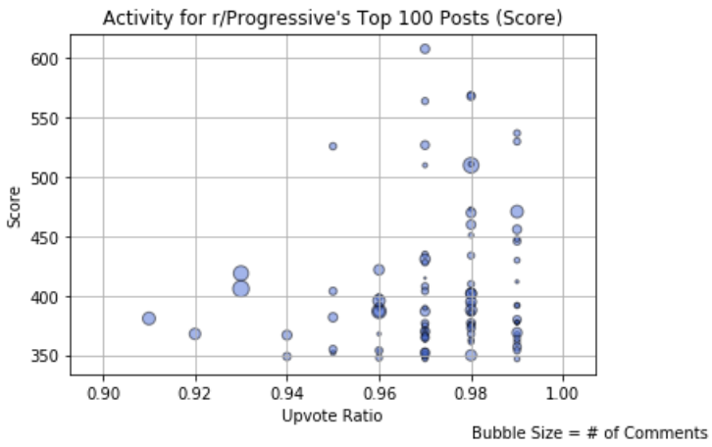
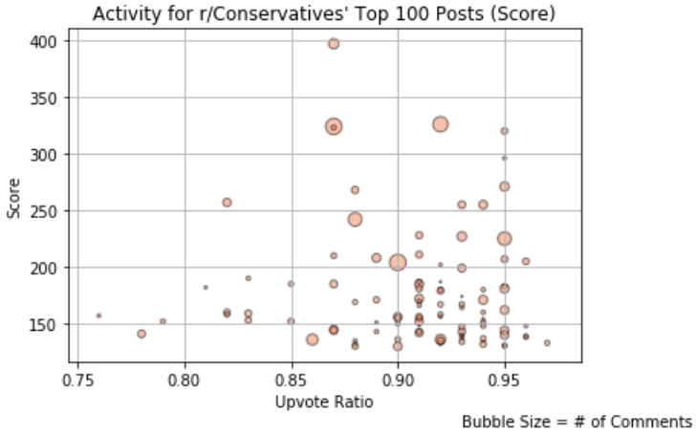


#5 Subreddit for Each Side (Subscribers)
r/Progressive (60.3k) & r/Conservatives (15.4k)

Slide 12
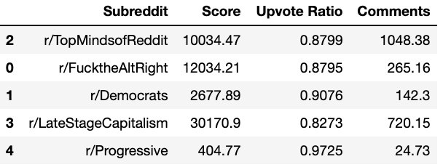
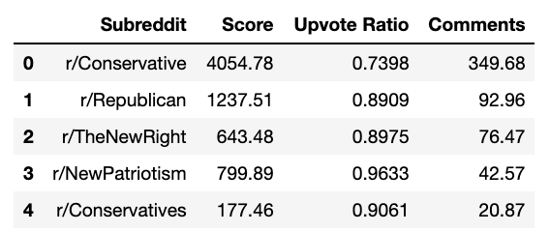
What Did We Discover About Engagement in Left-Leaning vs. Right-Leaning Subreddits?
Based on the posts, left-leaning Redditors were more
active (scores & comments):
 | Avg. Score | Avg. Upvote Ratio | Avg. Comments
Left-Leaning | 11064.45 | 0.89 | 440.14
Right-Leaning | 1382.62 | 0.88 | 116.51

Slide 13
Part 2 Knowing Their Engagement, Are Left-Leaning and Right-Leaning Redditors Also Posting in “Neutral” Subreddits? Overview: - Identify top neutral subreddits - Pull 1000 “Top” authors per subreddit in the last year - Pull 1000 “Controversial” authors per subreddit in the last year - Create venn diagrams to see overlap

Slide 14
Why Did We Pull “Top” and “Controversial”? Posts created by authors can be classified as “Top”, “Gilded”, “Hot”, “New” or “Controversial”. We noticed a small number of authors who often post on their specific party subreddits, get classified as “Controversial” (posts receiving equal upvotes and downvotes with a lot of activity) in subreddits outside of their political party.

Slide 15
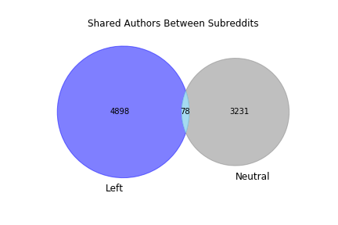
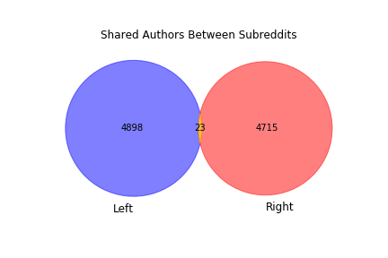
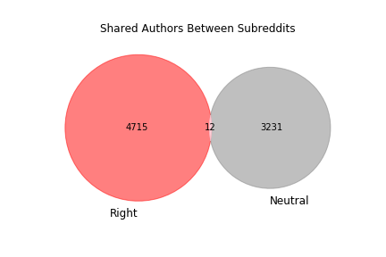
Where are Authors Posting?

Slide 16
What Did We Discover?

Slide 17
Part 3 Knowing Part 2, How Are Left-Leaning and Right-Leaning Redditors’ Posts Performing in “Neutral” Subreddits? Overview: - Create bubble scatters to see performance

Slide 18
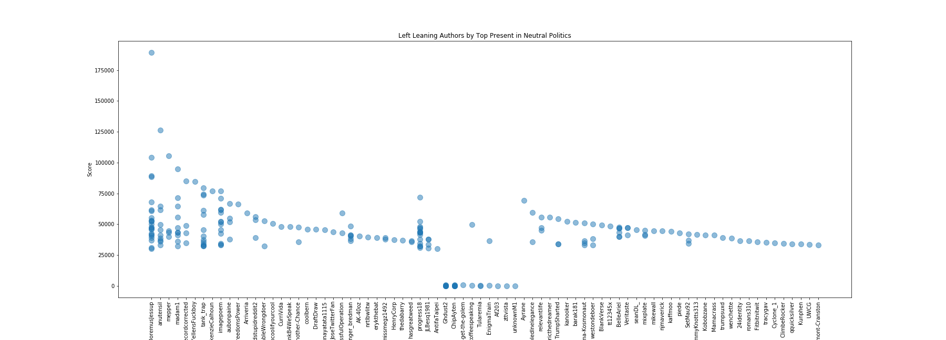

Slide 19
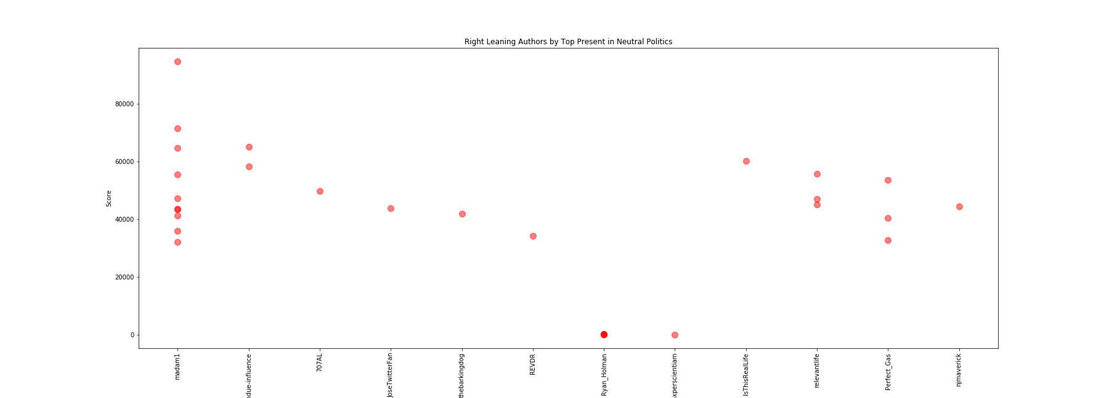

Slide 20
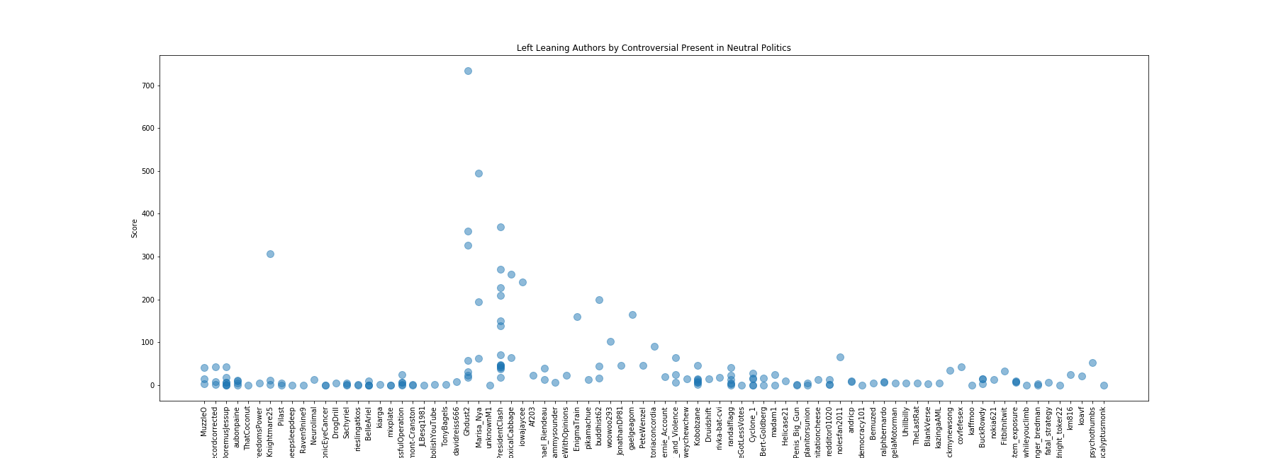

Slide 21
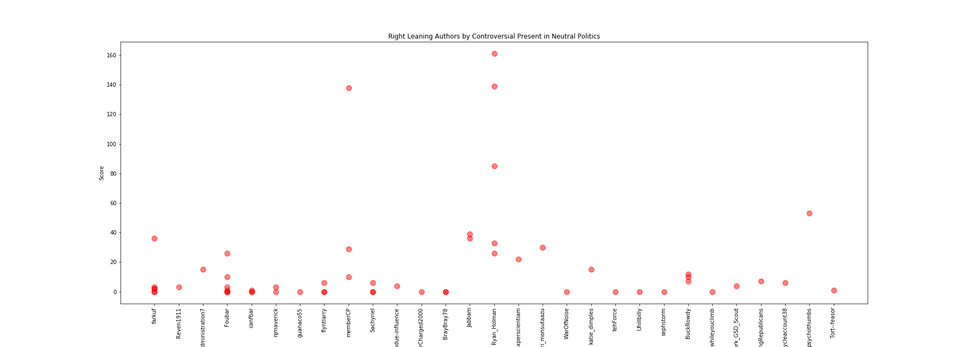

Slide 22
What Did We Discover?

Slide 23
Part 4 Now That We Conclude Reddit Leans Left, How Do the Subreddits of Democratic Presidential Candidates Compare to Current Polling Data? Overview: - Find current polling data for top candidates - Research to find the top Subreddit for each of the top 20 candidates - Use pie charts to illustrate and compare percentages

Slide 24
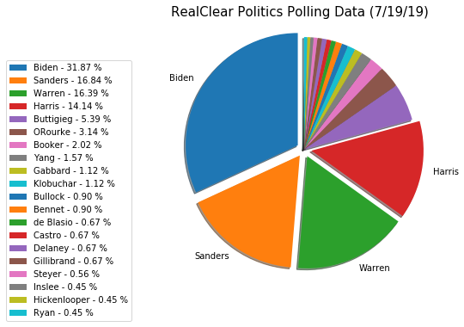
Current Polling Data

Slide 25
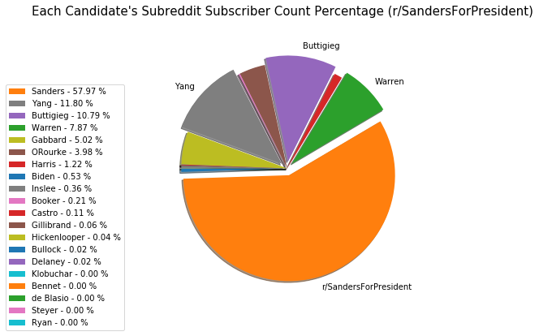
Candidates’ Subreddit by Subscriber Count

Slide 26
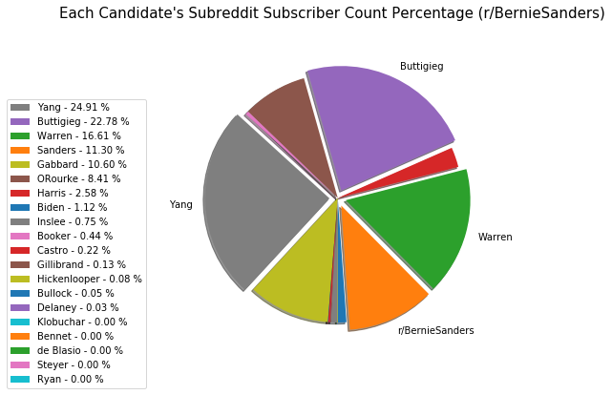
Candidates’ Subreddit by Subscriber Count

Slide 27
Comparison (Polling Data vs. Subreddit Subscriber Counts)

Slide 28
What Did We Discover?

Slide 29
Things to Consider: - Banned subreddits weren’t included Examples: r/The_Donald with its 771k subscribers (this was later discovered to be unbanned and was moved to quarantine) and r/Physical_Removal to name a couple
- Excluded from results are any posts classified as “Gilded”, “Hot”, or “New”
- We had to drop multiple “None” Authors (posts were deleted/banned/removed)
- Our limitations were based on what Praw was able to pull (one year of data and only 1000 posts)
- Smaller subreddits didn’t have enough for us to pull
1000 posts

Slide 30
Our Main Question What is the political landscape of Reddit?
Final Conclusion Reddit is a left-leaning platform with a tendency to lean to the far left. There is more favorable overlapping activity amongst subscribers and authors in left-leaning subreddits and “neutral” subreddits.

