Slide 1
Controlling for sequence count variation Calculating alpha and beta diversity

Slide 2
Uneven sequences per sample
You will get a different number of sequences for each of your samples.
This can cause issues in analyses, leading samples to group together due to similar number of sequences as opposed to biological reasons.
Sequences per sample
extraction blank
untouched
surfaces
hands
ceramic
touched
glass
touched
plastic
touched
wood
touched
metal
touched
Notes:
Class exercise – students run alpha and beta diversity on samples with all reads versus normalizing and rarifying

Slide 3
Rarifying or normalizing your sequences per sample
Rarify – random subsample without replacement so that each data set has the same number of sequences
Cumulative sum scaling (CSS) – proportions scaling with corrections for issues with differential abundance that are introduced by total-sum normalization. Raw counts are divided by the cumulative sum of counts up to a percentile (e.g. 75%) determined using a data driven approach.
DESeq- detects and corrects dispersion estimates that are too low through modeling of the dependence of the dispersion on the average expression strength over all samples. Originally for RNAseq data and adapted for microbiome data.
Notes:
Class exercise – students run alpha and beta diversity on samples with all reads versus normalizing and rarifying

Slide 4
Rarifying or normalizing your sequences per sample
Weiss et al. 2015
For abundance-based metrics, rarefying as well as alternatives like DESeq and metagenomeSeq’s cumulative sum scaling (CSS), seem to correctly cluster samples according to biological origin.
Effects of differential abundance testing model choice:
When the mean library sizes in the differential abundance groups differ by more than 2-3x, or the library sizes differ in distribution, our simulation studies reveal that each statistical method improved in its false positive rate when samples were rarefied. However, when the difference in library size mean is less than 2-3x, and the library sizes are similarly distributed, rarefying results in a loss of power for all methods.
Notes:
Class exercise – students run alpha and beta diversity on samples with all reads versus normalizing and rarifying

Slide 5
Are your treatments different? Alpha and Beta Diversity

Slide 6
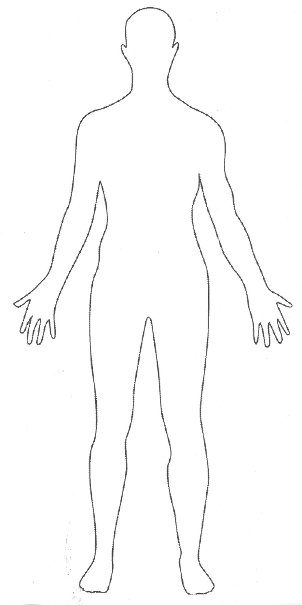
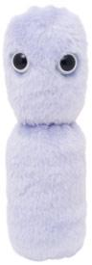
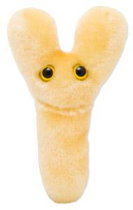
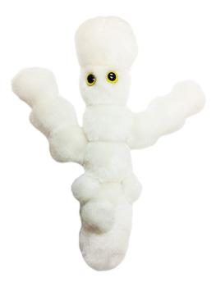
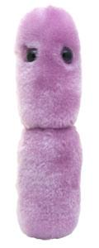
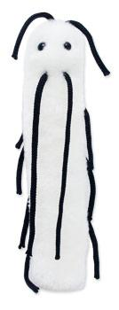
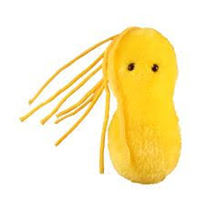
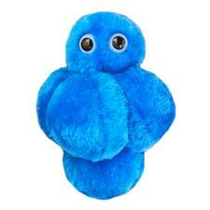
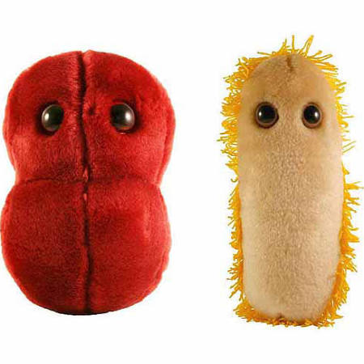
Alpha diversity: number of types of microbes

Slide 7
Alpha diversity metrics
Species diversity = species richness and species evenness.
Species richness = the number of different species.
Species richness = measure of similarity in counts of each species.
In QIIME, alpha diversity options can be viewed with
alpha_diversity.py –s
ace, berger_parker_d, brillouin_d, chao1, chao1_ci, dominance, doubles, enspie, equitability, esty_ci, fisher_alpha, gini_index, goods_coverage, heip_e, kempton_taylor_q, margalef, mcintosh_d, mcintosh_e, menhinick, michaelis_menten_fit, observed_otus, observed_species, osd, simpson_reciprocal, robbins, shannon, simpson, simpson_e, singles, strong, PD_whole_tree
PD_whole_tree – Faith’s phylogenetic diversity. All branch lengths are added up in the 16S rRNA tree of your sequences.
Chao1 – based on the number of rare taxa. If you have a lot of OTUs counted just a few times, there’s likely a high number of undetected OTUs. Type of species richness.
Shannon's index - accounts for both abundance and evenness of the species present.
Observed otus – simply counting OTUs
Simpson –Proportion of species relative to the total number of species. Type of species richness.

Slide 8
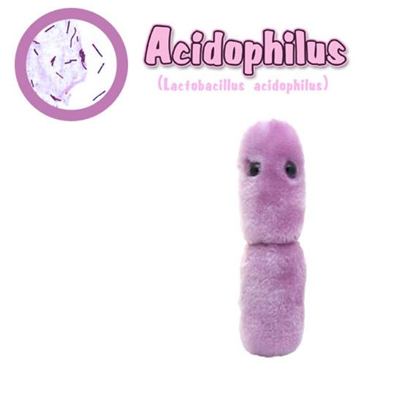
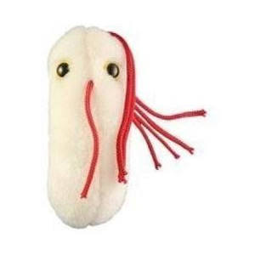
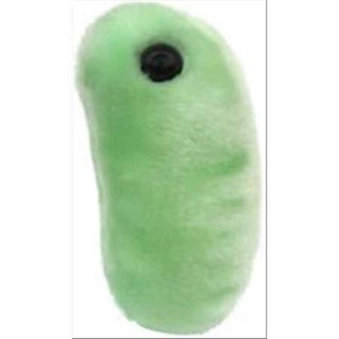
Beta diversity: difference between communities

Slide 9
Beta diversity metrics
In QIIME, alpha diversity options can be viewed with
beta_diversity.py –s
abund_jaccard, binary_chisq, binary_chord, binary_euclidean, binary_hamming, binary_jaccard, binary_lennon, binary_ochiai, binary_otu_gain, binary_pearson, binary_sorensen_dice, bray_curtis, bray_curtis_faith, bray_curtis_magurran, canberra, chisq, chord, euclidean, gower, hellinger, kulczynski, manhattan, morisita_horn, pearson, soergel, spearman_approx, specprof, unifrac, unifrac_g, unifrac_g_full_tree, unweighted_unifrac, unweighted_unifrac_full_tree, weighted_normalized_unifrac, weighted_unifrac
Unifrac – distance between two microbial communities measured by the fraction of total unshared branch lengths. Unweighted unifrac– does not include relative abundance. Weighted unifrac – Includes relative abundance.
Bray Curtis dissimilarity – Compositional dissimilarity based on counts of OTUs in each sample. Related to the Sorensen Dice similarity index.
Do you have a phylogenetic tree? Is it robust?

Slide 10
PCoA: visualize beta diversity
PC2 – 5%
PC1 – 15%

Slide 11
Next week (final week) Machine learning

