Slide 1
Inspecting your OTU table

Slide 2
.biom format
http://biom-format.org/
efficient handling and storage of large, sparse biological contingency tables
Can also store metadata in biom file (although we don’t with amplicon data tables
Standard format useful for multiple tools (QIIME, VAMPS, MG-RAST)

Slide 3
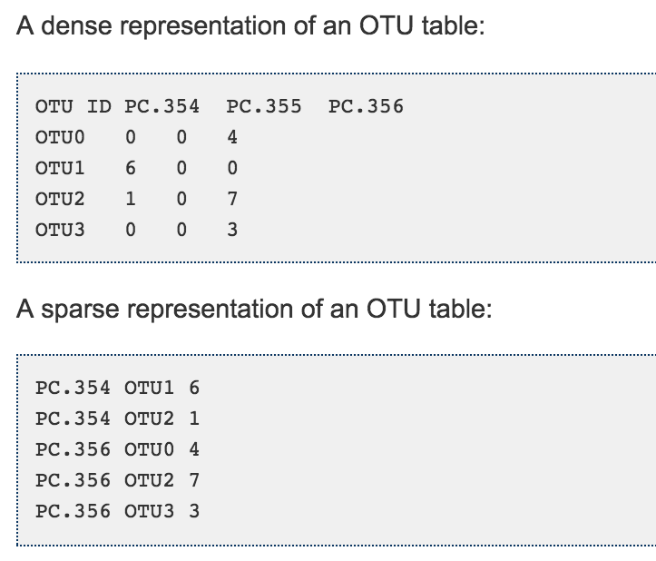
.biom format
http://biom-format.org/
efficient handling and storage of large, sparse biological contingency tables
Can also store metadata in biom file (although we don’t with amplicon data tables
Standard format useful for multiple tools (QIIME, VAMPS, MG-RAST)

Slide 4
.Biom format commands
You may want to convert your biom table to a “classic” OTU table
http://biom-format.org/documentation/biom_conversion.html
biom convert -i table.biom -o table.from_biom_w_taxonomy.txt --to-tsv --header-key taxonomy
You will want to summarize the information in your .biom table
http://biom-format.org/documentation/summarizing_biom_tables.html#summarizing-sample-data
biom summarize-table -i rich_sparse_otu_table.biom -o rich_sparse_otu_table_summary.txt

Slide 5
How does your sequence/sample distribution look?
You can open the results of summarize-table in excel or similar
What is the range of sequences per sample?
How many sequences do your blanks/negative control samples have?
Compare your closed reference summarize-table output to your split_library output or closed vs open reference otu table. Why are they different?

Slide 6
Sequences per sample
extraction blank
untouched
surfaces
hands
ceramic
touched
glass
touched
plastic
touched
wood
touched
metal
touched
Notes:
Opened in excel and organized by sample type and sorted by seqs per sample within sample type

Slide 7
How many extremely rare OTUs do you have? Are they all real?
filter_otus_from_otu_table.py
Bokulich et al. 2013. For data sets where a mock community is not included for calibration, we recommend a conservative OTU threshold of c = 0.005%.
--min_count_fraction 0.00005
http://www.nature.com/nmeth/journal/v10/n1/full/nmeth.2276.html
New OTU picking method should help with this issue https://github.com/amnona/deblurring
Notes:
Note, if doing a metaanalysis, I wouldn’t filter the min fraction filtering step. It can cause issues.

Slide 8
What taxa are represented in your OTU table? Are they all Bacteria or Archaea?
filter_taxa_from_otu_table.py
Either run summarize_taxa, convert your .biom to a classic OTU table, or grep and check for the following, or just filter out c__Chloroplast, f__mitochondria
Open-ref otu picking, also check for sequences not clustering with either Bacteria or Archaea
Notes:
Note, if doing a metaanalysis, I wouldn’t filter the min fraction filtering step. It can cause issues.

Slide 9
Check your sequence distribution again Were some sample affected more than others?
Consider filtering out samples that don’t meet a minimum threshold of sequences
filter_samples_from_otu_table.py
-n, --min_count

Slide 10
Rarifying or normalizing your sequences per sample

