Slide 1
SWEAR-ANALYSIS
Project Demonstration.

Slide 2
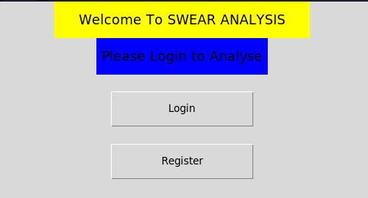
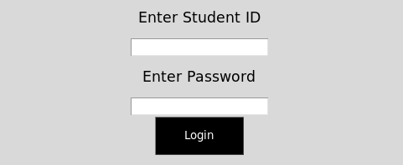
Login(Student)
To proceed into the project you have to log in/register.

Slide 3
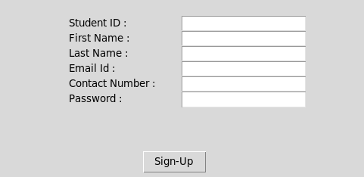
Registration Form
When Registration is clicked, it presents a form for filling in details to register into the software:
After registration you’ll be taken back to login.

Slide 4
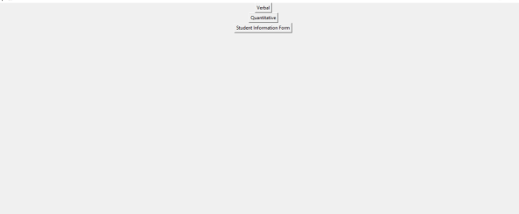
Add more Details
After logging in , you have to add more details.Click the button to proceed.
Student information details

Slide 5
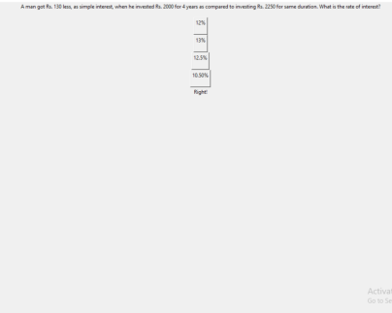
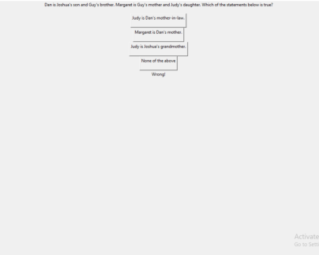
Selecting modules and quizes
Select modules to interact with :

