Slide 1






WHISPERSEND
CAPSTONE PROJECT PHASE B
24-1-D-21
Supervisors: Alexander Keselman
Jessica Amirov
Yarden Gabay

Slide 2

INTRODUCTION
We use the Internet daily for file transfers
It is crucial to keep information private and secure
Most encryption applications rely on centralized servers

Slide 3

PROBLEM OVERVIEW
Need for secure communication
Exposure of Information to Third Parties
Frequent hacks
Notes:
1. **Need for Secure Communication**: There's a pressing need for secure, private communication methods that avoid central vulnerabilities.
2. **Frequent Hacks**: Centralized systems are hacked multiple times a year, compromising sensitive data.
3. **Privacy Risks**: Reliance on centralized servers can lead to unauthorized data access and privacy breaches.

Slide 4
OUR SOLUTION
A SECURE WEB APPLICATION FOR ALL DEVICES
Peer-to-Peer network
Asymmetric encryption for data security
User-Friendly and accessible for all devices
Offers security almost as robust as blockchain
Notes:
Decentralized, Peer-to-Peer Network:
Explanation: P2P networks distribute data across multiple nodes, eliminating the need for a central server.
Benefits: Increases security by removing single points of failure and reducing attack surfaces.
Asymmetric Encryption for Data Security:
Explanation: Uses a pair of keys – public and private. The public key encrypts data, and only the corresponding private key can decrypt it.
Benefits: Ensures that only authorized users can access the data, providing robust security.
## Our Solution: A Secure Web Application for All Devices
### Key Features
**Decentralized, Peer-to-Peer Network**
- **Explanation**: P2P networks distribute data across multiple nodes, eliminating the need for a central server.
- **Benefits**: Increases security by removing single points of failure and reducing attack surfaces.
**Asymmetric Encryption for Data Security**
- **Explanation**: Uses a pair of keys – public and private. The public key encrypts data, and only the corresponding private key can decrypt it.
- **Benefits**: Ensures that only authorized users can access the data, providing robust security.
**User-Friendly and Accessible**
- **Multi-Device Compatibility**: Works seamlessly on desktops, tablets, and smartphones.
- **No Registration Required**: Easy to use without the need for lengthy sign-ups.
**Privacy and Anonymity**
- **No Central Data Storage**: Data is not stored on central servers, reducing the risk of unauthorized access.
- **Automatic Key Deletion**: Encryption keys are automatically deleted when users leave the site.
**Compliance with Data Protection Laws**
- **Regulatory Adherence**: Meets strict data protection regulations like GDPR and HIPAA.
**Maintaining User Trust**
- **Reliable and Secure**: Provides a trustworthy platform for secure file transfers, enhancing user confidence.

Slide 5
Key System Requirements
User-Friendly web interface
Secure key generation without storage in DB
Direct anonymous communication with a focus on user privacy
Notes:
Decentralized, Peer-to-Peer Network:
Explanation: P2P networks distribute data across multiple nodes, eliminating the need for a central server.
Benefits: Increases security by removing single points of failure and reducing attack surfaces.
Asymmetric Encryption for Data Security:
Explanation: Uses a pair of keys – public and private. The public key encrypts data, and only the corresponding private key can decrypt it.
Benefits: Ensures that only authorized users can access the data, providing robust security.
## Our Solution: A Secure Web Application for All Devices
### Key Features
**Decentralized, Peer-to-Peer Network**
- **Explanation**: P2P networks distribute data across multiple nodes, eliminating the need for a central server.
- **Benefits**: Increases security by removing single points of failure and reducing attack surfaces.
**Asymmetric Encryption for Data Security**
- **Explanation**: Uses a pair of keys – public and private. The public key encrypts data, and only the corresponding private key can decrypt it.
- **Benefits**: Ensures that only authorized users can access the data, providing robust security.
**User-Friendly and Accessible**
- **Multi-Device Compatibility**: Works seamlessly on desktops, tablets, and smartphones.
- **No Registration Required**: Easy to use without the need for lengthy sign-ups.
**Privacy and Anonymity**
- **No Central Data Storage**: Data is not stored on central servers, reducing the risk of unauthorized access.
- **Automatic Key Deletion**: Encryption keys are automatically deleted when users leave the site.
**Compliance with Data Protection Laws**
- **Regulatory Adherence**: Meets strict data protection regulations like GDPR and HIPAA.
**Maintaining User Trust**
- **Reliable and Secure**: Provides a trustworthy platform for secure file transfers, enhancing user confidence.

Slide 6

Technologies & Tools
PeerJS
Ethers.js
Tailwind CSS
GitHub
Turn server

Slide 7
Success Criteria
Security
Performance
User Experience
Data Privacy
Notes:
Security: Ensures proper encryption and decryption, preventing unauthorized access, with full anonymity maintained by deleting and regenerating keys for each session.
Performance: Efficient peer-to-peer communication with minimal delays, supporting multiple users simultaneously without server overload.
User Experience: Delivers a reactive chat experience in line with online chat standards, with high user satisfaction for ease of use and reliability.
Data Privacy: No storage of encryption keys, ensuring complete anonymity.
שמרנו על מקסימום דיסקרטיות כמו ששינינו שמות לקבצים
הצפנה ופענוח נותנים את אותו קובץ
שימוש בנונס

Slide 8
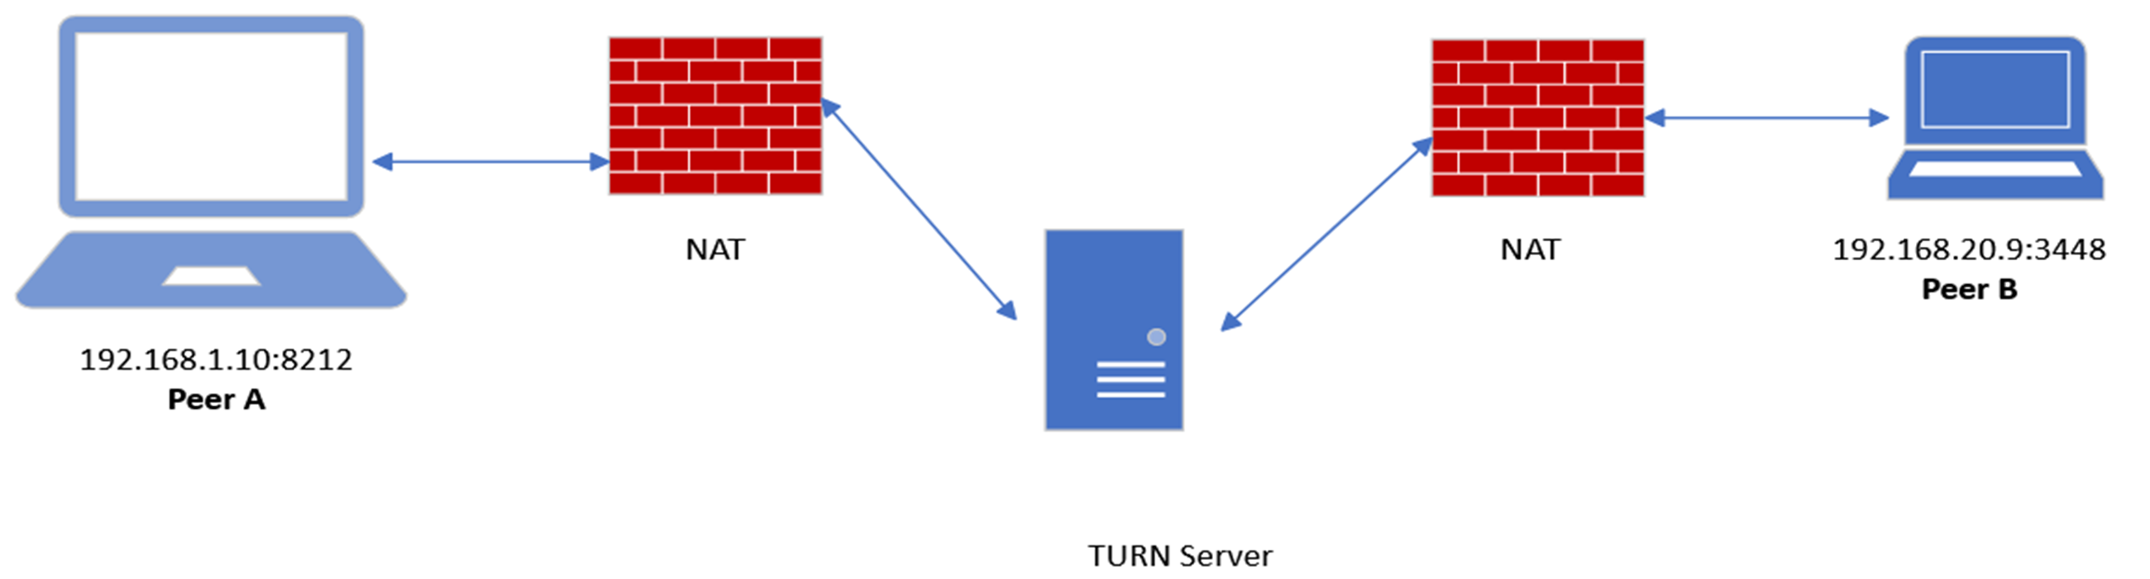
Challenges
User Accessibility for Non-Technical Users
P2P Connection in Restricted Networks
Notes:
Key Generation Compatibility: Overcame size and format issues by switching from Elliptic to Ethers.js for key generation.
Performance: Optimized file encryption and chat functions to ensure fast processing with different files of varying sizes.
User Accessibility for Non-Technical Users: Solved by designing a simple, intuitive interface with context-specific instructions, automating encryption tasks to avoid overwhelming users.
**P2P Connection in Restricted Networks**: Solved by configuring external STUN/TURN servers to relay information when direct P2P connections are blocked within restricted LAN environments, ensuring seamless communication. Example: using Google's STUN server in the configuration.

Slide 9
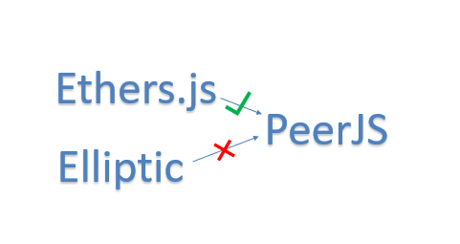
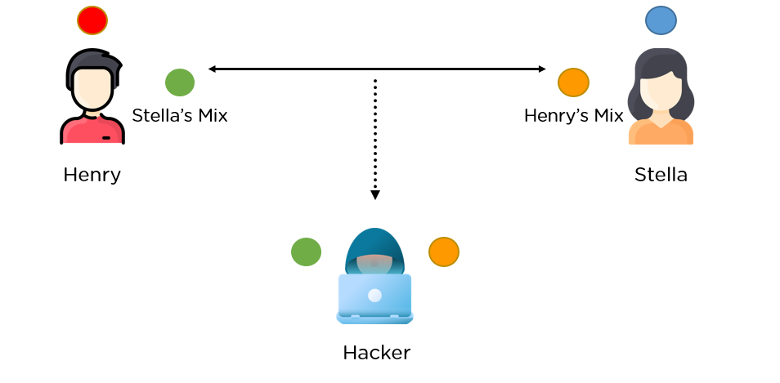
Challenges
Key Generation
Key Format Compatibility in PeerJS
Notes:
Key Generation Compatibility: Overcame size and format issues by switching from Elliptic to Ethers.js for key generation.
Performance: Optimized file encryption and chat functions to ensure fast processing with different files of varying sizes.
User Accessibility for Non-Technical Users: Solved by designing a simple, intuitive interface with context-specific instructions, automating encryption tasks to avoid overwhelming users.
**P2P Connection in Restricted Networks**: Solved by configuring external STUN/TURN servers to relay information when direct P2P connections are blocked within restricted LAN environments, ensuring seamless communication. Example: using Google's STUN server in the configuration.

Slide 10
System Demo
How It Works
Step 1: User enters the site and encryption keys are generated.
Step 2: User invites a peer using their unique Peer ID.
Step 3: Files are encrypted and decrypted in the direct chat.
Notes:
Suppose I am within the college's LAN network, which has various restrictions.
These restrictions prevent me from establishing a direct P2P connection.
In this case, we will use an external TURN server that is outside of my LAN network.
The TURN server will relay my information, so there won't be a true direct P2P connection.

Slide 11

THANKS FOR LISTENING
ANY QUESTIONS ?

