Slide 1





Slide 2
Train – test split
EDA
Model Building
Final Evaluation
X
y
X_train (70%)
Y_train
X_train
Y_train
X_train
Y_train
X_valid (15%)
Y_valid
X_valid (15%)
Y_valid
X_valid (15%)
Y_valid
X_test (15%)
Y_test
X_test (15%)
Y_test

Slide 3
Data
90% of patient healthy
10% with cancer

Slide 4

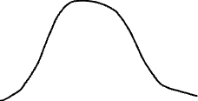
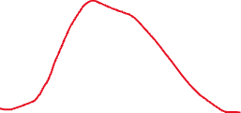
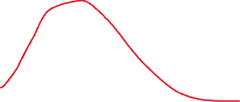
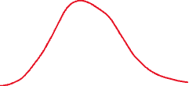
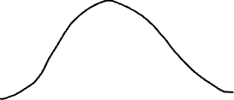

Slide 5
X_train (120 samples)
Y_train (120 answers here)
Y_test (30 answers here)
LogisticRegression
X_test (30 samples here)
Y_pred (30 predictions here)

Slide 6
Regression
X
y
Age | Sex | Experience | Salary
19 | M | 0 | 54000
26 | M | 3 | 67000
34 | F | 10 | 85000
56 | M | 25 | 120000
44 | F | 10 | 95000
27 | F | 7 | 87000

Slide 7
Classification
X
y
Age | Sex | Sugar Every Week | Cancer
19 | M | 0 | 0
26 | M | 3 | 0
34 | F | 10 | 0
56 | M | 25 | 1
44 | F | 10 | 1
27 | F | 7 | 0

Slide 8
Age | Sex | Sugar
X_test (15%)
Y_pred
Target
54000
65000
120000
18000
Y_test
Target
80000
60000
110000
25000
Model

Slide 9




Y_pred
54000
65000
120000
18000
Y_test
80000
60000
110000
25000

Slide 10


Slide 11
Age | Sex | Sugar Every Week | Y_test
19 | M | 0 | No
26 | M | 3 | No
34 | F | 10 | No
56 | M | 25 | Yes
44 | F | 10 | Yes
27 | F | 7 | No
Y_pred
No
Yes
No
Yes
No
No

Slide 12
Defintions
True Positives (TP): actually positive and predicted as positive
True Negative (TN): actually negative and predicted as negative
False Positive (FP): actually negative and predicted positive
False Negative (FN): actually positive and predicted negative

Slide 13
X
y
X_train (70%)
Y_train
X_train (70%)
Y_train
X_valid (15%)
Y_valid
X_valid (15%)
Y_valid
X_test (15%)
Y_test

Slide 14
Fold 1
Fold 2
Fold 3
Fold 4
Fold 5
X_train
Y_train
X_train
Y_train
X_train
Y_train
X_train
Y_train
X_valid
Y_valid
X_train
Y_train
X_valid
Y_valid
X_valid
Y_valid
X_train
Y_train
X_valid
Y_valid
X_train
Y_train
X_valid
Y_valid
X_train
Y_train
X_test (15%)
Y_test
R2 = 78%
R2 = 79%
R2 = 58%
R2 = 98%
R2 = 78%

