Slide 1
Video Game Sales
Tableau Hands-On

Slide 2
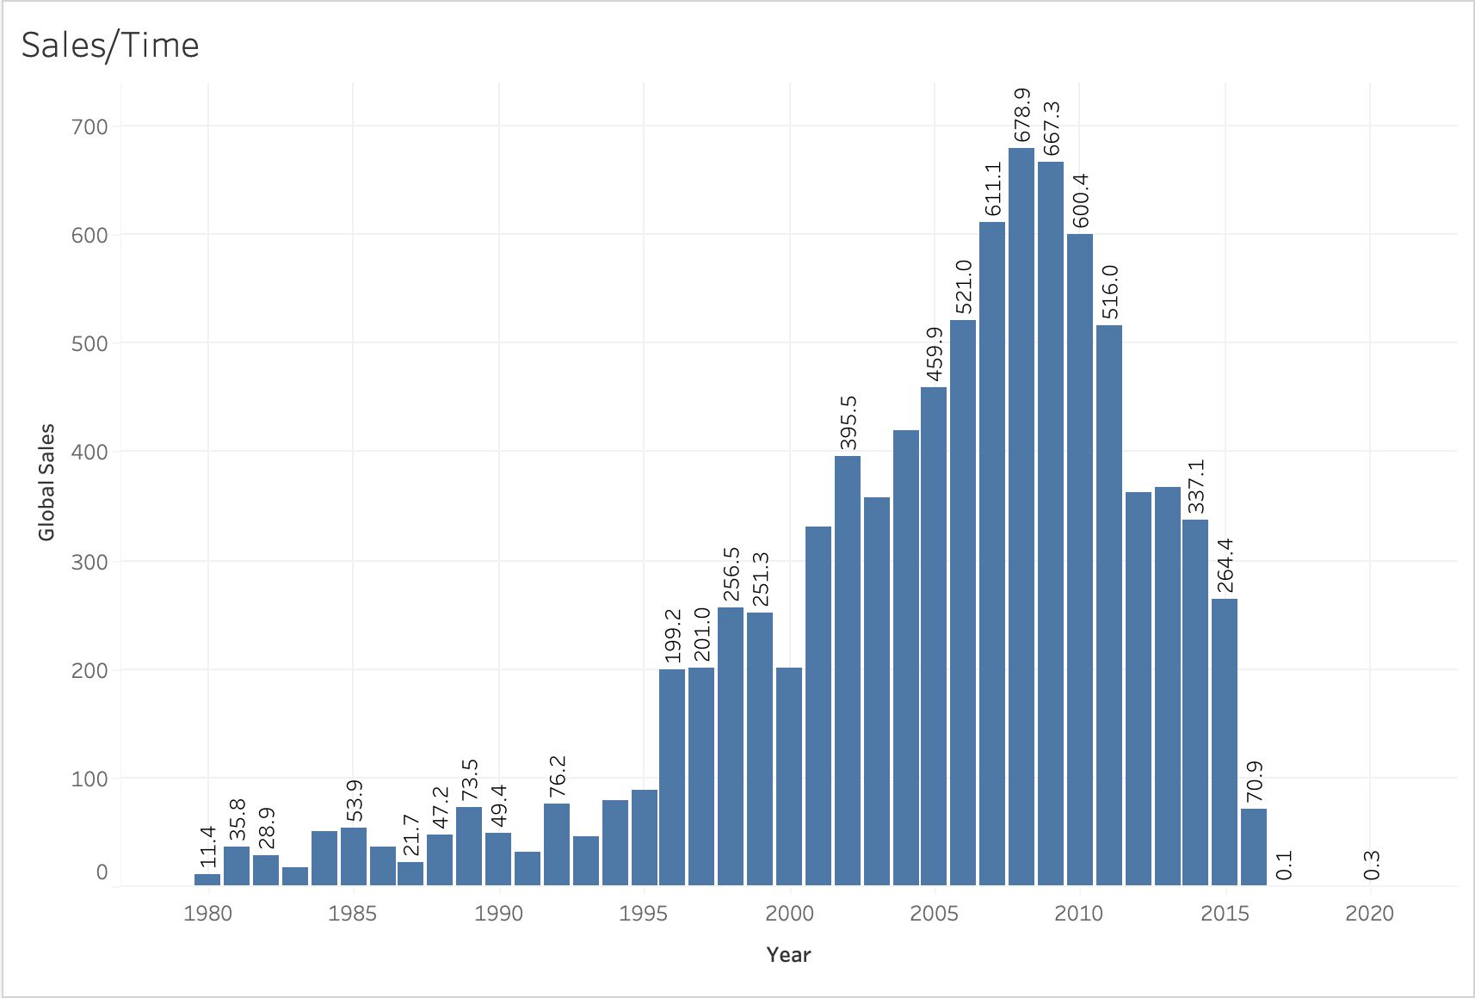
Sales Trends Over Time - Global
You can see that the peak for sales happened around 2008. Sales have reached a low point in 2015 to the level they were at around 1995.

Slide 3
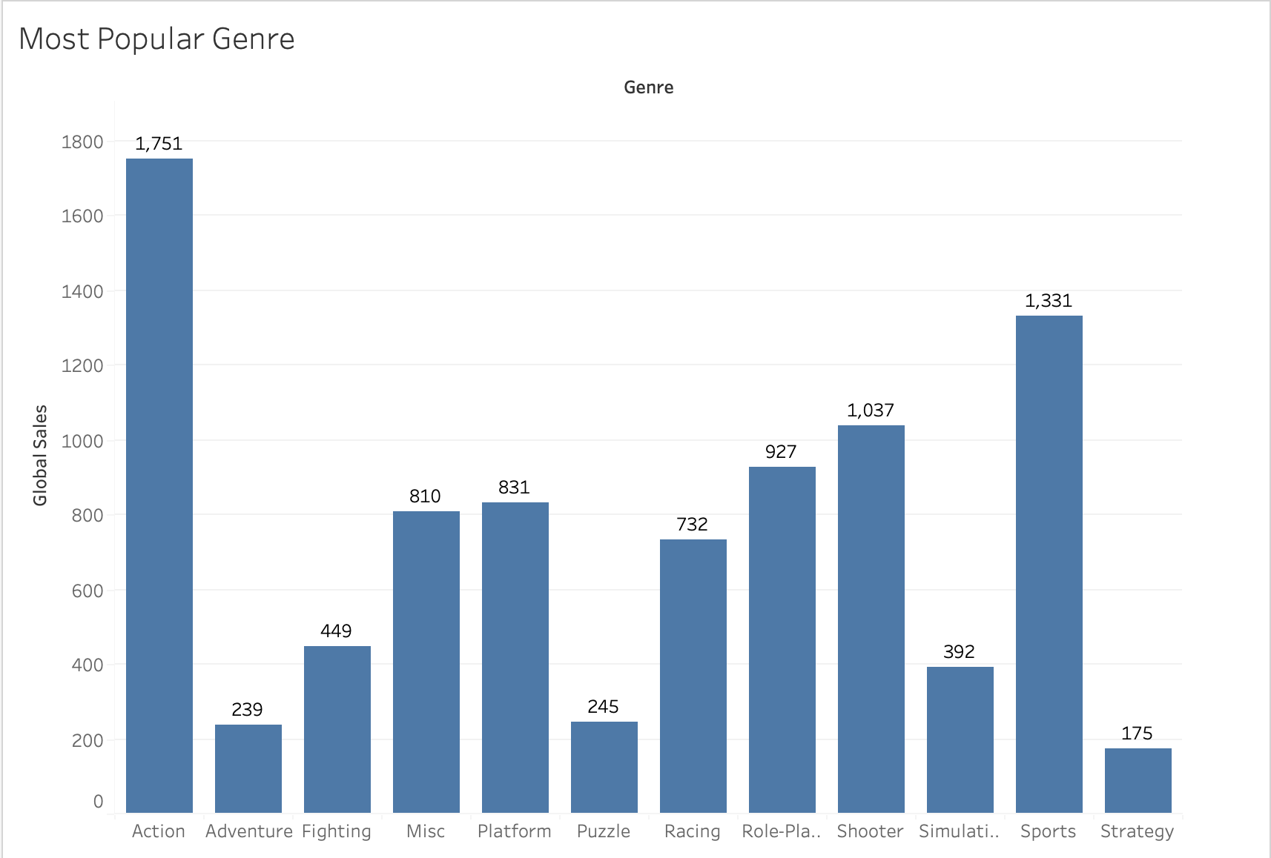
Sales by Genre
Action was the most popular genre based on sales, Sports the second most popular.
Puzzle games are the least favorite genre.

Slide 4
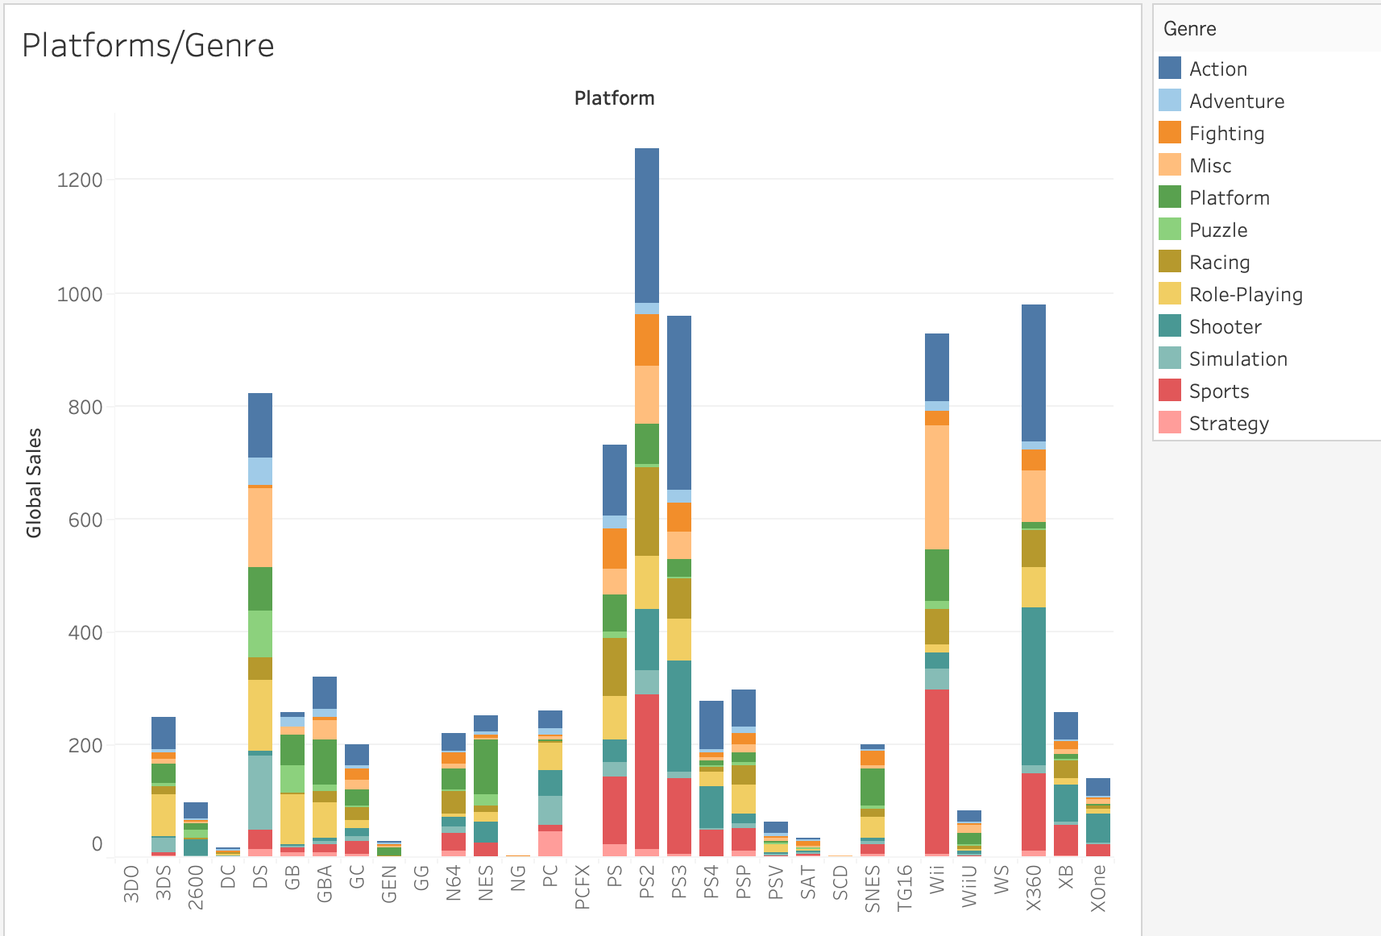
Sales Based on Platform & Genre
DS, PS2, PS3, Wii, and XBOX360 have the most sales out of all platforms.
Further, most popular genres for PS platforms were Sports, Action, and Shooter games.
XBOX360’s most popular genres were Sports, Shooter, and Action.
Wii’s most popular genre was Sports.

Slide 5
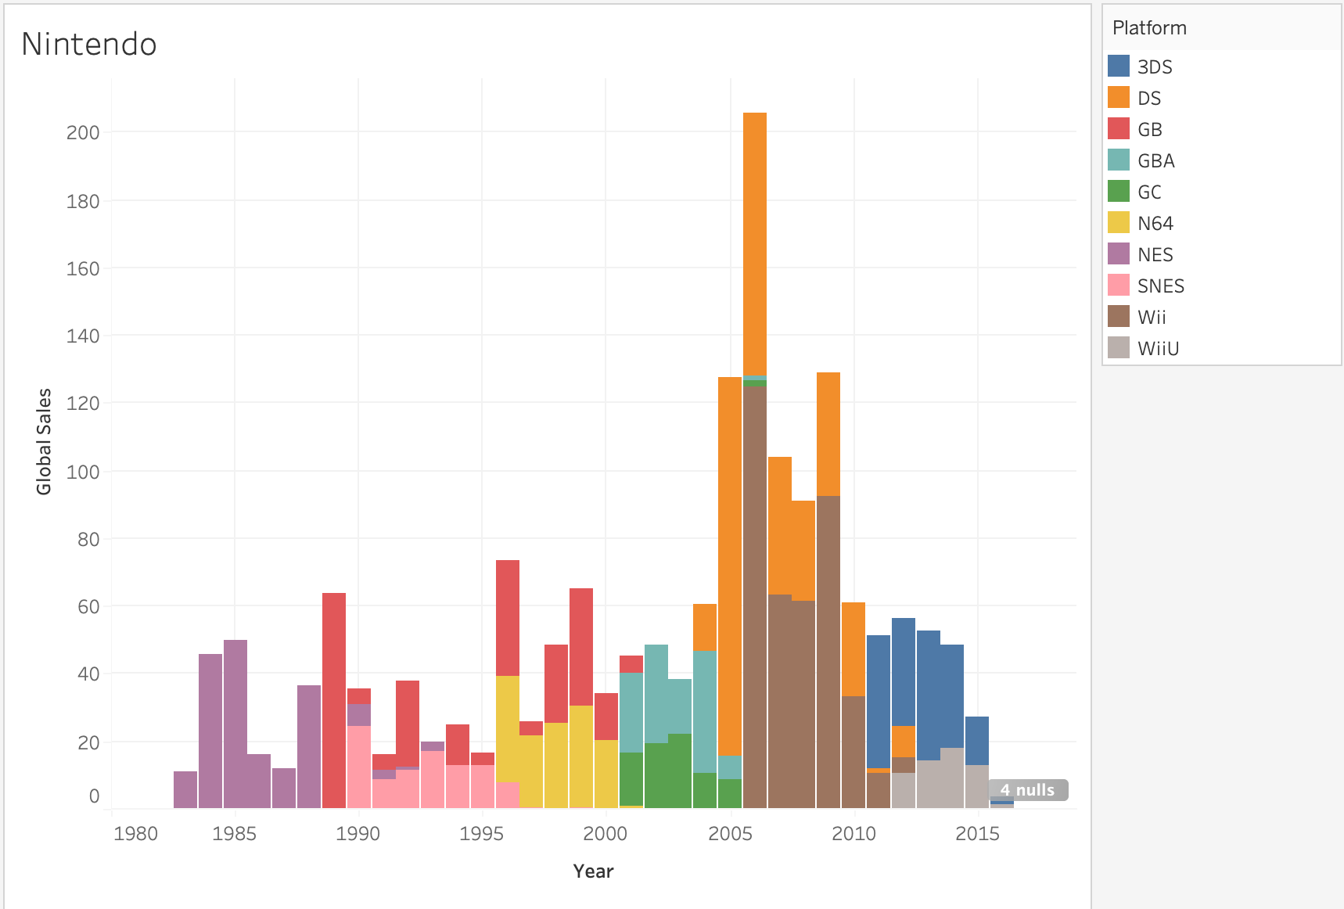
Nintendo Sales
Nintendo had their peak, which was a huge spike, around 2006, when the Wii was introduced.
Their most popular platforms have been Wii, and 3DS.

