Slide 1

TXDOT Motor Crashes, Injuries & Deaths
Data Wrangling & Visualization
Final Project

Slide 2
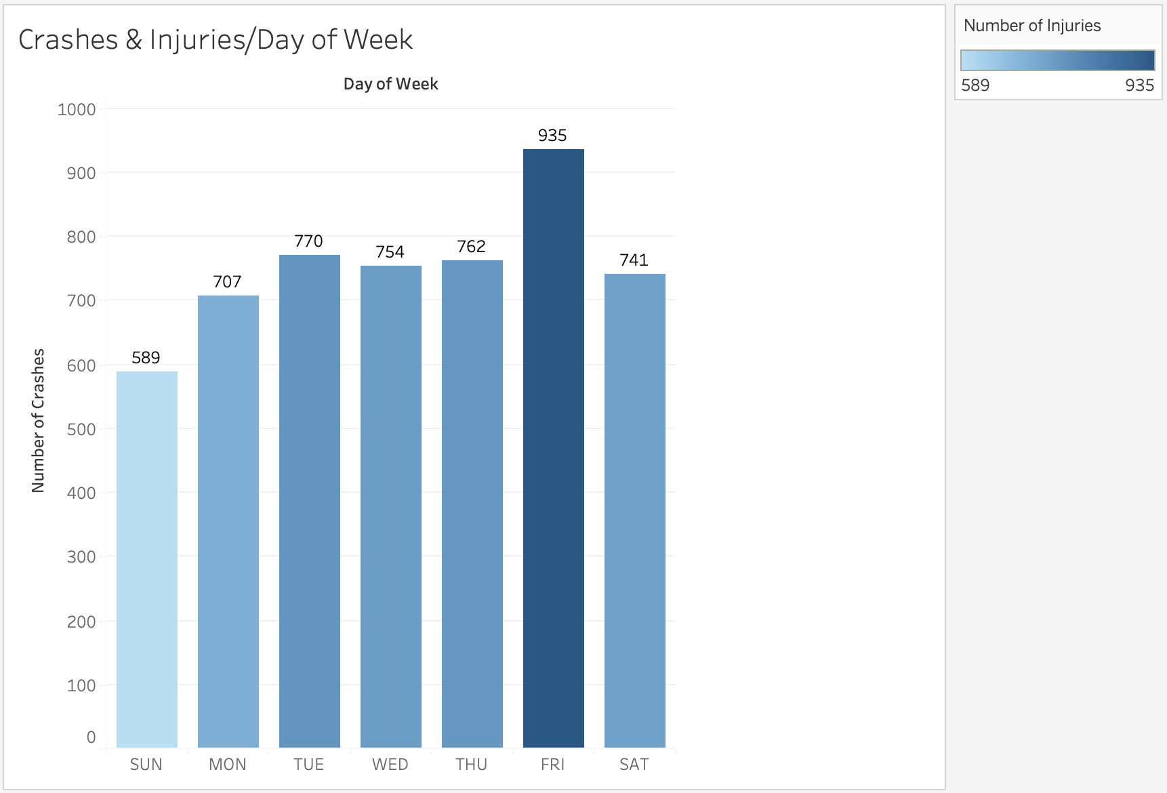
Crashes & Injuries by Day of Week
Friday has the most amount of car crashes, and Sunday has the least.
As expected, you can see from the shading that Friday and Sunday both respectively have the most and least amount of injuries.
This is to be expected, as logically more car crashes means more injuries – they are positively correlated.

Slide 3
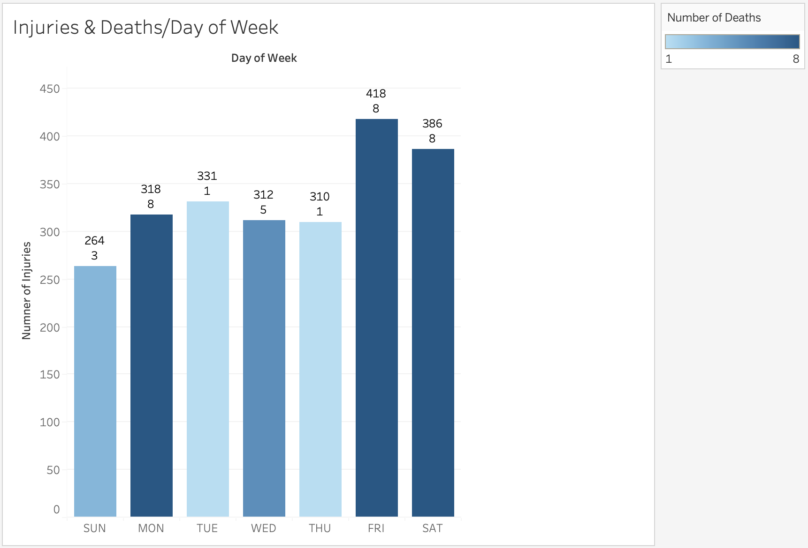
Injuries & Deaths by Day of Week
Friday and Saturday have the most amount of injuries.
Sunday has the least amount of injuries.
It is interesting to note that most deaths happened on Friday, Saturday and Monday. This is interesting, because significantly fewer injuries happen on Mondays than the weekend.
It could be inferred that some pretty deadly accidents happen on Mondays. Is it because people are tired from the weekend?

Slide 4
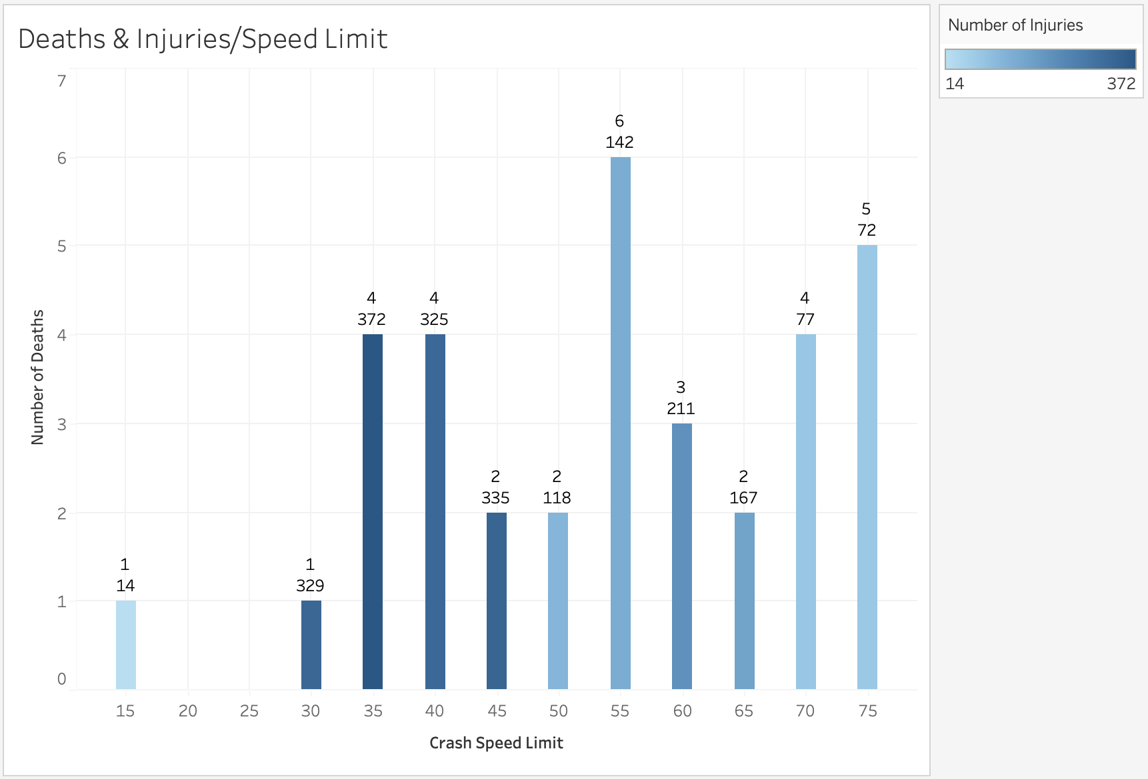
Deaths & Injuries by Speed Limit
55 MPH has the most amount of deaths.
15 and 30 MPH have the least amount of deaths.
It is interesting to note that 35 MPH has the most amount of injuries, with less deaths.
It can be inferred that while traveling at 55 and 75 MPH can be more deadly, you are more likely to get injured between 30 – 45 MPH.

Slide 5
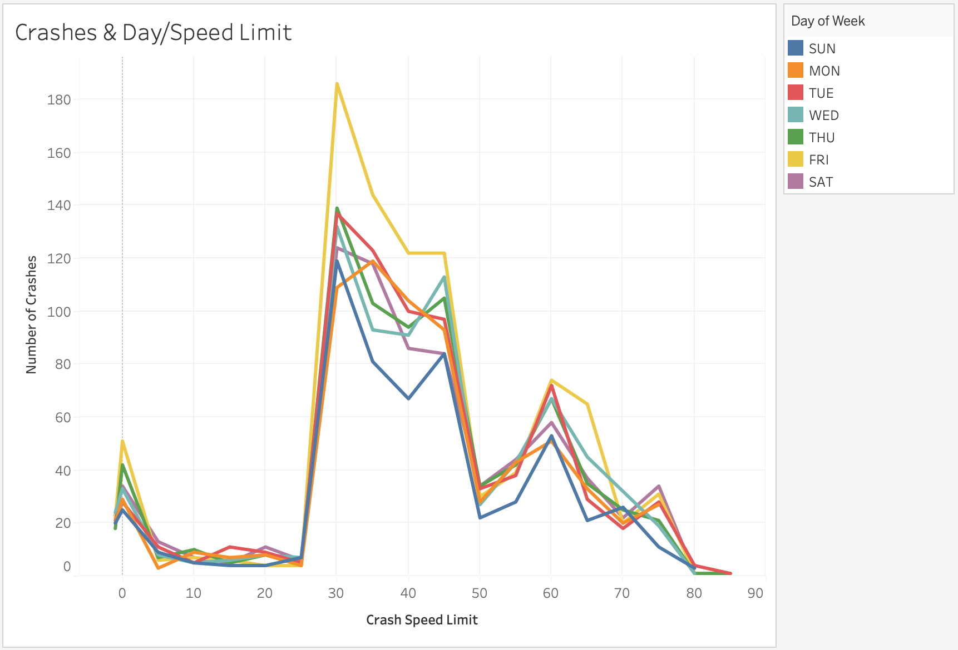
Crashes & Day of Week by Speed Limit
Fridays have the most amount of crashes at 30 MPH.
Other than that, there is not much of a difference between days of the week and crashes in different speed limits.
45 MPH, 60 MPH and 75 MPH are other common speed limits to have crashes in.
It is interesting to note that considerably more crashes happen between 30 and 45 MPH than at 60 MPH.

Slide 6
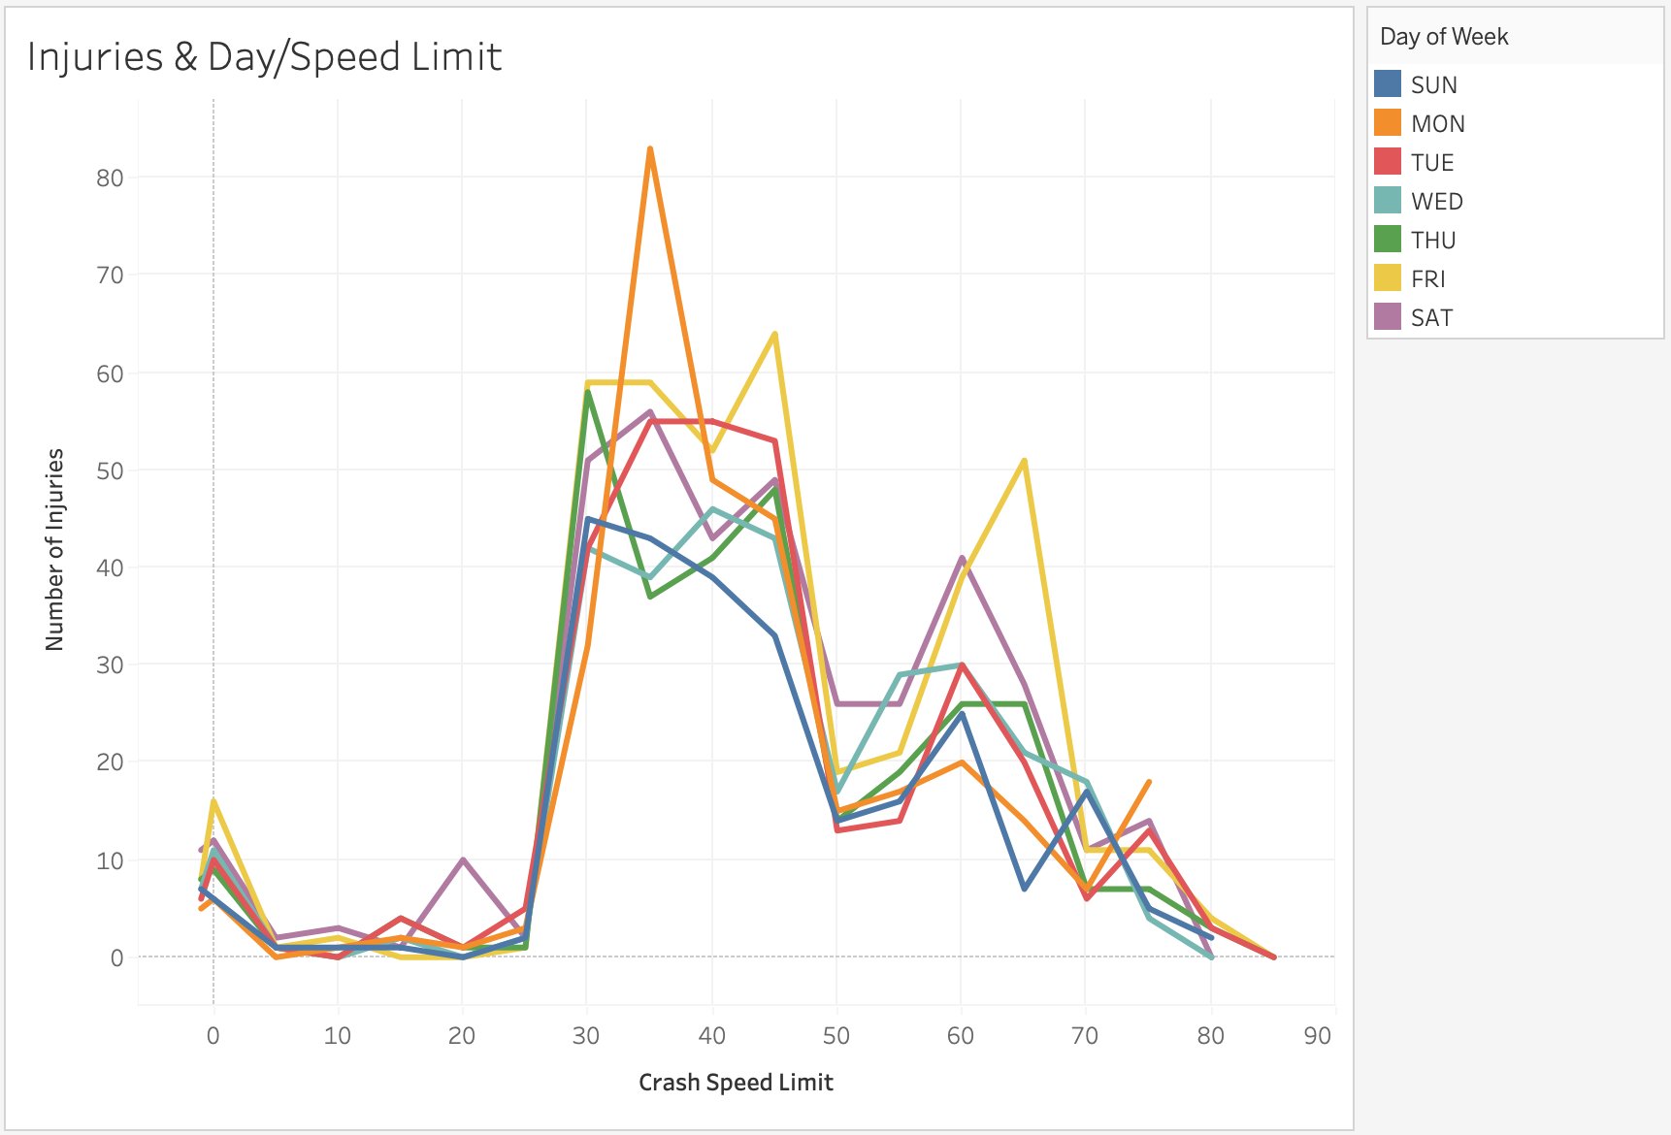
Injuries & Day of Week by Speed Limit
Most of the injuries happen on Mondays in 35 MPH speed limits.
Fridays are another bad day for injuries, but they are more common in 45 and 65 MPH zones.
You can roughly tell from this chart that most injuries generally happen between 30 and 45 MPH.
Another good chance for injury is in 60 – 65 MPH zones.

Slide 7
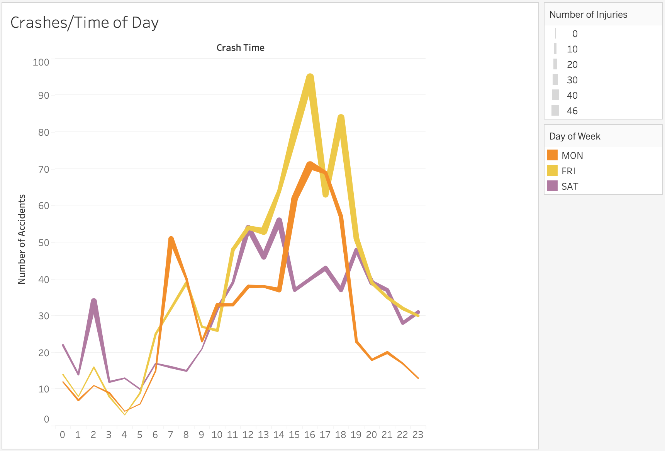
Crashes & Injuries by Time of Day
You can see that generally, most crashes happen between 4:00 – 6:00 pm.
Friday has the most accidents, Saturday the least.
Saturday has a spike of accidents & injuries at 2:00 am, but most happen 12:00 – 2:00 pm.
More people get into accidents on their way home on Mondays than on their way to work.
It is interesting to note that far fewer accidents happen on Fridays at 5:00, than 4:00 or 6:00 pm.

