Slide 1
E-retail factors for customer activation and retention: A case study from Indian e-commerce customers
Submitted By:
Jessica Ghimeliya
Data Science Intern
Flip Robo Technologies

Slide 2
Introduction
Business Problem Framing:
Customer satisfaction has emerged as one of the most important factors that guarantee the success of online store; it has been posited as a key stimulant of purchase, repurchase intentions and customer loyalty.
A comprehensive review of the literature, theories and models have been carried out to propose the models for customer activation and customer retention.
Five major factors that contributed to the success of an e-commerce store have been identified as: service quality, system quality, information quality, trust and net benefit. The research furthermore investigated the factors that influence the online customers repeat purchase intention. The combination of both utilitarian value and hedonistic values are needed to affect the repeat purchase intention (loyalty) positively. The data is collected from the Indian online shoppers. Results indicate the e-retail success factors, which are very much critical for customer satisfaction.

Slide 3
Introduction
Conceptual Background of the Domain Problem
Customer retention refers to the ability of a company or product to retain their customers over some specified period. High customer retention means customers of the product or business tend to return to, continue to buy or in some other way not defect to another product or business, or to non-use entirely. Selling organizations generally attempt to reduce customer defections.
Customer retention starts with the first contact an organization has with a customer and continues throughout the entire lifetime of a relationship and successful retention efforts take this entire lifecycle into account. A company's ability to attract and retain new customers is related not only to its product or services, but also to the way it services its existing customers, the value the customers actually perceive as a result of utilizing the solutions, and the reputation it creates within and across the marketplace.

Slide 4
Motivation for the Problem Undertaken
Successful customer retention involves more than giving the customer what they expect. Generating loyal advocates of the brand might mean exceeding customer expectations. Creating customer loyalty puts customer value rather than maximizing profits and shareholder value at the centre of business strategy'.
The key differentiation in a competitive environment is often the delivery of a consistently high standard of customer service. Furthermore, in the emerging world of Customer Success, retention is a major objective.

Slide 5
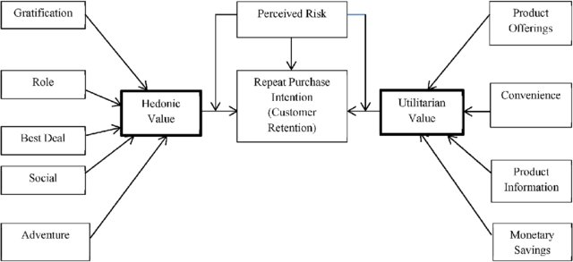
Diagrammatic Representation of Customer Retention
The customer retention is based on three main factors: Hedonic value, Perceived Risk and Utilitarian
The hedonic value has five values: Gratification, Role, Best Deal, Social, Adventure.
The Utilitarian value has four values: Product Offering, Convenience, Product Information, Monetary Saving.

Slide 6
Hardware and Software Requirements and Tools Used:
Hardware Used:
RAM: 8 GB
CPU: AMD A8 Quad Core 2.2 Ghz
GPU: AMD Redon R5 Graphics
Software Tools used:
Programming language: Python 3.0
Distribution: Anaconda Navigator
Browser-based language shell: Jupyter Notebook
Libraries/Packages Used:
Pandas
Numpy
Matplotlib
Seaborn

Slide 7
Analytical Problem Framing:
Mathematical/ Analytical Modelling of the Problem :
The dataset is being provided by Flip Robo Technologies in .xlsx (Microsoft Excel) format and contains 269 records with 71 features.
We began with loading the dataset and reading the dataset from the xlsx file using the read_excel() function from the Pandas Python package. Next, we performed Non-Graphical Exploratory Data Analysis (EDA) such as checking the data types and missing values using pandas info() function.
Later, we performed graphical EDA to get more insights from our dataset.

Slide 8
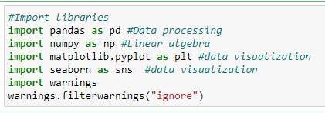

Working with the Dataset
Importing Libraries/Packages
Loading the dataset:

Slide 9
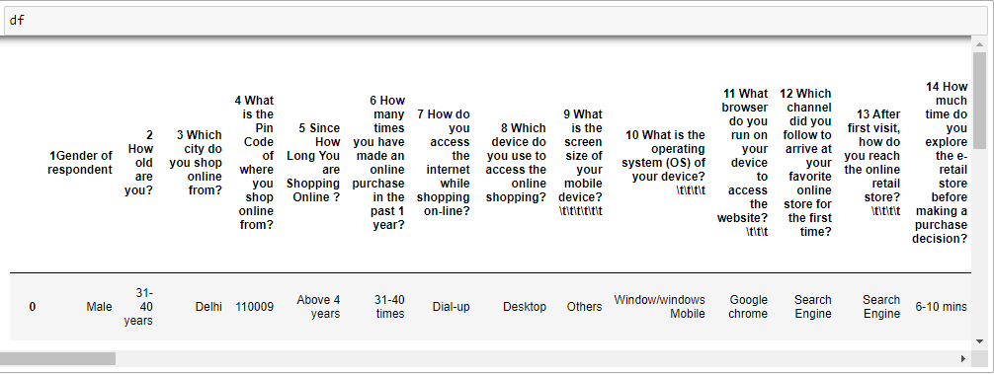

Data Sources and their formats
Observation:
Data has 269 rows and 71 columns

Slide 10
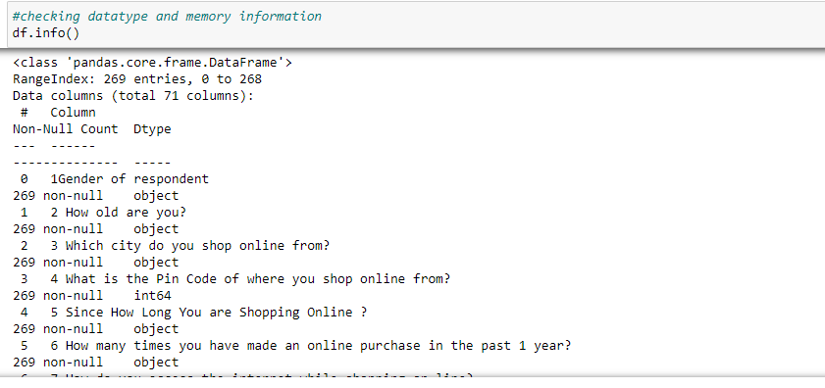
Data type Information:
Observations:
There are 1 numerical column and 70 categorical columns.

Slide 11
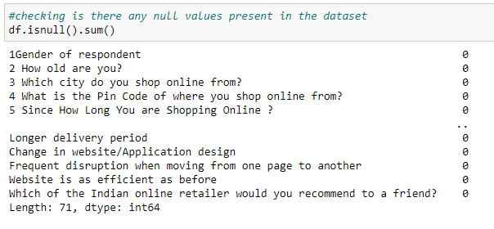
Missing Values In dataset
Observation:
There are no missing values present in the dataset.

Slide 12
Visualizations:
Univariate Analysis: Univariate analysis is the simplest form of data analysis where the data being analyzed contains only one variable.
In this project analysis, I have used count-plot because it helped to understand each feature of data like people of which age used which site more, which type of device more to order any product, and people of which age or gender researched about the product before buying it, etc.

Slide 13
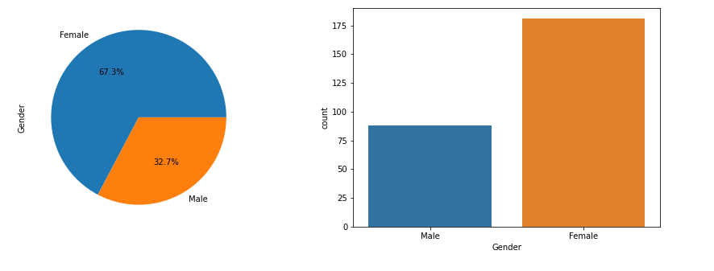
Some of count plots, pie plots and the observations made from them are shown.
Observation
We can see that Female(181) respondents are more in comparison to the Male(88) respondents.

Slide 14
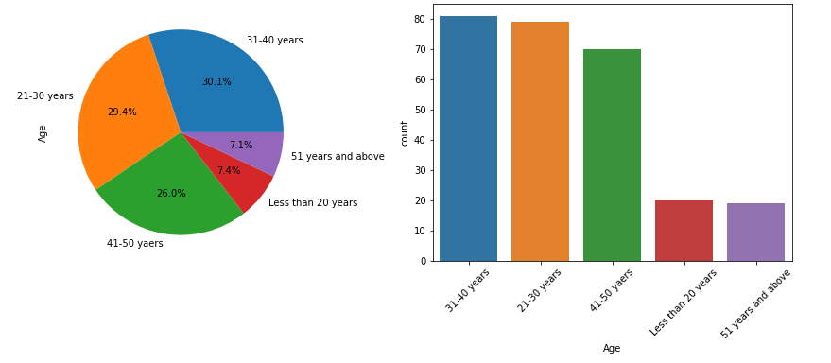
Observation:
From the plots we can clearly see that most of the respondents are from the following three categories:-
1) 31-40 years 2) 21-30 years 3) 41-50 years
Very few respondents are from these two categories :-
1) Less than 20 years 2) 51 years and above.

Slide 15
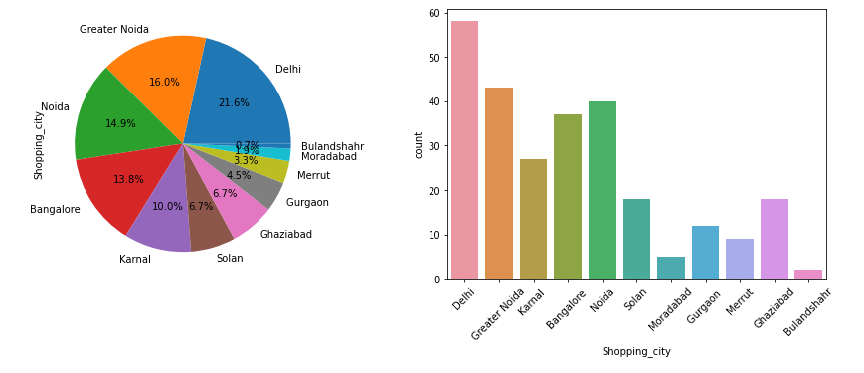
Observation:
We can see that most people are ordering from Delhi & least people are ordering from Bulandshahr
Shopping_cities in decreasing order:
1.Delhi > 2.Greater Noida > 3.Noida > 4.Bangalore > 5.Karnal > 6.Solan > 7.Ghaziabad > 8.Gurgaon > 9.Merrut > 10.Noradabad > 11.Bulandshahr

Slide 16
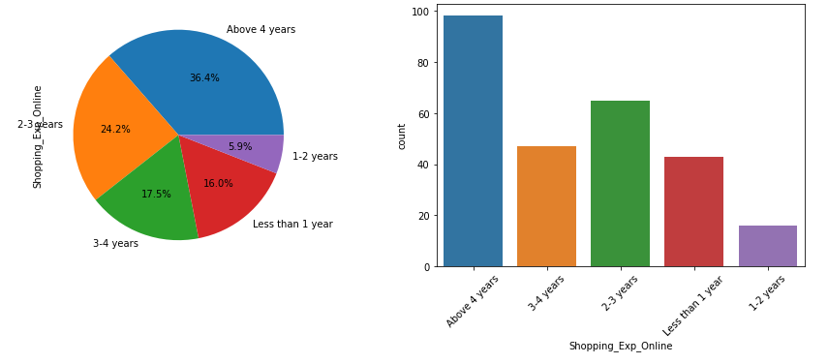
Observation:
We can see that most of the online shoppers of our dataset have more than 4 years of shopping experience
Very few of the shoppers have experience of 1-2 years.

Slide 17
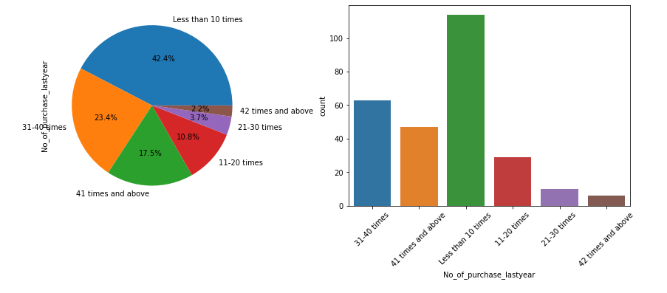
Observation:
From the above plots we can conclude that majority people purchase less than 10 times in last one year

Slide 18
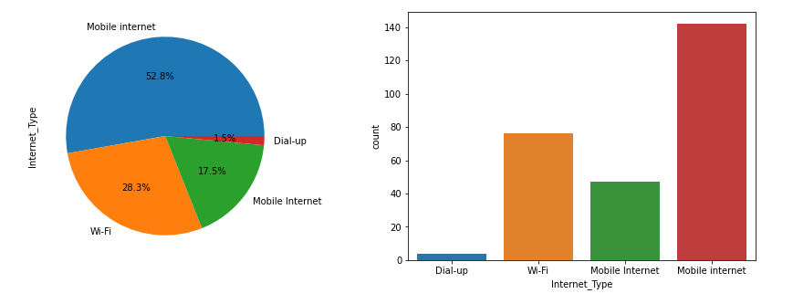
Observation:
From the above plots we can conclude that most of people depend on "Mobile Internet" & followed by "Wi-Fi" for the online shopping.

Slide 19
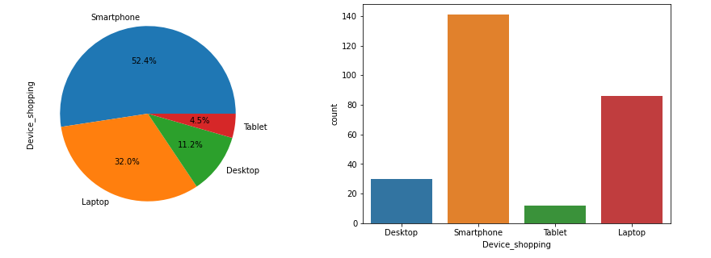
Observation:
Above plots clearly say that "Smartphone" is the most popular device followed by the "Laptop".

Slide 20
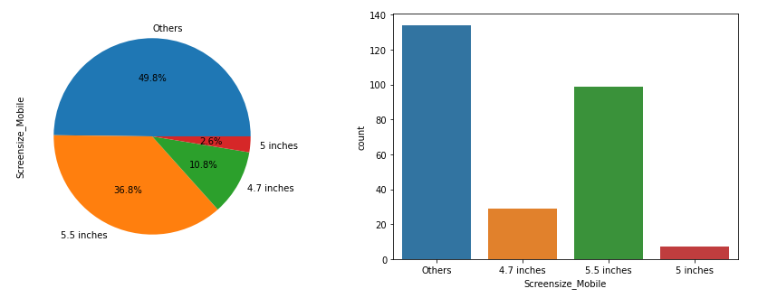
Observation:
The data which we have it is saying most people have screen size apart from 4.7,5.5,5 inches. But the screen size does not matter for the online shopping.

Slide 21
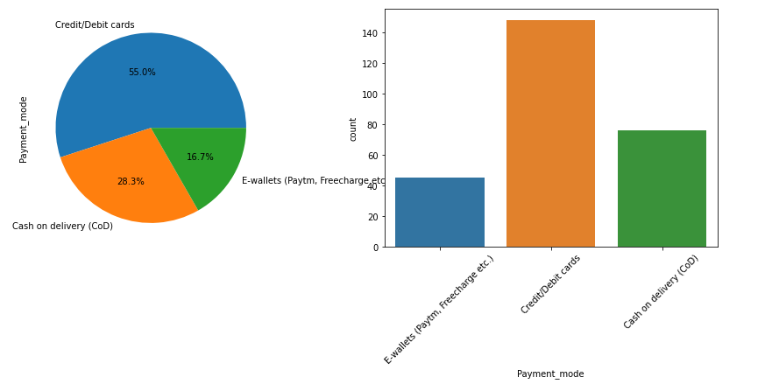
Observation:
We can see that most people prefer Credit/Debit card for their payment options.
After Credit/Debit card comes the Cash on Delivery(COD).
Least people go with E-wallets(Paytm, Freecharge).

Slide 22
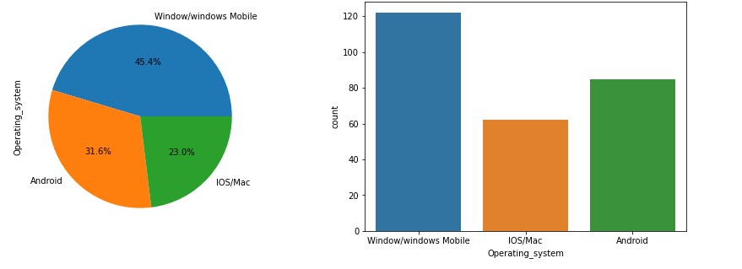
Observation:
Most people are using the windows phone/windows.
Very few people are using the IOS/MAC operating system.

Slide 23
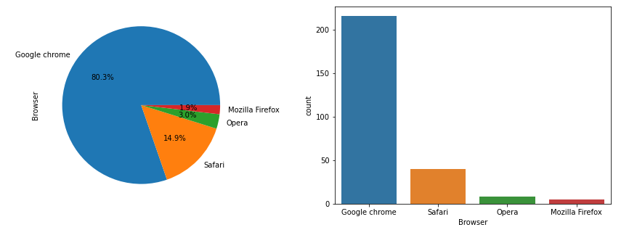
Observation:
We can see that mostly people use "Google chrome" followed by "Safari".
Very less people use "Mozilla Firefox" & "Opera".

Slide 24
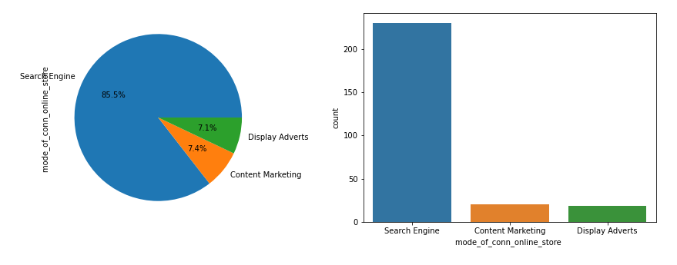
Observation:
Search Engine is the channel which is used mostly by the people for the first time to arrive at their favorite online store.

Slide 25
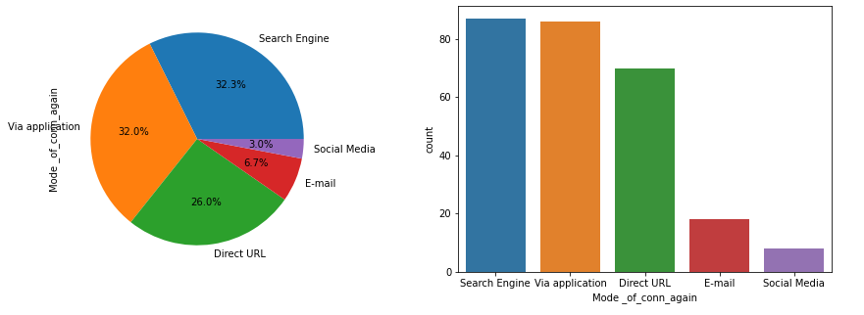
Observation:
After first visit, mostly people again use online store via search engine or applications and then followed by direct URL. Very Less of the people are using via e-mail and social media.

Slide 26
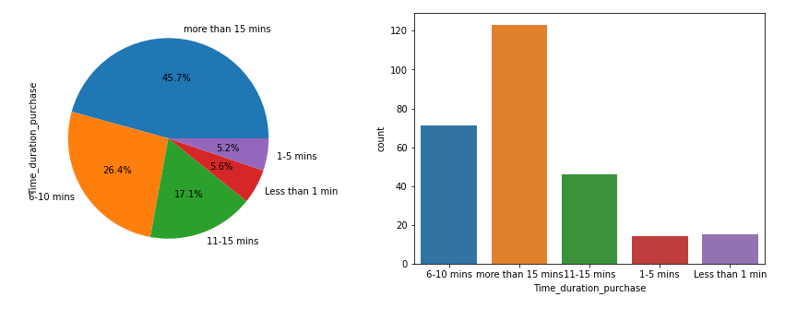
Observation:
For making a purchase decision most of the people spent more than 15 mins to explore the e-retail store.

Slide 27
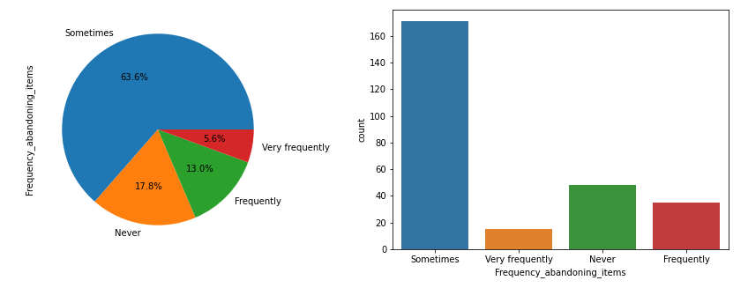
Observation:
Sometimes most of the people do abandoned the items in list while shopping online.

Slide 28
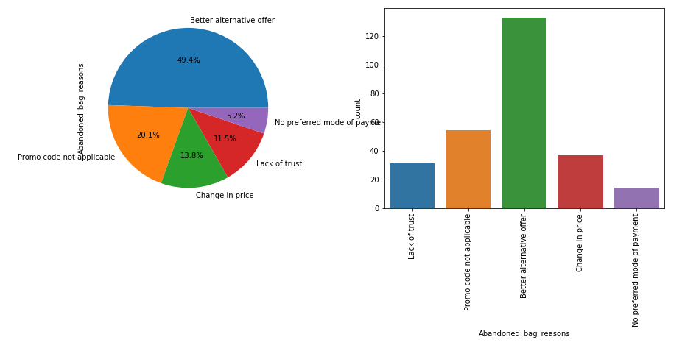
Observation:
Most people abandoned the items of their list because they have waited for" Better_alternative_offers" followed by "Promo code not applicable".

Slide 29
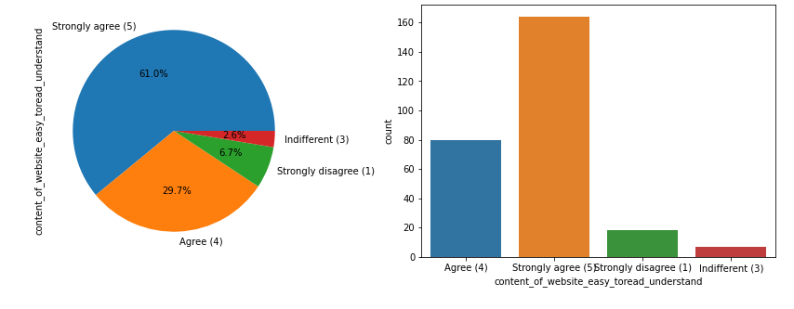
Observation:
Most people strongly agree that the content must be easy to read and understand.

Slide 30
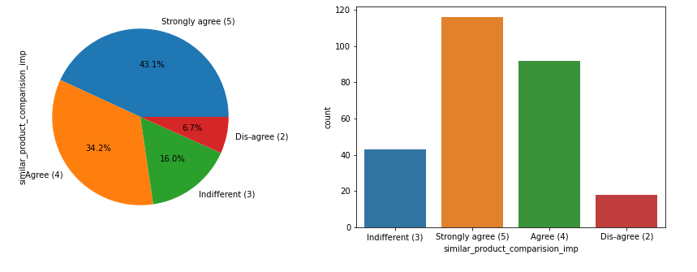
Observation:
Most people strongly agree that product comparison is very much important.

Slide 31
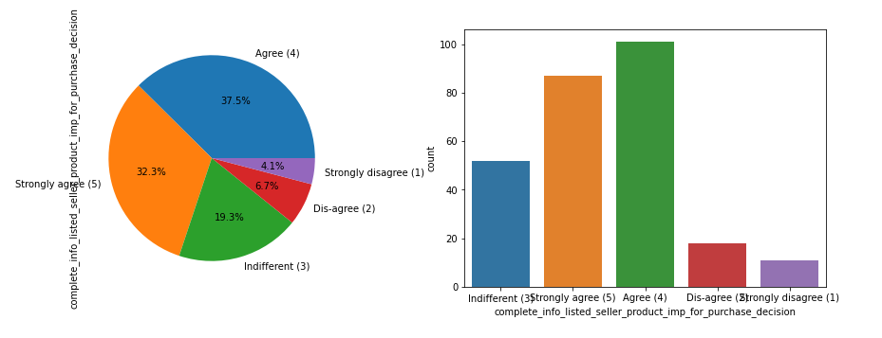
Observation:
Mostly people agree and some of people strongly agree that complete information on products is important for purchase decision.

Slide 32
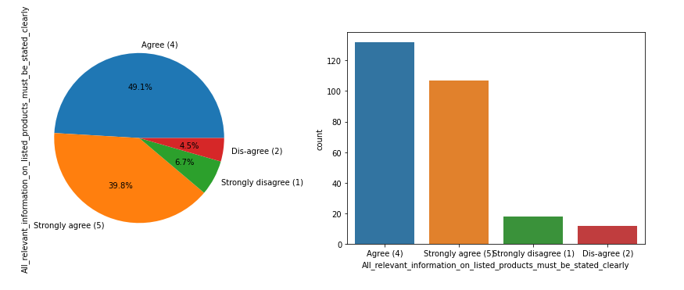
Observation:
From the above plots we can say that most of the people agree with "Importance of all relevant information on listed products must be stated clearly".

Slide 33
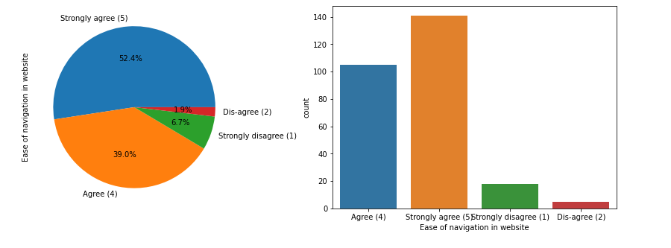
Observation:
Mostly people strongly agree that "ease in navigation of website" is very important.
Very less people dis-agree with "Important of ease in navigation of website“.

Slide 34
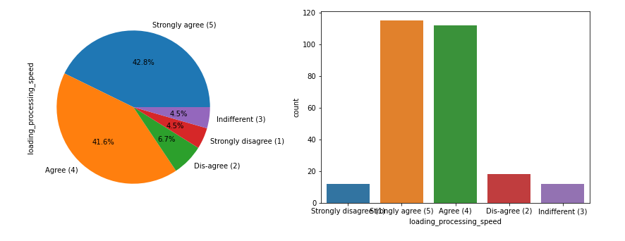
Observation:
Mostly people agree followed by strongly agree with the importance of loading processing speed.

Slide 35
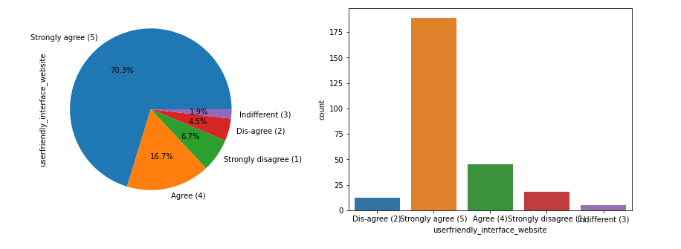
Observation:
We can see that most of our respondents strongly agree to the point that "userfriendly interface of the website" is very important.

Slide 36
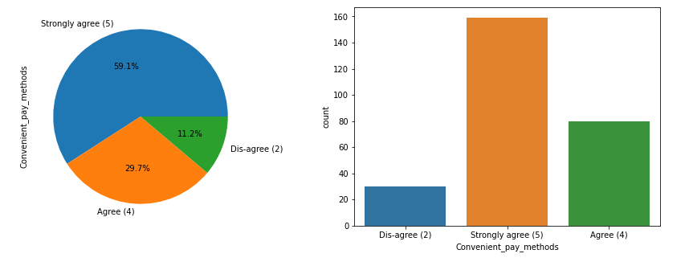
Observation:
Many of the respondents strongly believe that if payment methods are convenient then it will be good for online shoppers.

Slide 37
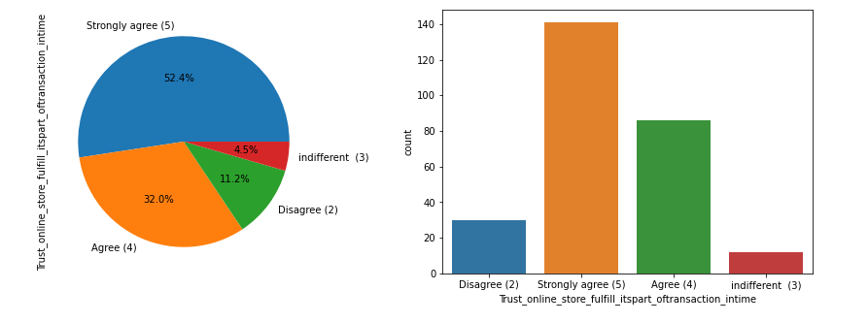
Observation:
Many of the respondents strongly trust that the online retail store will fulfill its part of the transaction at the stipulated time.

Slide 38
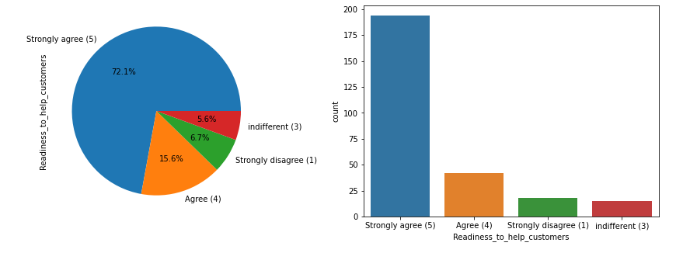
Observation:
Most of Customers firmly believe that approach of "Readiness to help the customers always" is the most important concern.

Slide 39
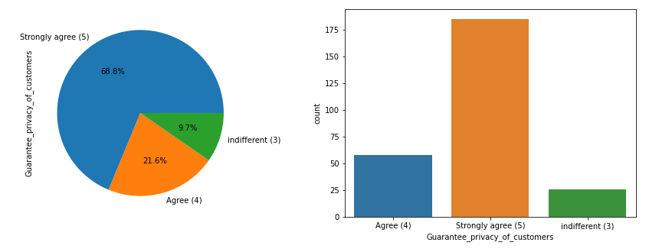
Observation:
As we all know that privacy is the most vital thing as all the customers data like credit-card number, debit-card number, are stored in the retailers database, and customer believes on the company that it will not breach the private data policy.
Our records also shows that most of customers strongly believe that online store must guarantee the privacy of the data of customers.

Slide 40
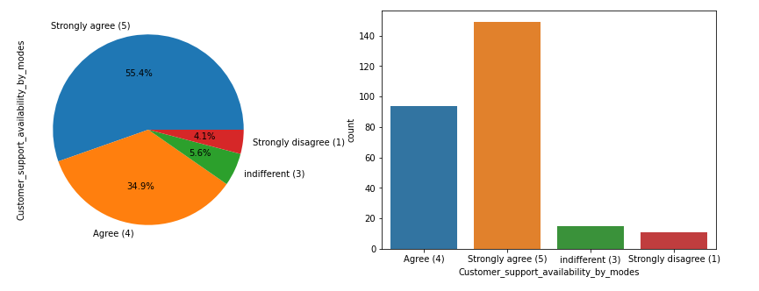
Observation:
Most of the customers expect that their online store must provide the assistance to them through various modes like ("Email", "Text messages", "Phone Call").

Slide 41
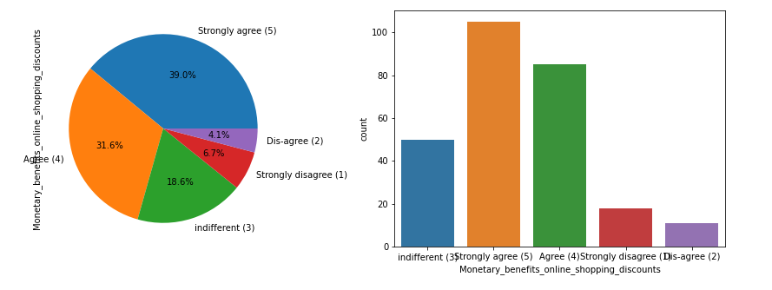
Observation:
Mostly of the customers are inclined towards the perks of monetary benefits while shopping in the forms of coupons, discount offers etc.

Slide 42
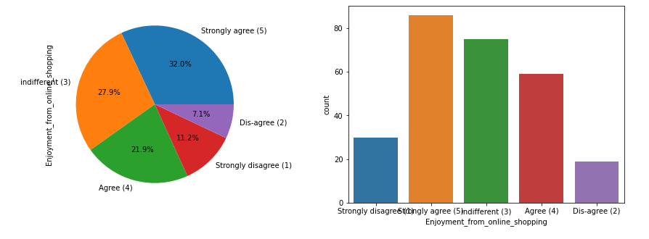
Observation:
Most people agree that they enjoy the online shopping.
Many of respondents are also unconcerned about the enjoyment.
Very few of them disagree with the fact of enjoyment while online shopping.

Slide 43
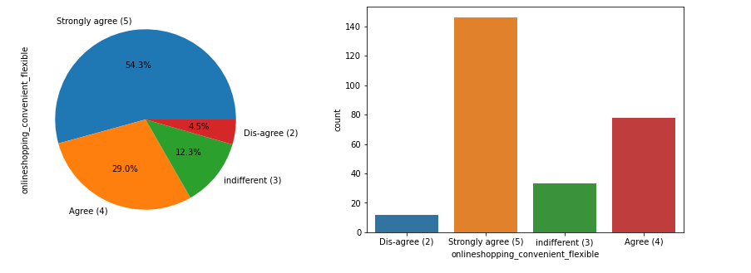
Observation:
Mostly people strongly agree with online shopping is flexible and convenient

Slide 44
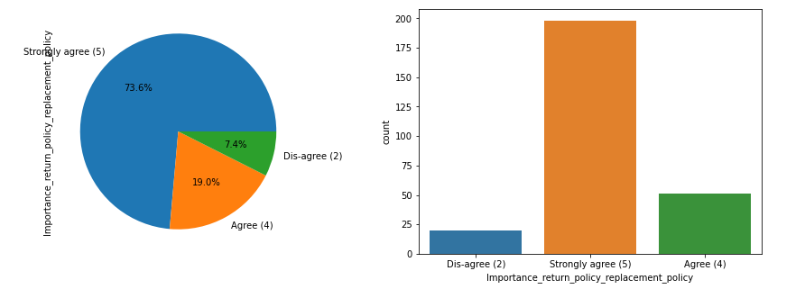
Observation:
As we all know that replacement and return policy is very much important for a customer since if the product which he/she bought, not performing well then they can return it to the seller without any problem by giving proper reason of return of product.
Most of the customers are agreeing with the fact that there must be customer friendly return or replacement policy must be present for the product.

Slide 45
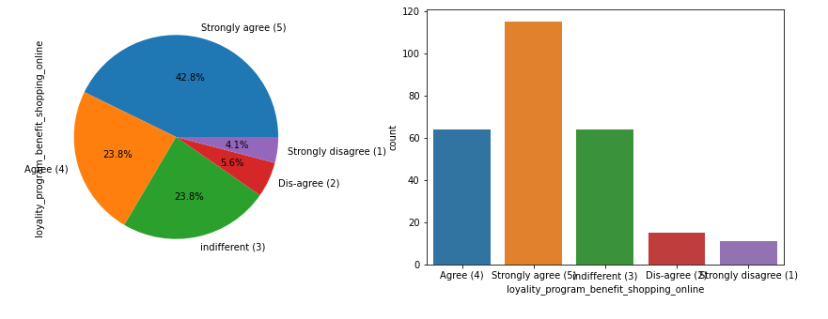
Observation:
Mostly people strongly agree with "Loyalty program is benefit of online shopping"

Slide 46
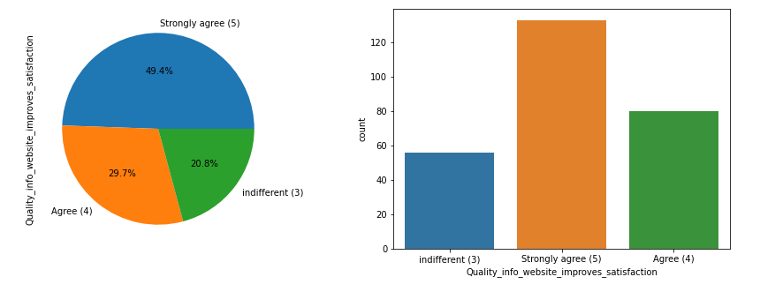
Observation:
We all know that quality information about the product helps us to understand the product well and we can decide upon reading the details whether to go for the shopping or not.
Customers are strongly agreeing with importance of the presence of the quality information present in the dashboard improves the satisfaction of the customers.

Slide 47
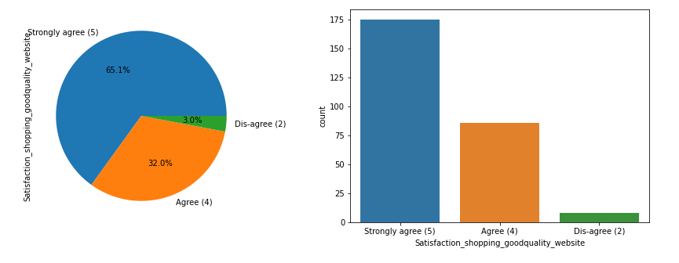
Observation:
Mostly people strongly agree for deriving satisfaction while shopping on a good quality website or a application.

Slide 48
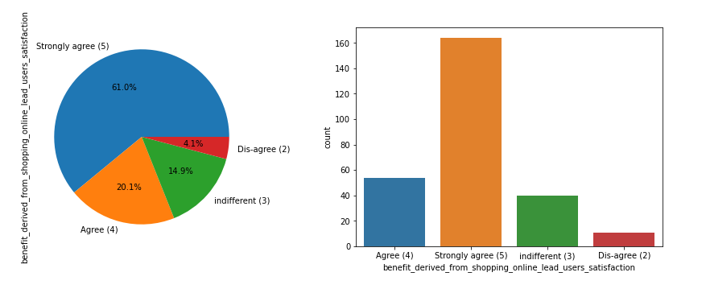
Observation:
We can see that from the plots that many customers believe that benefit derived from the online shopping leads to customer satisfaction.

Slide 49
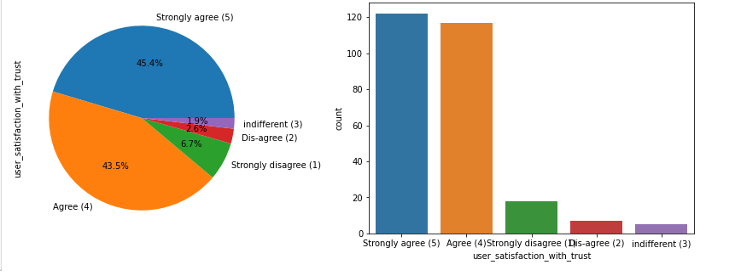
Observation:
We can see that mostly people strongly agree with existence of user satisfaction with trust on the online seller.

Slide 50
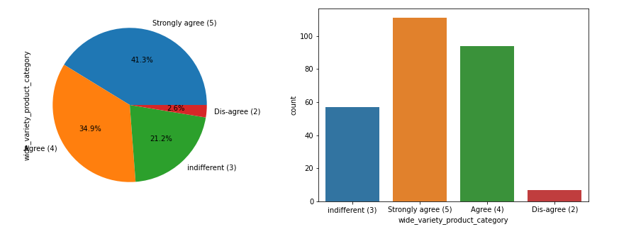
Observation:
We can see that many people agree with offering a wide variety of listed product in different category

Slide 51
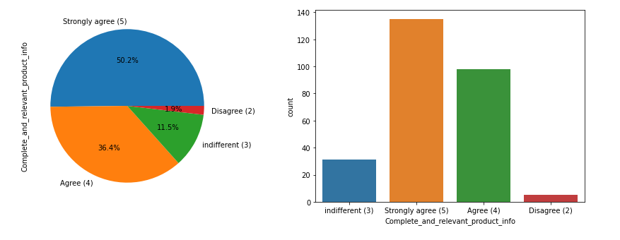
Observation:
Mostly people are strongly agreeing that there should be complete and relevant information of every products.

Slide 52
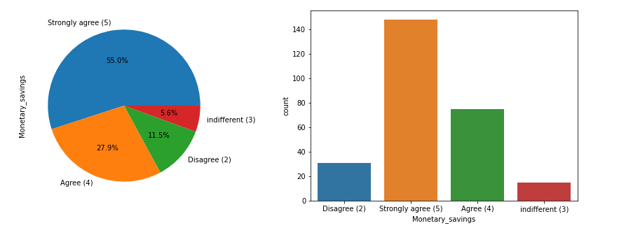
Observation:
We can see that large amount of people strongly agree with "Monetary savings"

Slide 53
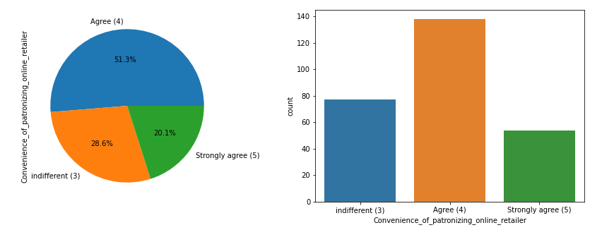
Observation:
We can see that people are agree with convenience of patronizing the online retailer.

Slide 54
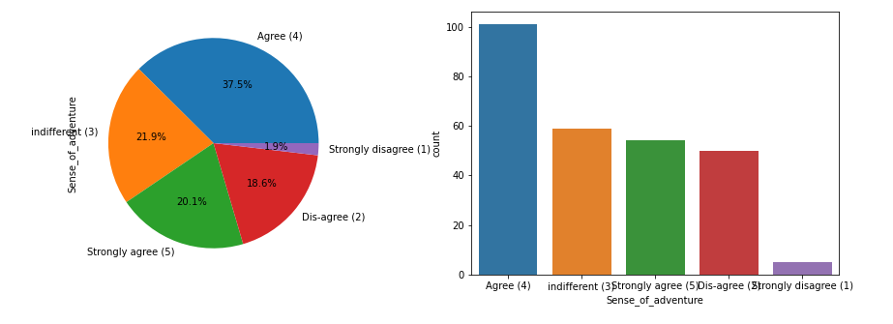
Observation:
Some of people agree that shopping online gives you the sense of adventure and some of people are indifferent and dis-agree with this.

Slide 55
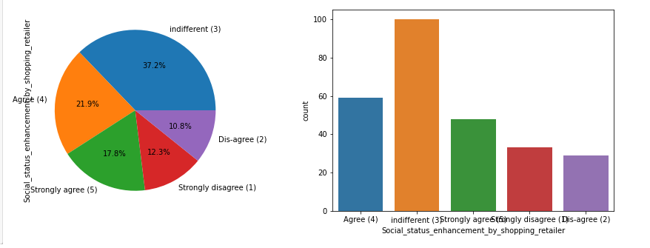
Observation:
We can see from the above plots that there is some mixed kind of response on "Shopping on your preferred e-retailer enhances your social status", Most of the respondent are not concerned about it, Some of are strongly concerned about it.

Slide 56
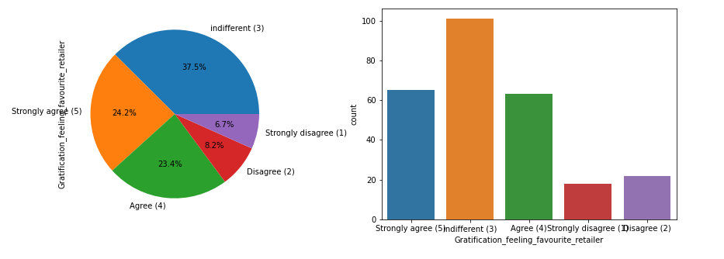
Observation:
We can see from the above plots that there is some mixed kind of response on "Gratification feeling while shopping from the favorite retailer", Most of the respondent are not concerned about it, Some of very strongly concerned about it.

Slide 57
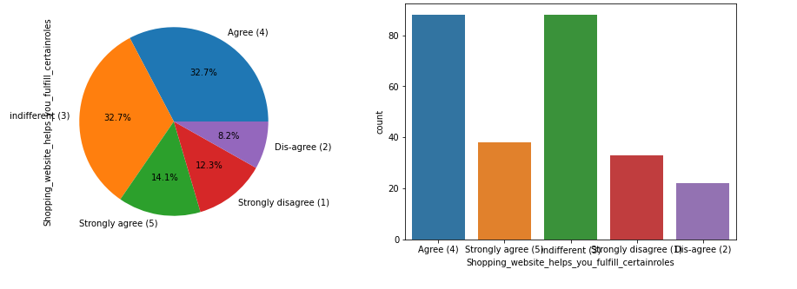
Observation:
We can see from the above plots that there is some mixed kind of response on "Shopping on the website helps you fulfill certain roles", Most of the respondent are not concerned about it, Some of are concerned about it.

Slide 58

Observation:
All of us expect value for the money whenever we shop anything from anywhere.
Here also the respondents are also stick to the value for money statement.

Slide 59

Observation:
Most of the Customers have shopped from all ("Amazon", "Flipkart", "Paytm", "Myntra", "Snapdeal").

Slide 60

Observation:
Most of the Customers have agreed that all("Amazon", "Flipkart", "Paytm", "Myntra", "Snapdeal") these websites or applications are easy to use.

Slide 61

Observation:
There are two website/applications (Amazon.in, Flipkart.com) that visually good as per the customer analysis.

Slide 62

Observation:
Only two websites/application (Amazon.in, Flipkart.com) have offers on wide variety of products.

Slide 63

Observation:
Only two websites/application (Amazon.in, Flipkart.com) have complete and relevant description of products.

Slide 64

Observation:
We can see that most responsive and fast website is "Amazon.com", "Paytm" followed by "Flipkart.com"
Slowest website is the "Snapdeal.com“.

Slide 65

Observation:
We can see that Amazon.in is more reliable followed by Paytm.com, Flipkart.com and Myntra.com.

Slide 66

Observation:
Amazon.in website or application has the quickness to complete purchase followed by Flipkart.com and Paytm.com.

Slide 67

Observation:
Amazon.in and Flipkart.com have more payment options rather than other online platforms.

Slide 68

Observation:
We can see that "Amazon.com" delivers the product fastly followed by the "Flipkart.com".

Slide 69

Observation:
We can see that "Amazon.in" has more privacy for the customers' information followed by Flipkart.com.

Slide 70

Observation:
We can see that "Amazon.in" has more security of customer financial information followed by "Flipkart.com".

Slide 71

Observation:
We can see that "Amazon.in" has perceived trustworthiness followed by "Flipkart.com".

Slide 72

Observation:
We can see that "Amazon.in", "Flipkart.com", "Myntra.com" and "Snapdeal.com" have online assistance through multi channels.

Slide 73

Observation:
We can see that "Amazon.in" have longer time to get logged in followed by "Paytm.com" then "Myntra.com" then "Flipkart.com".

Slide 74

Observation:
We can see that "Amazon.in" has longer time in displaying graphics and photos followed by "Myntra.com", "Snapdeal.com".

Slide 75

Observation:
We can see that "Myntra.com" have declared the prices of the products very late followed by "Paytm.com", "Snapdeal.com" and "Flipkart.com".

Slide 76

Observation:
We can see that "Myntra.com" and "Paytm.com" takes more time to load the page followed by "Flipkart.com" and "Snapdeal.com".

Slide 77

Observation:
We can clearly see from the plot that "Snapdeal" has constraints on payment methods for many products followed by "Amazon".
Myntra and Snapdeal are open to different payment methods.

Slide 78

Observation:
From the above data given by the respondents we can clearly say that most quickly delivering website is ‘Myntra’. From the data ,most lately delivering website is "Paytm". Flipkart and Amazon both deliver the product on average time.

Slide 79

Observation:
We can see that "Amazon.in" is likely to change design in website or application then "Paytm.com".
Other platforms are very less likely to change the designs of website or application.

Slide 80

Observation:
From the above plot, we can see that "Amazon.in" has frequent disruption while moving from one page to another followed by "Myntra.com", "Snapdeal.com", "Paytm.com" and "Flipkart.com"

Slide 81

Observation:
From the polls we can say that most efficient website is "Amazon" followed by "Flipkart".
Most inefficient website is "Snapdeal".

Slide 82

Observation:
We can see that the best choice of most of the people is "Amazon" followed by "Flipkart" & "Myntra".
Very few people will recommend "Snapdeal" & "Paytm".

Slide 83
Analysis
Amazon.in is the peoples favorite choice for the online shopping ,since it is offering the sales of its products with various additional benefits like “Fastest delivering orders", "Fastest loading and responsive website", "More products are available for any section of item”, etc. Flipkart is also performing good but it comes after the Amazon.
Least rated online retailer companies are Snapdeal.com and Paytm.com ,very less proportion of the population are following them due to the various reasons like “Very long delivery periods", "Slow loading website", "Less varieties of the products are listed on them” etc.

Slide 84
Conclusion
When customers are satisfied with a company or service, there is a high possibility that they will share their experience with other people Therefore it is crucial for E-commerce to take into account their customer satisfaction because this will retain customer loyalty as well as attract potential customers.
To conclude, having the right customer retention strategy will keep sellers company growing if they know how to take advantage of it. Then customers will find their way back and continue buying stuff from the best company.

Slide 85
THANK YOU

