Slide 1
Twelve Monkeys, Analyzed
Presented by, Jessica Scharber

Slide 2
Objectives
Environment and Culture
Effective Listening
Verbal and Non-Verbal Messages
Emotional Messages
Interpersonal Relationships
Interpersonal Conflict

Slide 3
The story takes place in the mid 1990’s and the year of 2035. The environment is mainly centered within a mental institution, on the streets of Baltimore, and in, what appears to be, an underground protected environment for modern society.
James Cole, played by Bruce Willis, shows up on the streets of Baltimore in a state of mental break, in the year of 1990, claiming he had time traveled from 30+ years in the future. After insisting that he needs to stop a biological attack from occurring in 1997 that kills 5 billion people, forcing the remaining population to live underground, he is placed in a mental institution. While he is there he forms a relationship with a rich kid, Jeffrey Goines, played by Brad Pitt, that has radical thoughts and an influential father. Jeffrey has a mysterious recurring role throughout the movie. Their psychiatrist, Dr. Railly, played by Madeleine Stowe, tries to understand what James is perceiving as reality and works to help him understand the mission he believes he is tasked with.

Slide 4
Cultures
James Cole – high-context, futuristic, and somber, the population is forced to be dependent on one another (collectivism) (Mirriam-Webster, n.d.)
Sub-Culture – Institutional, little interpersonal communication, depressed, isolating and violent
Effects on Communication - causes him to react emotionally, distracting from his message (Rasmussen College, lesson content, 2019)
Jeffrey Goines - low-context, expressive, blissful, individualist
Sub-Culture – Institutional, unprofessional, childish, belligerent and chaotic, out of touch with reality
Effects on Communication - Endless distractions from effective listening.
Dr. Katherine Railly - low-context, expressive, blissful, individualist,
Sub-Culture - Scientific, professional, authoritative and orderly
Effects on Communication - bias against time travel causing her to prejudge and ignore James’ message (Sole, 2011, p. 50)

Slide 5
Example of Good vs Bad Listening
Good – Dr. Railly displays excellent, formal, effective listening skills as she makes eye contact, focuses on the words James is saying and also pays attention to the desperate nature of his nonverbal communication. She is evaluative as she listens comprehensively and empathetically (Sole, 2011, p. 49). She acknowledges James’ claims and asks for clarification.
Bad - James is unable to maintain eye contact, focus and communicate his message clearly due to internal noise; the medication he’s been given and the trauma he’s endured, which results in an internal barrier in the interpersonal communication process with the doctor (T. Petricini, reading, May 14, 2019). His listening skills are affected likewise and additionally, he doesn’t acknowledge the doctor’s feedback.

Slide 6
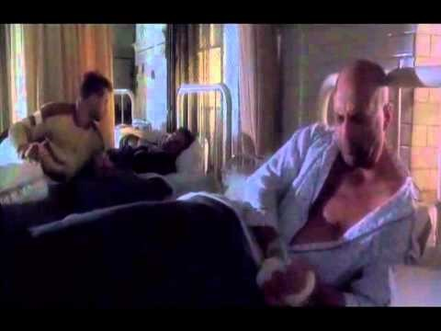
Example of an Emotional Message

Slide 7
Verbal and Non-Verbal Messages
In the beginning of the movie you will observe asynchronous, public communication being sent from scientists (Roven & Gillium, 1995). It is being channeled by way of a radio broadcast to the inmates. Sleep and muffled language are noise that interfere with the mediated message received by the inmates in the jail environment (Sole, 2011, pp. 5, 10).
Small group communication takes place next when James is being questioned by the board of scientists. They are seeking information and understanding of his perceptions so they can analyze the feedback and then apply the knowledge to synthesize an accurate evaluation (T. Petricini, reading, May 8, 2019). The channel is clear but noise comes in the form of confusion in James’ mind (Sole, 2011, pp. 5, 10).
After James meets his psychiatrist you see many examples of in person, interpersonal, dyadic communication between them, both acting as sender and receiver of information and feedback. Once again, the channel is clear but noise comes in the form of confusion in James’ mind (Sole, 2011, pp. 5, 10).
You can see nonverbal, intrapersonal communication as James stares in deep thought and scribbles his thoughts while in the mental institution. Even James’ intrapersonal communication is unclear due to the noise of his confusion (Sole, 2011, pp. 5, 10).

Slide 8
Example of Verbal and Non-Verbal Messages
https://www.youtube.com/watch?v=Ack-zTCBgQA

Slide 9
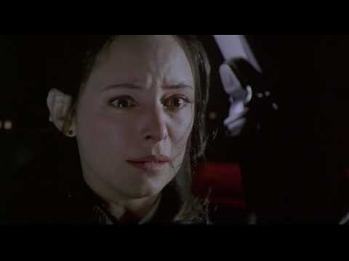
Example of Verbal and Non-Verbal Messages (cont.)

Slide 10
The Relationships
James and Jeffrey - While James and Jeffrey were in the hospital together, they had a friendship that was in the experimenting stage, but over the course of the movie, six years passes without any kind of relationship maintenance and their relationship deteriorates from friendship to social acquaintances (T. Petricini, reading, May 28, 2019).
James and Kathryn – In the beginning of the movie, James and Kathryn have a strictly professional interpersonal relationship. As Kathryn spends more time communicating with James she begins to develop a more intimate relationship with him but she stuggles with the internal and external dialectal tension the relationship is saddled with. By the end of the movie James and Kathryn’s love for each other overcomes the tension in the relationship and they advance to a stage of committed (T. Petricini, reading, May 28, 2019).

Slide 11

Interpersonal Conflict

Slide 12
Review
Environment and Culture
Effective Listening
Verbal and Non-Verbal Messages
Emotional Messages
Interpersonal Relationships
Interpersonal Conflict

Slide 13
Evaluation

Slide 14
References
Mirriam-Webster. (n.d.). Collectivism. In Mirriam-Webster. Retrieved June 7, 2019, from https://www.merriam-webster.com/dictionary/collectivism
Petricini, T. (Presenter). (2019) Reading presented at Rasmussen College, .
Rasmussen College (Presenter). (2019). Module 02 - Culture, Perception and the Self in Interpersonal Communication & Listening in Interpersonal Communication. Reading presented at Rasmussen College, .
Roven, C. (Producer), & Gillium, T. (Director). (1995). Twelve monkeys [Motion picture]. United States: Universal Pictures.
Sole, K. (2011). Making Connections: Understanding Interpersonal Communications [PDF]. Retrieved from https://content.learntoday.info/Thuze/Connections/ OEBPS/book.html

