Slide 1
Programming Assignments
There will be 6 programming assignments starting from today.
The 1st , 2nd and 3rd assignments are about Python basics The 4th, 5th, and 6th assignments are about Scientific Python Packages
2/15
2/22
3/1
3/8
3/15 (no class)
3/22
1st assignment
2nd assignment
3rd assignment

Slide 2
Programming Assignments
The 1st assignment is to develop the game rock-paper-scissors
The 2nd assignment is to develop the game tic-tac-toe
The 3rd assignment is about encoding and decoding of Morse Code.
Scientific Python Packages: pandas, numpy, matloplib, scipy, scikit-learn, etc
The 4st assignment is to analyze 1D data/signal: recover signal from noise
The 5th assignment is to analyze 2D data/images: track objects in images
The 6th assignment is to analyze tabular data: predict the prices of homes

Slide 3
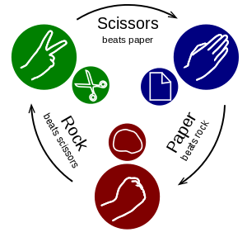
Programming Assignment 1 - due on Mar. 1 – 11:00am
Develop the classic game rock-paper-scissors in Python
It is a simultaneous game with two players. Each player chooses one of rock, paper or scissors, without knowing the other one's choice. The rules are: rock beats scissors; scissors beat paper; and paper beats rock. It is a tie if both players make the same choice.
https://en.wikipedia.org/wiki/Rock%E2%80%93paper%E2%80%93scissors

Slide 4
Develop the classic game rock-paper-scissors in Python
There are two players:
one player is a human user
the other player is a (simple) computer algorithm
The Python program of the game can be divided into several functions.
(I have done this for you.)
Your task is to implement these functions in Assignment1_Rock_Paper_Scissor.py.
Submit it to Blackboard, and write your name in the py file.
Read the doc - Assignment1_Rock_Paper_Scissors.pdf

Slide 5
Develop the classic game rock-paper-scissors in Python
Think about how to divide a large program into many small functions that are easier to implement, and draw a flow chart.
a record of the game
Human | Computer | Outcome
paper | rock | human wins
scissors | rock | computer wins
paper | scissors | commuter wins
rock | rock | a draw/tie
Human Player
Computer Player
paper
rock
Judge
GameRecord is [list1, list2, list3]
list1 is ['p', 's', 'p', 'r']
list2 is ['r', 'r', 's', 'r']
"encode" the Outcome:
Outcome is 0 if it is a tie
Outcome is 1 if computer wins
Outcome is 2 if human wins
list3 is [2, 1, 1, 0]
Outcome
(e.g. human wins)
Flow chart

Slide 6
Develop the classic game rock-paper-scissors in Python
def HumanPlayer(GameRecord):
'''
Parameter: GameRecord (the record of both players' choices and outcomes)
Return: ChoiceOfHumanPlayer, a string that can be rock, paper, scissors, or quit
Description:
This function asks the user to make a choice (i.e. input a string)
This function will NOT return/exit until it gets a valid input from the user
valid inputs are: rock or r, paper or p, scissors or s, game or g, quit or q
quit means the user wants to quit the game
game means the user wants to see/print the GameRecord
'''

Slide 7
Develop the classic game rock-paper-scissors in Python
def ComputerPlayer(GameRecord):
'''
Parameter: GameRecord (the record of both players' choices and outcomes)
Return: ChoiceOfComputerPlayer, a string that can only be rock, paper, scissors
Description:
ComputerPlayer will randomly make a choice
ComputerPlayer should not look at the current choice of HumanPlayer
'''

Slide 8
Develop the classic game rock-paper-scissors in Python
def Judge(ChoiceOfComputerPlayer, ChoiceOfHumanPlayer):
'''
Parameters:
ChoiceOfComputerPlayer is a string from ComputerPlayer
ChoiceOfHumanPlayer is a string from HumanPlayer
Return: Outcome
Outcome is 0 if it is a draw/tie
Outcome is 1 if ComputerPlayer wins
Outcome is 2 if HumanPlayer wins
Description:
this function determines the outcome of a game
'''

Slide 9
Develop the classic game rock-paper-scissors in Python
def UpdateGameRecord(GameRecord,
ChoiceOfComputerPlayer,
ChoiceOfHumanPlayer,
Outcome):
'''
Parameters:
GameRecord is the record of both players' choices and and outcomes
ChoiceOfComputerPlayer is a string from ComputerPlayer
ChoiceOfHumanPlayer is a string from HumanPlayer
Outcome is an integer from Judge
Return: None
Description:
this function updates GameRecord, a list of three lists
'''

Slide 10
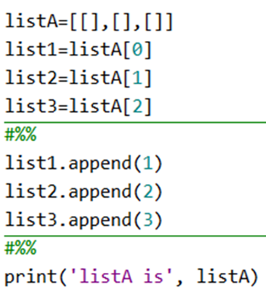
Develop the classic game rock-paper-scissors in Python
define and modify a list of lists
try this program, and then you will figure it out

Slide 11
Develop the classic game rock-paper-scissors in Python
def PlayGame():
'''
This function controls the game (by using the other functions)
'''
quit
game over
Create an empty GameRecord
game
human player makes a choice
print GameRecord
computer player makes a choice
Judge decides the outcome
You may need a while loop
You may need to break the loop
(another person) Update GameRecord

Slide 12
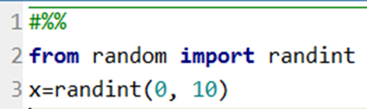
Develop the classic game rock-paper-scissors in Python
Computer Player will use a simple algorithm: random choice
paper
rock
scissors
probability: 1/3 1/3 1/3
We will use the randint function in a Python library named random
try the function, then you will figure it out
integer
0
paper

Slide 13
Develop the classic game rock-paper-scissors in Python
Computer Player can use an advanced algorithm: weighted random choice
The probability distribution from the human player
paper
rock
scissors
probability: 0.1 0.2 0.7
The probability distribution from the computer player
scissors
paper
rock
probability: 0.1 0.2 0.7
use the choice function in numpy package
import numpy as np
prob = np.random.choice(['rock', 'paper', 'scissors'], 1, p=[0.7, 0.2, 0.1])[0]

Slide 14
More algorithms on http://www.rpscontest.com/
"Although rock-paper-scissors (RPS) may seem like a trivial game, it actually involves the hard computational problem of temporal pattern recognition. This problem is fundamental to the fields of machine learning, artificial intelligence, and data compression. In fact, it might even be essential to understanding how human intelligence works." - www.rpscontest.com
"This website is intended to host an ongoing competition to rank RPS programs. All submissions must be made using the Python programming language. The source code for all submissions will be publicly viewable. You may make as many submissions as you like. May the best AI win!"

