Slide 1

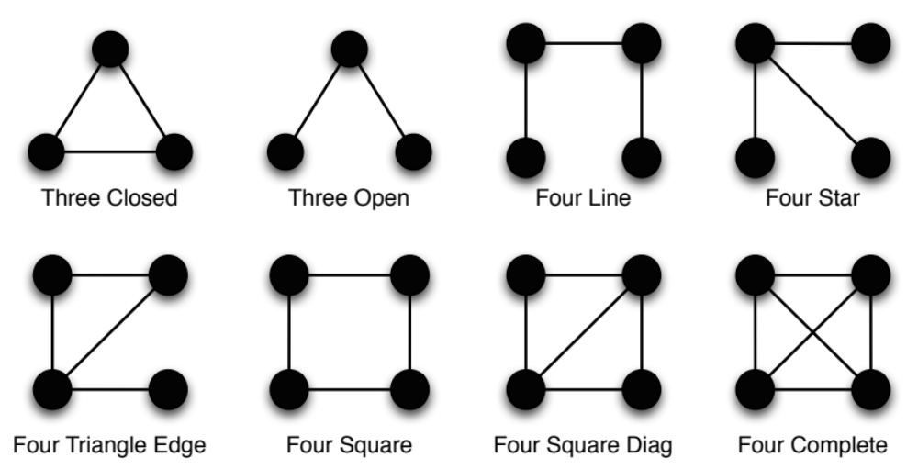
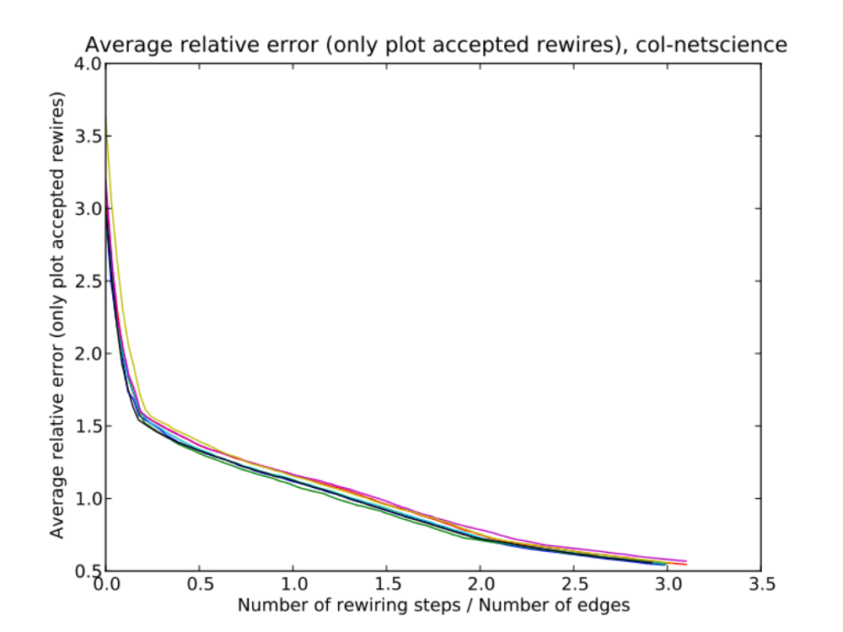
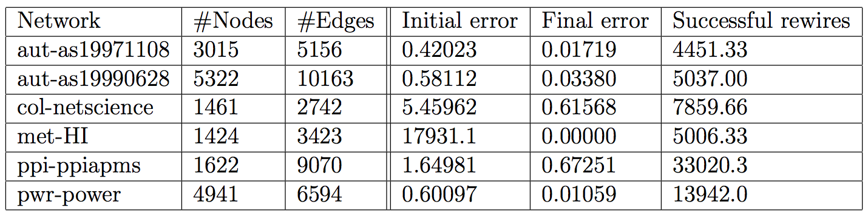
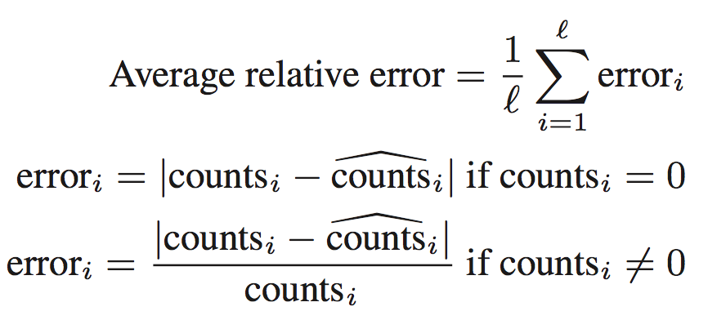
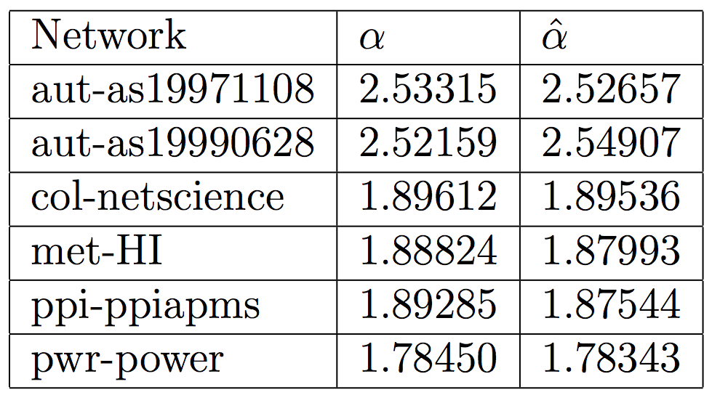
Null Models For Social Networks
Jessica Su and Sen Wu
Department of Computer Science, Stanford University
Introduction
Results
Our objective is to create a random graph with specific motif counts. A motif is a small, connected subgraph of a larger graph, and we only consider motifs with four or fewer vertices. A graph’s motif counts are a list of numbers indicating how many motifs of each type appear in the graph.
Since this problem is difficult, we instead focus on generating an arbitrary graph with specific motif counts. First we generate the graph assuming we know the degree distribution of the desired graph. Then we outline a way to relax this assumption.
We ran this algorithm for five days and averaged the results over three trials. The results are shown below. In the worst case (ppi-ppiapms) we get a 59.2% decrease in error. In all other cases the decrease is much greater. On one network (met-HI, a metabolic network) we get motif counts that are identical to the ones specified in the input.
Conclusion
Hill climbing produces great results on most networks. We hope to produce even better results by subtly tweaking the algorithm. We will also investigate which network properties correlate with better performance.
Methods
We generate this graph through hill climbing. We start with a reasonable initial graph (a graph with the same degree distribution as the desired graph). Then at each step, we apply a transformation to the graph. If this transformation reduces the motif error, we keep the changes; otherwise, we discard them.
Rewiring. One reasonable transformation to use is a “rewiring step.” We randomly select two disjoint edges from the graph, then swap their endpoints (connect the source node of edge 1 to the destination node of edge 2, and vice versa). This transformation is appealing because it preserves the degree distribution of the graph.
Definition of error. The error is defined as
Incremental motif counts. To calculate the motif error we must count the motifs before and after each step. To speed this up we count motifs incrementally, storing the old motif counts and only counting the motifs that were added or deleted on the last step. The computation associated with creating or deleting an edge runs in O((d₁ + d₂)²), where d₁ and d₂ are the degrees of its vertices.
CONCLUSIONS
Extensions
Previously we were given the degree distribution of the graph. We relax this requirement by predicting the degree distribution from the motif counts. Assuming a power-law degree distribution, we can specify the degree distribution with a single parameter α (and a normalization constant).
We use Gradient Boosting Trees to predict α from the motif counts. The error between the ground truth and the predicted α is very small. In future work we will use the predicted α to generate the initial graph in the hill climbing algorithm.
CONTACT
Jessica Su
Email: jtysu@stanford.edu
Sen Wu
Email: ronaldosen@gmail.com

