Slide 1
Understanding Players
Raw player data to six actionable segments
For technical and non-technical audiences · product, marketing & business view
Betty · 100,000 player records · snapshot 2025-11-13

Slide 2
Executive summary: what we found
TL;DR
• 100,000 player records were explored; 59,922 had full, meaningful activity data and were profiled in detail.
• They split into 6 clearly different segments – customers who deserve different treatment.
• Whales (18% of players) generate ~90% of gross gaming revenue – protecting them is priority #1.
• Some players cost money: Net-Loss Gamers (~14%) produce negative GGR, and bonus abuse concentrates in them and in Dormant accounts.
• The smallest spenders are proportionally the most profitable (best GGR per deposited dollar).
i.e. relative to how little they put in, the operator keeps the highest share of their money.
• Recommendation – protect the whales, restrict the loss-makers, grow the healthy core, convert the slow ones.

Slide 3
The question – and the path to an answer
Roadmap
The business question
The data science cycle, in plain language
Are all players the same? Do different players behave differently – and if so, should we talk to them, reward them and manage risk for them differently?
• 1. Understand the data – what do we have, what is missing?
• 2. Build meaningful measurements – features that capture real behaviour.
• 3. Shape the numbers – make huge and tiny values comparable fairly.
• 4. Group similar players – clustering (K-Means and friends).
• 5. Check the groups are solid – metrics + reproducibility.
• 6. Turn groups into actions – segment profiles, differentiation, recommendations.
The task: let the data answer.
Approach: Group players who behave alike, then translate each group into actions – for product, for marketing, and for the business.
Betty_v1 · Player Segmentation — data science walkthrough
3

Slide 4
Step 1 · Understand the data
The Data
• 100,000 player accounts × 77 attributes: account details, marketing/UTM, KYC & compliance, responsible-gambling flags, and money activity.
• Snapshot date 2025-11-13 – every “lifetime” number is measured up to this point.
• Most players are in Canada; core activity fields (deposits, withdrawals, bets, wins, logins) are reliable for ~60% of profiles (missing data).
• Plain-language view: one giant loyalty-card ledger – sign-up, marketing source, risk flags, and who spent/cashed out what.
Technical snapshot
• Source: Data Science Task Data.xlsx - Result 1.csv
• REFERENCE_DATE = max(loaded_at) = 2025-11-13
• Money & frequency fields heavily right-skewed (Fisher skew 7–50)
• Several alias / near-duplicate columns (e.g. login_rate vs login_frequency) collapsed in EDA
• marketing_network column is 100% empty → excluded
• Nullable flags: unrecorded ≠ False (NaN kept, never imputed)
Betty_v1 · Player Segmentation — data science walkthrough
4

Slide 5
Step 1 (deep dive) · Exploring the data (EDA)
The Data
• Goal: know the data before modelling – quality, gaps, and how each number behaves.
• Big finding: a handful of players dominate spending – think “0.1% of whales, a long tail…”
• Missingness matters: many risk/abuse booleans were simply never recorded – that is “unknown”, not “no”.
• Demographics are weak differentiators (almost everyone Canadian, no meaningful age/income split).
• Key Lesson: behaviour (who spends, who logs in, who withdraws) drives segmentation, not demographics.
Technical snapshot
• Univariate + completeness audits per column
• GAIN from explicit data-type audit: dates normalized, aliases merged
• House-edge sanity check: mean GGR / mean bets ≈ 5.2% (slot economics)
• 0.03% implausible birth years (e.g. 0196) → age clipped to [18,100]
• 43 derived features documented (feature_dictionary.csv)
• Enumeration of KYC, RG, bonus-abuse flag coverage
Betty_v1 · Player Segmentation — data science walkthrough
5

Slide 6
Step 2 · Build meaningful measurements
Features
Raw columns were turned into a compact set of measurements, each with a real business meaning. Ten were chosen for clustering – covering life cycle, engagement and value.
Group | Feature (what it measures)
Life cycle | tenure_days – how long the account has existed
Life cycle | time_to_first_deposit – how fast a player first funds
Engagement | total_logins – overall activity level
Engagement | login_rate – sustained habit (logins per month)
Value | total_deposits / total_withdrawals – money in / money out
Value | net_deposits – net money position (signed)
Behaviour | turnover-to-deposit ratio – betting velocity
Behaviour | withdrawal_ratio – how much is cashed out vs staked
Behaviour | bets_per_login – depth of each session
• 43 derived features in total (features/feature_dictionary.csv).
• Only 10 kept for modelling – the rest are aliases, too-missing, or not actionable.
• ratios are not time-normalised; rates are per month – both documented.
Betty · Player Segmentation — data science walkthrough
6

Slide 7
Step 3 · Shape the numbers so the model stays fair
Distribution · Scaling
• The problem: a £100,000 depositor makes a £100 depositor look identical – raw numbers are unfairly heavy-tailed.
• Compress the tails: log-transform money & activity so a “big” and a “small” player are compared on a fair scale (safe for zeros, invertible).
• Standardize: after compression, rescale every measurement so none dominates the grouping by sheer unit size.
• Filter to complete records: 59,922 players with every measurement present were used; the other 40,078 lack too much data to judge.
Technical: transforms applied
• log1p(x)=ln(1+x) for non-negative; slog1p=sign(x)·ln(1+|x|) when negatives exist
• Rule: transform when Fisher skew > 3; keep otherwise
• e.g. deposits 24.1 → 0.6 · turnover ratio 49.5 → 0.3 · withdrawals 26.6 → 1.0
• z-score (StandardScaler): mean 0, std 1 on the same 59,922 matrix
• All transforms reversible → clusters can be read back in £/days
Betty_v1 · Player Segmentation — data science walkthrough
7

Slide 8
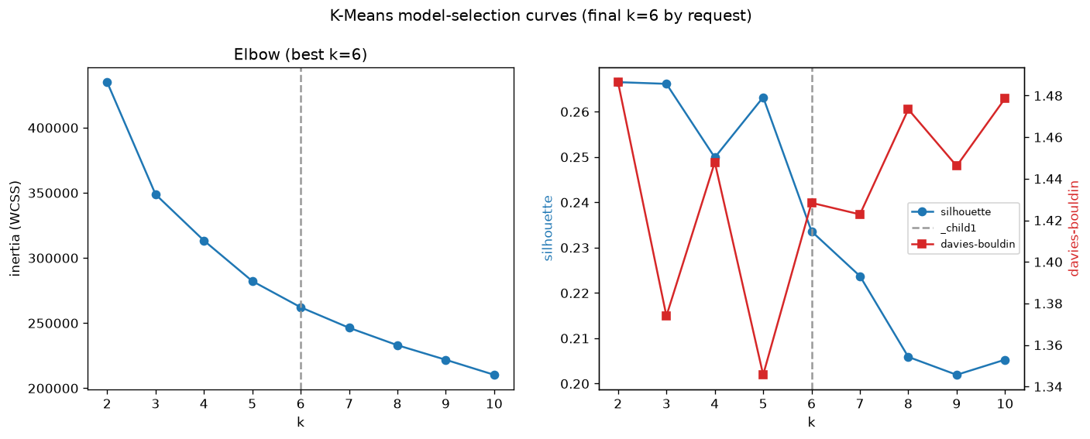
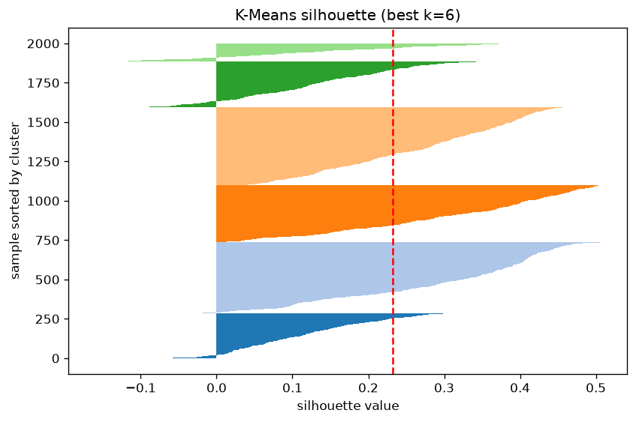
Step 4 · Build the grouping – K-Means
Modelling
Plain language: K-Means “finds 6 natural groups” so that players inside a group are alike and groups differ from each other – like sorting customers by “who behaves like whom”.
• Tried k = 2…10. k = 2, 3 and 5 score almost identically (silhouette 0.267 / 0.266 / 0.263).
• 6 groups – six genuinely actionable segments (silhouette 0.234).
• Technical: inertia + silhouette + Davies-Bouldin curves evaluated; n_init=10, deterministic seed; metrics in kmeans_metrics.csv.
Betty_v1 · Player Segmentation — data science walkthrough
8

Slide 9
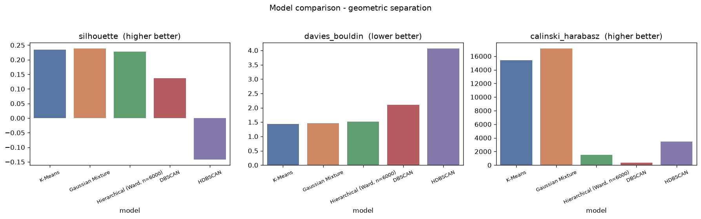
Step 5 · We compared five grouping methods – then checked they hold up
Evaluation
• Plain language: more sophisticated algorithms were tried (soft groups, tree structures, density-based). K-Means wins for practicality and, crucially, it is the most stable – rerunning it gives (almost) the same groups every time.
• Stability = trust: if a model gives a different answer every run, you cannot build business rules on it. K-Means 0.996 vs GMM 0.804, Hierarchical 0.579.
Model (fitted) | Groups | Noise pts | Silhouette | Davies-Bouldin | Stability (ARI)
K-Means, k=6 | 6 | 0 | 0.234 | 1.428 | 0.996
Gaussian Mixture, k=3 | 3 | 0 | 0.239 | 1.462 | 0.804
Hierarchical (Ward), k=4 | 4 | 0 | 0.228 | 1.513 | 0.579
DBSCAN, eps=1.0, min-samples=20 | 3 | 2,375 | 0.137 | 2.108 | 0.855
HDBSCAN, min-cluster=500 | 7 | 31,438 | -0.142 | 4.062 | 0.640
Betty_v1 · Player Segmentation — data science walkthrough
9

Slide 10
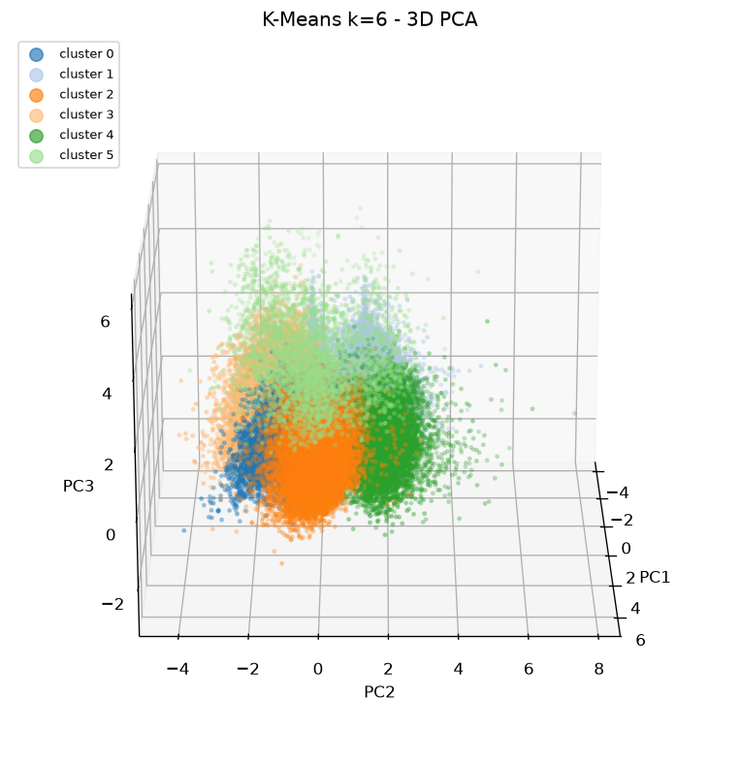
The K-Means result: six player segments
6 Groups
# | Segment name | Share | Players
0 | Steady Balanced Regulars | 15.1% | 9,078
1 | Dormant / Lapsed Light Accounts | 22.3% | 13,366
2 | High-Value VIP / Whales | 18.0% | 10,787
3 | Casual Low-Stakes Winners | 25.2% | 15,122
4 | High-Spend Net-Loss Gamers | 13.6% | 8,125
5 | Loyal Slow-Converters | 5.7% | 3,444
• No “noise” points – every profiled player belongs to exactly one segment (unlike HDBSCAN, which would leave 31k unassigned).
.
Betty_v1 · Player Segmentation — data science walkthrough
10

Slide 11
Segment 0 – Steady Balanced Regulars
15.1% of players
The dependable core – steady spenders who give more than they take, on an even keel.
Product view
Key numbers (median)
• Everyday loyalty and tier-progression; they respond to being rewarded for consistency, not to chase-the-bonus mechanics.
Metric | Value
Deposits | £280
Withdrawals | £50
Bets | 1,541
Logins | 52
Net position | +£125
GGR | £218
Tenure | 101 d
Active | 90%
Marketing view
• Upsell into the mid-tier and cross-sell between products; sources are balanced (Organic / Referral / Google).
Business view
• Baseline profit engine – healthy margin per deposited dollar (1.04 GGR/£1) with the lowest risk profile; ideal growth pool.
Watch out:
Long-running loyalty is healthy, but 50% are already idle >60 days
Betty_v1 · Player Segmentation — data science walkthrough
12

Slide 12
Segment 1 – Dormant / Lapsed Light Accounts
22.3% of players
Light-touch, faded-out accounts – they are around, but barely move.
Product view
Key numbers (median)
• Account hygiene first: merge/close duplicate and suspended accounts; archive truly stale profiles instead of paying to keep them.
Metric | Value
Deposits | £20
Withdrawals | £42
Bets | 27
Logins | 3
Net position | -£12
GGR | £4
Tenure | 184 d
Bonus abuse | 15.6%
Marketing view
• Guarded win-back only – they have the 2nd-highest bonus-abuse rate (15.6%), so reactivation offers must carry strict terms.
Business view
• Commercially negligible (0.1% of GGR) and costly through bonus leakage
Watch out:
87.7% sit in the NegativeValue profit segment
Betty_v1 · Player Segmentation — data science walkthrough
13

Slide 13
Segment 2 – High-Value VIP / Whales
18.0% of players
High-Value VIPs – the whales who fund the business (and deserve white-glove care).
Product view
Key numbers (median)
• Dedicated VIP manager, fast withdrawals, personal limits and bespoke journeys – not reload-bonus churn.
Metric | Value
Deposits | £8,180
Withdrawals | £5,328
Bets | 45,351
Logins | 413
Net position | +£2,121
GGR | £3,144
Self-excluded | 7.0%
RG med/high | 11.1%
Marketing view
• Premium acquisition matters: they arrive via Google/paid search – defend and scale that channel with dedicated creative.
Business view
• Strongest economics in the book – ~90% of total GGR – but the highest formal exit rate and self-exclusion; protect the player to protect the value.
Watch out:
Their GGR margin is lower (0.38) – they win more back. Priority is retention + RG monitoring, not volume.
Betty_v1 · Player Segmentation — data science walkthrough
14

Slide 14
Segment 3 – Casual Low-Stakes Winners
25.2% of players
Small-stakes, frequent small wins – the cleanest, cheapest segment to serve.
Product view
Key numbers (median)
• Light-touch engagement: leaderboards, in-account “winning” moments and safe cross-sell – zero deposit-bonus dependence.
Metric | Value
Deposits | £45
Withdrawals | £0
Bets | 195
Logins | 4
Net position | +£40
GGR | £60
Tenure | 208 d
Bonus abuse | 1.3%
Marketing view
• Virtually no bonus abuse (1.3%) – keep them out of bonus churn; low-frequency, high-relevance comms beat volume.
Business view
• Best margin per deposited dollar (1.28 GGR/£1) even at tiny stakes – the margin champion despite small ticket sizes.
Watch out:
Biggest blind spot: 76% idle >60 days – win-back / Day3 deposit reminders are the main lever here.
Betty_v1 · Player Segmentation — data science walkthrough
15

Slide 15
Segment 4 – High-Spend Net-Loss Gamers
13.6% of players
High spend, consistent net losses, and a red-flag behaviour profile – they cost the business money.
Product view
Key numbers (median)
• Restrict incentives: lower or remove bonus eligibility and impose wagering/velocity caps on this profile.
Metric | Value
Deposits | £435
Withdrawals | £670
Bets | 1,875
Logins | 85
Net position | -£150
GGR | -£7
Win rate | ~100%
Bonus abuse | 16.9%
Marketing view
• Do not market them as VIPs; engage with loss-limit nudges and cooling-off prompts rather than offers.
Business view
• The only segment with NEGATIVE GGR (-3.1% of total): they withdraw more than they deposit despite heavy betting – manage, don't grow.
Watch out:
93% sit in NegativeValue profit segment – this is a risk-management cohort, not a growth cohort.
Betty_v1 · Player Segmentation — data science walkthrough
16

Slide 16
Segment 5 – Loyal Slow-Converters
5.7% of players
Loyal and careful – they stay for years but take their time before the first deposit.
Product view
Key numbers (median)
• Fix the onboarding journey: median 74 days from registration to first deposit – a welcome funnel with structured first-deposit offers.
Metric | Value
Deposits | £596
Withdrawals | £248
Bets | 3,196
Logins | 115
Net position | +£145
GGR | £285
Tenure | 369 d
First deposit | 74 d
Marketing view
• Google + Facebook driven (38% + 14%) – A/B the sign-up-to-deposit funnel there; highest MFA adoption (3.6%) = cautious, trust first.
Business view
• Longest tenure (369 d) and consistently positive net position – converting them earlier lifts lifetime value materially.
Watch out:
Small cohort by share (5.7%) but the slow-conversion gap is the single most fixable leak in the journey.
Betty_v1 · Player Segmentation — data science walkthrough
17

Slide 17
Step 6 · Do the clusters actually differ?
Business validation
Yes – and not by a little. The table shows the metrics that matter, per segment.
Metric | C0 Reg. | C1 Dorm. | C2 Whales | C3 Casual | C4 Net-Loss | C5 Slow
Median GGR | £218 | £4 | £3,144 | £60 | -£7 | £285
Share of total GGR | 3.9% | 0.1% | 89.8% | 3.0% | -3.1% | 6.4%
GGR per £1 deposit | 1.04 | 0.12 | 0.38 | 1.28 | -0.02 | 0.70
Active span (median) | 101 d | 184 d | 331 d | 208 d | 179 d | 369 d
Formal churn/Self-excl. | 7.8% | 6.0% | 16.7% | 12.2% | 8.9% | 10.2%
Idle >60 days | 50% | 72% | 63% | 76% | 60% | 65%
Bonus dependency | 5.4% | 15.6% | 4.7% | 1.3% | 16.9% | 5.9%
Tenure (median) | 101 d | 184 d | 331 d | 208 d | 179 d | 369 d
Logins (median) | 52 | 3 | 413 | 4 | 85 | 115
• A ~1,000× gap in GGR between segments (C2 £3,144 vs C1 £4) – commercial difference is extreme.
• Type of churn differs too: Whales leave formally (self-exclusion/timeout), Casual players just fade away.
Betty_v1 · Player Segmentation — data science walkthrough
17

Slide 18
What can be done differently (recommendations)
Actions
# | Action | Target segment | Why first
1 | Protect & safeguard – VIP manager, RG monitoring, self-limit offers | C2 Whales | ~90% of GGR at risk; exit 16.7%
2 | Restrict bonuses + loss-limit nudges | C4 Net-Loss | Only negative-GGR cohort; highest abuse
3 | Clean-up + guard-railed win-back | C1 Dormant | Lowest effort, stops abuse leakage
4 | Tier-progression & cross-sell program | C0 Regulars | Healthy core, cheapest to grow
5 | Optimise onboarding / first-deposit funnel | C5 Slow-Converters | 74-day first-deposit gap
6 | Light-touch engagement mechanics | C3 Casual | Large base, margin-first growth
• Cross-cutting: segment-specific incentives only (no one-size bonuses), cluster labels into the CRM/CDP, governed A/B tests before full rollout, RG thresholds tuned per segment spend-band.
Betty_v1 · Player Segmentation — data science walkthrough
18

Slide 19
Caveats – what this model is NOT claiming
Limitations
• 40,078 players (40%) had too much missing data to profile – they have no cluster label. That means “not assessed for modelling”, NOT “low value”.
• Hierarchical and DBSCAN were fitted on subsamples (6k / 15k players) for computing reasons – their segment boundaries depend on that sample.
• Many risk/abuse booleans were never recorded (e.g. bonus abuse recorded for only ~6% of players) – flagged as “unknown”, never assumed clean.
• With 59,922 rows, significance tests are trivially “significant” – we therefore relied on effect sizes and stability, not just p-values.
• Recommendations are hypotheses. Validate each with segment-targeted A/B tests before full rollout.
Betty_v1 · Player Segmentation — data science walkthrough
19

Slide 20
Appendix – technical details
For the data team
Stability of the deployed models (mean over 10 pairwise runs)
Distances used by each algorithm (see distance_measures.md)
Model | Perturbation | ARI mean | ARI ± | NMI mean | NMI ±
K-Means (k=6) | random seeds, full data | 0.996 | 0.002 | 0.993 | 0.003
Gaussian Mixture (k=3) | random seeds, full data | 0.804 | 0.240 | 0.834 | 0.204
Hierarchical (Ward) | 5 draws, n=6,000 | 0.579 | 0.119 | 0.595 | 0.077
DBSCAN | 5 draws, n=15,000 | 0.855 | 0.015 | 0.710 | 0.023
HDBSCAN | 5 draws, n=30,000 | 0.640 | 0.201 | 0.698 | 0.101
• K-Means – Euclidean (squared)
• GMM – Mahalanobis (per-cluster covariance)
• Hierarchical – Ward (ESS increase)
• DBSCAN – core-distance reachability
• HDBSCAN – mutual reachability distance
Data flow and files
• raw CSV (100,000×77) → EDA → 43 derived features → 10 features, log/z-scored → 59,922 complete-case matrix (feature_matrix_11_complete.csv).
• All 5 models fit on the same matrix; labels per model in *_assignments.csv; cluster-labelled raw data in master_dataset_clusters.csv.
• Viz: PCA scatters (2D 58.5% / 3D 70.2% explained variance, viz-only), 3D rotating GIFs, elbow/silhouette/dendrogram/AIC-BIC, model & stability comparison charts.
Betty_v1 · Player Segmentation — data science walkthrough

