Slide 1
Design and Development of a Web-Based Teacher–Room Tracking System with Real-Time Monitoring and 3D Classroom Visualization
Capstone 2 Project Defense
Researchers/Developers: Marven James M. Baguio, Christian B. Bantayao, Kheysha Fatte Earl Dagohoy, Sandy Jean A. Panong, Jessie James C. Parajes, John Lester P. Zarsosa
Adviser: Adormie C. Macario
Defense Date: October 8, 2026
PHINMA COC- COLLEGE OF INFORMATION TECHNOLOGY
1

Slide 2
2. Problems & Objectives- 3 minutes
General Problem:
To design, develop, and evaluate a reliable and automated Teacher–Room Tracking System that improves attendance accuracy, real-time monitoring, and reporting efficiency within the College of Education.
Specific objectives:
To improve the accuracy of teacher attendance records by implementing an automated real-time check-in and monitoring mechanism that accounts for parallel teaching schedules.
To provide validated attendance reports efficiently by automating data consolidation and retrieval from the centralized attendance repository.
To create a centralized and automated digital repository for storing and managing teacher attendance records.
To implement an automated notification and alert mechanism that informs administrators of late teacher arrivals, missed attendance checks, and unverified teacher presence in real time to support timely decision-making and improve attendance monitoring efficiency.
CAPSTONE PROJECT DEFENSE • 30-MINUTE PRESENTATION
4

Slide 3
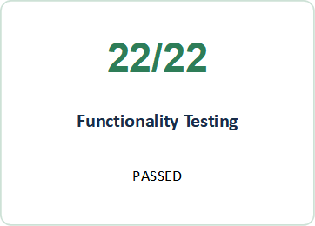
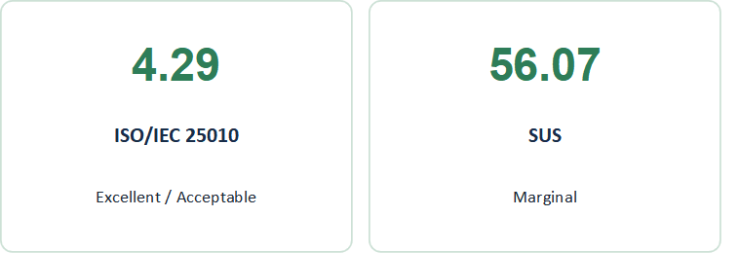
3. Results- 3 minutes
CAPSTONE PROJECT DEFENSE • 30-MINUTE PRESENTATION
4

Slide 4
4. System Demonstration
Live walkthrough of all core user roles, workflows, edge cases, and security.- 15 minutes
☐ Authentication/login
☐ Dashboard
☐ Add Users
☐ Add Schedule
☐ QR Scanning
☐ Attendance
☐ 3D Visualization
☐ Attendance Remarks Request
☐ Reports / outputs
☐ Logout / session behavior
CAPSTONE PROJECT DEFENSE • 30-MINUTE PRESENTATION
4

Slide 5
6. Conclusions and Recommendations- 3 minutes
CONCLUSION
Addressed manual attendance and classroom monitoring problems.
Achieved 4.29 Very High ISO/IEC 25010 rating.
Achieved 100% functionality testing and 100% evaluator testing.
Provides centralized records, real-time monitoring, notifications, reports, and 3D visualization.
SUS: 56.07 (Marginal) → usability needs improvement.
RECOMMENDATIONS
Continue system implementation and maintenance.
Improve UI, navigation, and overall usability.
Strengthen security, privacy, backup, and recovery.
Provide user orientation and technical support.
Monitor system performance and gather continuous user feedback.
Conduct future evaluations with more users and longer deployment.
CAPSTONE PROJECT DEFENSE • 30-MINUTE PRESENTATION
11

Slide 6
Q and A- 15 minutes
CAPSTONE PROJECT DEFENSE • 30-MINUTE PRESENTATION
2

Slide 7
end
CAPSTONE PROJECT DEFENSE • 30-MINUTE PRESENTATION
9

