Slide 1
Spatial capture recapture and related methods

Slide 2
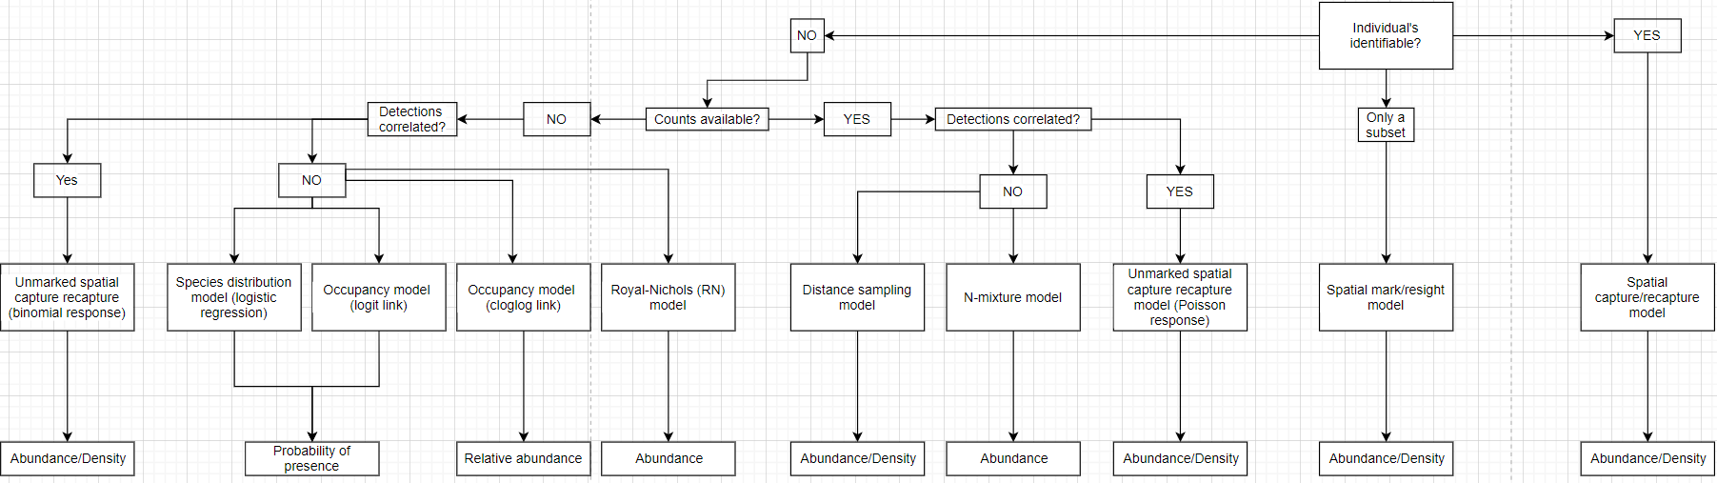
But first, let’s take stock
Start here

Slide 3
A brief history
Apparently goes back to the 16th century! (Pollock 2000).
Extensive development in 20th century (nonspatial)
Simplest form/example (Lincoln-Peterson estimator) :
Step 1: Capture individuals, mark, and release
Step 2: Capture individuals with same methods, count marked (i.e., “recaptured”) individuals
M = # marked in Step 1
C = # captured in Step 2
R = # marked captured in Step 2

Slide 4
Assumptions/problems (and why go spatial?)
Closed population (no movement resulting in immigration/emigration)
If significant migration, recruitment, or mortality – consider open population model
No loss in markers
Equal detectability
If population is not spatially closed, consider spatial model
Sampling area is ‘known’
If no prior information on animal movement/space use is known, consider spatial model

Slide 5
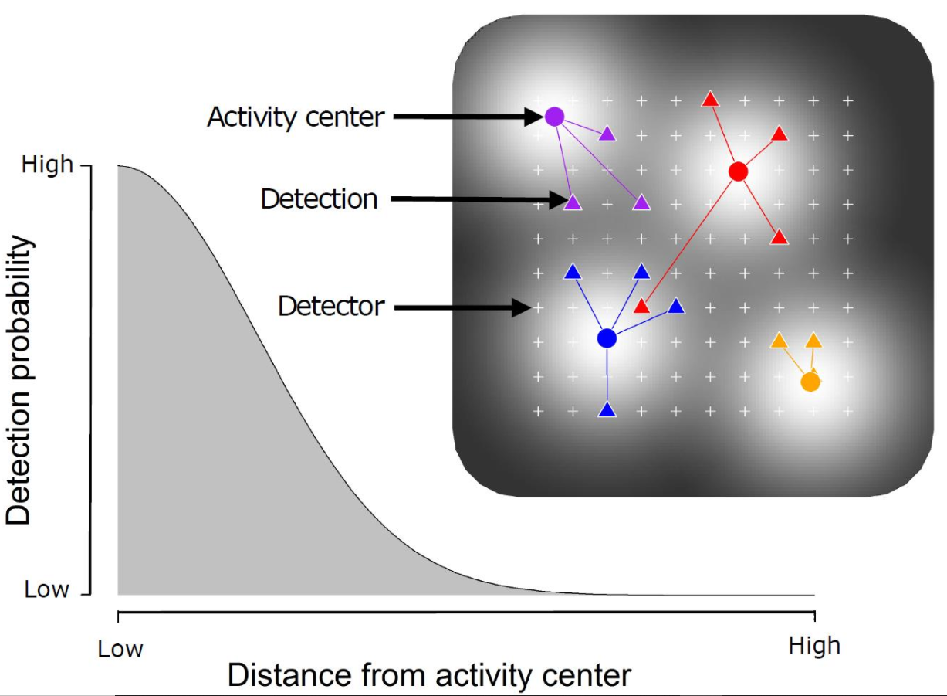
Spatial capture- recapture
India Stephenson (2018)

Slide 6
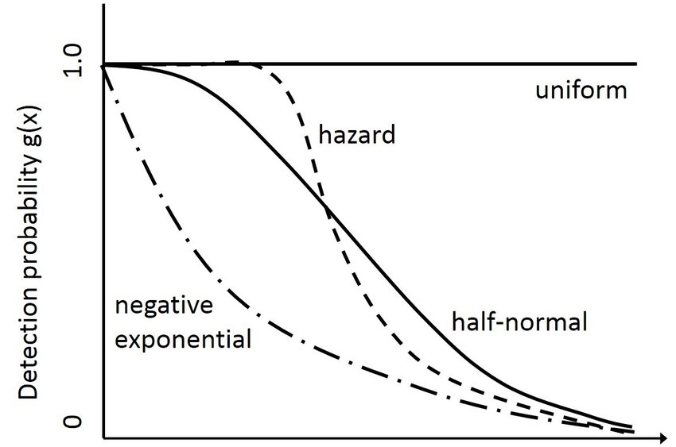
Detection Functions

Slide 7
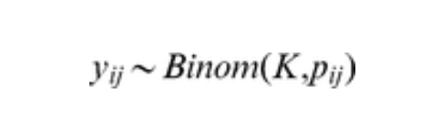
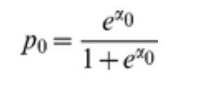
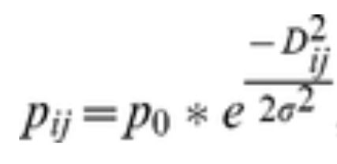
The math
Individual encounter histories
Baseline detection probability
Decaying probability of detection
based on distance from activity center
and spatial ‘ranging’ parameter
2.45 σ = home range radius

Slide 8
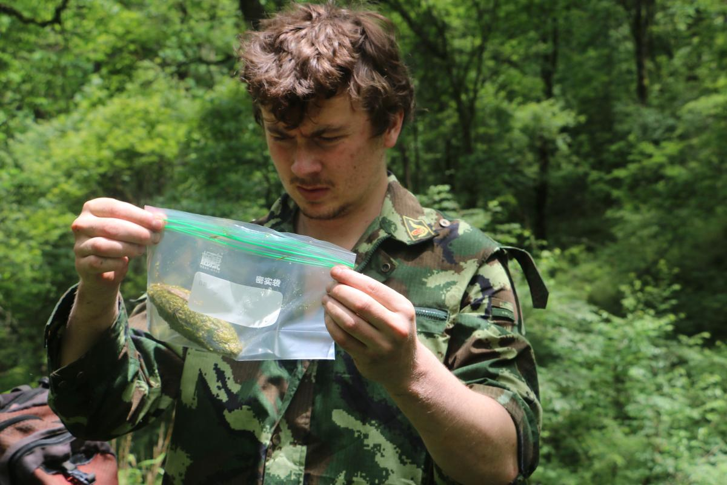
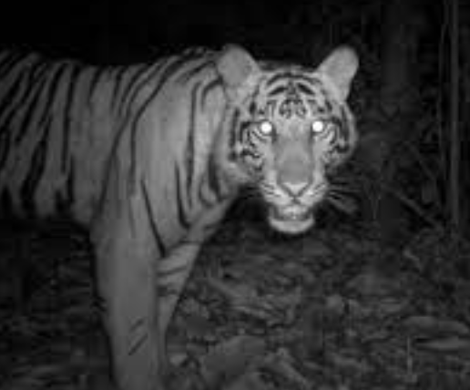
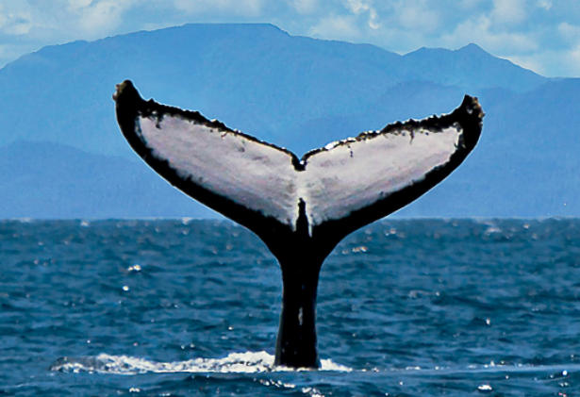
Examples of spatial capture/recapture
Noninvasive (scat and/or hair) genetics
Unique coat pelage in camera trap images
Unique whale flukes

Slide 9
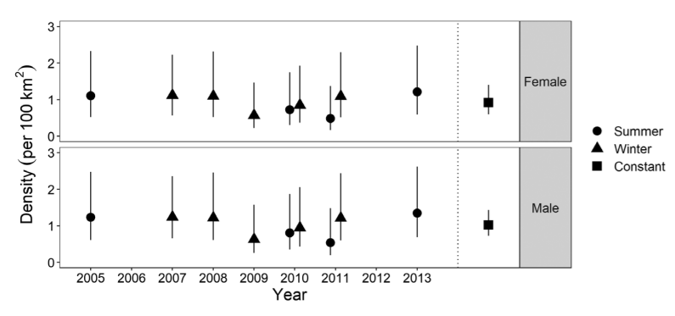
Example – cheetah density in Namibia
Camera trap-based analysis of cheetah population in Southern Namibia
Multi-year study, multi-session SCR model to track density trends
Reason for multi-session, closed population model (as opposed to open population model?)

Slide 10
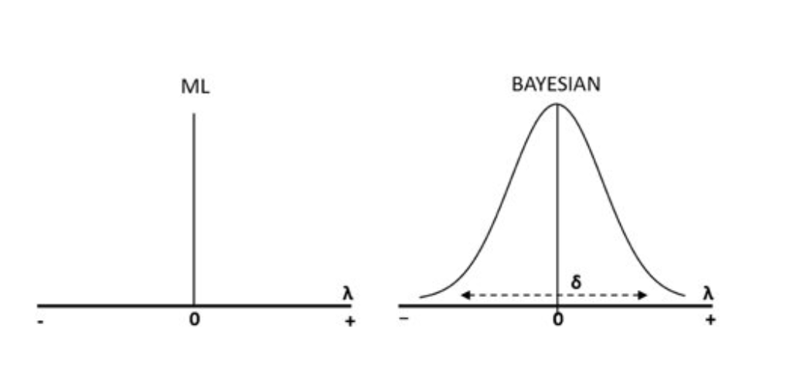
Maximum likelihood vs. Bayesian
At times fierce debate on relative merits of each
In reality, results are generally very similar
Briefly
The importance of priors

Slide 11
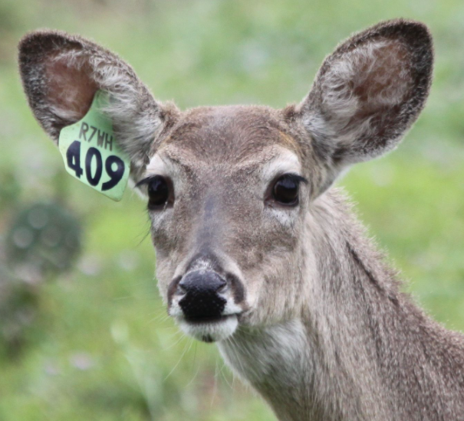
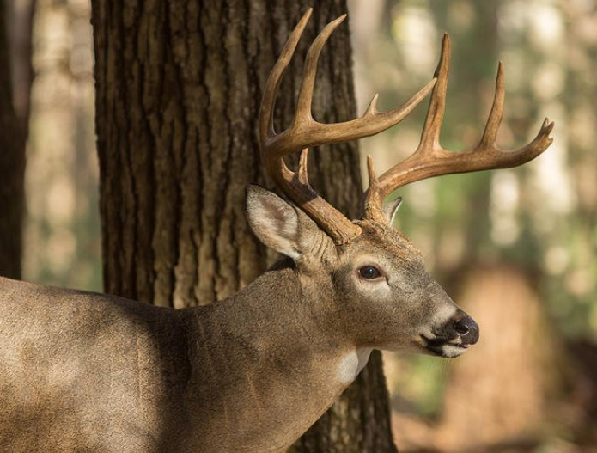
Partially marked populations?
Spatial mark resight models
Incorporate spatial capture recapture and spatial count data components (Rich et al. 2014)
Can include the ‘marking’ process in model

Slide 12
The same modeling framework can be applied to unmarked populations
Unmarked spatial capture recapture (uSCR) Chandler and Royal (2013)
Currently only implemented with Bayesian methods
Data-augmented ‘superpopulation’ that individuals are ‘drawn’ from to derive realized population
Now ‘counts’ and not ‘captures’

Slide 13
Class exercise
Fit either a SCR or uSCR model to Hopland fire deer data (or your own if you have it formatted) that includes environmental covariate effects on density
Derive a density and population estimate
Produce a map of predicted density

