Slide 1
COMP 5531
Professor - Dr. Bipin C. Desai
Lab TA Yogesh Yadav Wednesday 3:15 - 5:15,
Lab TA Reethu Navale Wednesday 8:30 - 10:30
Term - Winter 2022

Slide 2
Agenda
Course Objective
Labs Details and Outline
Introduction to Apache, PHP and MYSQL
Software Installation and Integration of Apache, PHP and MYSQL
Apache
PHP
MYSQL

Slide 3
Course Objective
The lab sessions aim at providing a starting point to your projects and also giving a better understanding of databases by hands-on practice.
What will we learn from the labs?
Basics of HTML, PHP, and MySQL
How to deliver a database application (e.g. your projects)

Slide 4
Labs Details and Outline
Week 2 Introduction to DBMS, MYSQL, PHP and Apache Web server
Week 3 DBMS/MYSQL Concepts, ER Diagrams
Week 4 MySQL Part 2
Week 5 RA, Calculus, Data Modelling and HTML Intro
Week 6 HTML Part 2, Project Phase 1 Discussion(Q&A)
Week 7 Functional Dependency, PHP Intro
Week 8 Normalization, PHP Part 2
Week 9 Subqueries, Aggregation, CSS Intro,Q&A for Main Project Phase I
Week 10 Views, Constraints, Triggers, CSS Part 2
Week 11 File Systems, NoSQL Intro, JScript
Week 12 Project Discussion, Q&A
Week 13 Project Discussion, Q&A

Slide 5
Introduction to DBMS, MYSQL, PHP and Apache Web server
Lab Week 1

Slide 6
Database Management System
A Database Management System (DBMS) is a software application that interacts with the user, applications and the database itself to capture and analyze data. The data stored in the database can be modified, retrieved and deleted, and can be of any type like strings, numbers, images etc.
User - External User/Customer/Developer using the application/service
Application - Service developed to cater to Customer requests
Database - A centralized repository/container to store all data
Data - record/piece of information
Relational DBMS (RDBMS): This type of DBMS, uses a structure that allows the users to identify and access data in relation to another piece of data in the database(tabular Format - rows and columns).

Slide 7
MYSQL
Open-source relational database management system
Developed, distributed, and supported by Oracle Corporation
Compatible across number of platforms - Windows/Linux/Mac
Uses standard SQL
Very fast, reliable(holds ACIDs property), and easy to use
Data is stored in tables. A table is a collection of related data, and it consists of columns and rows

Slide 8
PHP
PHP: Hypertext Preprocessor
Programming language that allows web developers to create dynamic content that interacts with databases
Used for developing web based software applications
Server side language to manage dynamic content, databases, session tracking, even build entire e-commerce sites
Supports popular databases, including MySQL, PostgreSQL, Oracle, Sybase, Informix, and Microsoft SQL Server

Slide 9
Apache Web Server
Open-source web server that delivers web content through the internet
Ability to handle large amounts of traffic with minimal configuration.
Apache WS scales with ease and with its modular functionality at its core, you can configure Apache to do what you want, how you want it. You can also remove unwanted modules to make Apache more lightweight and efficient.
Supports TCP/IP, HTTP(Port 80), HTTPS(Port 443) protocol

Slide 10
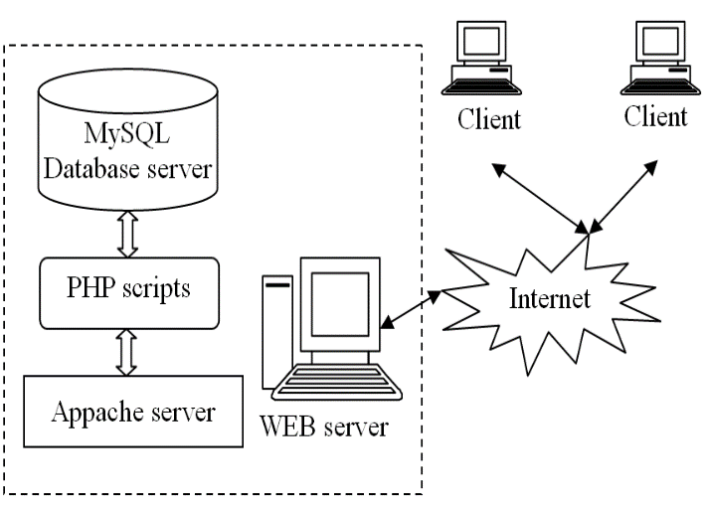
Integration - MYSQL,PHP and Apache Web Server

Slide 11
Software Install and Integration
MySQL, PHP and Apache
Download and Install Link
Windows - https://youtu.be/qpPYYX-i1cs
Linux - https://devanswers.co/install-apache-mysql-php-lamp-stack-ubuntu-20-04/
Mac OS - https://tecadmin.net/install-apache-macos-homebrew/

Slide 12
Thank You

