Slide 1
Database, Data Models,DBMS Concepts, ER Modelling
Week 3 Lab

Slide 2
Agenda
Database and Data Models
DBMS ? What is DBMS? File System vs DBMS
Levels of Abstraction
Data Independence
Data Modelling - ER Diagrams
Hands-Ons Example

Slide 3
Database
What is Data
Definition 1: Systematic collection of data, typically describing and storing the activities of one or more related organizations.
Definition 2: Structured collection of records or data that is stored in a computer system. The data in a database can then be easily accessed, managed, modified, updated, controlled, and organized.
Data is a collection of a distinct small unit of information. It can be used in a variety of forms like text, numbers, media, bytes, etc. it can be stored in pieces of paper or electronic memory, etc.

Slide 4
Database(cont.)
Data in a database has to be organized according to certain data model.
The data model in most common use today is the relational model in which a database might contain information about the following:
Entities (for example, students, faculty and courses)
Relationships (for example, students enrolling in courses, faculty teaching courses)
Most DBMS today are based on the relational data model.

Slide 5
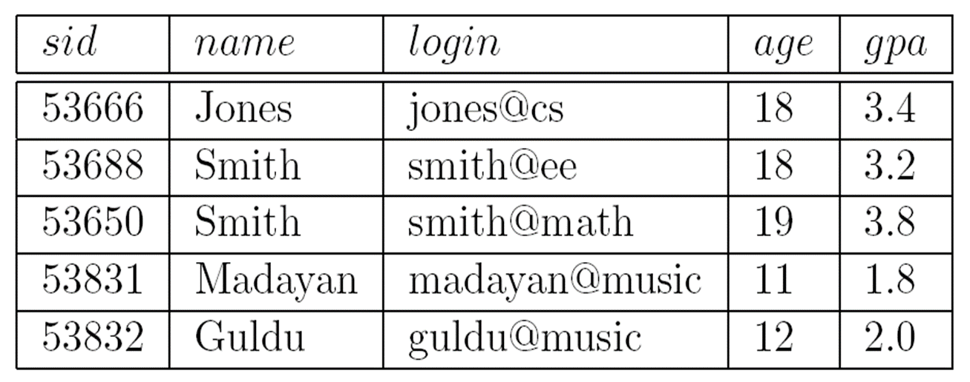
Database(cont.)
An instance of the Students relation

Slide 6
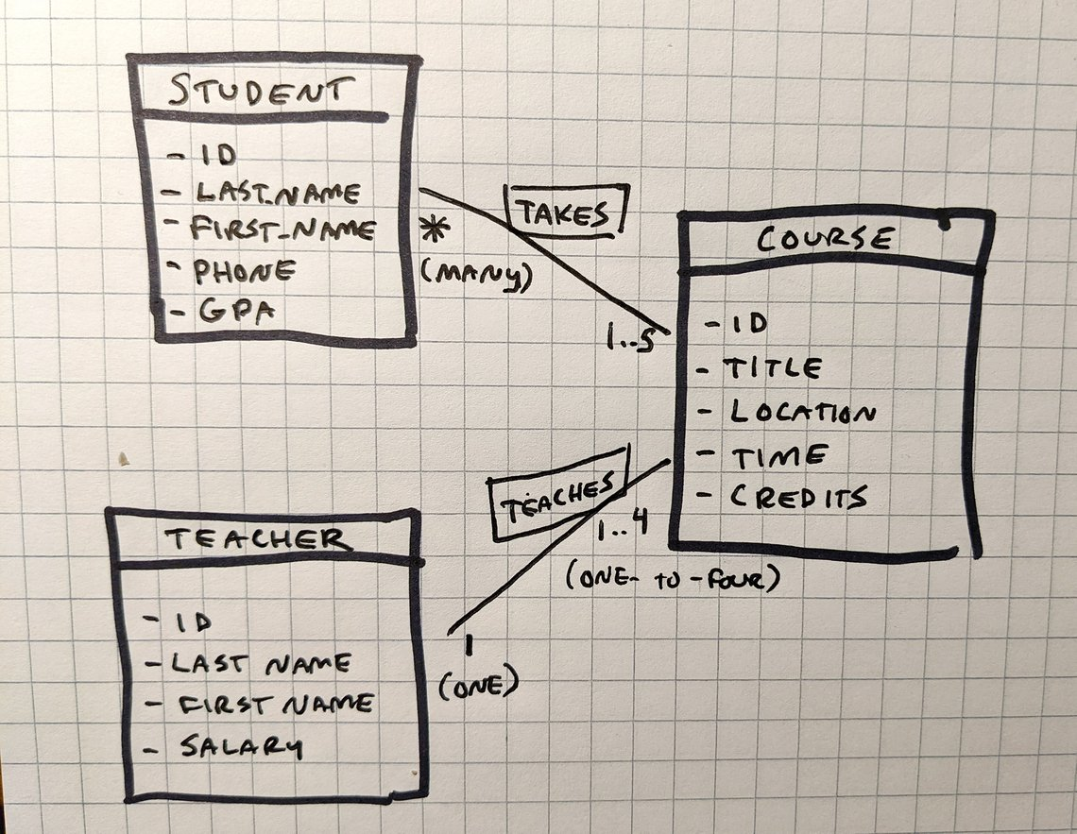
Database(cont.)
An Instance of Entities(Student,Course,Teacher) and Relationship(Takes,Teaches)

Slide 7
Relational Data Model
Schema: in the relational model, the schema for a relation specifies its name, the name of each field (also known as attribute or column), and the data type of each field.
Example
Students ( sid: string, name: string, gpa: real )
Schema
attribute
datatype

Slide 8
Other Data Models
In addition to the relational data model (which has been used in numerous systems, including IBM’s DB2, Oracle, Sybase, Access, MySQL), other important data models include:
The hierarchical model
The object-oriented model
The object-relational model

Slide 9
ACID properties of Relational Database
Four crucial properties define relational database transactions: atomicity, consistency, isolation, and durability—typically referred to as ACID.
Atomicity - This ensures the data operation will complete either with success or with failure. It follows the 'all or nothing' strategy. For example, a transaction will either be committed or will abort.
Consistency - If we perform any operation over the data, its value before and after the operation should be preserved. For example, the account balance before and after the transaction should be correct, i.e., it should remain conserved.
Isolation - There can be concurrent users for accessing data at the same time from the database. Thus, isolation between the data should remain isolated. For example, when multiple transactions occur at the same time, one transaction effects should not be visible to the other transactions in the database.
Durability - It ensures that once it completes the operation and commits the data, data changes should remain permanent.

Slide 10
DBMS(Database Management System)
A database management system, or DBMS, is software designed to assist in maintaining and utilizing large collections of data.
DBMS provides the interface to perform the various operations like creation, deletion, modification, etc.
DBMS allows the user to create their databases as per their requirement.
DBMS accepts the request from the application and provides specific data through the operating system.
DBMS contains the group of programs which acts according to the user instruction.
It provides security to the database.

Slide 11
DBMS Responsibilities
Allows users to create new databases and specify their schema (logical structure of the data), using a data-definition language (DDL).
Gives users the ability to query the data and modify the data, using a query language and data-manipulation language (DML).
Supports intelligent storage of very large amounts of data.
Protects the data from accident or not proper use.
Example: We can enable DBMS to not allow the insertion of records for two different students with the same student ID
Allows efficient access to the data for queries and modifications.
Example: The use of indexes over a specified field, e.g. on the name field for employees, allows fast response for queries asking a specific name.
Controls access to data from many users at once (concurrency), without allowing “bad” interactions that can corrupt the data accidentally.
Recovers from failures and crashes.

Slide 12
Exercise
Indicate if the following statements are true or false:
A database is a collection of programs.
A database system is a collection of data.
A Database has data and relationships.
Table is the basic data storage unit in a Relational database.
Relationships link data from individual tables to increase the usefulness of the database.
A transaction is a unit of work that is performed against a database.
Durability ensures that the result or effect of a committed transaction persists in case of a system failure.
Isolation ensures that the database properly changes states upon a successfully committed transaction

Slide 13
File System Vs. DBMS
If we are dealing with a large collection of data, what’s the cons of storing data in operating system files?
Main memory size Vs. disk size? We may not have enough main memory to hold all the data. We must therefore store data in a storage device, disk for example, and bring only relevant parts into main memory for processing as needed.
Can it answer questions? In a file system, the only way to retrieve specific information is to search the “exact” plaintext.
Consistency? We must protect the data from inconsistent changes made by different users accessing the data concurrently.
Crash? We must ensure that data is restored to a consistent state if the system crashes while changes are being made.
Security mechanism? Operating systems provide only a password mechanism for security. This is not sufficiently flexible to enforce security policies in which different users have permission to access different subsets of the data.

Slide 14
File System Vs. DBMS(cntd.)
Advantages of a DBMS?
Data Independence: the DBMS provides an abstract view of the data that hides the details of data representation and storage;
Efficient Data Access
Data Integrity and Security: the DBMS can enforce integrity constraints, and also it can enforce access controls that govern what data is visible to different classes of users;
Data Administration (Centralization): experienced professionals, so-called DBA, can be responsible for organizing the data representation to minimize redundancy and for fine-tuning the storage of the data to make retrieval efficient;
Concurrent Access and Crash Recovery
Reduced Application Development Time: clearly, the DBMS supports important functions that are common to many applications accessing data in the DBMS (reuse).

Slide 15
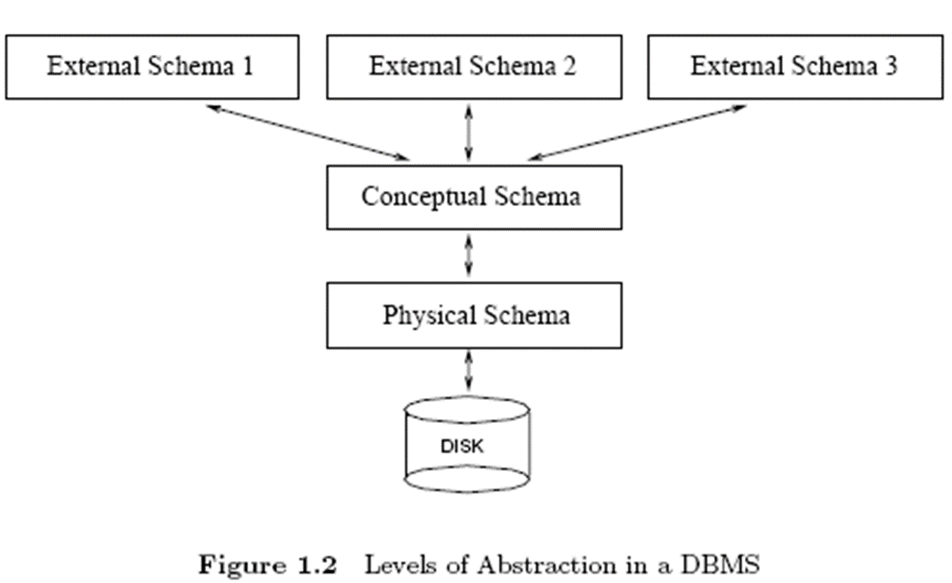
Levels of Abstraction
The data in a DBMS is described at three levels of abstraction.

Slide 16
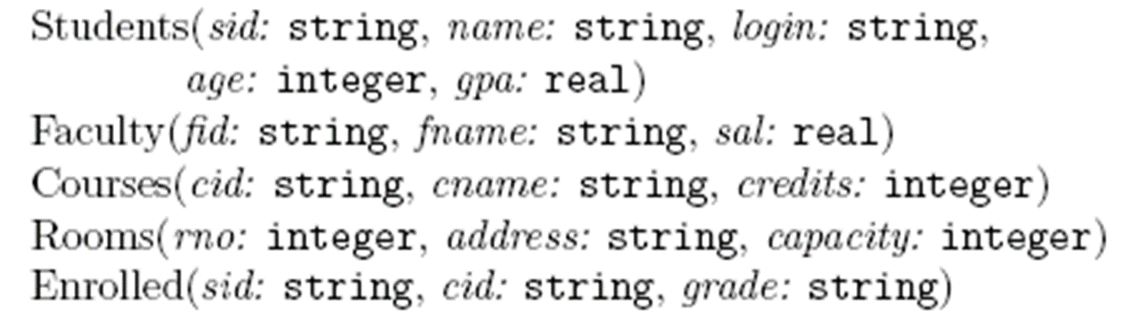
Conceptual Schema
Describes the structure of the whole database at the conceptual level. Conceptual level is also known as logical level
The conceptual level describes what data are to be stored in the database and also describes what relationship exists among those data.
In the conceptual level, internal details such as an implementation of the data structure are hidden.

Slide 17
Physical Schema
The physical schema specifies physical storage structure of the database.
For example, how the relations described in the conceptual schema are actually stored on disks and/or tapes.
Describe complex low-level data structures in detail
What storage tool/techniques are used by organizations to store the relationships,entities,records etc

Slide 18
External Schema
External schemas, which usually are also in terms of the data model of the DBMS, allow data access to be customized at the level of individual users or groups of users, which result in the concept of “View”.
Any given database has exactly one conceptual schema and one physical schema, but it may have several external schemas.

Slide 19
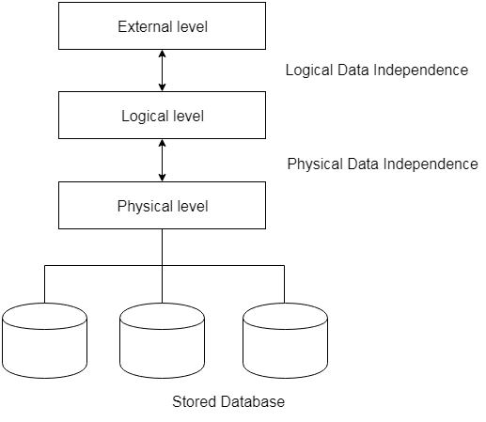
Data Independence
Characteristic of being able to modify the schema at one level of the database system without altering the schema at the next higher level.

Slide 20
Logical and Physical Data Independence
Logical
Logical data independence refers characteristic of being able to change the conceptual schema without having to change the external schema.
Logical data independence is used to separate the external level from the conceptual view.
If we do any changes in the conceptual view of the data, then the user view of the data would not be affected.
Logical data independence occurs at the user interface level.

Slide 21
Logical and Physical Data Independence(cntd.)
Physical
Physical data independence can be defined as the capacity to change the internal schema without having to change the conceptual schema.
If we do any changes in the storage size of the database system server, then the Conceptual structure of the database will not be affected.
Physical data independence is used to separate conceptual levels from the internal levels.
Physical data independence occurs at the logical interface level.

Slide 22
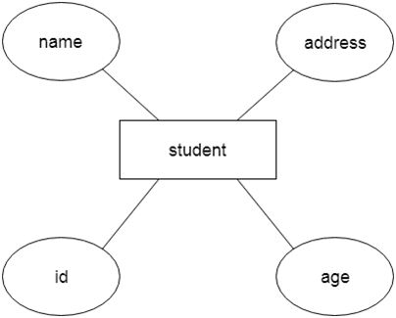
ER model
ER model stands for an Entity-Relationship model. It is a high-level data model. This model is used to define the data elements and relationship for a specified system.
It develops a conceptual design for the database. It also develops a very simple and easy to design view of data.
In ER modeling, the database structure is portrayed as a diagram called an entity-relationship diagram.

Slide 23
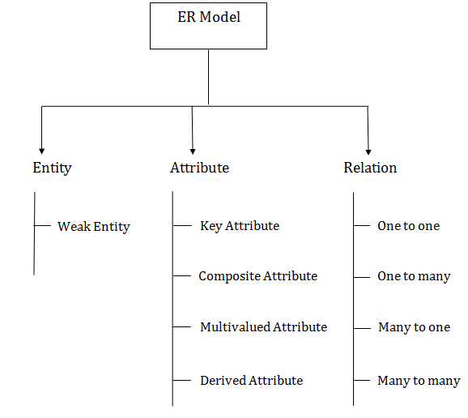
Component of ER Diagram

Slide 24
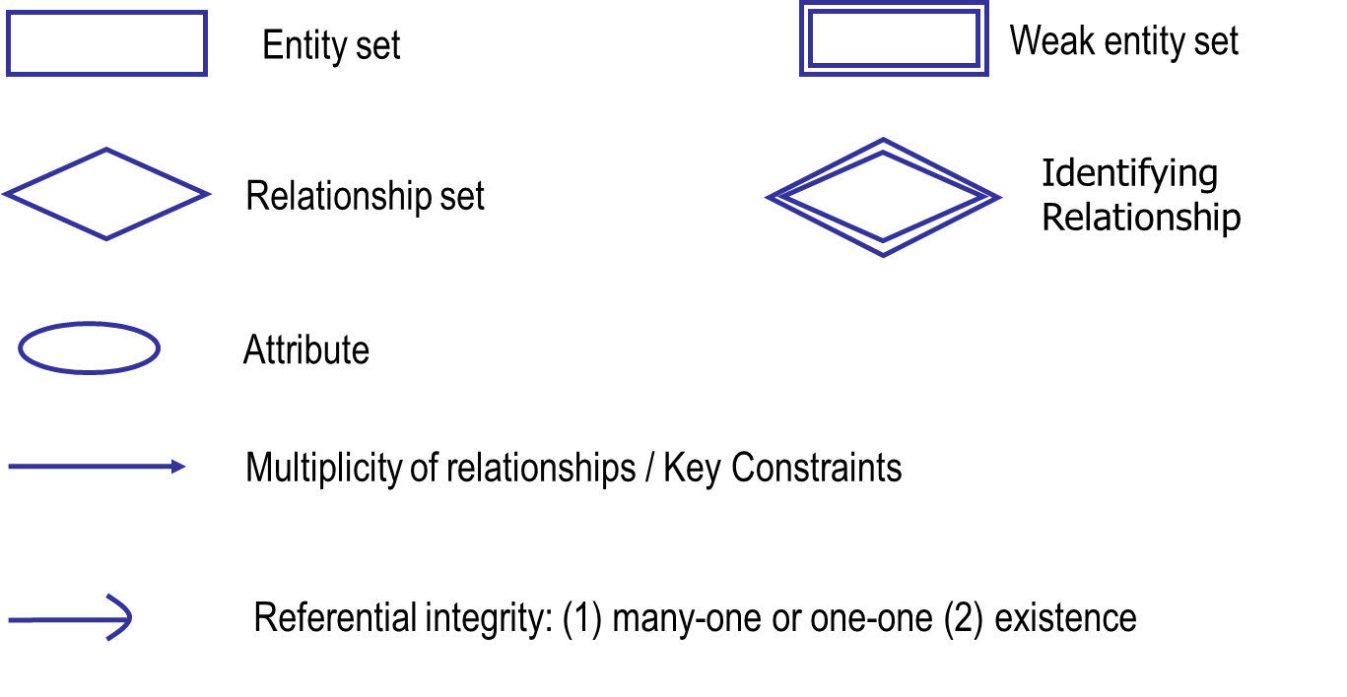
ER Modelling - Basic Notation

Slide 25
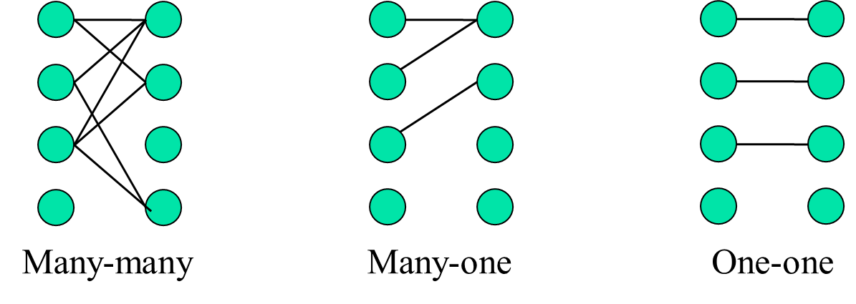
ER Modelling - Multiplicity of Relationships

Slide 26
Exercise #1 - 1
A database for a bank includes information about customers and their accounts.
Information about customer includes name, address, phone, and social security number.
Accounts have numbers, type (saving, checking), and balances.
An account can be owned by several customers, and a customer can have multiple accounts.
Come up with a ER Diagram for the above info

Slide 27
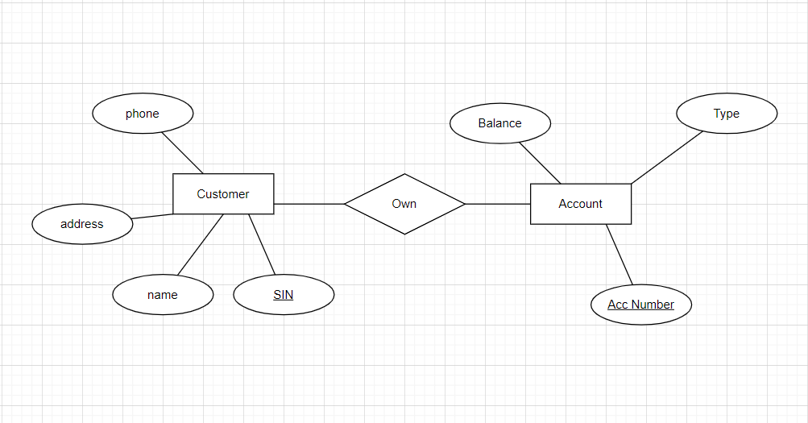
Exercise #1 - 2

Slide 28
Exercise #2 - 1
Change your design so that an account can have exactly one customer

Slide 29
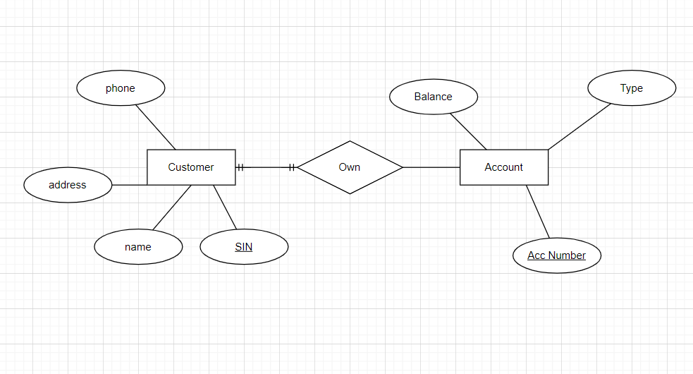
Exercise #2 - 2

Slide 30
Exercise #3 - 1
Further change your design so a customer can have at most one account

Slide 31
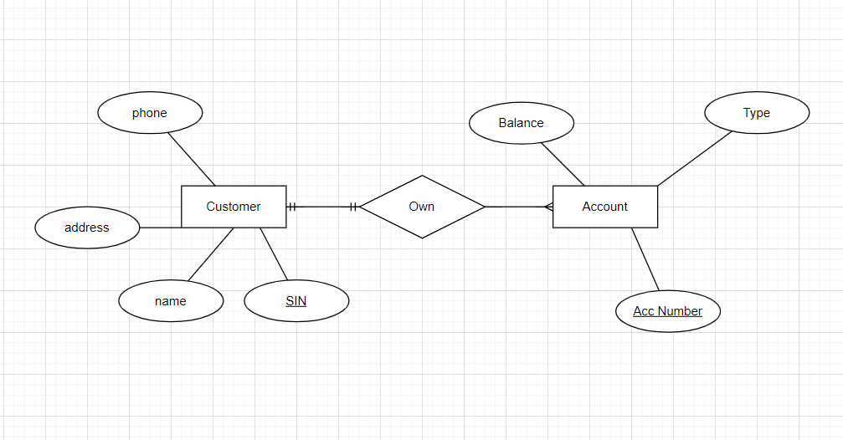
Exercise #3 - 2

Slide 32
Exercise #4 - 1
Change your original design so that a customer can have a set of addresses (street, city, state) and a set of phones.

Slide 33
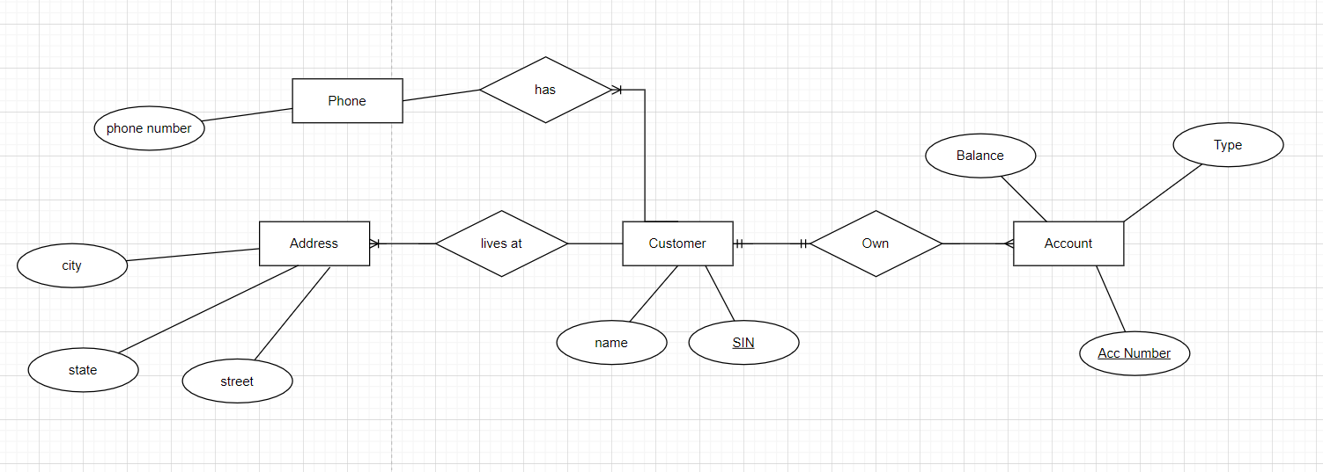
Exercise #4 - 2

Slide 34
Exercise #5 - 1
Further change your original design so that a customer can have a set of addresses. Also, at each address, there is a set of phones.

Slide 35
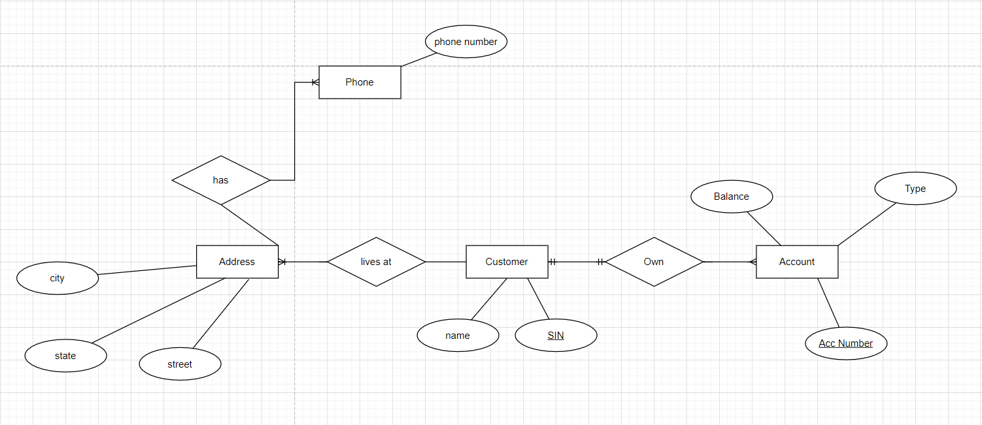
Exercise #5 - 2

Slide 36
Exercise #6 - 1
Design a database for a university registrar.
This database should include information about students, departments, professors, courses(Define Attributes and relationship for each attribute on your own)
Student are enrolled in which courses
Professors teach which courses,
Student are grades
TA for the course (TAs are students)
Department offers courses
Any other information you deem appropriate.

Slide 37
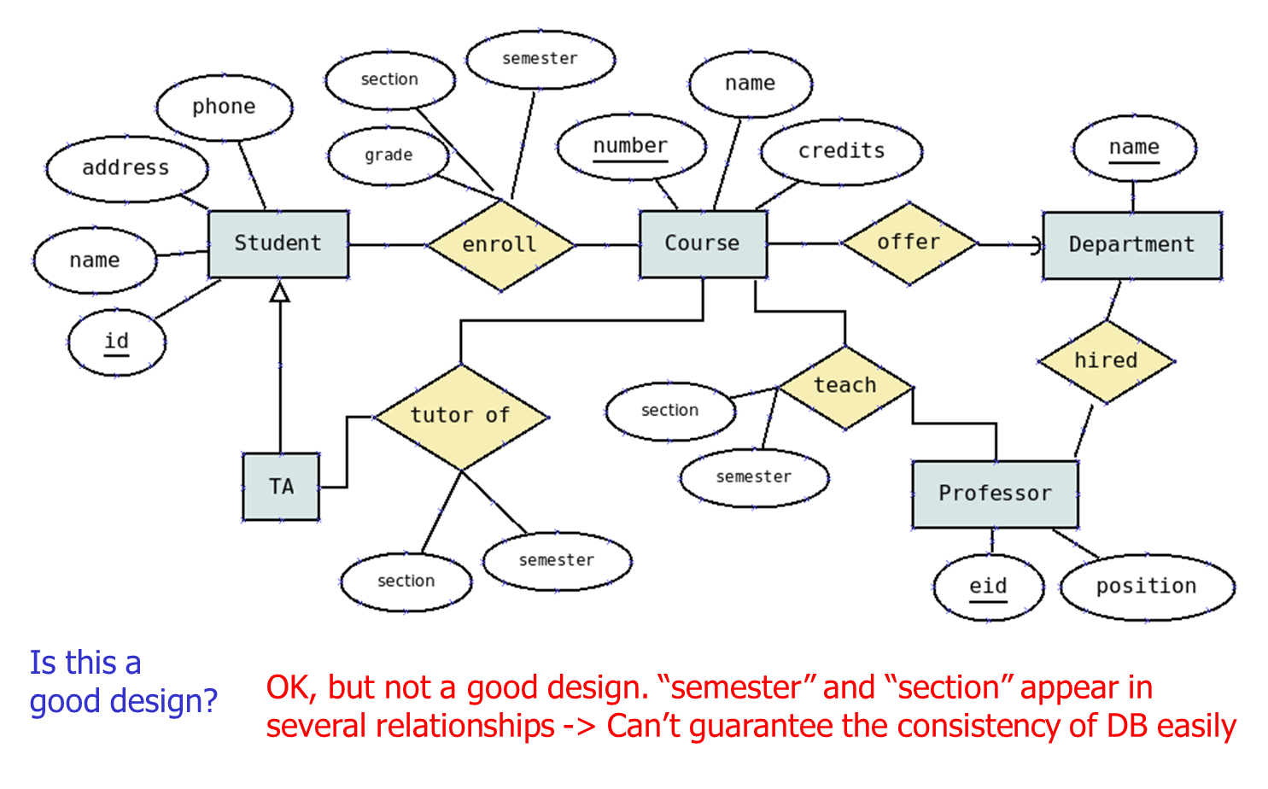
Exercise #6 - Solution 1

Slide 38
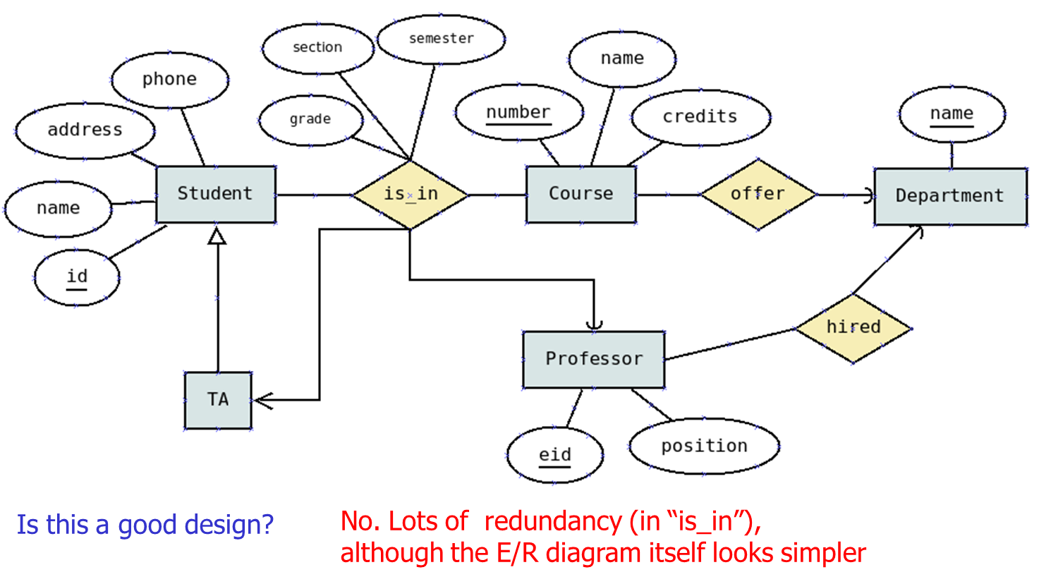
Exercise #6 - Solution 2

Slide 39
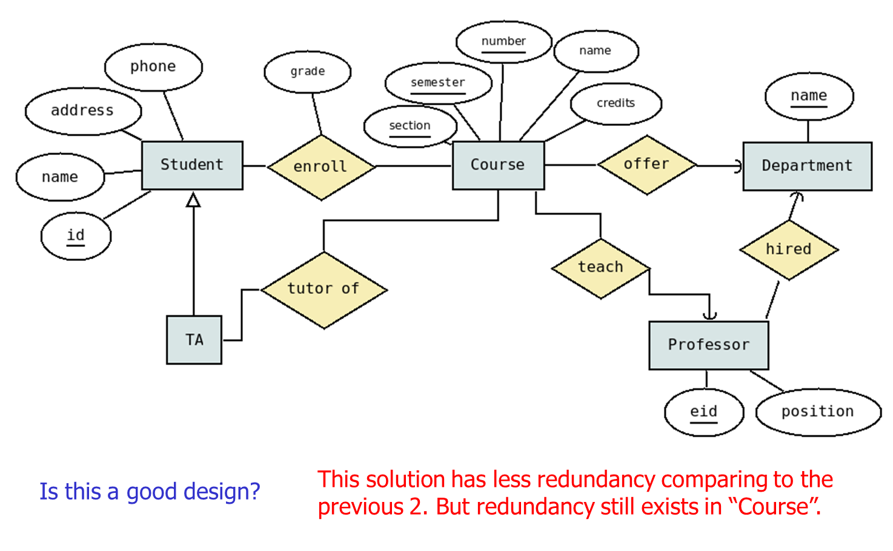
Exercise #6 - Solution 3

Slide 40
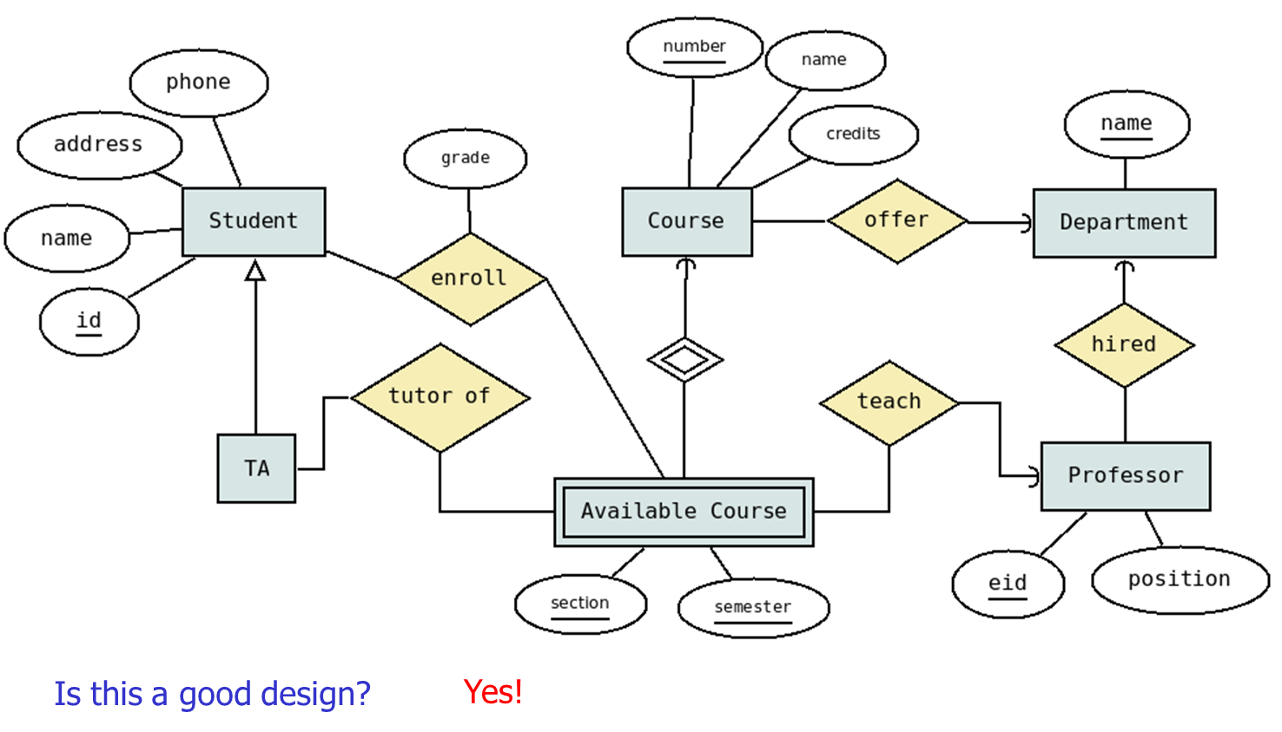
Exercise #6 - Solution 4

Slide 41
Draw.io Link - https://drive.google.com/file/d/12JmPcJsGXCOi4LRL5FOvyJRNquJ0fBZJ/view?usp=sharing

Slide 42
Thank You

