Slide 1
ER Modelling, MySQL Hands On
Week 4 Lab

Slide 2
Agenda
MYSQL Basics
ER Diagram - HR Database
MYSQL Hands On - HR Database

Slide 3
MySQL Basics
GitHib Link -
https://github.com/yogeshoyadav08/lab4_mysql_handson/blob/29fa6e93b6812517a6ecf26e622daf0442fd7cb5/mysql_basics.md

Slide 4
ER Modelling Exercise - HR Database
Entity Details
Design Considerations
1. ID columns across each entity are Primary key columns
2. PK-FK relationship needs to be implemented in the ER Diagram
3. Relationship: 1 to 1, 1 to many, many to 1 or many to many needs to be incorporated.
1. Region
`REGION_ID` decimal(5,0) NOT NULL,
`REGION_NAME` varchar(25) DEFAULT NULL
2. countries
`COUNTRY_ID` varchar(2) NOT NULL,
`COUNTRY_NAME` varchar(40) DEFAULT NULL,
`REGION_ID` decimal(10,0) DEFAULT NULL
3. locations
`LOCATION_ID` decimal(4,0) NOT NULL DEFAULT '0',
`STREET_ADDRESS` varchar(40) DEFAULT NULL,
`POSTAL_CODE` varchar(12) DEFAULT NULL,
`CITY` varchar(30) NOT NULL,
`STATE_PROVINCE` varchar(25) DEFAULT NULL,
`COUNTRY_ID` varchar(2) DEFAULT NULL
4. departments
`DEPARTMENT_ID` decimal(4,0) NOT NULL DEFAULT '0',
`DEPARTMENT_NAME` varchar(30) NOT NULL,
`MANAGER_ID` decimal(6,0) DEFAULT NULL,
`LOCATION_ID` decimal(4,0) DEFAULT NULL
5. jobs
`JOB_ID` varchar(10) NOT NULL DEFAULT '',
`JOB_TITLE` varchar(35) NOT NULL,
`MIN_SALARY` decimal(6,0) DEFAULT NULL,
`MAX_SALARY` decimal(6,0) DEFAULT NULL
6. employees
`EMPLOYEE_ID` decimal(6,0) NOT NULL DEFAULT '0',
`FIRST_NAME` varchar(20) DEFAULT NULL,
`LAST_NAME` varchar(25) NOT NULL,
`EMAIL` varchar(25) NOT NULL,
`PHONE_NUMBER` varchar(20) DEFAULT NULL,
`HIRE_DATE` date NOT NULL,
`JOB_ID` varchar(10) NOT NULL,
`SALARY` decimal(8,2) DEFAULT NULL,
`COMMISSION_PCT` decimal(2,2) DEFAULT NULL,
`MANAGER_ID` decimal(6,0) DEFAULT NULL,
`DEPARTMENT_ID` decimal(4,0) DEFAULT NULL
7. job_history
`EMPLOYEE_ID` decimal(6,0) NOT NULL,
`START_DATE` date NOT NULL,
`END_DATE` date NOT NULL,
`JOB_ID` varchar(10) NOT NULL,
`DEPARTMENT_ID` decimal(4,0) DEFAULT NULL

Slide 5
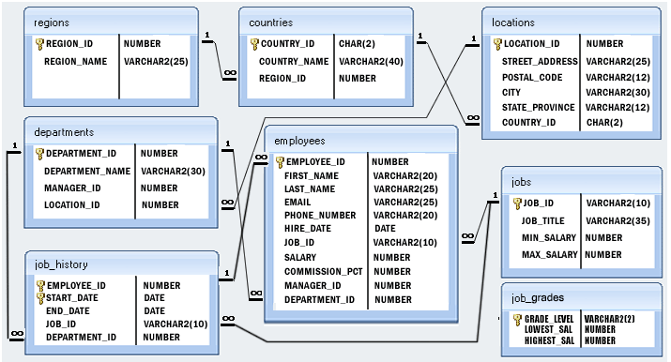
ER Diagram
Note - Ignore Job_Grades table in ER Diagram

Slide 6
MySQL Hands On
GitHub Link -
https://github.com/yogeshoyadav08/lab4_mysql_handson/blob/29fa6e93b6812517a6ecf26e622daf0442fd7cb5/mysql_hands_on_exercise.md

Slide 7
Lab Contents
Lab Content Link -
https://liveconcordia-my.sharepoint.com/:f:/g/personal/y_yada_live_concordia_ca/EjrbFl_LgkhLvGja_1PrKMsBOiXXKMK7BnWPpYFT029CpA?e=0nK29T

Slide 8
Thank You

