Slide 1
Relational Algebra,Relational Calculus, HTML Introduction
Week 5 Lab

Slide 2
Agenda
Relational Algebra
HTML Introduction

Slide 3
Relational Algebra
Relational Algebra is procedural query language, which takes Relation as input and generate relation as output. Relational algebra mainly provides theoretical foundation for relational databases and SQL.

Slide 4
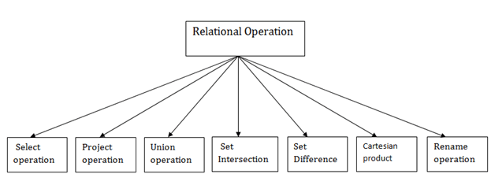
Relational Algebra - Types

Slide 5
Relational Algebra CNTD.
Link - https://github.com/yogeshoyadav08/Comp5531Database-Webtechnology/blob/99f001b80d8051b9370d0f2d916ab44afcdf6267/lab5/RA/Tutorial_RA.pdf

Slide 6
HTML Basics and Intro
Link - https://github.com/yogeshoyadav08/Comp5531Database-Webtechnology

Slide 7
Thank You

