Slide 1

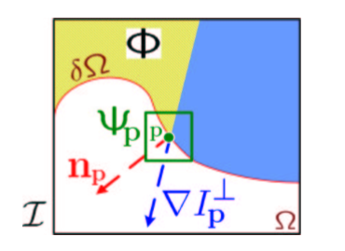



Object Removal by Exemplar-Based Inpainting -- [Criminisi et al. 2003]
Patch Priorities
Confidence term
Data term

Slide 2
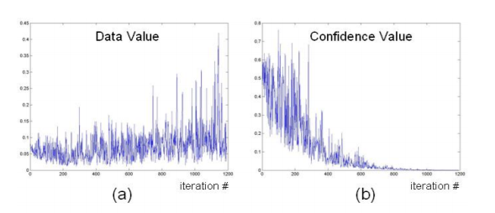
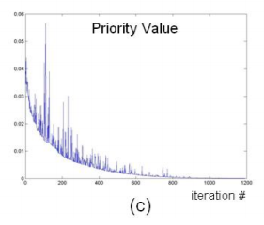
Robust Algorithm for Exemplar-based Image Inpainting -- [Cheng et al. 2005]
Evaluation Criminis’s work:
Patch Priorities
Confidence term
Data term
Numerical multiplication is essentially sensitive to extreme values and their influences are usually over amplified.

Slide 3



Robust Algorithm for Exemplar-based Image Inpainting -- [Cheng et al. 2005]
Patch Priorities
Regularizing Function
Robust Priorities
α+β=1

