Slide 1
Possible case studies
Two candidate time periods where we have measurements (currents, waves, bottom water properties) offshore of Frying Pan Shoals and the NCDEQ dataset:
August/September, 2025: Our student, Arden, sees Brunswick county beaches (south of the Cape Fear) light up with low salinity and high enterococcus. There was a lot of rain at that time last year.
May/June, 2024: Arden sees a smaller signal at both New Hanover county and Brunswick county beaches, so perhaps the plume was more offshore.
Perhaps start with August/September 2025.

Slide 2
Ideas moving forward
Some goals of exploratory data analysis might be:
Characterize the spatial relationship between satellite-derived water quality variables (Chl, Turbidity) and SST versus known high enterococcus levels at adjacent, “downstream” and “upstream" DEQ sites (Since we will know something about the currents).
Characterize the temporal relationship and/or quantify lag time (if applicable) between precipitation events vs. high Chl and/or Turbidity vs. high levels of enterococcus.
This could be from Sentinel-3 OLCI satellite data, which has better spatial resolution and does coastal water Chl pretty well.
Then, if we find something interesting, look at the phytoplankton community composition and/or plume water “color” from PACE?

Slide 3
Ideas moving forward
Some goals of exploratory data analysis might be:
Characterize the spatial relationship between satellite-derived water quality variables (Chl, Turbidity) and SST versus known high enterococcus levels at adjacent, “downstream” and “upstream" DEQ sites (Since we will know something about the currents).
Characterize the temporal relationship and/or quantify lag time (if applicable) between precipitation events vs. high Chl and/or Turbidity vs. high levels of enterococcus. – MIGHT BE HARD (spotty data).
Could some combination of satellite parameters “isolate” the high enterococcus / low salinity sites from those that don’t have poor WQ. Aug/Sep 2025 north of the Cape Fear River sites are protected.
Notes:
Because the enterococcus sampling is so spotty, the lag might be a challenge (but we can try!). It also would be very interesting if some combination of satellite parameters were able to “isolate” the high enterococcus/low salinity sites from those that don’t have the poor-quality water. In this August/September period, the locations just NORTH of the CFR should be fairly protected from the plume.

Slide 4
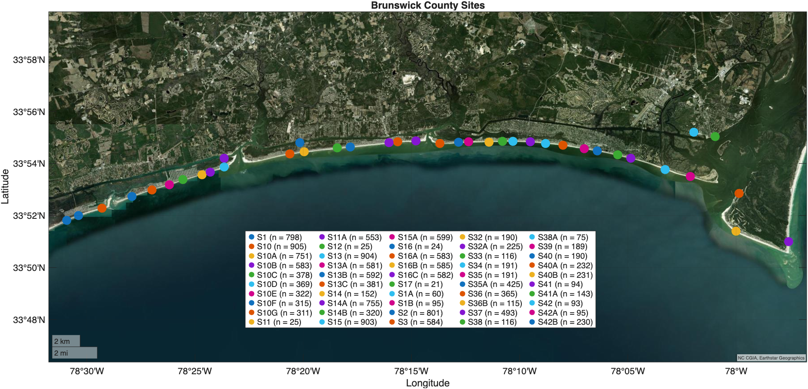
Specifically sites SOUTH of the Cape Fear River

Slide 5
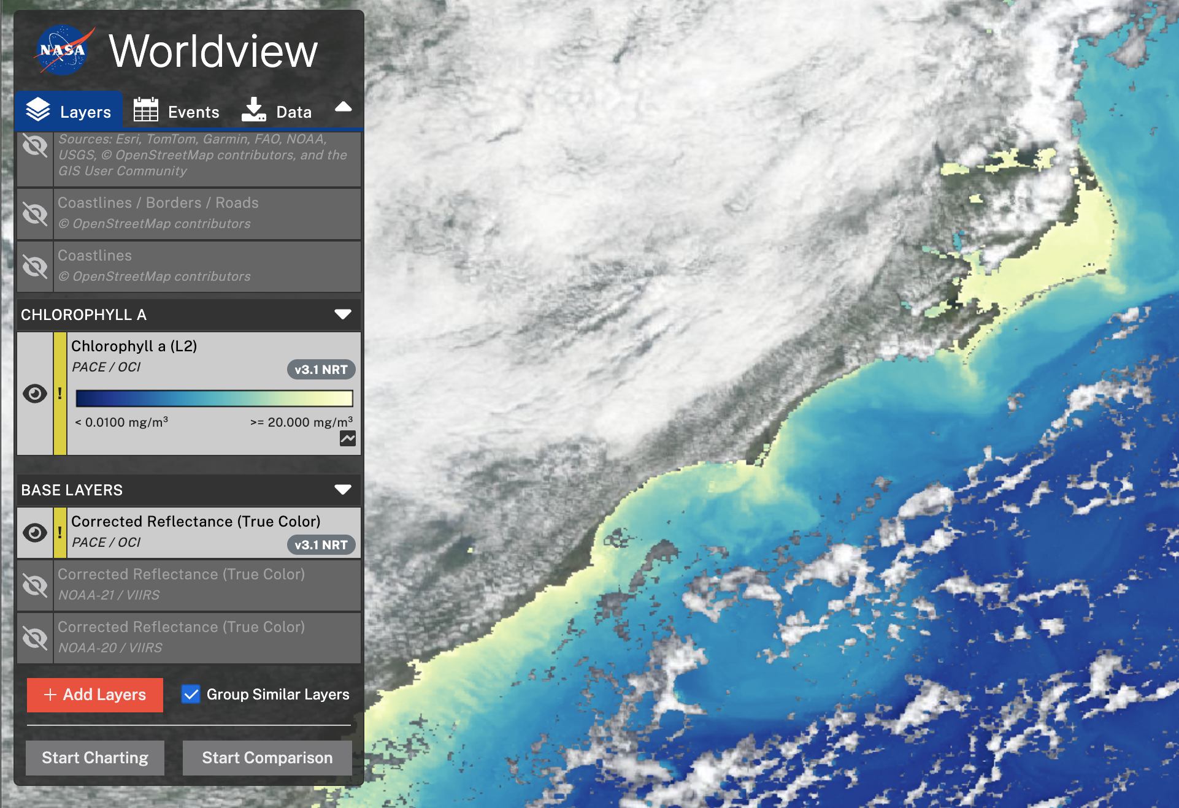
August 19, 2025

Slide 6
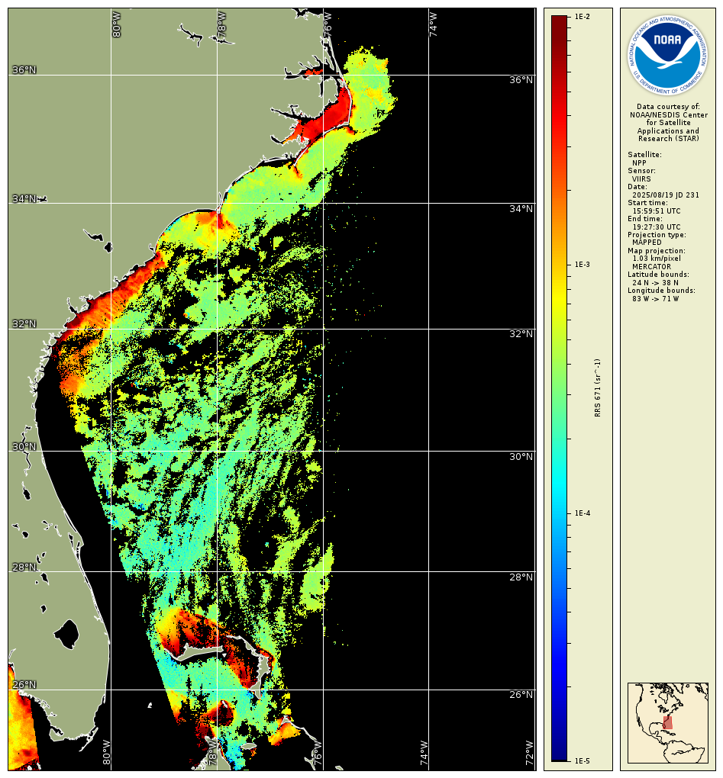

Slide 7
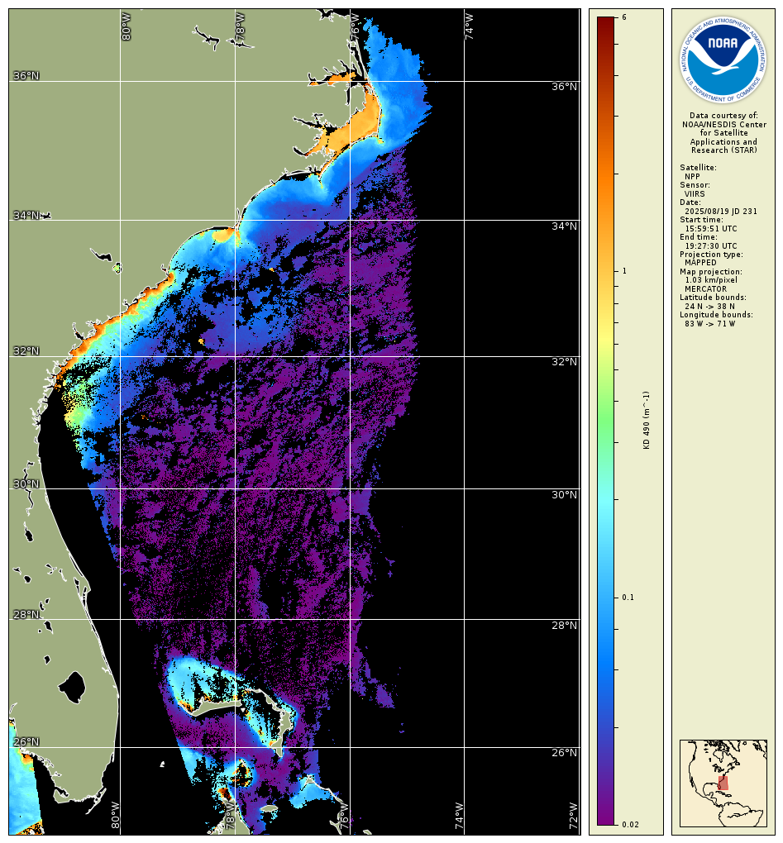

Slide 8
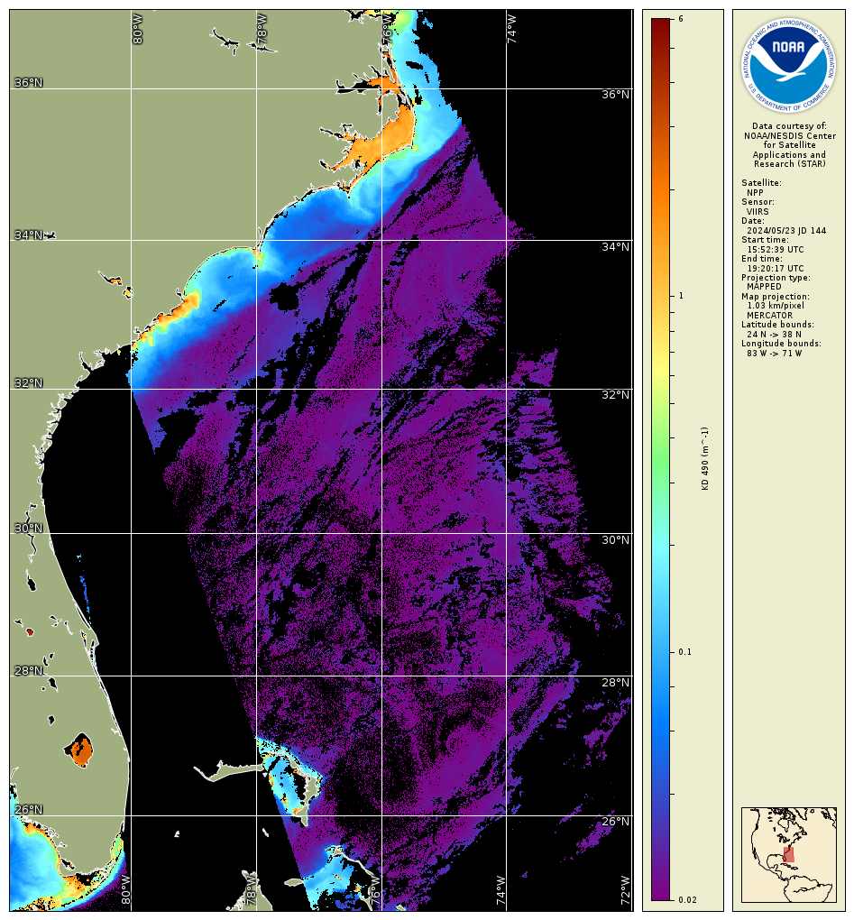

Slide 9
