Slide 1

SMART INDIA HACKATHON 2025
SMART TOURIST SAFETY MONITORING SYSTEM
Problem Statement ID – SIH25002
Problem Statement Title- Smart Tourist Safety Monitoring & Incident Response System using Al, Geo-Fencing, and Blockchain-based Digital ID
Theme- Travel and Tourism
PS Category- Software
Team ID- 66593
Team Name – Innovatorsunited

Slide 2
SMART TOURIST SAFETY MONITORING SYSTEM
Innovatorsunited
Innovation
Uniqueness
Mobile app with offline maps & geo-fencing
Blockchain-based Digital Tourist ID (secure, verifiable)
AI hazard prediction (on-device + cloud)
SOS button with satellite fallback (Iridium / NavIC)
Admin dashboard for authorities
Works in network dead zones.
Combines prevention and response
Scalable for remote tourism.

Slide 3
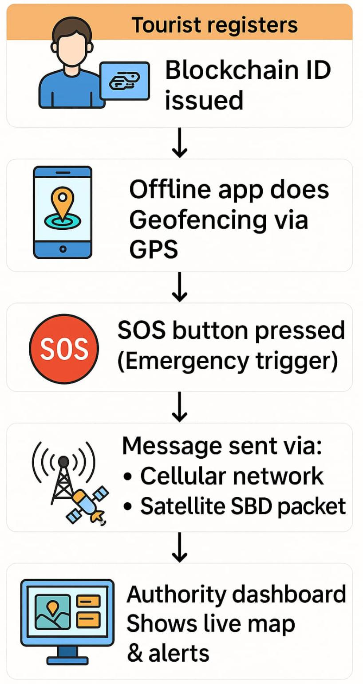
TECHNICAL APPROACH
Innovatorsunited
Process
Tech Stack
Mobile App: Flutter / React Native
Backend: Node.js / Python FastAPI
AI: TensorFlow Lite for offline hazard detection
Blockchain: Hyperledger / Ethereum (Private)
Maps: Mapbox / OSM (offline tiles + geo-fencing)
Satellite IoT: Iridium RockBLOCK 9603 / NavIC receivers
Mesh fallback: Bluetooth / Wi-Fi Direct

Slide 4



FEASIBILITY AND VIABILITY
Innovatorsunited
Challenges
Solutions
Hardware:Iridium RockBLOCK (~₹27,000 per device)
Airtime: ~₹1,400/month/device (low-tier SBD plan)
Pilot (50 devices) ≈ ₹25–26 lakh (Year 1)
Satellite airtime cost scaling
GPS inaccuracy in hilly regions
Device power/battery in remote areas
Optimize payloads (200–800 bytes)
Use mesh relays to reduce satellite hits
Solar-powered IoT dongles for longer life

Slide 5
IMPACT AND BENEFITS
Innovatorsunited
Target Audience
Benefits
Impacts
Solo travelers and families who want safety assurance.
Local tourism departments ensuring visitor safety and satisfaction.
Tourists: Enhanced safety, quick help, secure ID
Authorities: Real-time monitoring, tamper-proof logs
Tourism Industry: Boosts trust, economic growth
Safer tourism → Increased visitor confidence
Faster emergency response time
Transparent system for authorities

Slide 6
RESEARCH AND REFERENCES
Innovatorsunited
Research sources
Similar solutions studied
Iridium RockBLOCK 9603 hardware & airtime plans
Inmarsat IsatData Pro pricing & modules
NavIC messaging services (Keltron prototypes)
Smart India Hackathon 2025 problem statement (Ministry of DoNER)
Mapbox / OpenStreetMap offline SDKs
TensorFlow Lite for on-device AI hazard models
Hyperledger Fabric for blockchain-based ID
Smart India Hackathon 2025 problem statement (Ministry of DoNER)

