Slide 1
Android: State Your Intentions
Jessica Kerr @jessitron

Slide 2
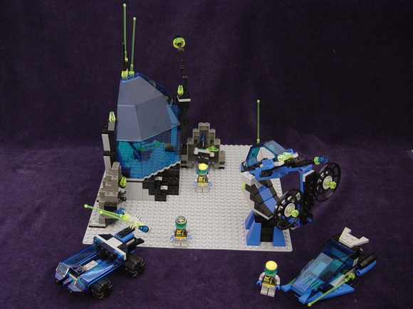

Slide 3
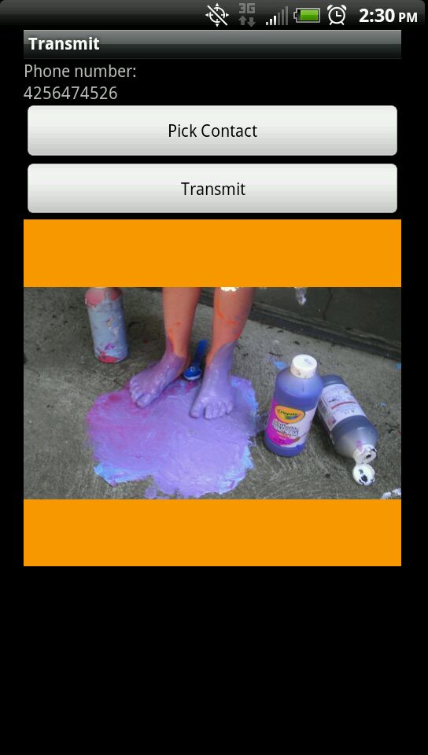

Slide 4



Slide 5
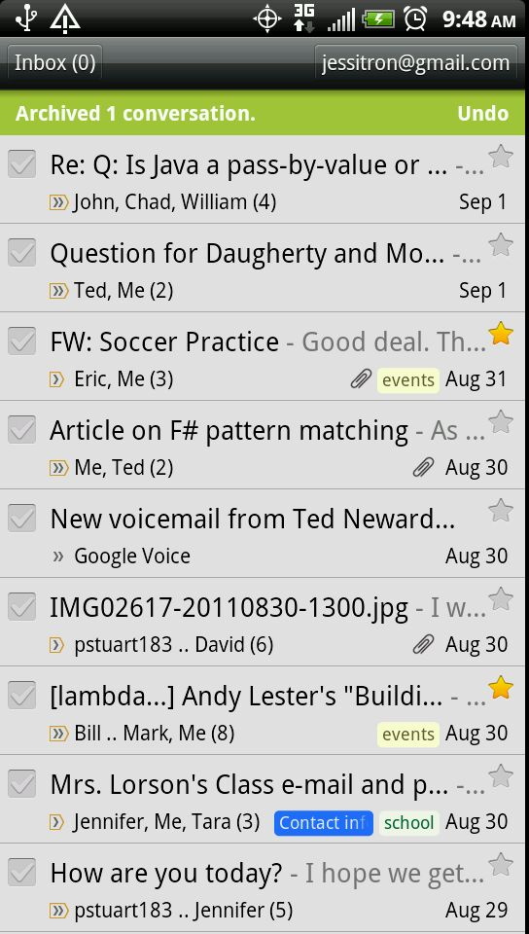
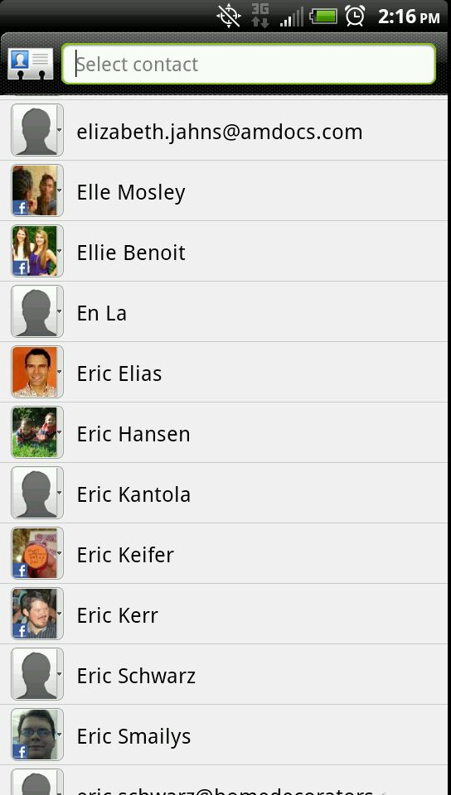
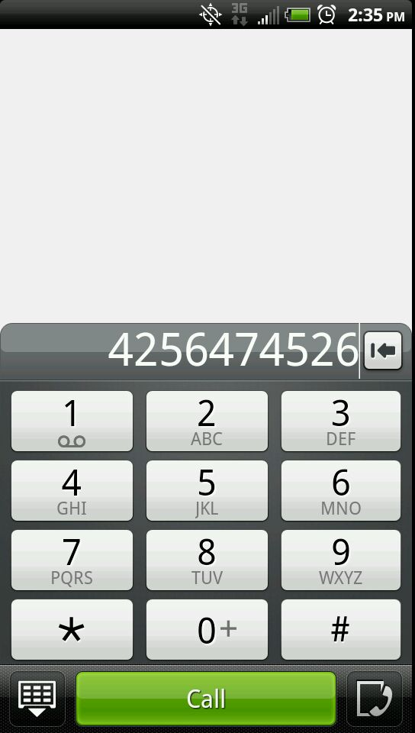
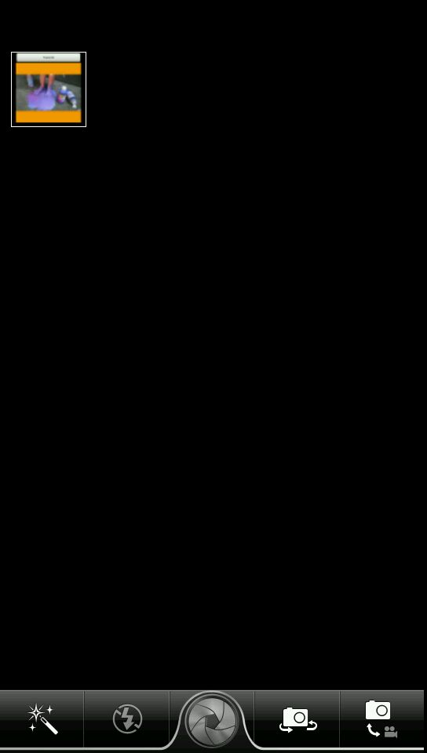

Slide 6
Tasks and activities
myapp
gmail
MAIN

Slide 7
Today's intentions
Parts of an intent
Resolving intents
Details of some intents
How to find out more

Slide 8
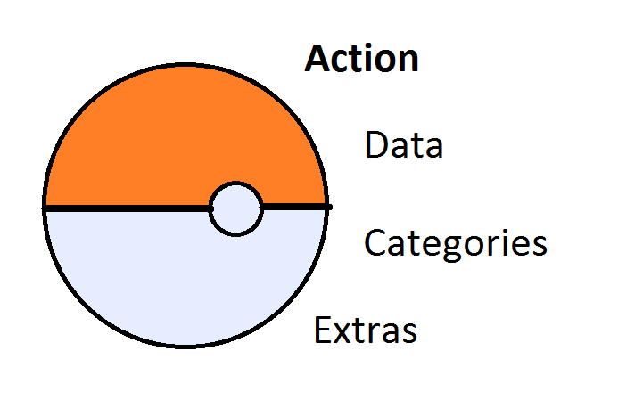
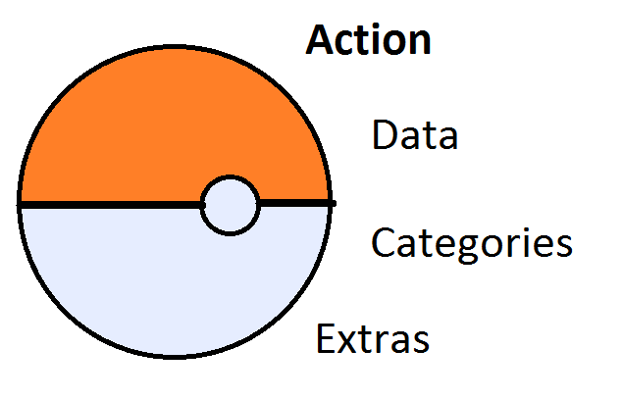
Parts of an Intent

Slide 9
Data
Type
Uri:
Scheme
Host
Port
Path or Path Pattern

Slide 10
Intent Filters
Target type
Action
Categories
Data
Notes:
extras can be primitives, arrays, or Serializable or Parcelable. Objects can be passed.

Slide 11
Pick a Contact
Permission | READ_CONTACTS
Action | Intent.ACTION_PICK
data | ContactsContract.Contacts.CONTENT_URI
Result | URI of chosen contact.
Notes:
Q for me: what else can I pick?
Contacts: show code

Slide 12
Getting results: step 1
final Intent pickContactsIntent =
new Intent(Intent.ACTION_PICK,
ContactsContract.Contacts.CONTENT_URI);
startActivityForResult(pickContactsIntent,
PICK_CONTACT_REQUEST_CODE);

Slide 13
Getting results: step 2
@Override
protected void onActivityResult(
int requestCode, int resultCode, Intent data) {
if (requestCode == PICK_CONTACT_REQUEST_CODE
&& resultCode == RESULT_OK)
{
gotAContact(data.getData());
}
}

Slide 14
Send a Message
Action | Intent.ACTION_SEND
Extras
Intent.EXTRA_STREAM |  | URI to image
Intent. EXTRA_PHONE_NUMBER
Notes:
MMS
Email
----- Meeting Notes (5/24/12 20:08) -----
type!!
- figure out what DEBUG_LOG_RESOLUTION does
- can you give other apps permission to access your data?

Slide 15
Pick an activity
Action | Intent.ACTION_PICK_ACTIVITY
Extras
Intent.EXTRA_INTENT |  | Present activities that fill this intent
Intent. EXTRA_TITLE |  | Title of the list
Result |  | Intent that will launch the chosen activity

Slide 16
Three ways to let the user choose
Just start the activity
Lets the user select a default activity for the action
Create chooser
Lets you set the title
No “set as default”
Pick activity
Lets you set the title
No “set as default”
You can see which activity they chose
Launch the chosen activity yourself

Slide 17
Take a Picture
Action | MediaStore.ACTION_IMAGE_CAPTURE
Extra | MediaStore.EXTRA_OUTPUT – File URI
Result | URI where image was saved
Notes:
----- Meeting Notes (5/24/12 20:08) -----
what comes back in the data here? it is the location, or a small version of the image?

Slide 18
Call a phone number
Action | Intent.ACTION_DIAL
Data | tel:xxxxxxxxxx

Slide 19
Activity Flags
FLAG_ACTIVITY_CLEAR_WHEN_TASK_RESET
Don’t hang around if the user leaves and comes back
FLAG_ACTIVITY_REORDER_TO_FRONT
Don’t have duplicates of this activity in the stack
FLAG_ACTIVITY_CLEAR_TOP
Prevent circles in the back stack
FLAG_ACTIVITY_NEW_TASK
Put this activity in the task of its own application
With FLAG_ACTIVITY_MULTIPLE_TASK, will always start a new task
FLAG_ACTIVITY_NO_ANIMATION, NO_HISTORY
Transparently forward to another activity

Slide 20

What else is available?
View
Browser
Contact
Image
Edit
Flash some lights

Slide 21
What is available on my device?
queryIntentActivityOptions
Package Manager
Application Info
Package Info

Slide 22
Go to the source
Chrome extension
Android SDK Reference Search
Adds “view source” link to API docs
Download the source yourself
source.android.com/source/downloading.html
“The initial sync operation will take an hour or more to complete.”
AndroidManifest.xml

Slide 23
Community Resources
Developer.android.com
StackOverflow
OpenIntents.org

Slide 24
Where to go next
Transmit sample application:
https://github.com/jessitron/Transmit
Download it, install it on your device
Take over the world
Notes:
----- Meeting Notes (5/24/12 20:08) -----
get a mouse clicker that will go into my usb port next to my phone
make a new repo called Tronsmit
fix the log button
what is the difference between an application and a package?

Slide 25
Don't forget
Replace "presentation title" with my title wherever it appears
App: try to duplicate crash when I hit “pick contact” but then exit, then try to go back.
What does it mean to set an app as a default? How does that stick, and what else does it affect?
Use ACTION_PICK_ACTIVITY to let them choose what the button will do

Slide 26
Resources not accessed through intents
Presentation title
MediaPlayer
MediaRecorder
ContentProviders
Photos and other media
SystemServices
LocationManager
SMSManager

Slide 27
Your own intentions
Create your own activities that fire
When the device approaches a specific geographic location
When the device turns on and off
When the battery gets low
To open a link to your own website

