Slide 1
Android: State Your Intentions
Jessica Kerr @jessitron

Slide 2
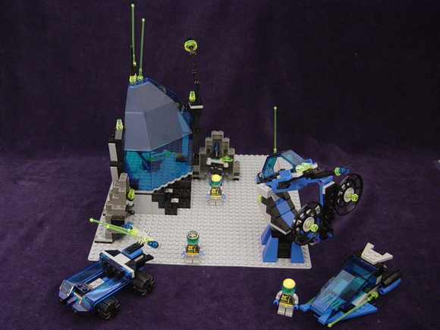

Slide 3
https://github.com/jessitron/Tronsmit
Notes:
Add a screenshot, later.

Slide 4



Slide 5
Tasks and activities
myapp
gmail
MAIN

Slide 6
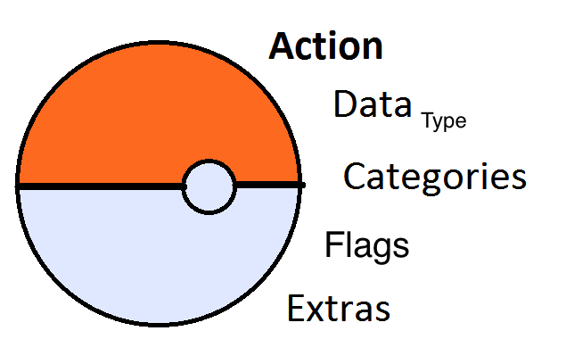
Parts of an Intent

Slide 7

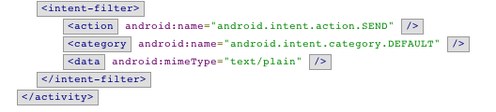
AndroidManifest.xml
…

Slide 8
Data
content://com.android.contacts/contacts/lookup/9a…8/1015
Scheme
Type
Host
Port
Path or Path Pattern

Slide 9
Intent Filters
Target type
Action
Categories
Data
Notes:
extras can be primitives, arrays, or Serializable or Parcelable. Objects can be passed.

Slide 10
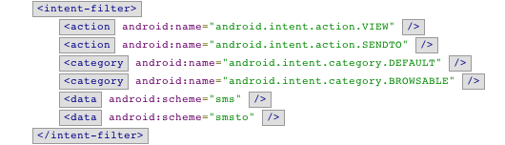
Intent Filter

Slide 11
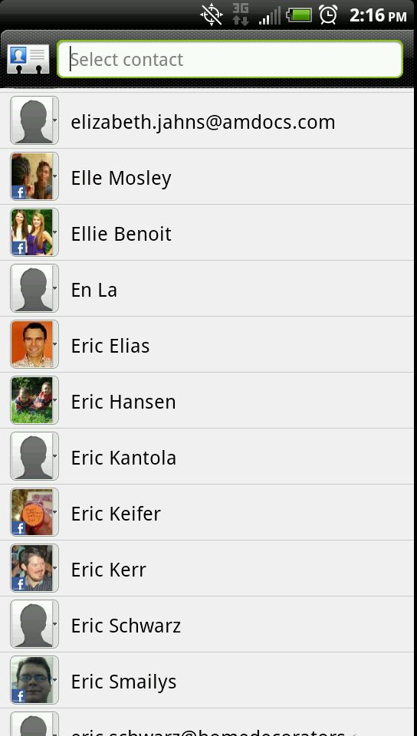
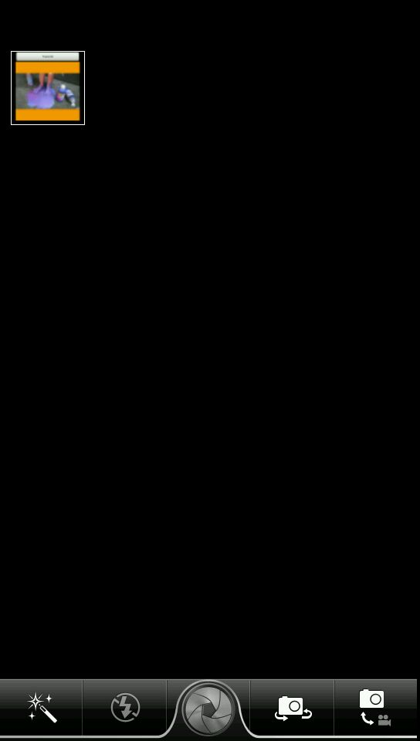
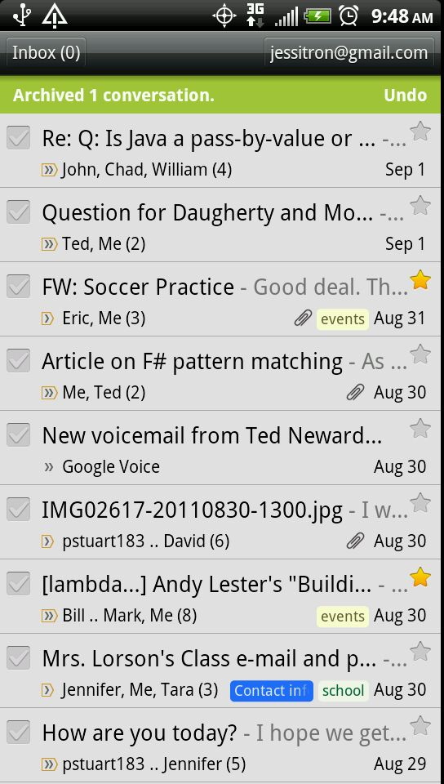
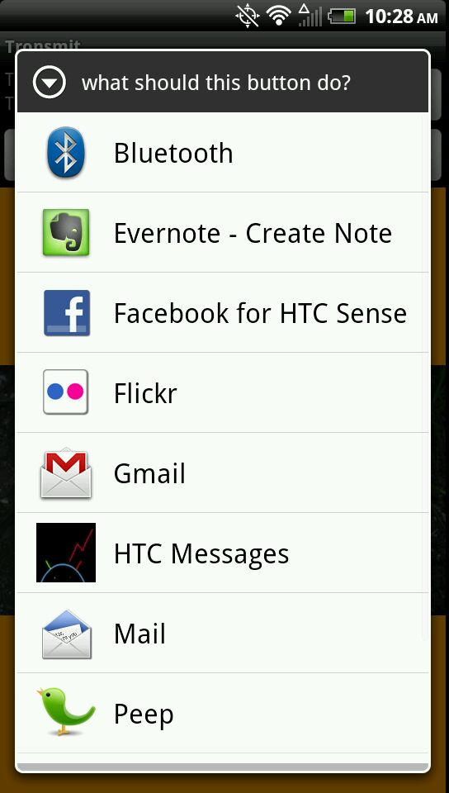
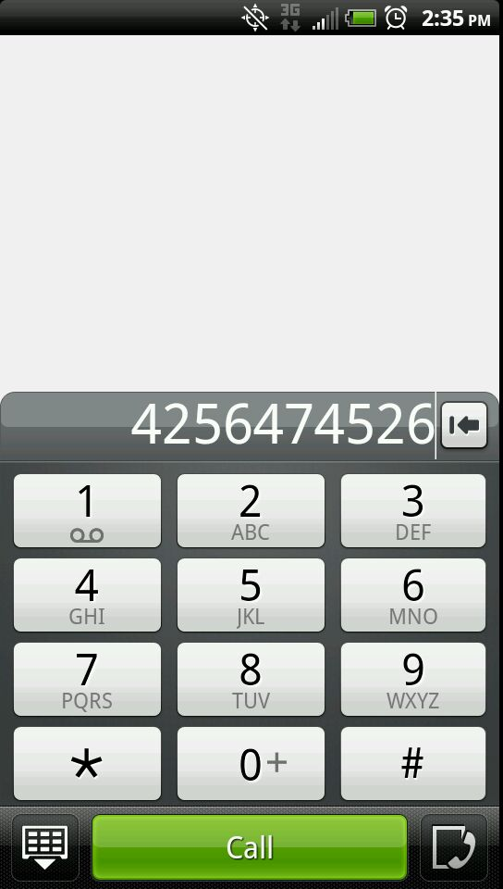

Slide 12
Pick a Contact
Permission | READ_CONTACTS
Action | Intent.ACTION_PICK
data | ContactsContract.Contacts.CONTENT_URI
Result | URI of chosen contact.
Notes:
Q for me: what else can I pick?
Get the filter out of the AndroidManifest that matches this

Slide 13
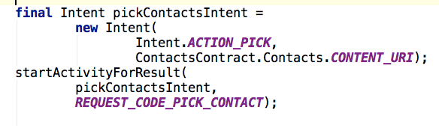
Getting results: step 1

Slide 14
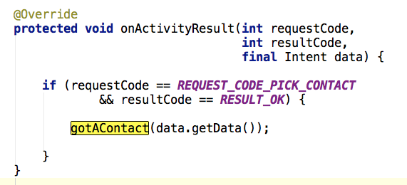
Getting results: step 2

Slide 15
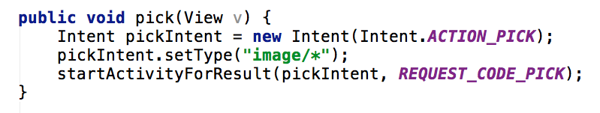
Pick something else: image

Slide 16
Send an Image
Action | Intent.ACTION_SEND
Type | Type of image: “image/jpeg”
Intent.EXTRA_STREAM | URI to image
EXTRA_PHONE_NUMBER or “address” | Destination phone number
Intent.EXTRA_TEXT or “sms_body” | body
Notes:
MMS
Email
Twitter. Etc.
- figure out what DEBUG_LOG_RESOLUTION does
- can you give other apps permission to access your data? A: you can make files or databases WORLD_WRITABLE. Or put them on the SD Card, if it has one.

Slide 17
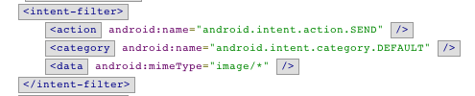
Match activities like…

Slide 18
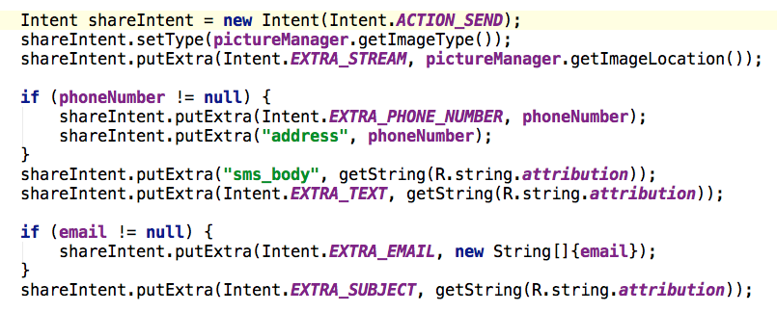
Create a SEND intent

Slide 19
Create a SEND intent

Slide 20
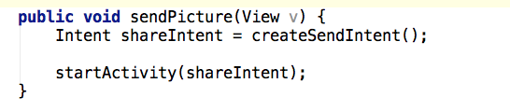
Throw it out there!
Notes:
Would like to add diagram of what this looks like activity/task wise. Want to see on phone what the back stack looks like

Slide 21
One Task, Two Processes
tronsmit
system
twitter
TronsmitActivity
PostActivity
Resolve
Activity

Slide 22
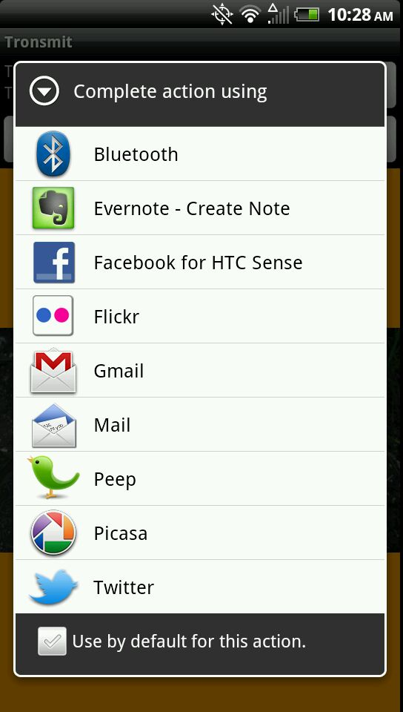
To unset:
Settings…
Applications…
Manage Applications…
- Default app -
Clear Defaults

Slide 23
Pick an activity
Action | Intent.ACTION_PICK_ACTIVITY
Extras
Intent.EXTRA_INTENT |  | Present activities that fill this intent
Intent. EXTRA_TITLE |  | Title of the list
Result |  | Intent that will launch the chosen activity

Slide 24
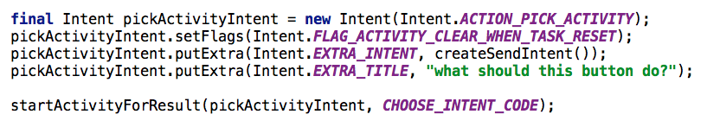
Find out what they picked

Slide 25
Pick Activity

Slide 26
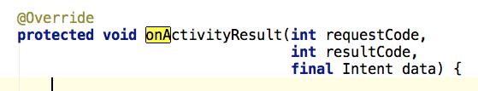
PICK_ACTIVITY result

Slide 27

Launch explicit intent
Component:
Package name of application
Fully qualified class name of activity

Slide 28
Three ways to let the user choose
 | “Set as default”? | Custom Title | Launches choice
Just start the activity | X |  | X
Intent.createChooser(…) |  | X | X
ACTION_PICK_ACTIVITY |  | X
Notes:
I wonder if I could add my HTC Activity to create chooser

Slide 29
Take a Picture
Action | MediaStore.ACTION_IMAGE_CAPTURE
Extra | MediaStore.EXTRA_OUTPUT – File URI
Result: data | URI where image was saved
Result: extra “data” | Small bitmap version of image
Notes:
----- Meeting Notes (5/24/12 20:08) -----
what comes back in the data here? it is the location, or a small version of the image?

Slide 30
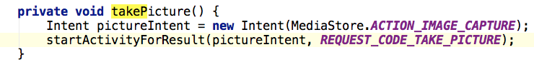
Take a Picture

Slide 31
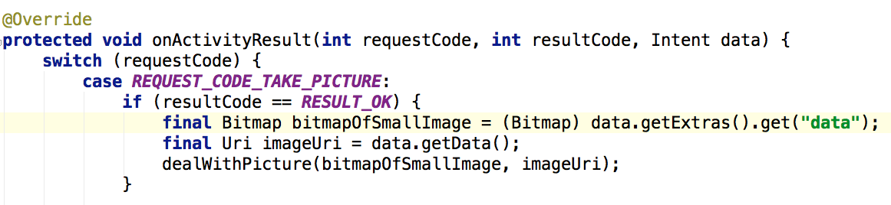
Take a picture - result

Slide 32
Let the user call a phone number
Action | Intent.ACTION_DIAL
Data | tel:xxxxxxxxxx

Slide 33
Call a phone number
Permission | CALL_PHONE
Action | Intent.ACTION_CALL
Data | tel:xxxxxxxxxx

Slide 34

What else is available?
View
Browser
Contact
Image
Edit
Map
Flash some lights

Slide 35
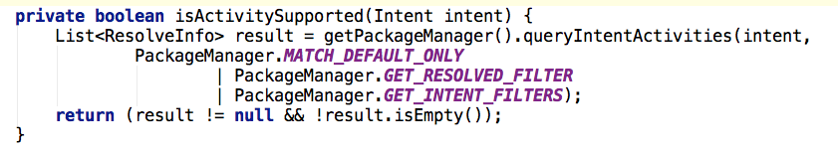
Is an activity resolvable?

Slide 36
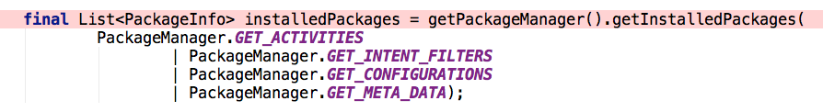
What is available on my device?
queryIntentActivities
Package Manager

Slide 37
Go to the source
Chrome extension
Android SDK Reference Search
Adds “view source” link to API docs
Download the source yourself
source.android.com/source/downloading.html
“The initial sync operation will take an hour or more to complete.”
AndroidManifest.xml

Slide 38
Community Resources
Developer.android.com
StackOverflow
OpenIntents.org

Slide 39
Resources not accessed through intents
Presentation title
MediaPlayer
MediaRecorder
ContentProviders
Photos and other media
SystemServices
LocationManager
SMSManager

Slide 40
Where to go next
Tronsmit sample application:
https://github.com/jessitron/Tronsmit
Download it, install it on your device
Try to take over the world
@jessitron
Notes:
----- Meeting Notes (5/24/12 20:08) -----
get a mouse clicker that will go into my usb port next to my phone
make a new repo called Tronsmit
fix the log button
what is the difference between an application and a package?

Slide 41
FLAG_ACTIVITY_NEW_TASK
myapp
MAIN
gmail

Slide 42
Activity Flags
FLAG_ACTIVITY_CLEAR_WHEN_TASK_RESET
Don’t hang around if the user leaves and comes back
FLAG_ACTIVITY_REORDER_TO_FRONT
Don’t have duplicates of this activity in the stack
FLAG_ACTIVITY_CLEAR_TOP
Prevent circles in the back stack
FLAG_ACTIVITY_NEW_TASK
Put this activity in the task of its own application
With FLAG_ACTIVITY_MULTIPLE_TASK, will always start a new task
FLAG_ACTIVITY_NO_ANIMATION, NO_HISTORY
Transparently forward to another activity

Slide 43
Don't forget
Replace "presentation title" with my title wherever it appears
App: try to duplicate crash when I hit “pick contact” but then exit, then try to go back.
What does it mean to set an app as a default? How does that stick, and what else does it affect?
Use ACTION_PICK_ACTIVITY to let them choose what the button will do

Slide 44
Your own intentions
Create your own activities that fire
When the device approaches a specific geographic location
When the device turns on and off
When the battery gets low
To open a link to your own website

