Slide 1
Android: State Your Intentions
Jessica Kerr @jessitron
St. Louis Days of .NET 2012
very early on Saturday
Notes:
Purpose of this talk: show you some stuff that Android makes really easy.
Two benefits – learn some details of how activities are triggered on Android, especially between applications. And see some of what’s not only possible, but easy.
Along the way we will learn about: permissions, security, legos, pokemon

Slide 2














































Platinum Sponsors
Gold Sponsors
Silver Sponsors

Slide 3
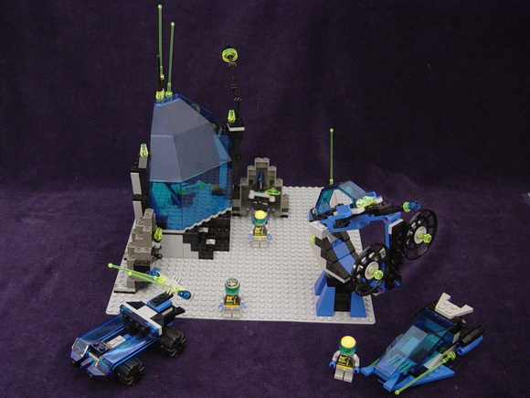
Notes:
If Java is like 2x4 bricks, Android is like this lego set. These big pieces have two benefits and one cost.
Benefit #1: you can build something looks really cool, fast.
Benefit #2: your space station looks like it’s on the same team as all the other Lego space station. Your Android app has a consistent user experience from other Android apps.

Slide 4
https://github.com/jessitron/Tronsmit
Notes:
Add a screenshot, later.

Slide 5
Application Components
Activities
Broadcast Receivers
Content Providers
Services
Notes:
Consider flipping to AndroidManifest.xml and show the activity definitions.
All of these communicate with intents.

Slide 6


Notes:
intents are messages. they are like pokemon.
Remember to define pokemon and describe how it works, then how intents are like that and different. (LIke: throw it out there, something pops out. Different: You don’t typically choose the pokemon that’s going to pop out.)

Slide 7
Tasks and activities
myapp
gmail
MAIN
Notes:
technical stuff: tasts and the back stack.
Each program runs as its own Linux user, in its own process.
Home is the launcher screen. your app can start from there. the main activity launches first, and can launch other activities.
Intents that use other applications launch the activity in the other app’s process, but in your back stack.

Slide 8
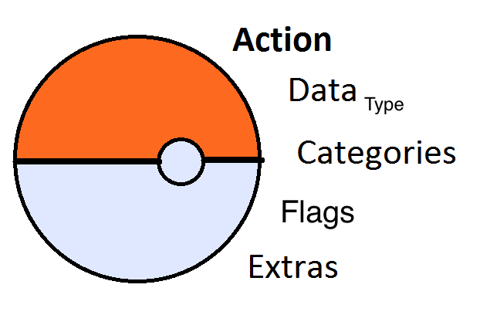
Parts of an Intent

Slide 9

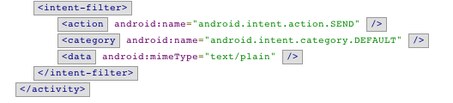
AndroidManifest.xml
…
Notes:
where did I steal this from?
this determines which activities will match while intents

Slide 10
Data
content://com.android.contacts/contacts/lookup/9a…8/1015
Scheme
Type
Host
Port
Path or Path Pattern

Slide 11
Intent Filters
Target type
Action
Categories
Data
Notes:
extras can be primitives, arrays, or Serializable or Parcelable. Objects can be passed.

Slide 12
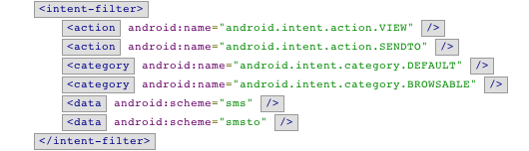
Intent Filter

Slide 13
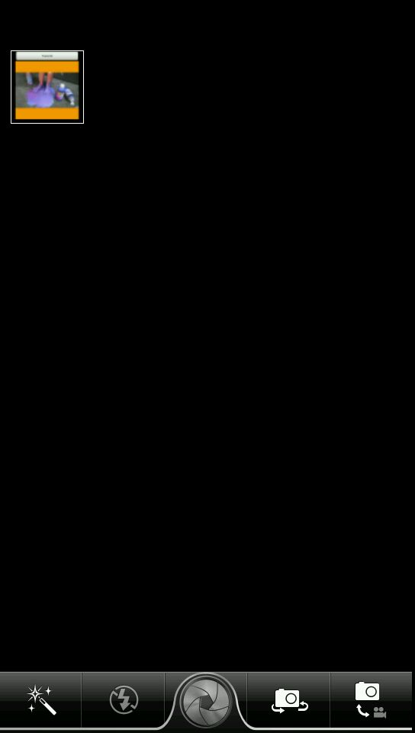
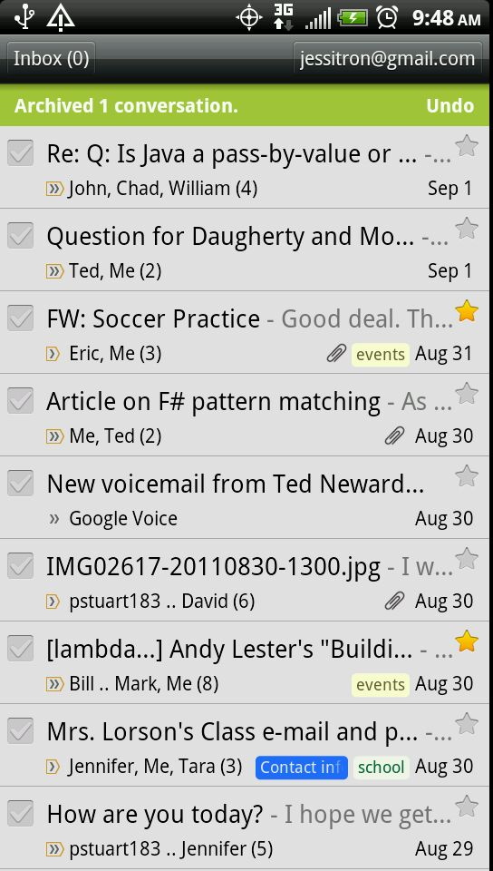
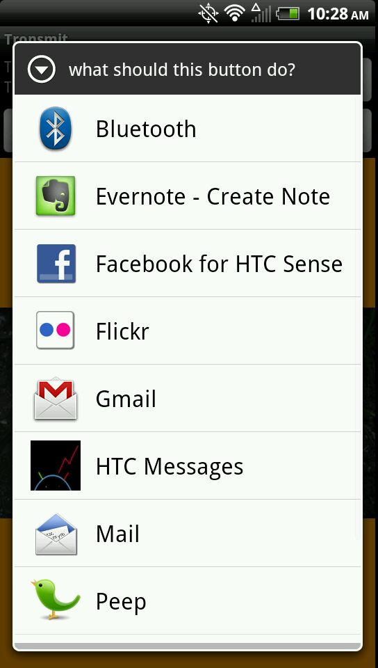
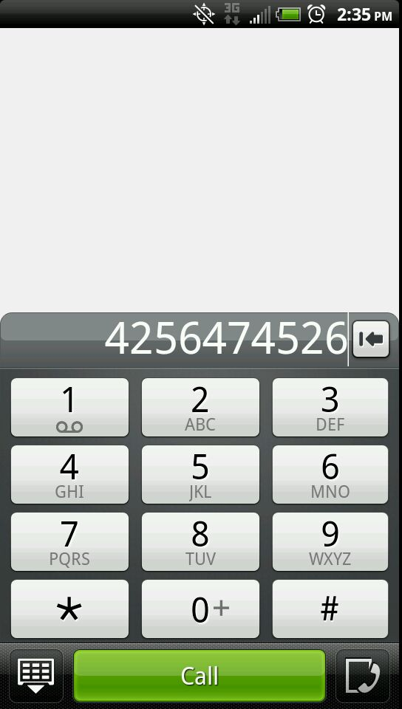
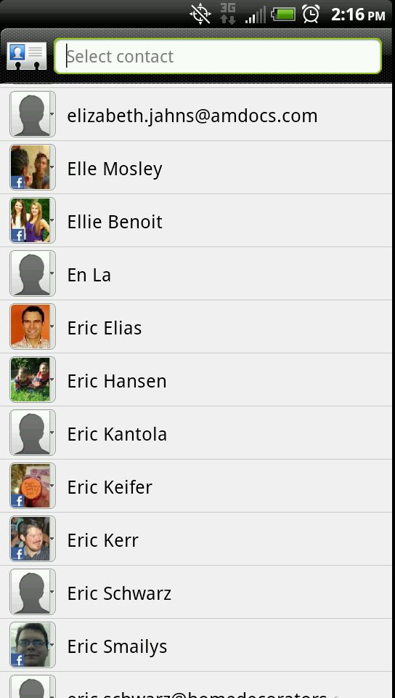

Slide 14
Pick a Contact
Permission | READ_CONTACTS
Action | Intent.ACTION_PICK
data | ContactsContract.Contacts.CONTENT_URI
Result | URI of chosen contact.
Notes:
Q for me: what else can I pick?
Get the filter out of the AndroidManifest that matches this

Slide 15
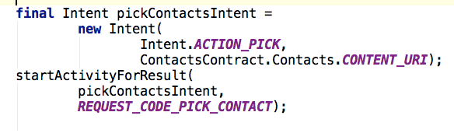
Getting results: step 1
Notes:
Concept: activity returning a result. A slide with the pokeball going back and forth between activities would be nice.

Slide 16
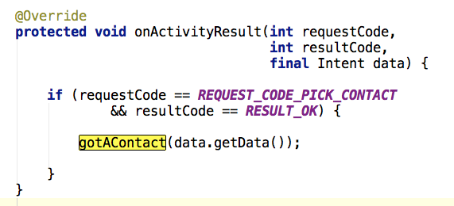
Getting results: step 2

Slide 17
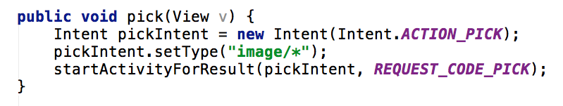
Pick something else: image

Slide 18
Send an Image
Action | Intent.ACTION_SEND
Type | Type of image: “image/jpeg”
Intent.EXTRA_STREAM | URI to image
EXTRA_PHONE_NUMBER or “address” | Destination phone number
Intent.EXTRA_TEXT or “sms_body” | body
Notes:
MMS
Email
Twitter. Etc.
- figure out what DEBUG_LOG_RESOLUTION does
- can you give other apps permission to access your data? A: you can make files or databases WORLD_WRITABLE. Or put them on the SD Card, if it has one.

Slide 19
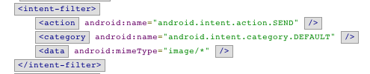
Match activities like…

Slide 20
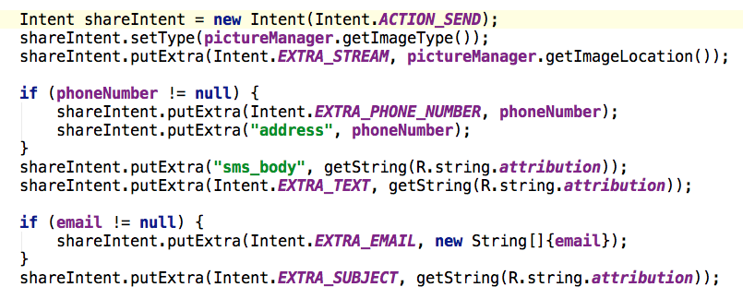
Create a SEND intent

Slide 21
Create a SEND intent

Slide 22
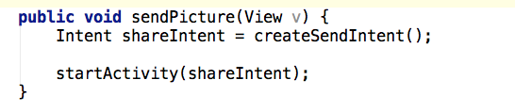
Throw it out there!
Notes:
concept:

Slide 23
One Task, Two Processes
tronsmit
system
twitter
TronsmitActivity
PostActivity
Resolve
Activity

Slide 24
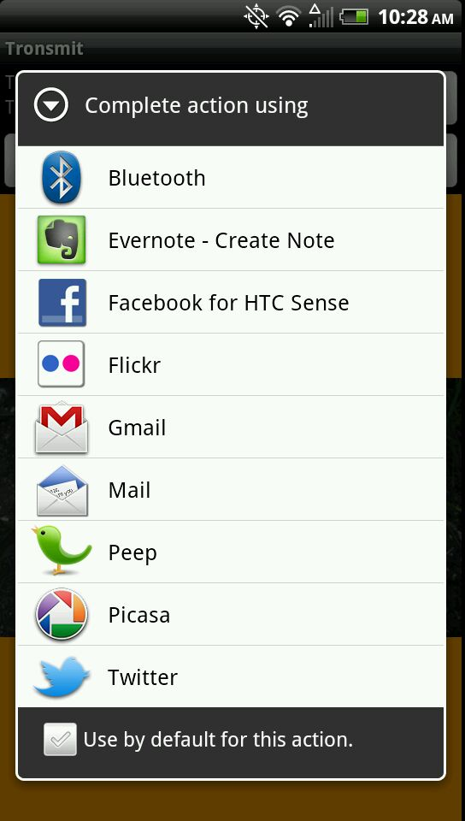
To unset:
Settings…
Applications…
Manage Applications…
- Default app -
Clear Defaults

Slide 25
Pick an activity
Action | Intent.ACTION_PICK_ACTIVITY
Extras
Intent.EXTRA_INTENT |  | Present activities that fill this intent
Intent. EXTRA_TITLE |  | Title of the list
Result |  | Intent that will launch the chosen activity

Slide 26
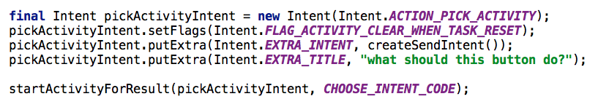
Find out what they picked

Slide 27
Pick Activity

Slide 28
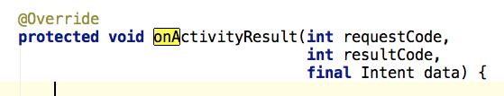
PICK_ACTIVITY result

Slide 29

Launch explicit intent
Component:
Package name of application
Fully qualified class name of activity

Slide 30
Three ways to let the user choose
 | “Set as default”? | Custom Title | Launches choice
Just start the activity | X |  | X
Intent.createChooser(…) |  | X | X
ACTION_PICK_ACTIVITY |  | X
Notes:
I wonder if I could add my HTC Activity to create chooser

Slide 31
Take a Picture
Action | MediaStore.ACTION_IMAGE_CAPTURE
Extra | MediaStore.EXTRA_OUTPUT – Content URI
Result: data | URI where image was saved (Gingerbread)
Result: extra “data” | Small bitmap version of image
Notes:
what comes back in the data here? it is the location, or a small version of the image? de-pends.
Make this more specific about OS, version

Slide 32
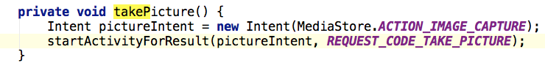
Take a Picture

Slide 33
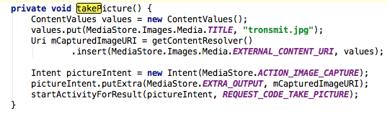
Take a Picture

Slide 34
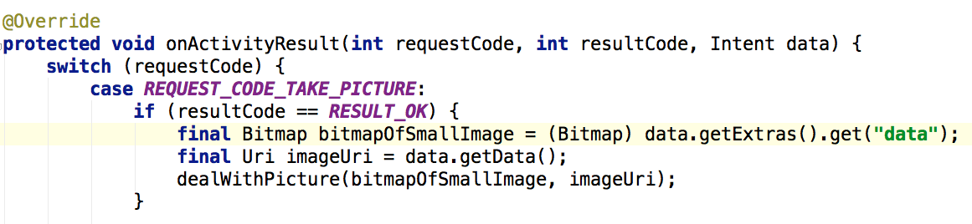
Take a picture - result

Slide 35
Let the user call a phone number
Action | Intent.ACTION_DIAL
Data | tel:xxxxxxxxxx

Slide 36
Call a phone number
Permission | CALL_PHONE
Action | Intent.ACTION_CALL
Data | tel:xxxxxxxxxx

Slide 37

What else is available?
View
Browser
Contact
Image
Edit
Map
Flash some lights

Slide 38
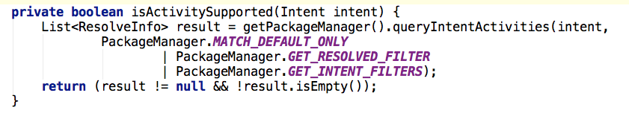
Is an activity resolvable?

Slide 39
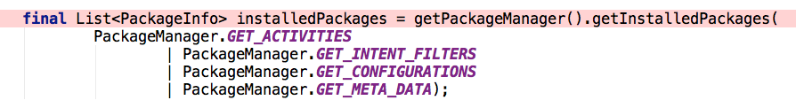
What is available on my device?
queryIntentActivities
Package Manager

Slide 40
Go to the source
Chrome extension
Android SDK Reference Search
look for: AndroidManifest.xml

Slide 41
Community Resources
Developer.android.com
StackOverflow
OpenIntents.org

Slide 42
Where to go next
Tronsmit sample application:
https://github.com/jessitron/Tronsmit
Download it, install it on your device
Try to take over the world
@jessitron
Notes:
----- Meeting Notes (5/24/12 20:08) -----
get a mouse clicker that will go into my usb port next to my phone
make a new repo called Tronsmit
fix the log button
what is the difference between an application and a package?

Slide 43
Resources not accessed through intents
Presentation title
MediaPlayer
MediaRecorder
ContentProviders
Photos and other media
SystemServices
LocationManager
SMSManager

Slide 44
FLAG_ACTIVITY_NEW_TASK
myapp
MAIN
gmail

Slide 45
Activity Flags
FLAG_ACTIVITY_CLEAR_WHEN_TASK_RESET
Don’t hang around if the user leaves and comes back
FLAG_ACTIVITY_REORDER_TO_FRONT
Don’t have duplicates of this activity in the stack
FLAG_ACTIVITY_CLEAR_TOP
Prevent circles in the back stack
FLAG_ACTIVITY_NEW_TASK
Put this activity in the task of its own application
With FLAG_ACTIVITY_MULTIPLE_TASK, will always start a new task
FLAG_ACTIVITY_NO_ANIMATION, NO_HISTORY
Transparently forward to another activity

Slide 46
Your own intentions
Create your own activities that fire
When the device approaches a specific geographic location
When the device turns on and off
When the battery gets low
To open a link to your own website

