Slide 1
Outland Adventures Solution
Vaneshiea Bell 9 March 2025
Jess Monnier
DeJanae Faison

Slide 2
Blue Team Introduction
Jess: Technical Sergeant in the Air Force. Background in teaching (math) and in Korean language. Currently training into the cyber field in the Air Force.
DeJanae: Background in Front End and Gaming Development. 3D creator and currently working in Back End development.
Vee: Data Analyst at Waste Management specializing in route optimization, with a background in customer service, nail technology, and pursuing a Software Development degree

Slide 3

Outland Adventures Case Study
Founder Blythe Timmerson and Jim Ford wanted to share their hiking and camping passion by providing guidance and equipment to a wide audience
Goals:
Introducing people to the beauty and challenges of nature
Planning and guiding trips to various exciting locations
Offering equipment for purchase or rental
Needs addressed by our project:
Comparison of amount of equipment rentals and purchases
Illustration of trends in trip destinations over time
Display of equipment approaching or beyond 5 years of rental use

Slide 4
Assumptions
Age of equipment matters (more) for rental equipment than for equipment sold as new, and so our item age report should apply to rentals.
If season or geopolitical events have an impact on trip destination choice, this is something that will be addressed outside of our database/report.
Equipment type does not impact whether it's more likely to be rented or purchased.
Sales, rental, and trip data would be most effective if grouped by quarter.

Slide 5
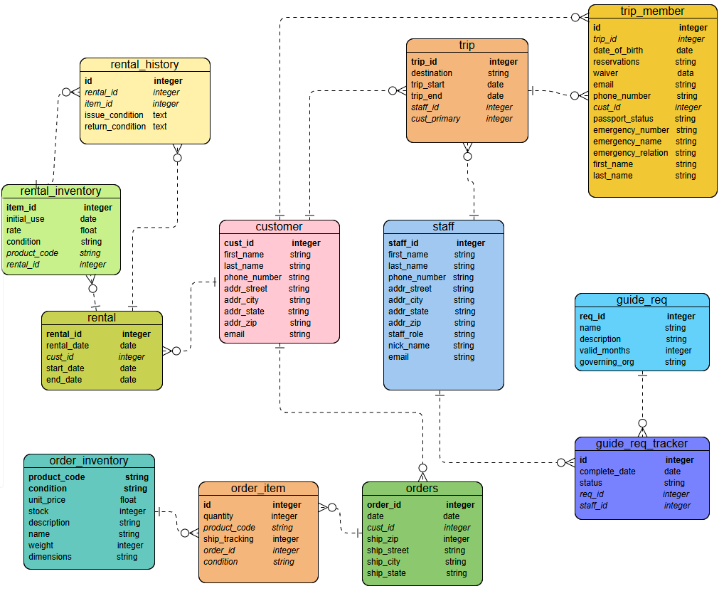
Finalized ERD

Slide 6
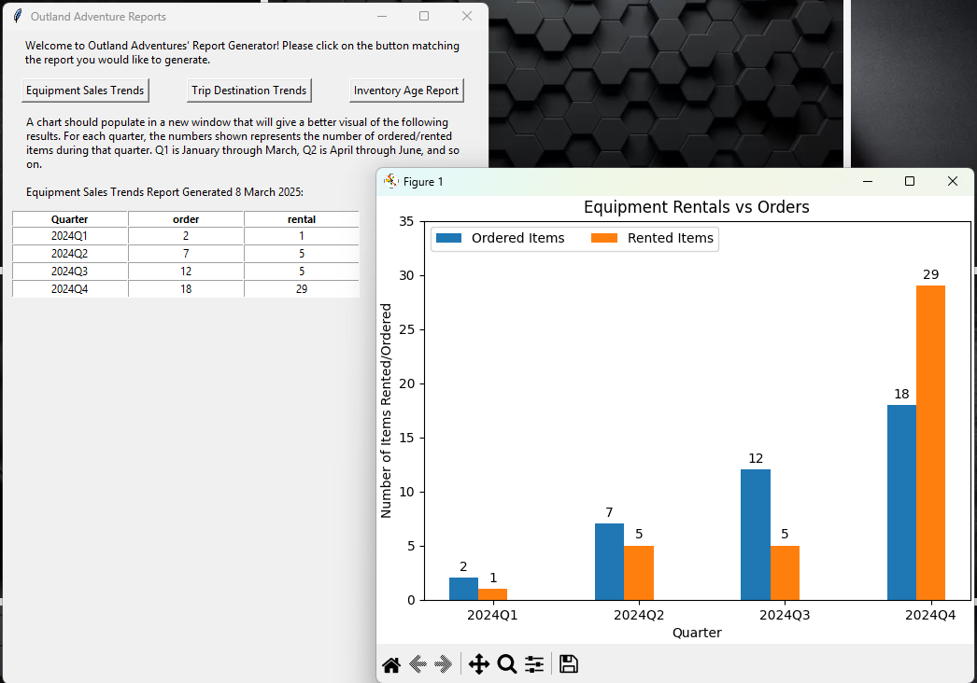
Report #1: Equipment Sales
The founders wondered whether the amount of equipment sales justified keeping new equipment on hand to sell.
To answer this question, we built a report that compared the number of items rented vs sold quarterly.
This report required some clever SQL querying:
A case to define the quarters
Grouping by quarter
Joining the rental and rental_history tables, as well as joining the order and order_item tables

Slide 7
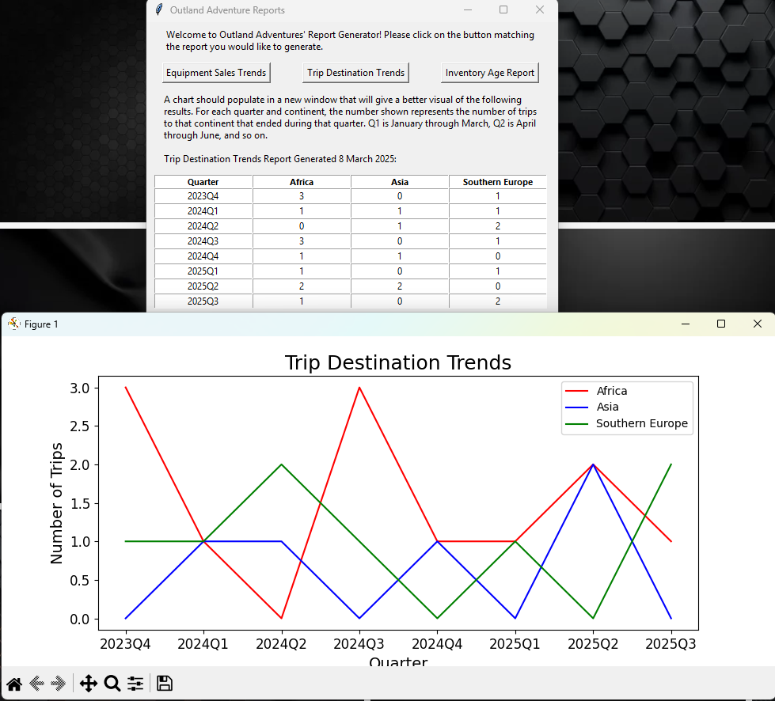
Report #2: Location Bookings
Another question the founders had was:
To date, trips have been led to Africa, Asia, and Southern Europe. Would a report on trips to these areas reveal a decline in bookings over time?
We designed this report to answer that question. This required some interesting SQL querying:
A case to group by quarter
Combining the use of substring, LIKE, and grouping to get the count of trips per continent

Slide 8
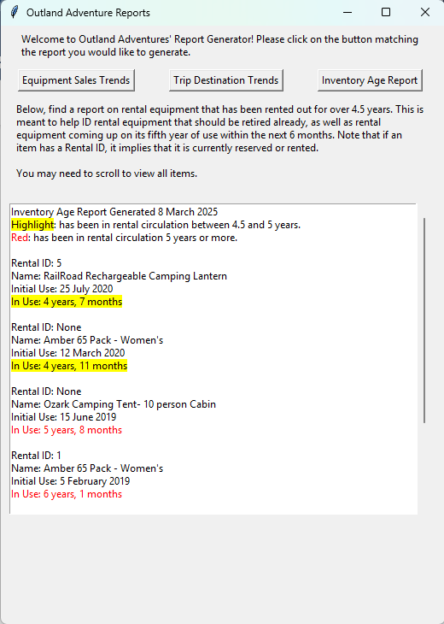
Report #3: Inventory Age
The founders were also concerned about the age of their inventory.
Any equipment over 5 years old should be accounted for
To accomplish this, we built a report to show items with an initial rental date approaching or older than 5 years ago. The necessary SQL query utilized:
Inner join
TimeStampDiff to get years & months in circulation
"Having" filter with a date interval

Slide 9
Conclusion
In summary, we built three reports to answer the three questions posed in the case study:
Is it worth continuing to sell equipment?
Is there a continent destination for trips that has seen a trending decline in bookings?
Is there any equipment that has been in rental use for too long?
Through thoughtful SQL queries and data analysis, we delivered actionable reports that, in a real business scenario, would ensure our clients could make informed decisions about their business strategies. We also learned a lot about using Python and MySQL in efficient, effective ways.

