Slide 1

Best Practices for Securely Using Shared Code Repositories
Jess Monnier | CSD-380 Assignment 11.2 | October 5, 2025

Slide 2
Introduction
Why should you care about securing shared repositories?
If it’s not sufficiently secured, you run greater risk of:
Intellectual Property (IP) theft
Compromise of your product (e.g. exploiting a vulnerability)
Supply chain attacks
Reputational damage

Slide 3
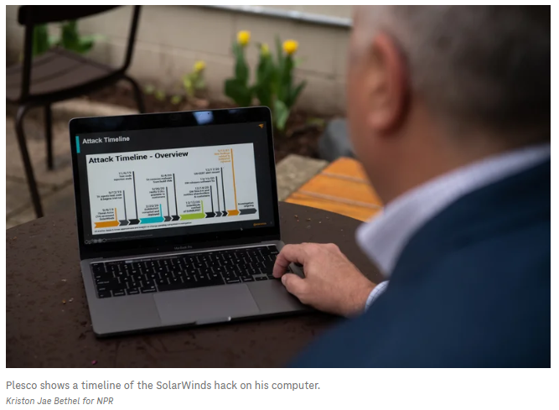
Threat Landscape & Common Risks
Some key threats include:
Credential leakage
Malicious pull requests or poisoned commits
Compromised developer machines
Dependency confusion attacks
Insider threats or privilege misuse

Slide 4
Secure Repository Platforms & Hosting Choices
Best Practices:
Use reputable platforms
When using cloud-hosting, look for enterprise security options
Enable encryption at rest and in transit
Add cryptographic verification
Example reputable platforms:
GitHub, GitLab, Bitbucket
Example security features to use:
SSO, audit logging, HTTPS, SSH, commit/tag signing

Slide 5
Access Control & Authentication
Ensure access to repositories is tightly controlled with these best practices:
“Least privilege” and/or role-based access control (RBAC)
Multi-factor authentication (MFA)
Rotate credentials & access tokens regularly
Disable inactive users promptly
Real world examples:
GitHub requires 2FA for contributors in popular projects (since 2023).
GitLab does not allow account sharing; each user must authenticate with their own identity.

Slide 6


Secrets Management & Sensitive Data Protection
To protect sensitive data…
Never hard-code credentials, API keys, tokens, etc.
Use secret management tools like HashiCorp Vault or AWS Secrets Manager.
Run automated secrets scanners before commits.
Add .gitignore rules for configuration files and other sensitive data.

Slide 7

Code Review, Branch Protection, & Workflow Policies
Enable branch protection rules
E.g. no direct pushes to main
Manage code merges
Require pull request reviews and approvals
CI checks
Require passing them before merging code
Prevent code loss
Don’t allow force-push or deletion of protected branches

Slide 8
Security Scanning & CI/CD Integration
Automate security checks during development to ensure consistency. Best practices include:
Integrate static testing tools in the pipeline
Use dependency vulnerability scanners
Scan for misconfigurations or exposed data

Slide 9

Monitoring, Logging, & Backups
Ensure you can detect, investigate, and recover from incidents with these best practices:
Enable audit logs for repository accesses and changes
Review logs for suspicious behavior
Implement backup policies for repositories
Use integrity checks and commit signing to detect tampering

Slide 10
Incident Response & Key Revocation
Mistakes happen, but you can ensure they’re handled appropriately with best practices like these:
Have a clear incident response plan
Revoke compromised credentials immediately
Rotate secrets/keys if they could be exposed
Audit recent code changes and roll back if needed

Slide 11

Summary
Use secure platforms with MFA
Enforce branch protection and code reviews
Scan for secrets and vulnerabilities
Control/monitor access with RBAC and audit logging
Have backups, monitoring, and incident plans in place

Slide 12
References
Fernandes, C. (2025, April 6). Source Code Security Best Practices: A Complete Guide. Assembla. Retrieved from https://get.assembla.com/blog/source-code-security/ Assembla
Kumar, A. (2024, October 21). Are Code Repositories Safe for Your Source Code? Encryption Consulting. Retrieved from https://www.encryptionconsulting.com/are-code-repositories-safe-for-your-source-code/ Encryption Consulting
National Cyber Security Centre (NCSC). (2019, February 20). Protect your code repository. In Secure development and deployment. Retrieved from https://www.ncsc.gov.uk/collection/developers-collection/principles/protect-your-code-repository
Temple‑Raston, D. (2021, April 16). A ‘Worst Nightmare’ Cyberattack: The Untold Story of the SolarWinds Hack. NPR. Retrieved from https://www.npr.org/2021/04/16/985439655/a-worst-nightmare-cyberattack-the-untold-story-of-the-solarwinds-hack

