Slide 1
Ad Campaign Performance
Predictive Model
Jessica Otaguro

Slide 2

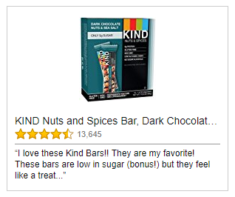
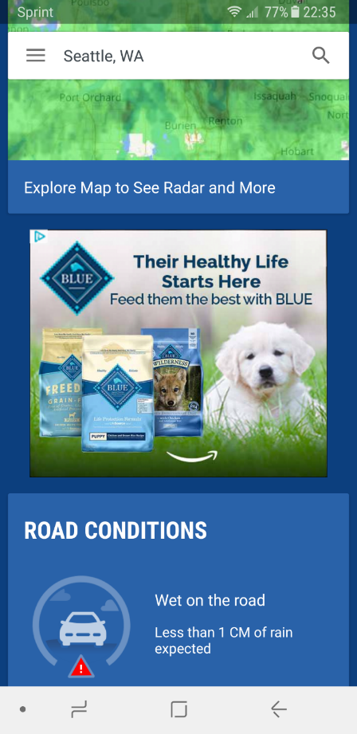
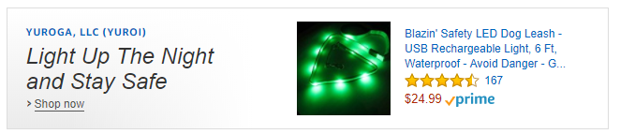
Amazon Advertising Platform
Allows advertisers to reach Amazon customers across the web through display and video ads

Slide 3
Can we predict return on ad spend based on campaign and product attributes such as campaign budget, time of year, product rating, and price?

Slide 4
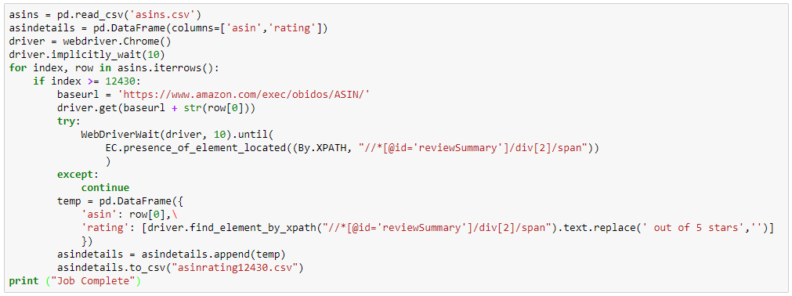
Data
Wrote script to scrape product category, price, rating, and number of reviews from Amazon.com for 12k ASINs

Slide 5
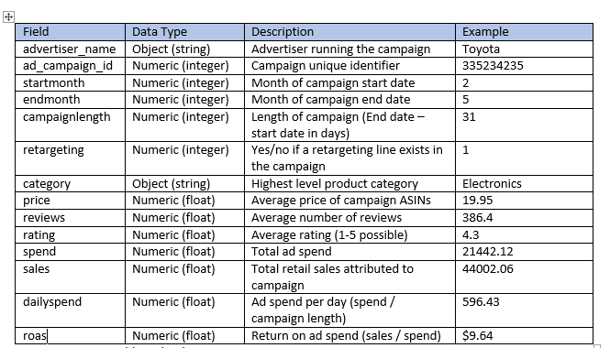
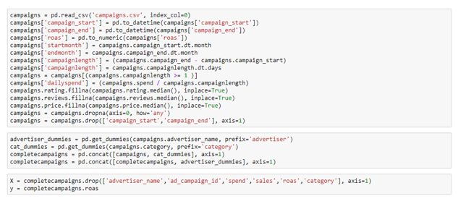
Data

Slide 6
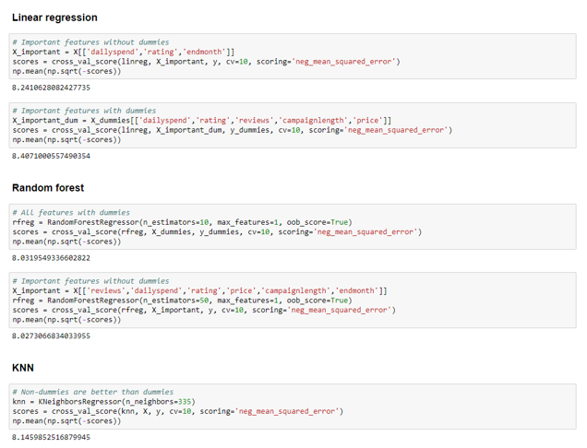
Modeling
Tested linear regression, k nearest neighbor, decision trees, and random forest, bagging estimators
Used all features, features w/o dummies, important features

Slide 7
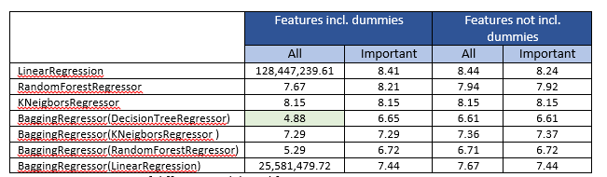
Modeling

Slide 8
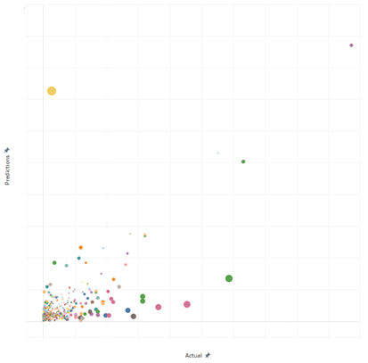
Modeling
Out of bag error = 0.35
Mean Absolute Error = 2.01
Root Mean Squared Error = 4.88
Null RMSE = 6.65

Slide 9
Next Steps
The model was able to predict return on ad spend fairly accurately for our testing set of campaigns, but can be improved and can evolve into a more accurate, scalable, and extensive model with the below next steps.
  Remove outliers from data set, hone features, and try additional estimators to make model more accurate
  Build distinct models for additional KPIs, regions, and entities
  Test model accuracy on future campaigns
  Incorporate additional features such as supply sources, segments, bids, etc.
  Capture only hero ASIN instead of all tracked ASINs
  Ingest retail product data systematically
  Build a tool on top of the script so that users can input campaign details and receive a prediction

