Slide 1
A History of Cities
By Jessica Pon

Slide 2
Introduction
How do metropolitan cities develop in the way they do?
Using venue data and k-means clustering to learn more about a city’s structure
Connect results to history of the city
Use said results to infer future development trends

Slide 3
Methodology
Using location data from various sources and venue data from Foursquare API
Determine 10 most common venue types in each neighborhood
Cluster neighborhoods based on venues in neighborhoods
Graph onto maps in respective cluster colors

Slide 4
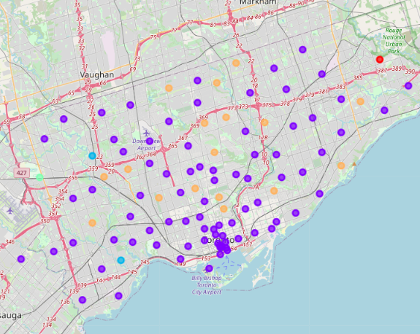
Toronto
Most neighborhoods in first cluster (purple); common venue being coffee shops and cafes
Likely due to low population density of city
City was originally a trading post
Explains the denser cluster around university and waterfront

Slide 5
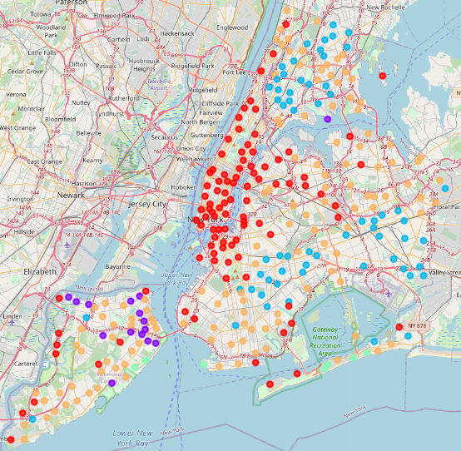
New York City
First cluster (red) dominates Manhattan; coffee shops and tourist destinations
Fifth and third clusters (orange and blue) on the other four boroughs; restaurants, bodegas, and parks
Splits between the suburban living areas and entertainment and business areas
Manhattan has developed to accommodate the tourists that visit

Slide 6
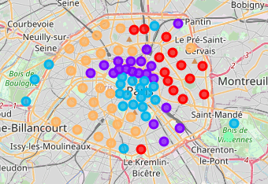
Paris
Western and eastern halves of city are divided (orange and red)
Purple and blue clustered around center of city
Falls in line with historical political divide within Paris
“Chic and trendy” areas in and around city center are vestiges of social divisions from Paris’s history

Slide 7
Conclusion
Using data science we can learn about how metropolitan areas are arranged and developed
We can contextualize this information in the history of the area
It is possible to determine which areas people are more likely to settle down in and which areas are meant more for visitors
In the future, this type of analysis could be used to predict how a city will further develop

