Slide 1
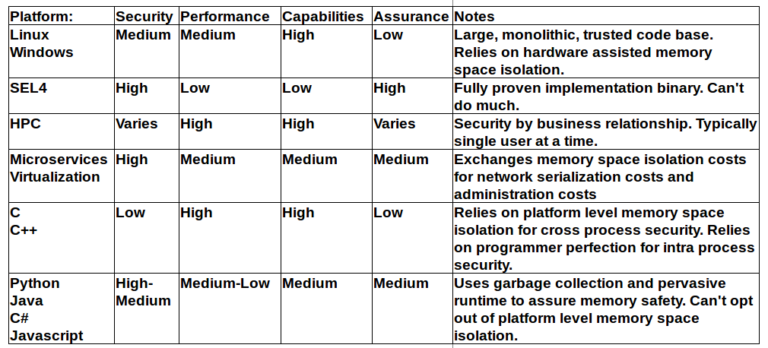
The Problem
All modern computing infrastructure has to make a tradeoff between Performance and Security

Slide 2
The Future
Imagine a computing world where:
  Creating high assurance code is easy.
    Cyber-Defense
    Avionics
    Firmware/SCADA
    Medical
  It is provably impossible for clicking on a link in an email to hurt you.
  Running untrusted code from the Internet is fast.
  Running untrusted code from the Internet is safe.

Slide 3
The Roadmap
Create a proving compiler.
  Next slides
Using that compiler, Create an operating system that:
  Will not load a binary unless it comes with a correct proof of good behavior.
  Uses this 'safe only loading' to avoid the performance penalties of memory space isolation.
  Uses this lack of memory space isolation to allow separate programs to interoperate with extremely high performance.
Create an ecosystem of software targeting this OS.
  Get everyone into this ecosystem.
Push the security higher and lower in the software stack.
  Higher: Capability based security.
  Lower: Drivers with proofs.
  Lower: Firmware with proofs.
  Lower: Open hardware.

Slide 4
The Proving Compiler
Input:
  Program source code in a performant language
    POC: A subset of C. IOC: Rust. FOC: Rust and others (Possibly C, C++, GLSL, SPIR-V, Python, Javascript, WebASM).
  Annotations for parts of the program.
    Suggesting invariants for the compiler to use in its proof.
    In Rust annotations would only be needed for unsafe modules/blocks.
Output:
  A machine language binary of the program.
    POC: unoptimized. FOC: optimized.
  A machine verifiable proof of memory safety of the binary (not the program).
    In minified, compressed Coq or Proof Carrying Code.
    Only assumes that the executing platform behaves as specified.

Slide 5
The Proving Compiler
Resources needed:
1-2 FTE-Years to POC.
Ability to collaborate in the open with academia and existing open projects in this space.
  Projects: Rust Belt, Rustc, TAL, Proof Carying Code, roboglia, Redox-OS, seL4, LLVM/clang, Corrode.
  Minimal exposure to classified information.
  Minimal exposure to proprietary information.
  Minimal proprietarization of work product.
(Optional) Ability to collaborate with existing proprietary projects in this space.
  Projects: Singularity, Midori.
  Requires business relationships.

